Slide 1

Presentation on Malignanat Comment Classification prediction
Submitted by:
Shama Tanweer

Slide 2
Introduction
The proliferation of social media enables people to express their opinions widely online. However, at the same time, this has resulted in the emergence of conflict and hate, making online environments uninviting for users. Online hate, described as abusive language, aggression, cyberbullying, hatefulness and many others has been identified as a major threat on online social media platforms. Social media platforms are the most prominent grounds for such toxic behaviour.
There has been a remarkable increase in the cases of cyberbullying and trolls on various social media platforms. Many celebrities and influences are facing backlashes from people and have to come across hateful and offensive comments. This can take a toll on anyone and affect them mentally leading to depression, mental illness, self-hatred and suicidal thoughts.
Researchers have applied various machine learning systems to try to tackle the problem of toxicit., There are various factors affecting the comments and can be related to the emotion, figure of speeches, and sometimes sarcasms which is related to indirect taunting is also rude and as a human it’ssometimes hard for us to distinguish between sarcasms and real appreciation.

Slide 3
Problem statement
Internet comments are bastions of hatred and vitriol. While online anonymity has provided a new outlet for aggression and hate speech, machine learning can be used to fight it
The objective is to build a model which can identify and tag unexpected comments on social media platforms by categorizing them as hateful , abusive , malignant ,loathe ,threat .So, that it can be controlled and restricted from spreading hatred and cyberbullying

Slide 4
Exploratory Data Analysis
Checking shape of data.
Checking data types of each features using dataframe.info() function.
checking for null values in each column.
Checking statistical analysis of numeric feature
Pointing out irrelevant features in dataset like ‘id.
Viewing the distribution of each labels using countplot.
Viewing the distribution of multilabel count using barplot.
Addition of new features like length (before preprocessing ) and cleaned_length (after preprocessing) to get an idea on the total length of the text.
Finding and removing of irrelevant words from text using regex ,nltk.

Slide 5
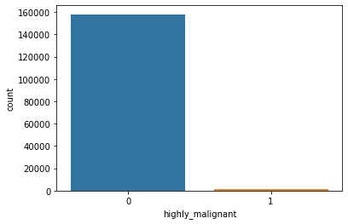
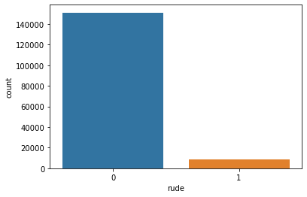
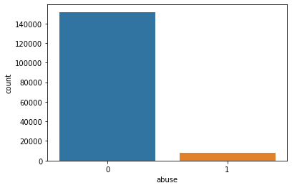
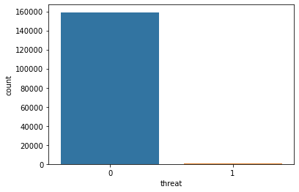

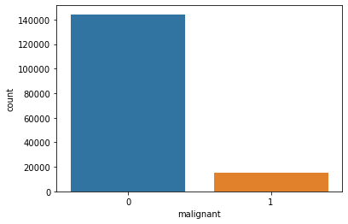
Data Visualisation
We observe that the data is unbalanced

Slide 6
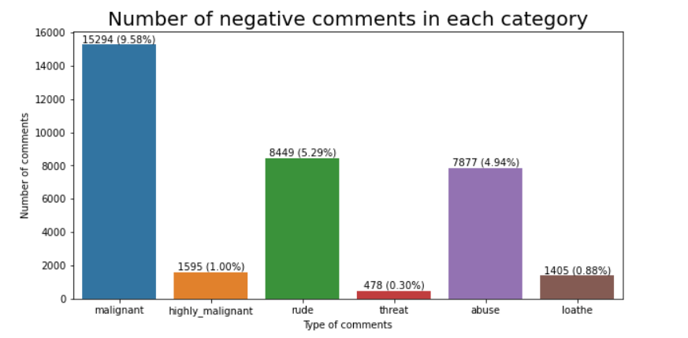
Again checking percentage of negative comments in each category:
Again checking percentage of negative comments in each category:
Most unwanted comments were of malignant type followed by rude and abuse.
Threat comments were least in number with only 0.30%

Slide 7
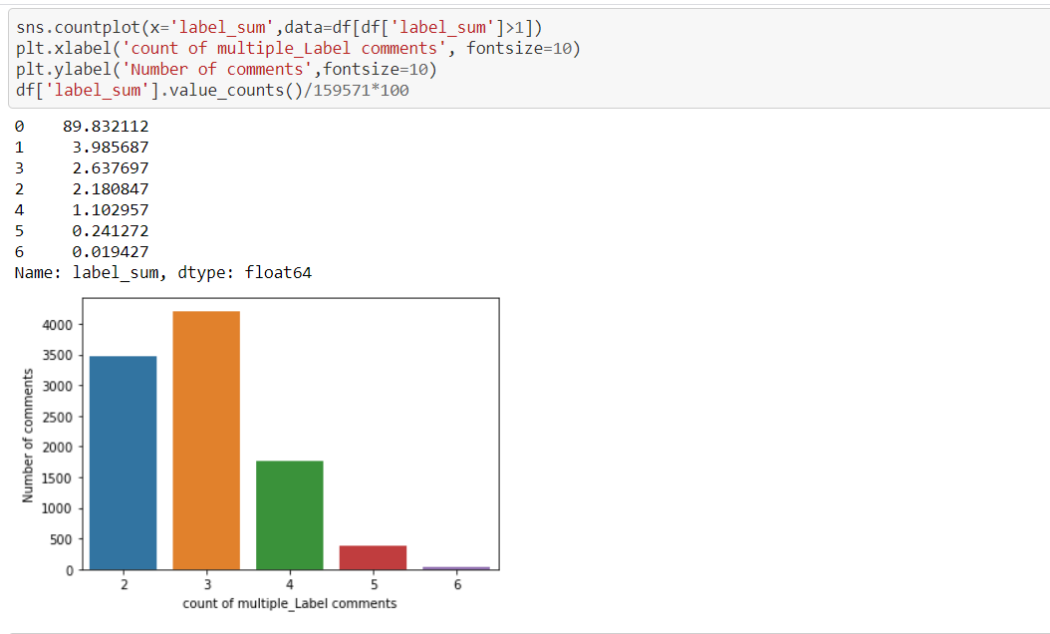
Some of the comments belonged to more than one category i.e comments belong to different label .To check this I have used below plot
3.98% comments belongs to only one label
0.01% comments belong to all the labels.
2.63% comments belongs to 3 different labels

Slide 8
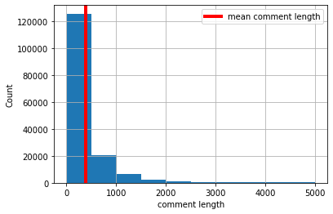
Checking average comment length before cleaning
In the train dataset, the average length of comments are 400, & we also notice that the frequency reduces as the number of characters increase

Slide 9
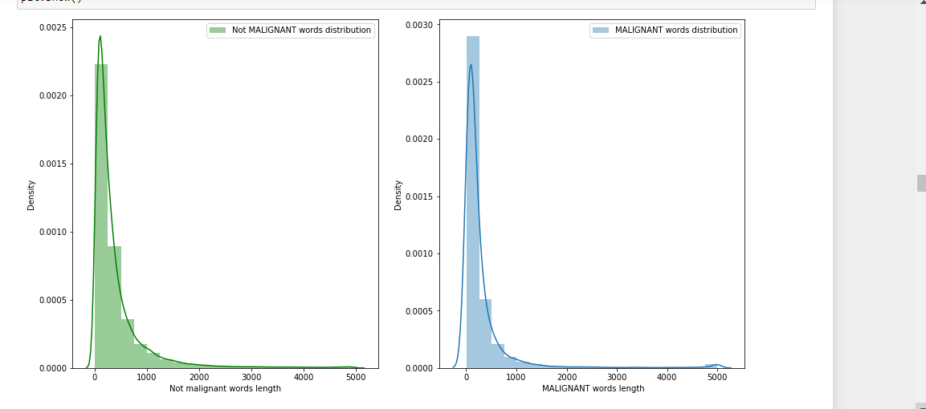
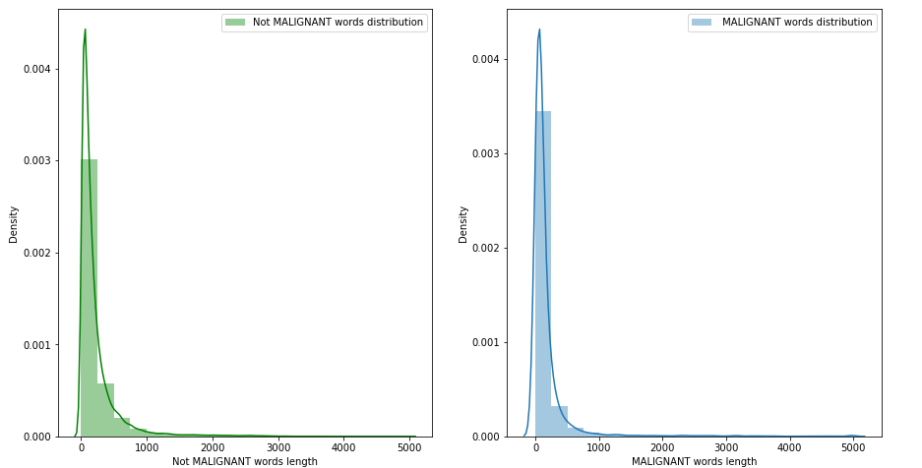
graph to show distribution of word count before cleaning and after cleaning Before cleaning:
After cleaning

Slide 10
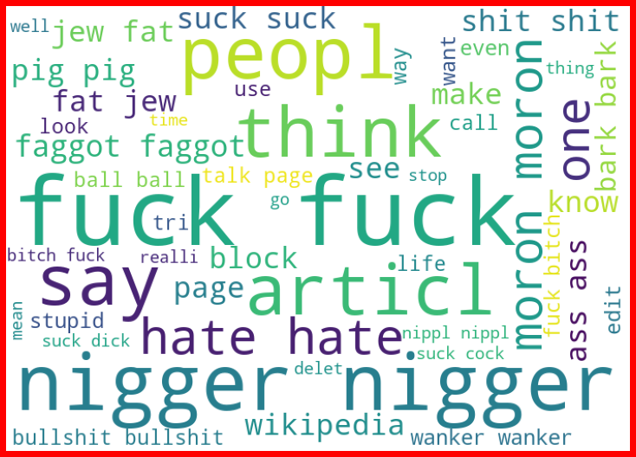
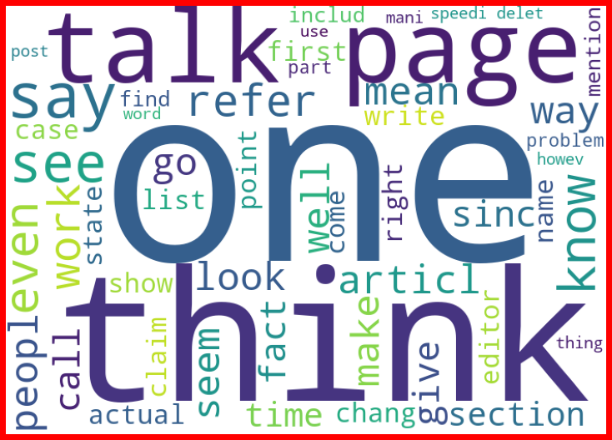
Word cloud for negative comment
Word cloud for positive/neutral comment

Slide 11
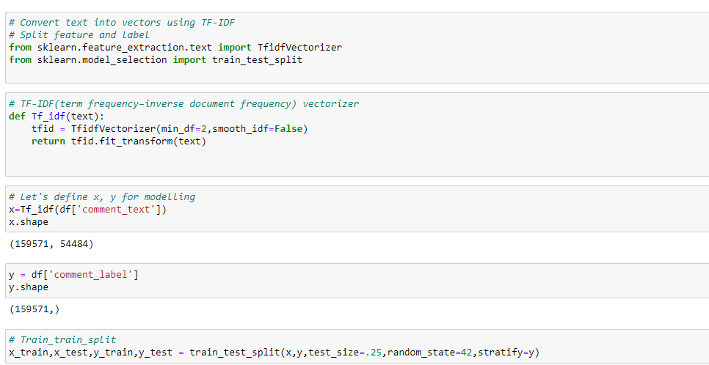
Training Classifier: We converted all the comment text into vectors , using TF-IDF. Then we have split features and label.

Slide 12
Model Building & Performance
it’s a classification type problem and below models were used:
'KneighborsClassifier'
LogisticRegression
DecisionTreeClassifier
RandomForestClassifier
AdaBoostClassifier
MultinomialNB

Slide 13
Evaluation Matrices:
Accuracy - it determines how often a model predicts default and non default correctly. Confusion matrices :It gives direct comparisons of values like True Positives, False Positives, True Negatives and False Negatives
classification report :It displays the precision, recall, F1, and support scores for the model
F1 score - the F1-score, is a measure of a model's accuracy on a dataset. It is used to evaluate binary classification systems, which classify examples into 'positive' or 'negative'. AUC: It represents the degree or measure of separability. It tells how much the model is capable of distinguishing between
Log_Loss:For any given problem, a lower log loss value means better predictions

Slide 14
All algorithm by using for loop
score=[]
cvs=[]
rocscore=[]
logloss=[]
for name, model in models:
print('*************************',name,'*************************',end='\n\n')
model_list.append(name)
model.fit(x_train,y_train)
print(model,end='\n\n')
pre=model.predict(x_test)
print('\n')
AS=accuracy_score(y_test,pre)
print('Accuracy score =',AS)
score.append(AS*100)
print('\n')
sc=cross_val_score(model,x,y, cv=10, scoring='accuracy').mean()
print('cross validation score =',sc)
cvs.append(sc*100)
print('\n')
loss = log_loss(y_test,pre)
print('Log loss : ', loss)
logloss.append(loss)
false_positive_rate,true_positive_rate,thresholds=roc_curve(y_test,pre)
roc_auc=auc(false_positive_rate,true_positive_rate)
print('roc_auc_score = ', roc_auc)
rocscore.append(roc_auc*100)
print('\n')
print('classification_report\n',classification_report(y_test,pre))
print('\n')
cm=confusion_matrix(y_test,pre)
print(cm)
print('\n')
plt.figure(figsize=(10,40))
plt.subplot(911)
plt.title(name)
print(sns.heatmap(cm,annot=True))
plt.subplot(912)
plt.title(name)
plt.plot(false_positive_rate,true_positive_rate, label='AUC= %0.2f'%roc_auc)
plt.plot([0,1],[0,1],'r--')
plt.legend(loc='lower right')
plt.ylabel('True positive rate')
plt.xlabel('False positive rate')
print('\n\n')

Slide 15
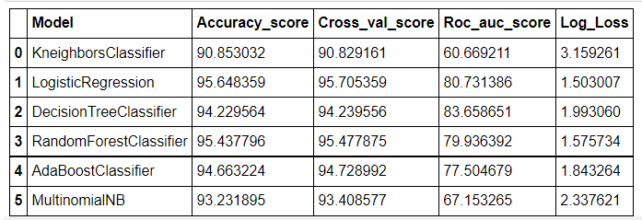
result=pd.DataFrame({'Model': model_list, 'Accuracy_score': score, 'Cross_val_score':cvs,'Roc_auc_score': rocscore,'Log_Loss':logloss})

Slide 16
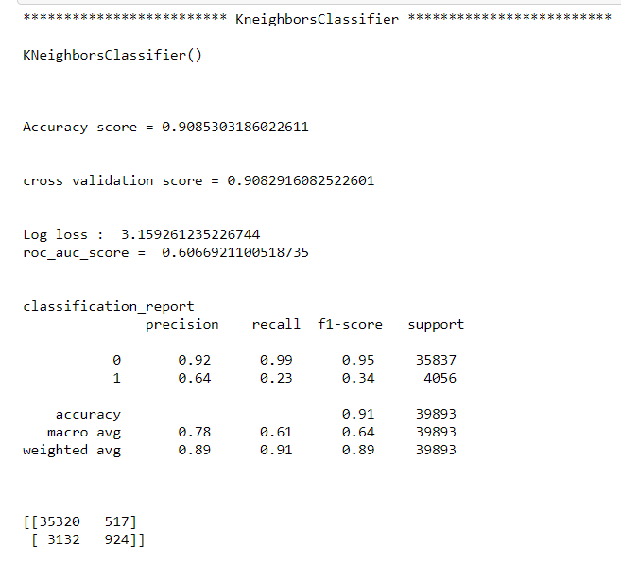
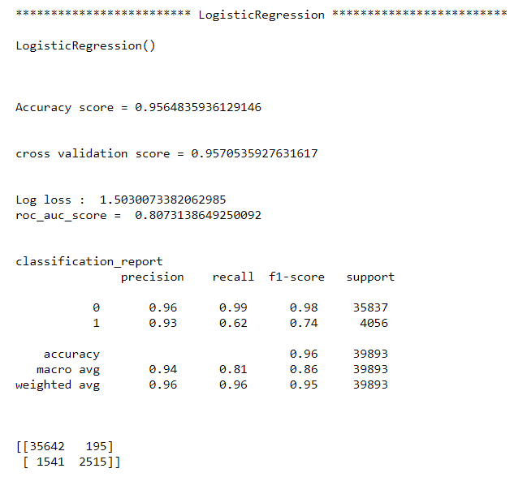
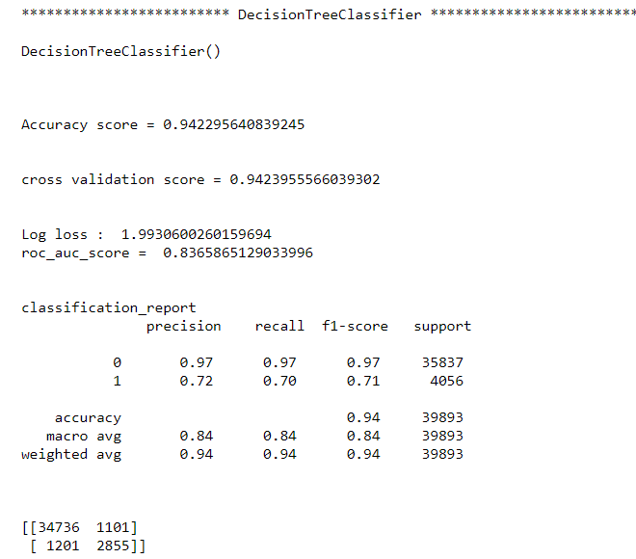
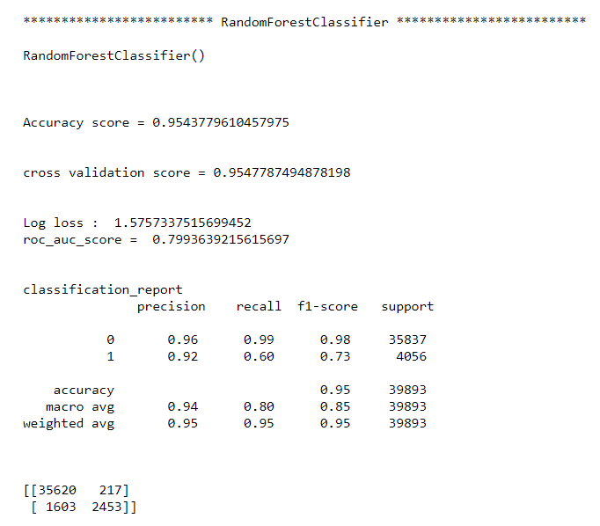

Slide 17
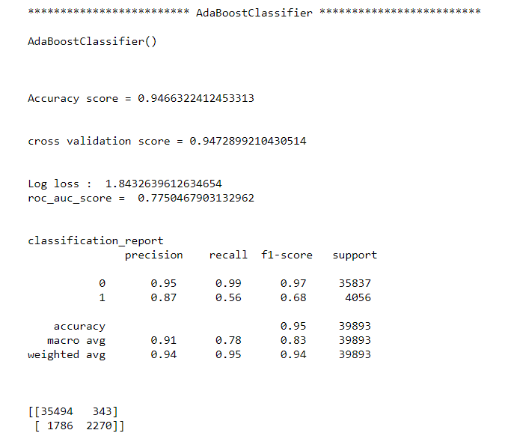
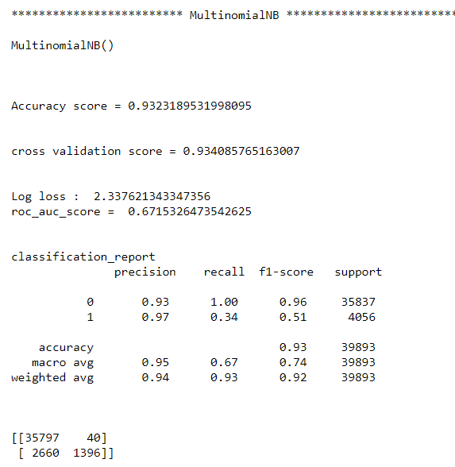

Slide 18
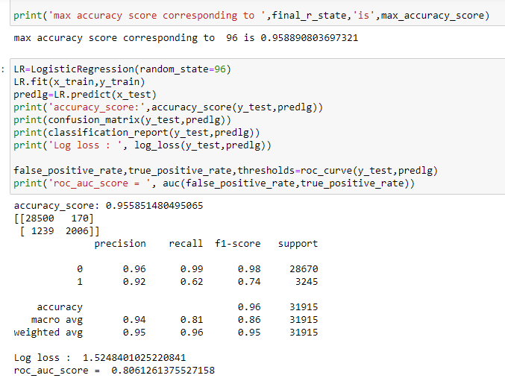
Final model
We choose Logistic Regression model as the final one,as it gives hightest accuracy score & also log_loss value is minimum which indicates better prediction

Slide 19
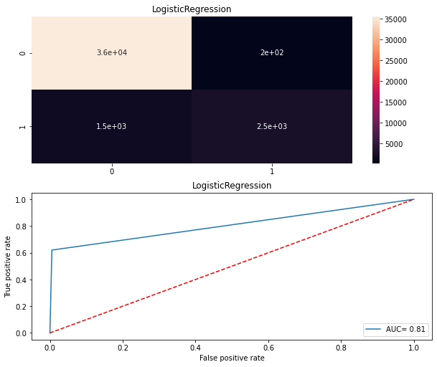
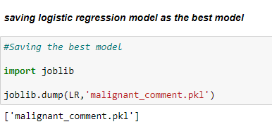

Slide 20
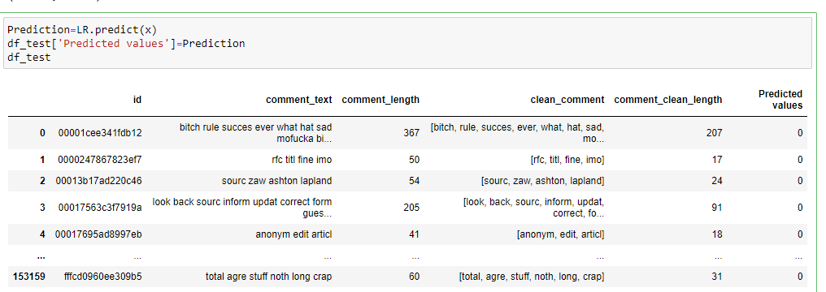
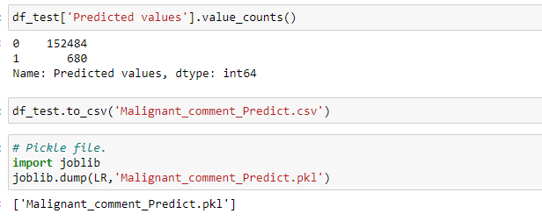
Predicting for Test Data All the preprocessing step performed fot train data .ie df has been performed for test data .ie df_test also

Slide 21
Conclusion
The saved model now can help to give an estimate of probability about the type of toxicity in the comment.
It was overall a nice experience on working on a real time project of NLP domain to see how datascience and machine learning is useful in this field.

