Slide 1
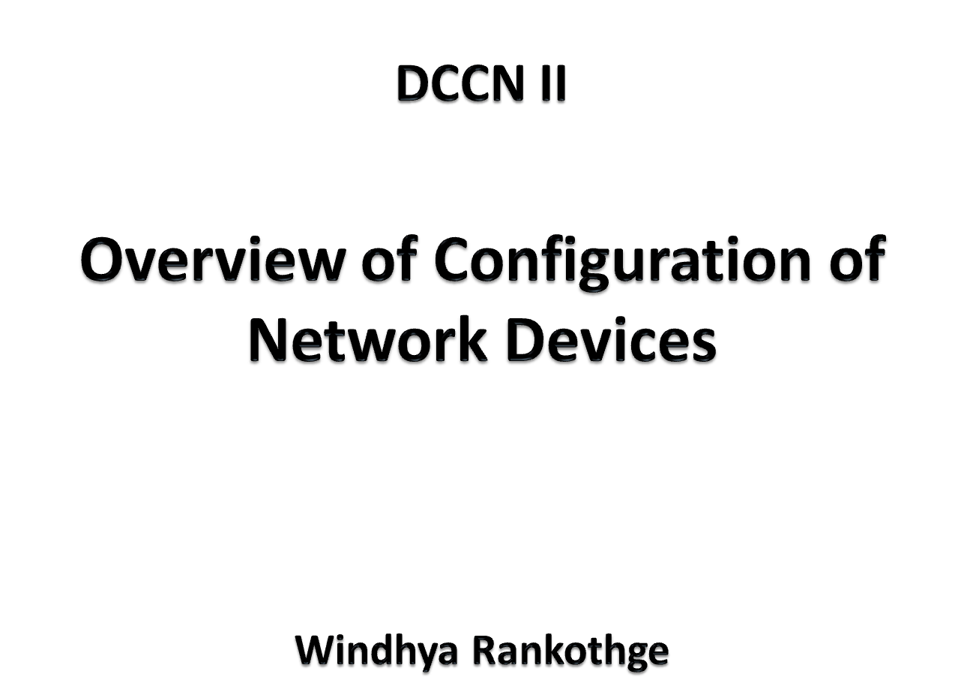

Slide 2
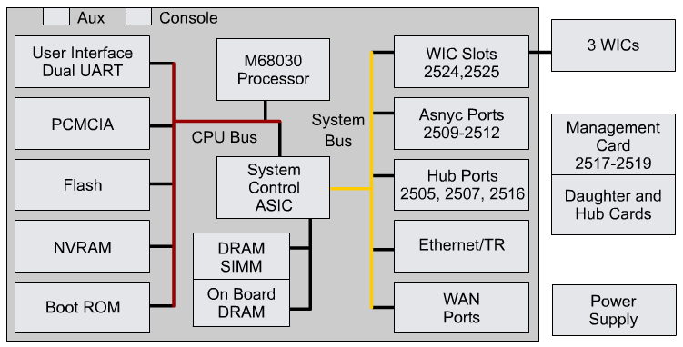
Network Devices - Internal Components
CPU
RAM
Flash
NVRAM
Buses
ROM
Interfaces
Power Supply

Slide 3
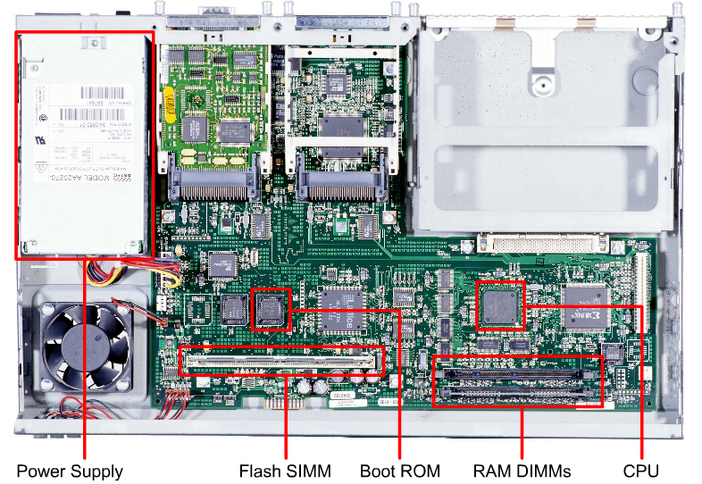
Network devices - Physical characteristics

Slide 4
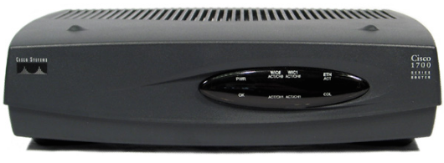
Cisco IOS Software
As with a computer, a network device cannot function without an operating system.
Cisco calls its operating system the Cisco Internetwork Operating System or Cisco IOS.

Slide 5
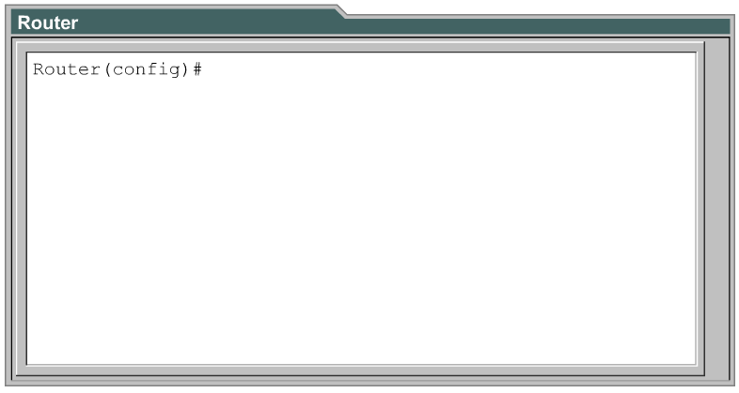
Command Line Interface (CLI)
The Cisco IOS software uses a command-line interface (CLI) as the traditional console environment.
This environment is accessible through several methods:
  Console
  AUX port
  Telnet

Slide 6
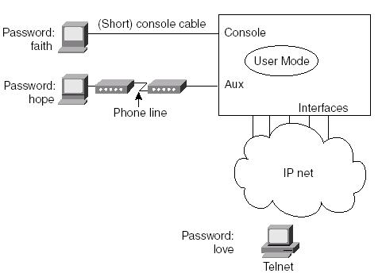

Slide 7
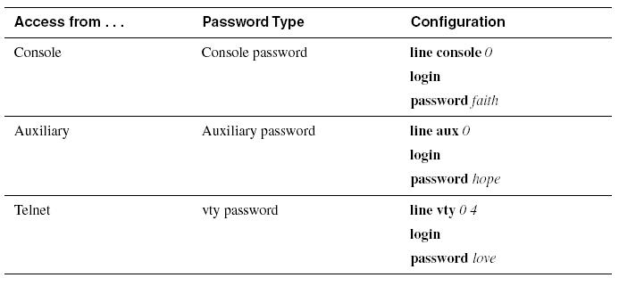
Passwords

Slide 8
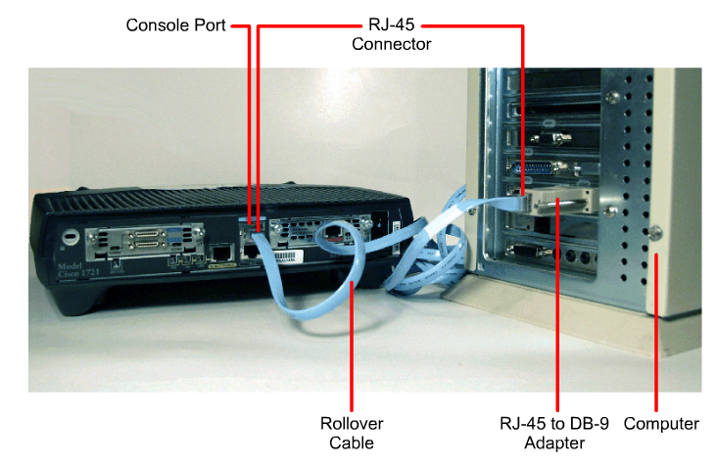
Console port connection

Slide 9
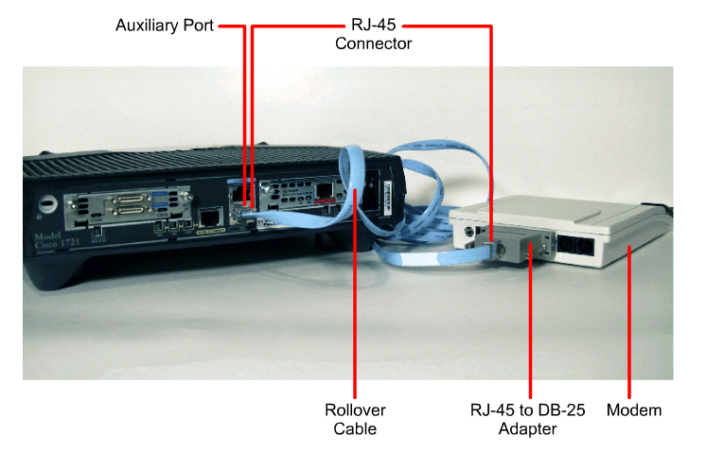
Auxiliary port connection

Slide 10
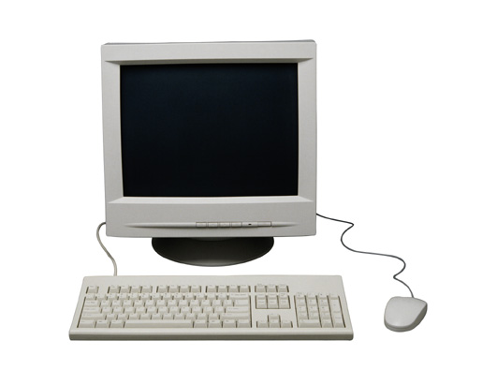
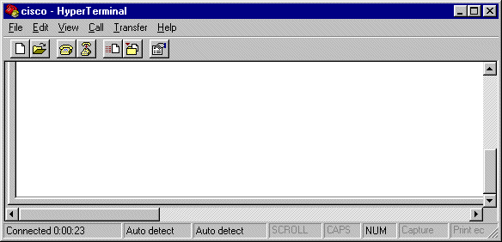
Connecting console interfaces
When connected using the console interface, the computer is acting as a
“dumb terminal”
<Router Output>

Slide 11
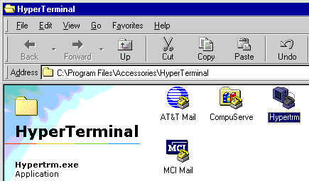
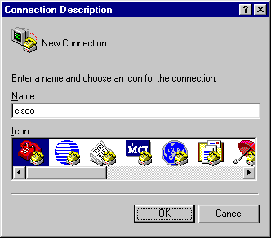
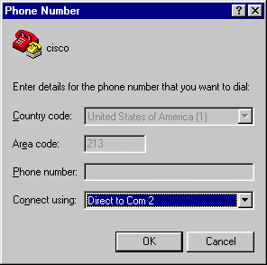
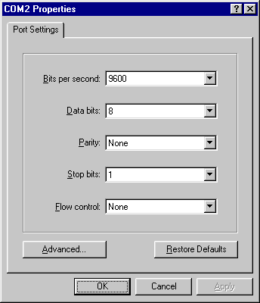
Connecting console interfaces
<Router Output>

Slide 12
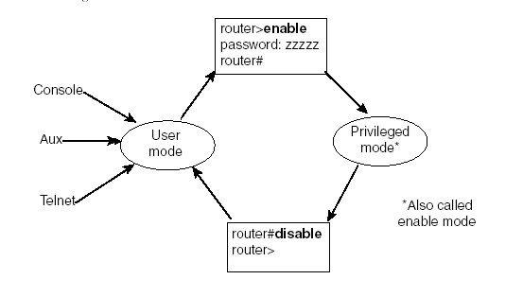
Modes use in configuration

Slide 13
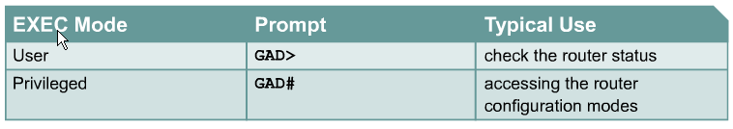
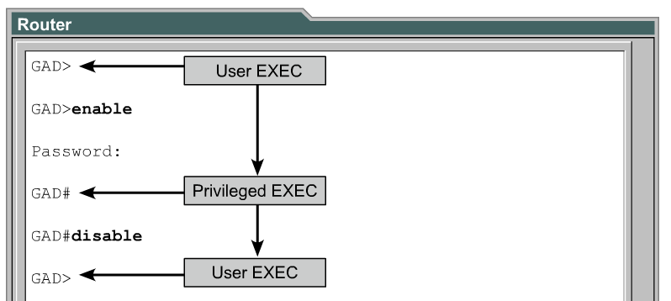
Modes use in configuration cont.

Slide 14
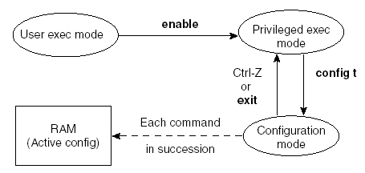
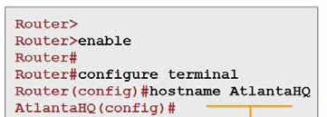
Modes use in configuration cont.

Slide 15
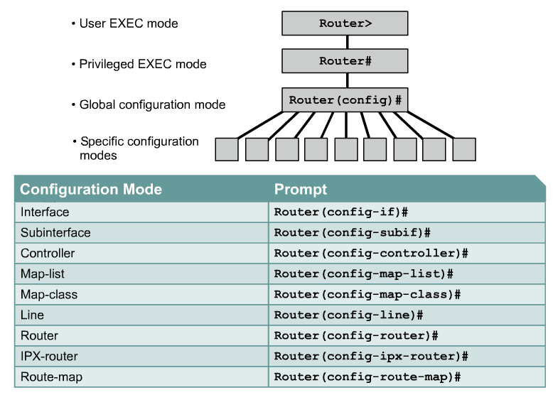
Modes use in configuration cont.

Slide 16
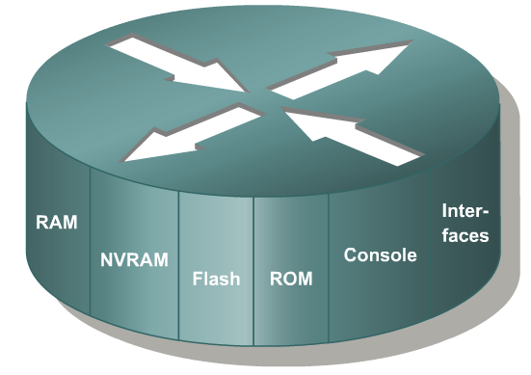
Router Memory

Slide 17
Router Memory cont.
RAM
- Store running or active configuration file
- Loses content when router is powered down
- A working storage
ROM
- Read-Only Memory
- Stores bootable IOS image and bootstrap program

Slide 18
Router Memory cont.
NVRAM
- Provides storage for the startup configuration file
- Retains content when router is powered down
Flash memory
- Holds the fully functional IOS image
- Retains content when router is powered down
- Is a type of electronically erasable, programmable ROM (EEPROM)

Slide 19
Router Memory cont.
Bootup program
startup-config
Bootable IOS
running-config
IOS

Slide 20
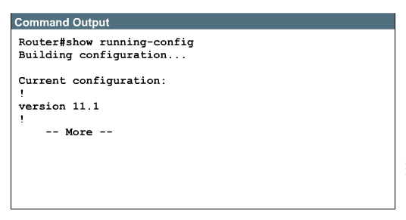
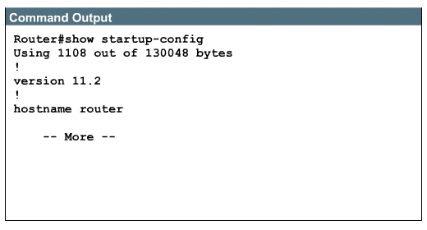
Displaying configuration files
show running-config
show startup-config

Slide 21
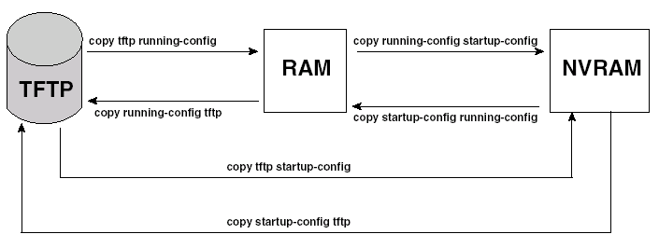
Managing configuration files
Copy Command
- copy files in a router (configuration file, new version of the IOS Software)
- Move configuration files among RAM, NVRAM, and TFTP server

Slide 22
copy running-config startup-config
Router# copy startup-config running-config
During bootup
running-config
startup-config
Router# copy running-config startup-config
Changes to the router are put in the running-config file.
If the router loses power or reboots, everything in RAM is lost including the running-config file.
To make sure the changes to the router’s configuration remain saved, you must copy the running-config from RAM into the startup-config into NVRAM:
Router# copy running-config startup-config

Slide 23
copy running-config startup-config cont.
Router#copy running-config startup-config
Destination filename [startup-config]?
Building configuration...
Router#show startup-config
!
version 12.0
service timestamps debug uptime
service timestamps log uptime
no service password-encryption
!
hostname Router
!
!
ip subnet-zero
!
interface Ethernet0
no ip address
no ip directed-broadcast
shutdown
!
The startup-config file now identical to running-config and the router will also have these changes if the router reboots.

Slide 24
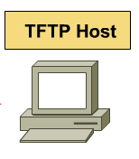
running-config
startup-config
IOS
copy tftp flash
copy tftp running-config
copy tftp startup-config
copy flash tftp
copy startup-config tftp
copy running-config tftp

Slide 25
