Slide 1
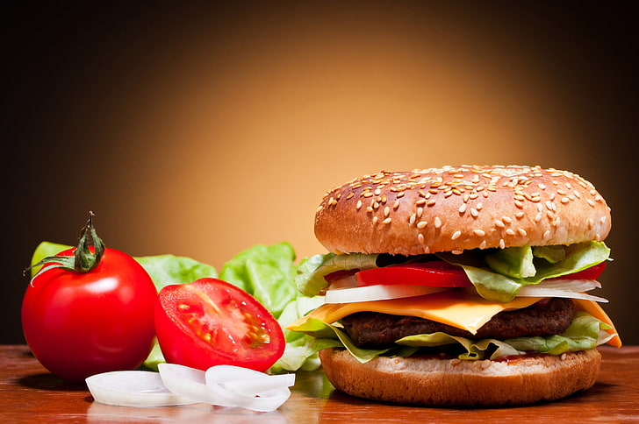
Healthy Food

Slide 2
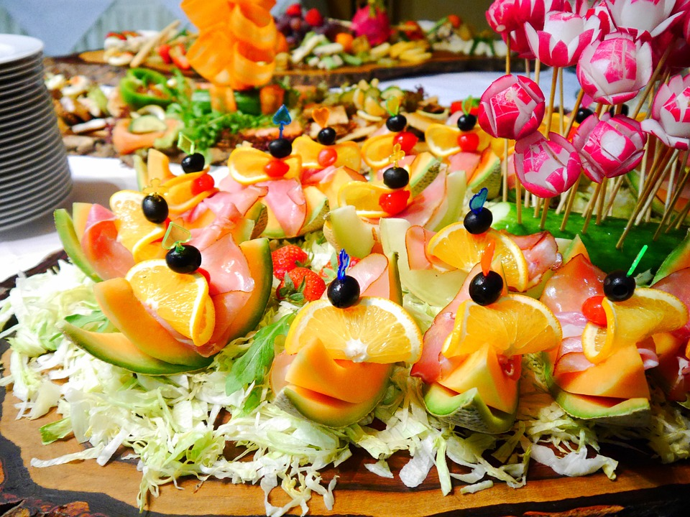
ABSTRACT
The "Healthy Food" project focuses on developing a comprehensive database that categorizes and analyzes various nutritious food items.

Slide 3
ER- DIAGRAM
Users
Recipes
Foods
(PK) | User ID
 | Name
 | Email
(PK) | Recipe ID
 | Title
 | Description
 | Preparation
(FK) | User ID
(FK) | Food ID
(PK) | Food ID
 | Name
 | Category
 | Calories
 | Protein
 | Fat
 | Carbs
+-----------------+
-------+
Recipe_Foods
(FK) | Recipe ID
(FK) | Food ID
 | Quantity
-----------------+
------------+

Slide 4
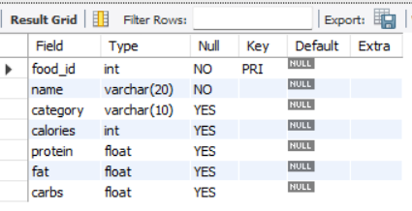
Structure Of Table
Foods Table
This table shows Food ID, Name, Category, Calories, Protein, Fat, Carbs
Syntax : DESC Foods;

Slide 5
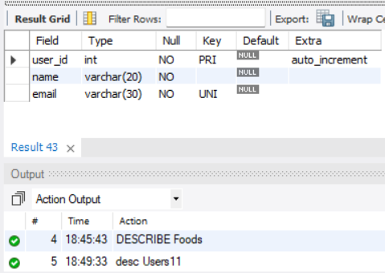
Structure Of Table
User Table
This table shows User ID, Name, Email
Syntax : Desc Users11;

Slide 6
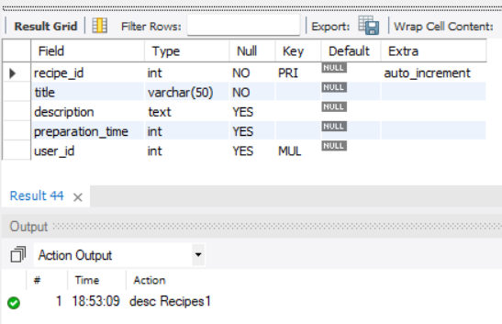
Structure Of Table
Recipes Table
This table shows Recipe ID, Title, Description, Preparation time, User ID
Syntax : Desc Recipes1;

Slide 7
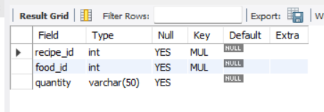
Structure Of Table
Recipe Foods Table
This table show recipe ID, Food ID, Quantity
Syntax : Desc Recipe_Foods1;

Slide 8
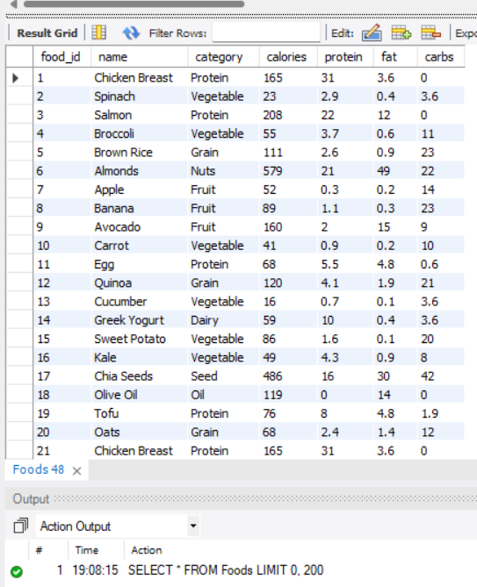
Contents of Table
Select * From Foods;

Slide 9
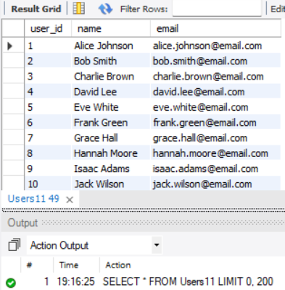
Contents of Table
Select * from Users11;

Slide 10
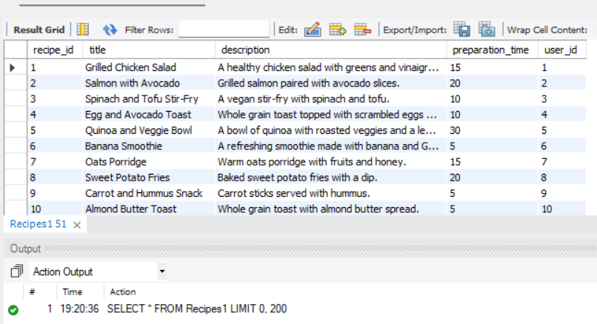
Contents of Table
Select * from Recipes1;

Slide 11
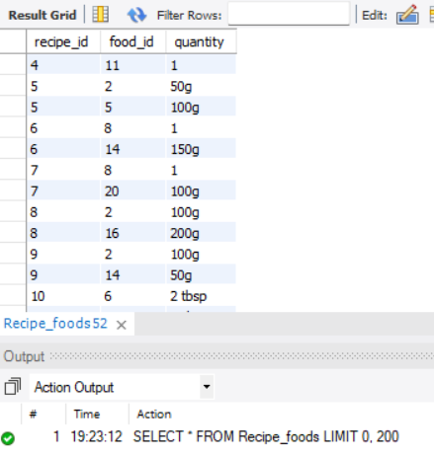
Contents of Table
Select * from Recipe_foods;

Slide 12
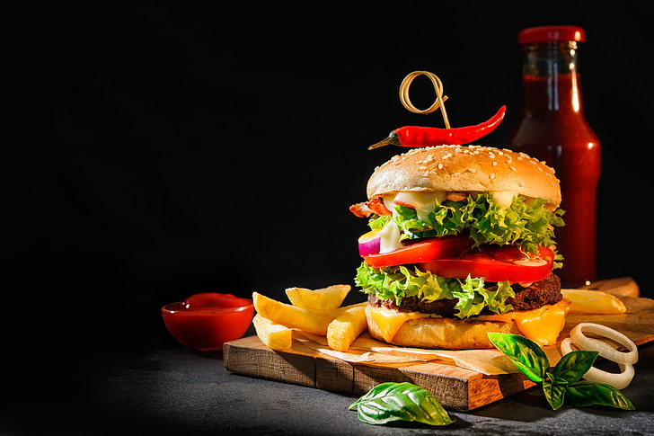
SUBQUERY

Slide 13
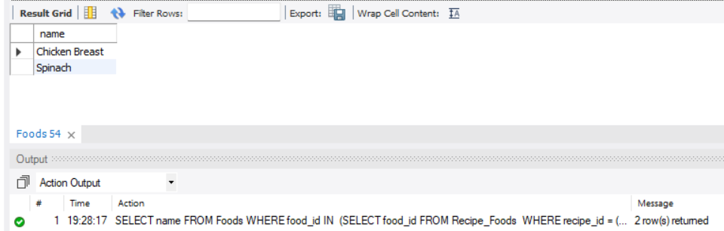
SUBQUERY
Find the foods that are used in the recipe "Grilled Chicken Salad“
SELECT name FROM Foods WHERE food_id IN (SELECT food_id FROM Recipe_Foods WHERE recipe_id = (SELECT recipe_id FROM Recipes1 WHERE title = 'Grilled Chicken Salad'));

Slide 14
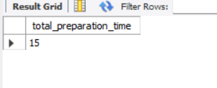
SUBQUERY
Find the total preparation time for all recipes created by 'Alice Johnson’:
SELECT SUM(preparation_time) AS total_preparation_time FROM Recipes1 WHERE user_id = (SELECT user_id FROM Users11 WHERE name = 'Alice Johnson');

Slide 15
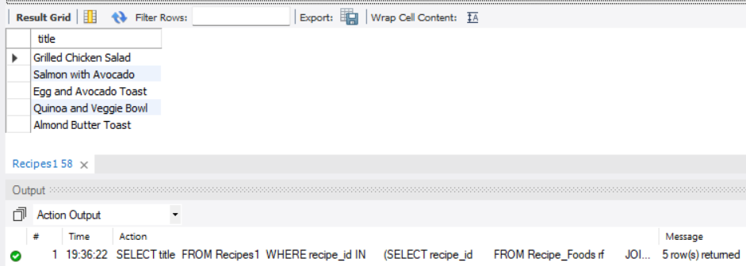
SUBQUERY
Find all recipes that contain more than 100 calories
SELECT title FROM Recipes1 WHERE recipe_id IN (SELECT recipe_id FROM Recipe_Foods rf JOIN Foods f ON rf.food_id = f.food_id WHERE f.calories > 100);

Slide 16
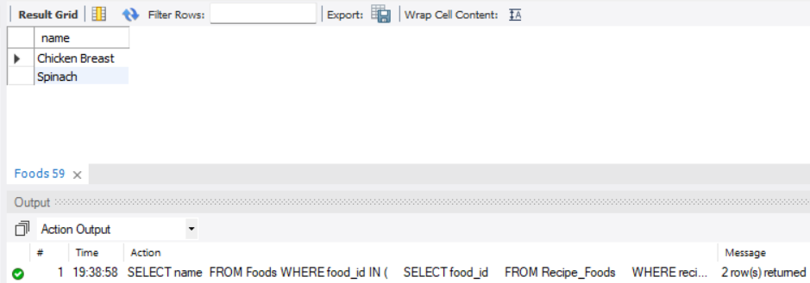
SUBQUERY
first find the user_id for Alice Johnson, and then retrieve all the foods used in the recipes created by this user.
SELECT name FROM FoodsWHERE food_id IN ( SELECT food_id FROM Recipe_Foods WHERE recipe_id IN ( SELECT recipe_id FROM Recipes1 WHERE user_id = ( SELECT user_id FROM Users11 WHERE name = 'Alice Johnson' ) ));

Slide 17
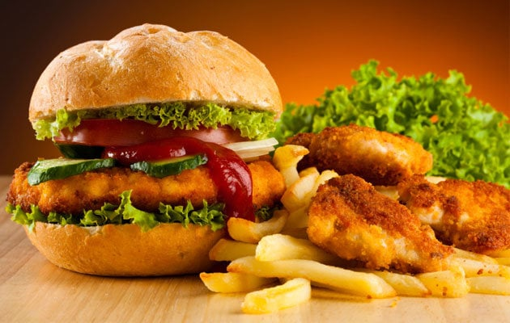
JOINS
This Photo by Unknown Author is licensed under CC BY-NC-ND

Slide 18
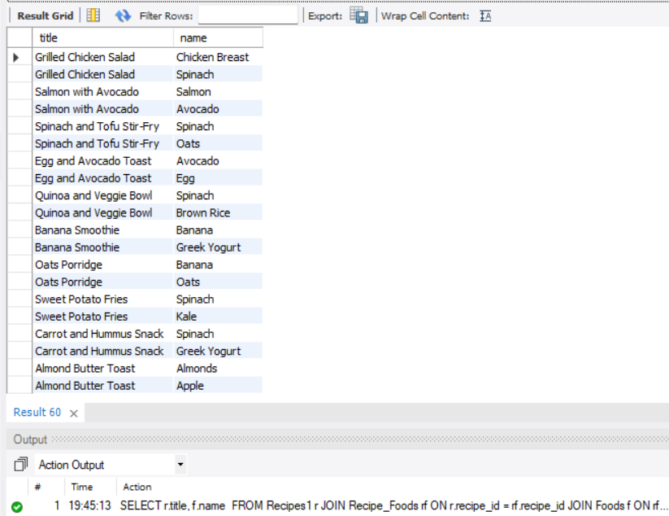
JOINS
Find all recipes along with the names of the foods they contain
SELECT r.title, f.name FROM Recipes1 rJOIN Recipe_Foods rf ON r.recipe_id = rf.recipe_idJOIN Foods f ON rf.food_id = f.food_id;

Slide 19
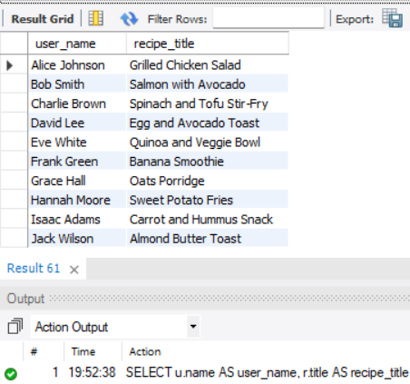
JOINS
Find users and the recipes they have created
SELECT u.name AS user_name, r.title AS recipe_title FROM Users11 uJOIN Recipes1 r ON u.user_id = r.user_id;

Slide 20
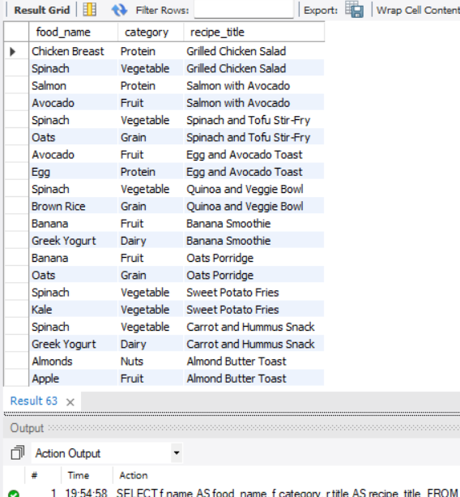
JOINS
Find all foods along with their categories and the recipes in which they are used
SELECT f.name AS food_name, f.category, r.title AS recipe_title FROM Foods fJOIN Recipe_Foods rf ON f.food_id = rf.food_idJOIN Recipes1 r ON rf.recipe_id = r.recipe_id;

Slide 21
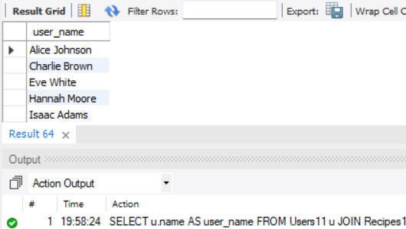
JOINS
Find the users who created recipes that contain 'Spinach' as an ingredient:
SELECT u.name AS user_nameFROM Users11 uJOIN Recipes1 r ON u.user_id = r.user_idJOIN Recipe_Foods rf ON r.recipe_id = rf.recipe_idJOIN Foods f ON rf.food_id = f.food_idWHERE f.name = 'Spinach';

Slide 22
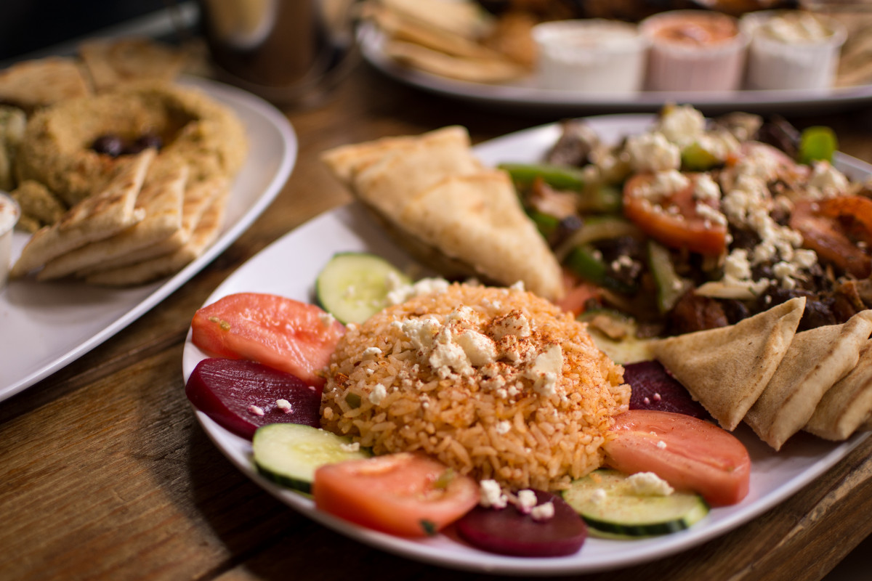
VIEW

Slide 23
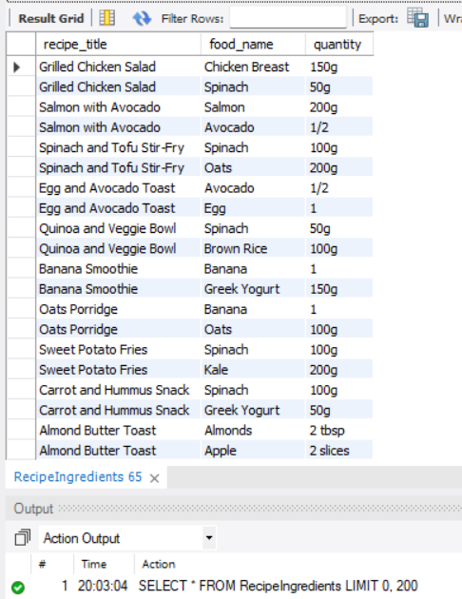
VIEW
How can you get a list of all recipes along with the foods used and their quantities?
SELECT * FROM RecipeIngredients;

Slide 24
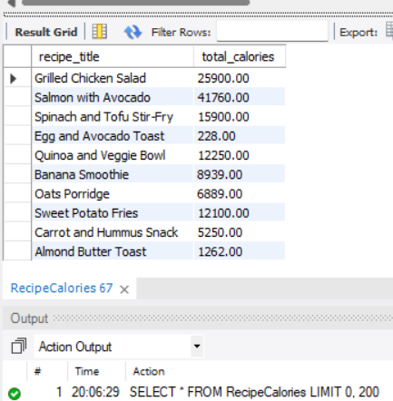
VIEW
How can you calculate the total calories for each recipe?
SELECT * FROM RecipeCalories;

Slide 25

Prepared By
Shamal Narkar
IT VEDANT
DS/AS/AI
This Photo by Unknown Author is licensed under CC BY-NC-ND

