Slide 1
Cloud Computing
GFS and HDFS
Based on “the google file system”
Keke Chen

Slide 2
Outline
Assumptions
Architecture
  Components
  Workflow
Master Server
  Metadata
  operations
Fault tolerance
Main system interactions
Discussion

Slide 3
Motivation
Store big data reliably
Allow parallel processing of big data

Slide 4
Assumptions
Inexpensive components that often fail
Large files
Large streaming reads and small random reads
Large sequential writes
Multiple users append to the same file
High bandwidth is more important than low latency.

Slide 5
Architecture
Chunks
  File → chunks → location of chunks (replicas)
Master server
  Single master
  Keep metadata
  accept requests on metadata
  Most management activities
Chunk servers
  Multiple
  Keep chunks of data
  Accept requests on chunk data

Slide 6
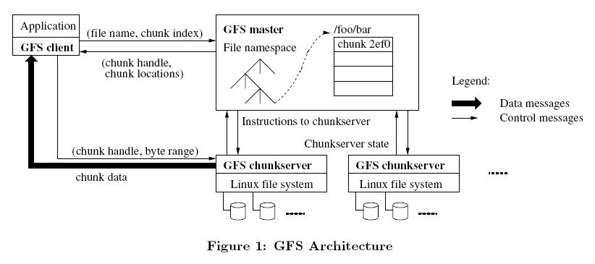

Slide 7
Design decisions
Single master
  Simplify design
  Single point-of-failure
  Limited number of files
    Meta data kept in memory
Large chunk size: e.g., 64M
  advantages
    Reduce client-master traffic
    Reduce network overhead – less network interactions
    Chunk index is smaller
  Disadvantages
    Not favor small files
    hot spots

Slide 8
Master: meta data
Metadata is stored in memory
Namespaces
  Directory → physical location
Files → chunks → chunk locations
Chunk locations
  Not stored by master, sent by chunk servers
Operation log

Slide 9
Master Operations
All namespace operations
  Name lookup
  Create/remove directories/files, etc
Manage chunk replicas
  Placement decision
  Create new chunks & replicas
  Balance load across all chunkservers
  Garbage claim

Slide 10
Master: namespace operations
Lookup table: full pathname→ metadata
Namespace tree
Locks on nodes in the tree
  /d1/d2/…/dn/leaf
  Read locks on the parent directories, r/w locks on full path
Advantage
  Concurrent mutations in the same directory
  Traditional inode based structure does not allow this

Slide 11
Master: chunk replica placement
Goals: maximize reliability, availability and bandwidth utilization
Physical location matters
  Lowest cost within the same rack
  “Distance”: # of network switches
In practice (hadoop)
  If we have 3 replicas
  Two chunks in the same rack
  The third one in another rack
Choice of chunkservers
  Low average disk utilization
  Limited # of recent writes → distribute write traffic

Slide 12
Re-replication
  Lost replicas for many reasons
  Prioritized: low # of replicas, live files, actively used chunks
  Following the same principle to place
Rebalancing
  Redistribute replicas periodically
    Better disk utilization
    Load balancing

Slide 13
Master: garbage collection
Lazy mechanism
  Mark deletion at once
  Reclaim resources later
Regular namespace scan
  For deleted files: remove metadata after three days (full deletion)
  For orphaned chunks, let chunkservers know they are deleted (in heartbeat messages)
Stale replica
  Use chunk version numbers

Slide 14
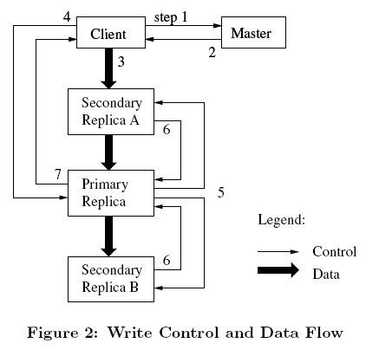
System Interactions
Mutation
  Master assign a“lease” to a replica - primary
  Primary knows the order of mutations

Slide 15
Consistency
It is expensive to maintain strict consistency
  duplicates, distributed
GFS uses a relaxed consistency
  Better support for appending
  Checkpointing

Slide 16
Fault Tolerance
High availability
  Fast recovery
  Chunk replication
  Master replication: inactive backup
Data integrity
  Checksumming
  Incremental update checksum to improve performance
    A chunk is split into 64K-byte blocks
    Update checksum after adding a block

Slide 17
Discussion
Advantages
  Works well for large data processing
  Using cheap commodity servers
Tradeoffs
  Single master design
  Reads most, appends most
Latest upgrades (GFS II)
  Distributed masters
  Introduce the “cell” – a number of racks in the same data center
  Improved performance of random r/w

Slide 18
Hadoop DFS (HDFS)
http://hadoop.apache.org/
Mimic GFS
  Same assumptions
  Highly similar design
  Different names:
    Master → namenode
    Chunkserver →datanode
    Chunk → block
    Operation log → EditLog

Slide 19
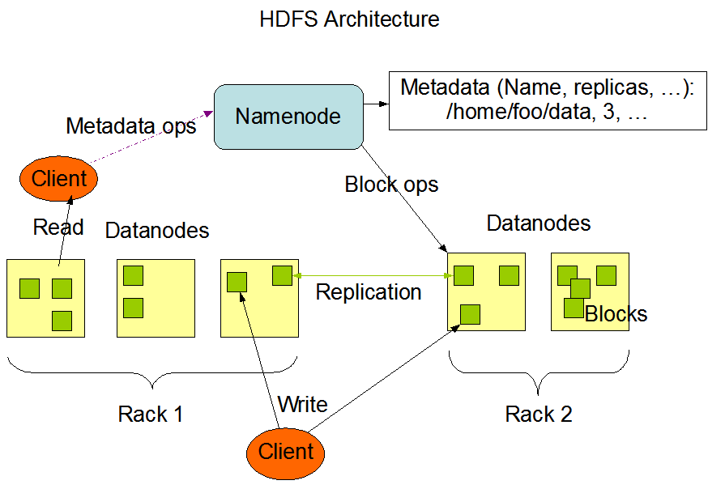

Slide 20
Working with HDFS
/usr/local/hadoop/
  sbin/ : scripts for starting/stopping the system
  bin/ : hdfs, hadoop
  etc/hadoop/ : configure files
  logs/ : system log files
Installation
  Single node: http://www.michael-noll.com/tutorials/running-hadoop-on-ubuntu-linux-single-node-cluster/
  Cluster: http://www.michael-noll.com/tutorials/running-hadoop-on-ubuntu-linux-multi-node-cluster/

Slide 21
More reading
The original GFS paper
  research.google.com/archive/gfs.html
YARN
  Resource manager: split cpu+memory into units
    OS mapping:
      HDFS -> file system
      YARN -> memory + cpu manager
    Together makes a distributed OS
  Flexibility: can run different distributed programs on top of YARN
    MapReduce
    Spark
    ‎

Slide 22
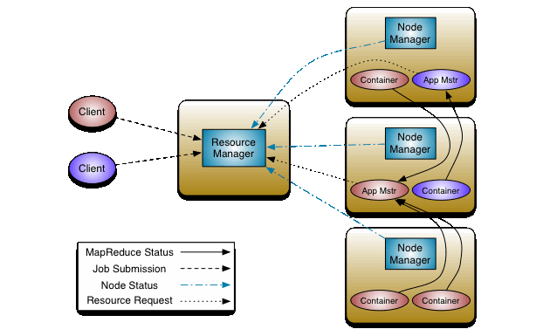
YARN illustrated

