Slide 1
Microservices and Docker
(adapted from Robert Bastian’s slides)

Slide 2
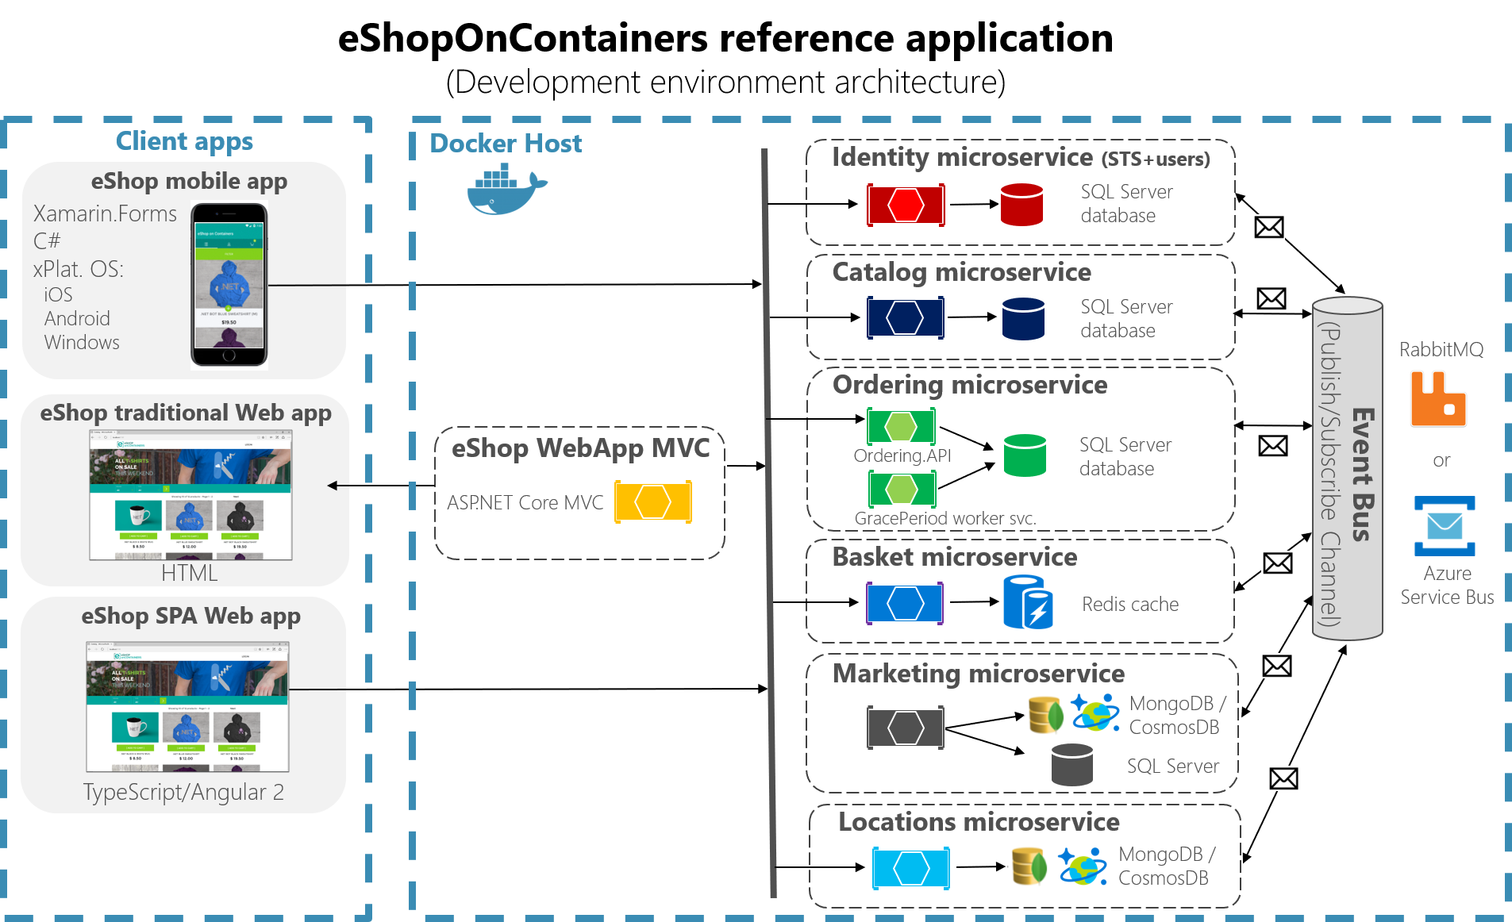
An example of microservice-based system
https://blogs.msdn.microsoft.com/dotnet/2017/08/02/microservices-and-docker-containers-architecture-patterns-and-development-guidance/

Slide 3
Drillinginfo’s case study: Why Docker?
A Drillinginfo (Robert Bastian’s company) case:
5+ individual teams building “micro services” in Java and Scala
Frictionless deployment of “micro-services” using Chef & AWS
25+ separate “micro-services” deployed in the previous 18 months
Each service is typically deployed to a single AWS virtual machine
Each service is deployed 6x - dev, test, staging (2x) and production (2x)
25+ “micro-services” became nearly 150 AWS virtual machines

Slide 4
Why Docker? COST!
The AWS bill is too damn high!
Decline in the global price of oil causing churn in our business
6 AWS virtual machines per service isn’t sustainable with our budget
AWS monthly bill started to gain visibility from sr. management and the board

Slide 5
Why Docker? WASTE!
We weren’t using the compute and memory resources purchased from AMZN!
Nearly all “micro-services” were at 1% CPU utilization
Nearly all “micro-services’ were only using 40% of memory (JVM)
150+ virtual machines essentially sitting idle

Slide 6
Why Docker? LOCK IN!
How would we leave AMZN if we wanted to?
Could we use Drillinginfo IT’s Openstack platform?
What about alternate IaaS providers like Rackspace or Azure?
What about Container as a Service (CaaS) providers like Joyent, Tutum or Profitbricks?
What about using Amazon’s Container Service?

Slide 7
My World Needs To Change - Problem Statement
“How can we deploy fewer virtual machines while increasing the density and utilization of services per machine without locking us into a specific IaaS provider?”

Slide 8
How Docker Solves All The Problems

Slide 9
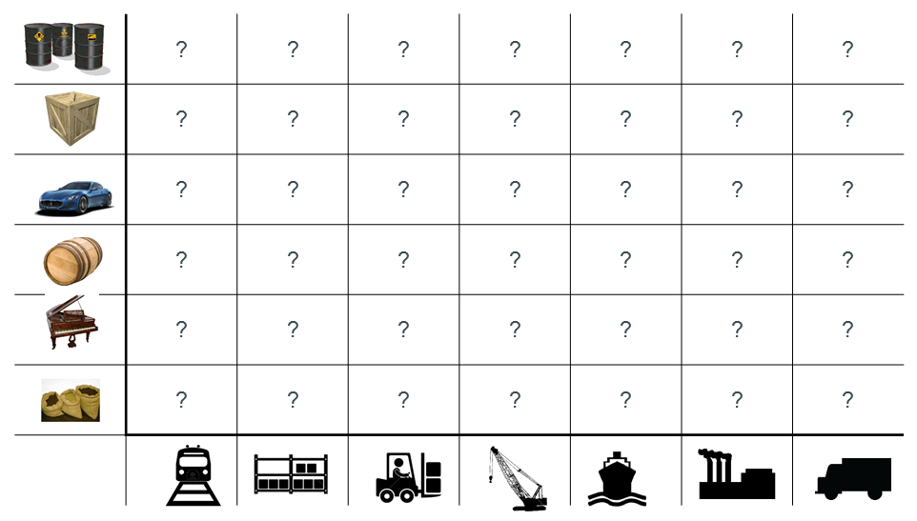
Docker Containers - Shipping Matrix From Hell

Slide 10
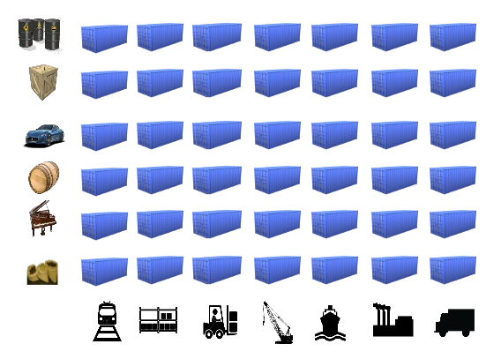
Docker Containers - Standard Shipping Container

Slide 11
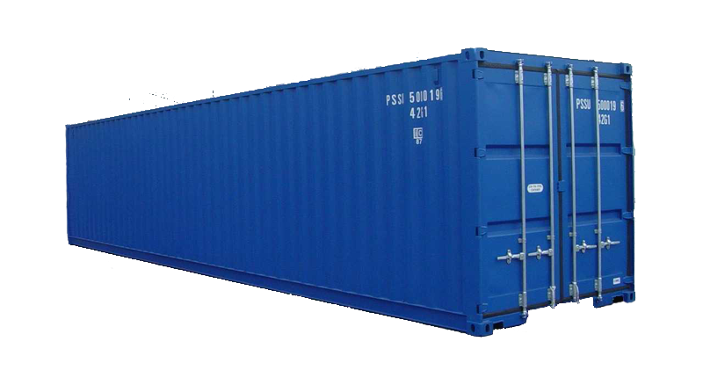
What’s Inside Doesn’t Matter
Notes:
Container metaphor: Monkeys and bananas

Slide 12
Why Docker Is Important - Before Containers
Very inefficient use of memory and CPU resources by VMs (each box is a VM)
12

Slide 13
Why Docker Is Important - After Containers
Isolated services in fewer VMs...
… and use VMs more efficiently.
Consider it as another level of consolidation! VM -> physical resources, containers -> VMs
13

Slide 14
Why Is Docker Important?
Docker container technology provides our “micro-services” platform:
Increased density of isolated “micro-services” per virtual machine (9:1!)
Containerized “micro-services” are portable across machines and providers
Containerized “micro-services” are much faster than virtual machines
14

Slide 15
Containers Alone Aren’t Enough
15

Slide 16
But Containers Aren’t Enough!
Running containerized “micro-services” in production requires much more than just Docker.
It requires a “Platform” that can do the following:
Building and pushing Docker images to an image repository
Pulling images, provisioning and scheduling containers
Discovering and binding to services running as containers
Containers discovering and binding to other containers
Operating and managing services in containers
16

Slide 17
Problem: Managing microservices deployed in containers

Slide 18
Note
What we see in the next are just some examples. New tools might be emerging for each of the tasks

Slide 19


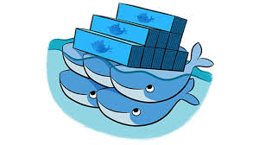
Drillinginfo Docker Platform: Build & Store Images
Problem: Detect changes at Github and build a new Docker image
Problem: Where do we store our Docker images?
19

Slide 20
Jenkins & Dockerhub
Problem: How do we build images? Jenkins automates the image builds.
Jenkins is an open source automation server written in Java. Jenkins helps to automate the non-human part of the software development process, with continuous integration and facilitating technical aspects of continuous delivery.
We started building our images with Ubuntu 14.04 (1GB)
We settled on Alpine, a minimal linux distribution (5MB)
Typical “micro-services” now ~ 390MB
Problem: Where do we put them? Dockerhub.
Tried Docker Trusted Registry and Core OS Enterprise Registry
Settled on using Dockerhub
Use latest and sem-ver tags on our images
20

Slide 21
Drillinginfo Docker Platform - Provisioning & Pooling
Docker Machine for provisioning virtual machines with Docker.
Docker Machine automates the provisioning of Docker hosts
Docker Swarm/Kubernetes for scheduling containers on a host.
Swarm combines Docker Machines into a single pool of compute and memory resources
Swarm provides container scheduling and supports plug-in schedulers
Docker Compose manages all the containers that run on the Swarm
21

Slide 22
Updates: current tools
Docker machine
Docker compose
Docker swarm/Kubernetes
Docker ecosystem: the moby project

Slide 23
Docker machine
What is it?
Since containers are “linux” containers, you need to have the linux host
For running in any non-linux environment, you will need to create a linux host first
Docker machine is used for this purpose

Slide 24
Docker machine
How it works?
It uses VirtualBox to get linux VM running
* Virtualbox runs on Windows, OS X, linux, Solaris Unix
Automatically create a linux host with VirtualBox

Slide 25
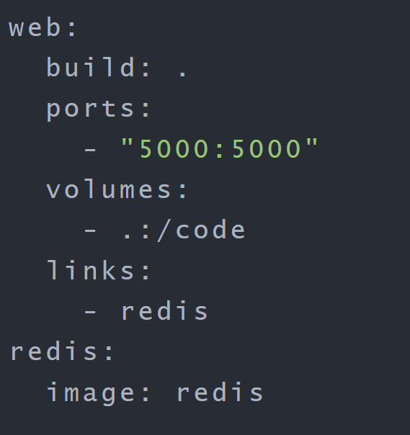
Docker compose
- For automatically provisioning docker containers on a single host
- Specify what you need with a YAML configuration file: docker-compose.yml
Two containers: “web” and “redis”
“web” is built from the Dockerfile in
the current directory, runs on
port mapping container 5000->host 5000,
mount a volume “.” to “/code” in the container,
and link to another container “redis”
“redis” uses the docker image redis from
Docker hub

Slide 26
Docker swarm
- manage a cluster of container hosts
Deploy services to the container hosts
Inspect a service on the swarm
Scale a service (more containers running the same service)
Update services

Slide 27
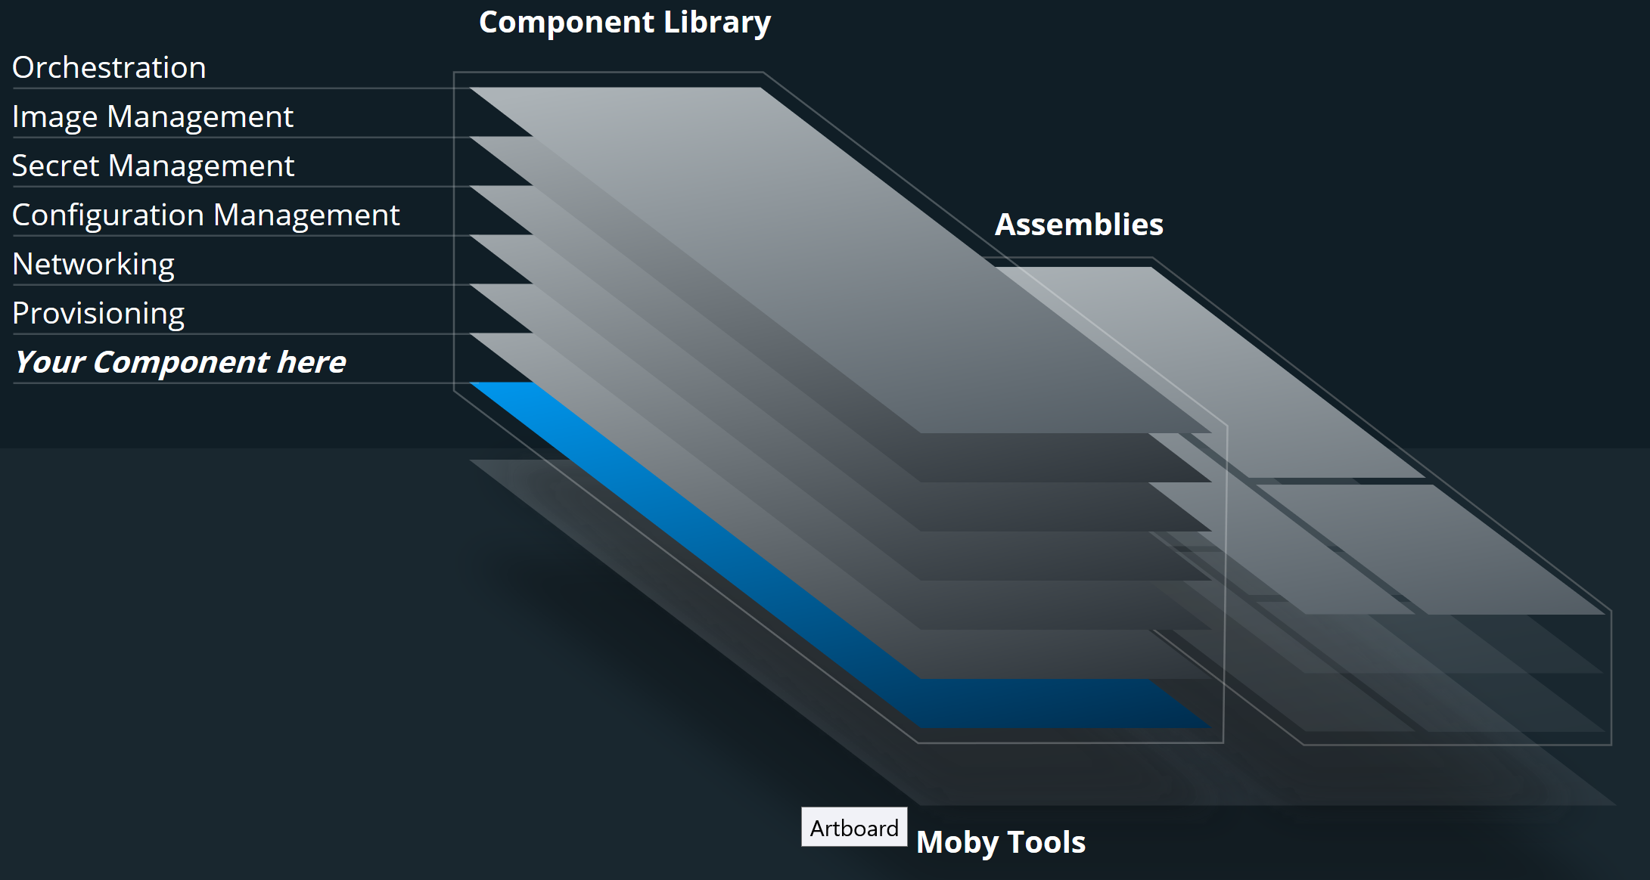
Moby project
Open source project proposed by docker
https://blog.docker.com/2017/04/introducing-the-moby-project/
Mobyproject.org

Slide 28
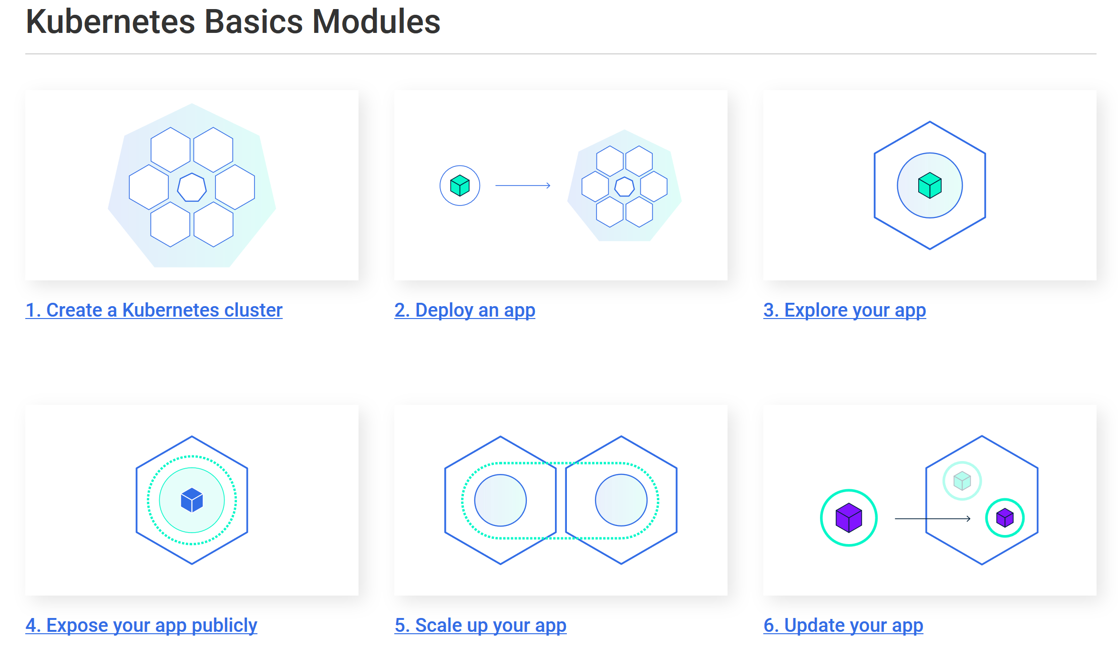
Kubernetes: a popular tool set for container management

Slide 29
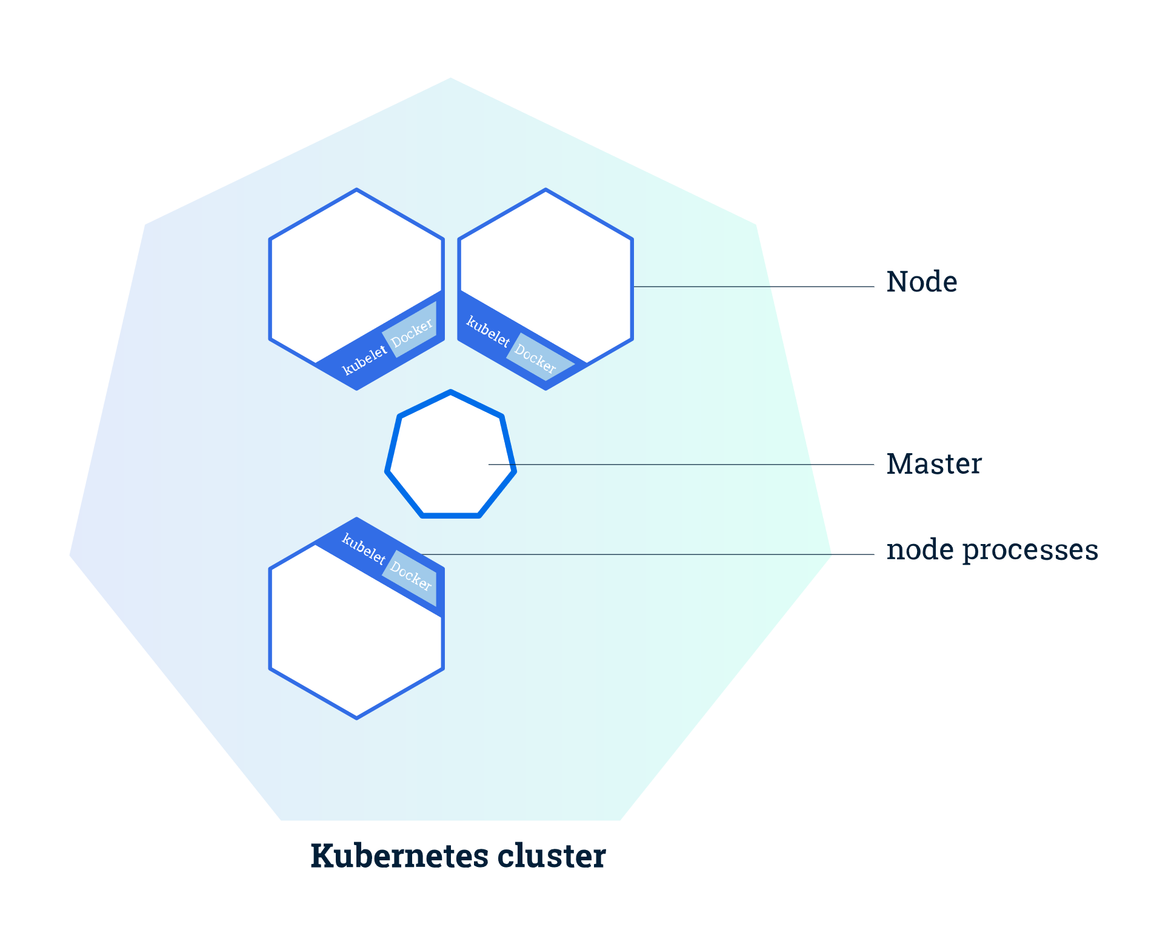
Kubernetes clusters
Kubernetes coordinates a highly available cluster of computers that are connected to work as a single unit.
Two types of nodes
Master
Worker nodes
Nodes can be VMs or physical machines

Slide 30
Kubernetes Deployment
Once you have a running Kubernetes cluster, you can deploy your containerized applications on top of it
Kubernetes Deployment configuration.
instructs Kubernetes how to create and update instances of your application
Once the application instances are created, a Kubernetes Deployment Controller continuously monitors those instances.
- If the Node hosting an instance goes down or is deleted, the Deployment controller replaces it.

Slide 31
Kubernetes Pods
When you created a Deployment, Kubernetes created a Pod to host your application instance.
A Pod is a Kubernetes abstraction that represents a group of one or more application containers, and some shared resources for those containers.
Shared storage, as Volumes
Networking, as a unique cluster IP address
Information about how to run each container, such as the container image version or specific ports to use

Slide 32
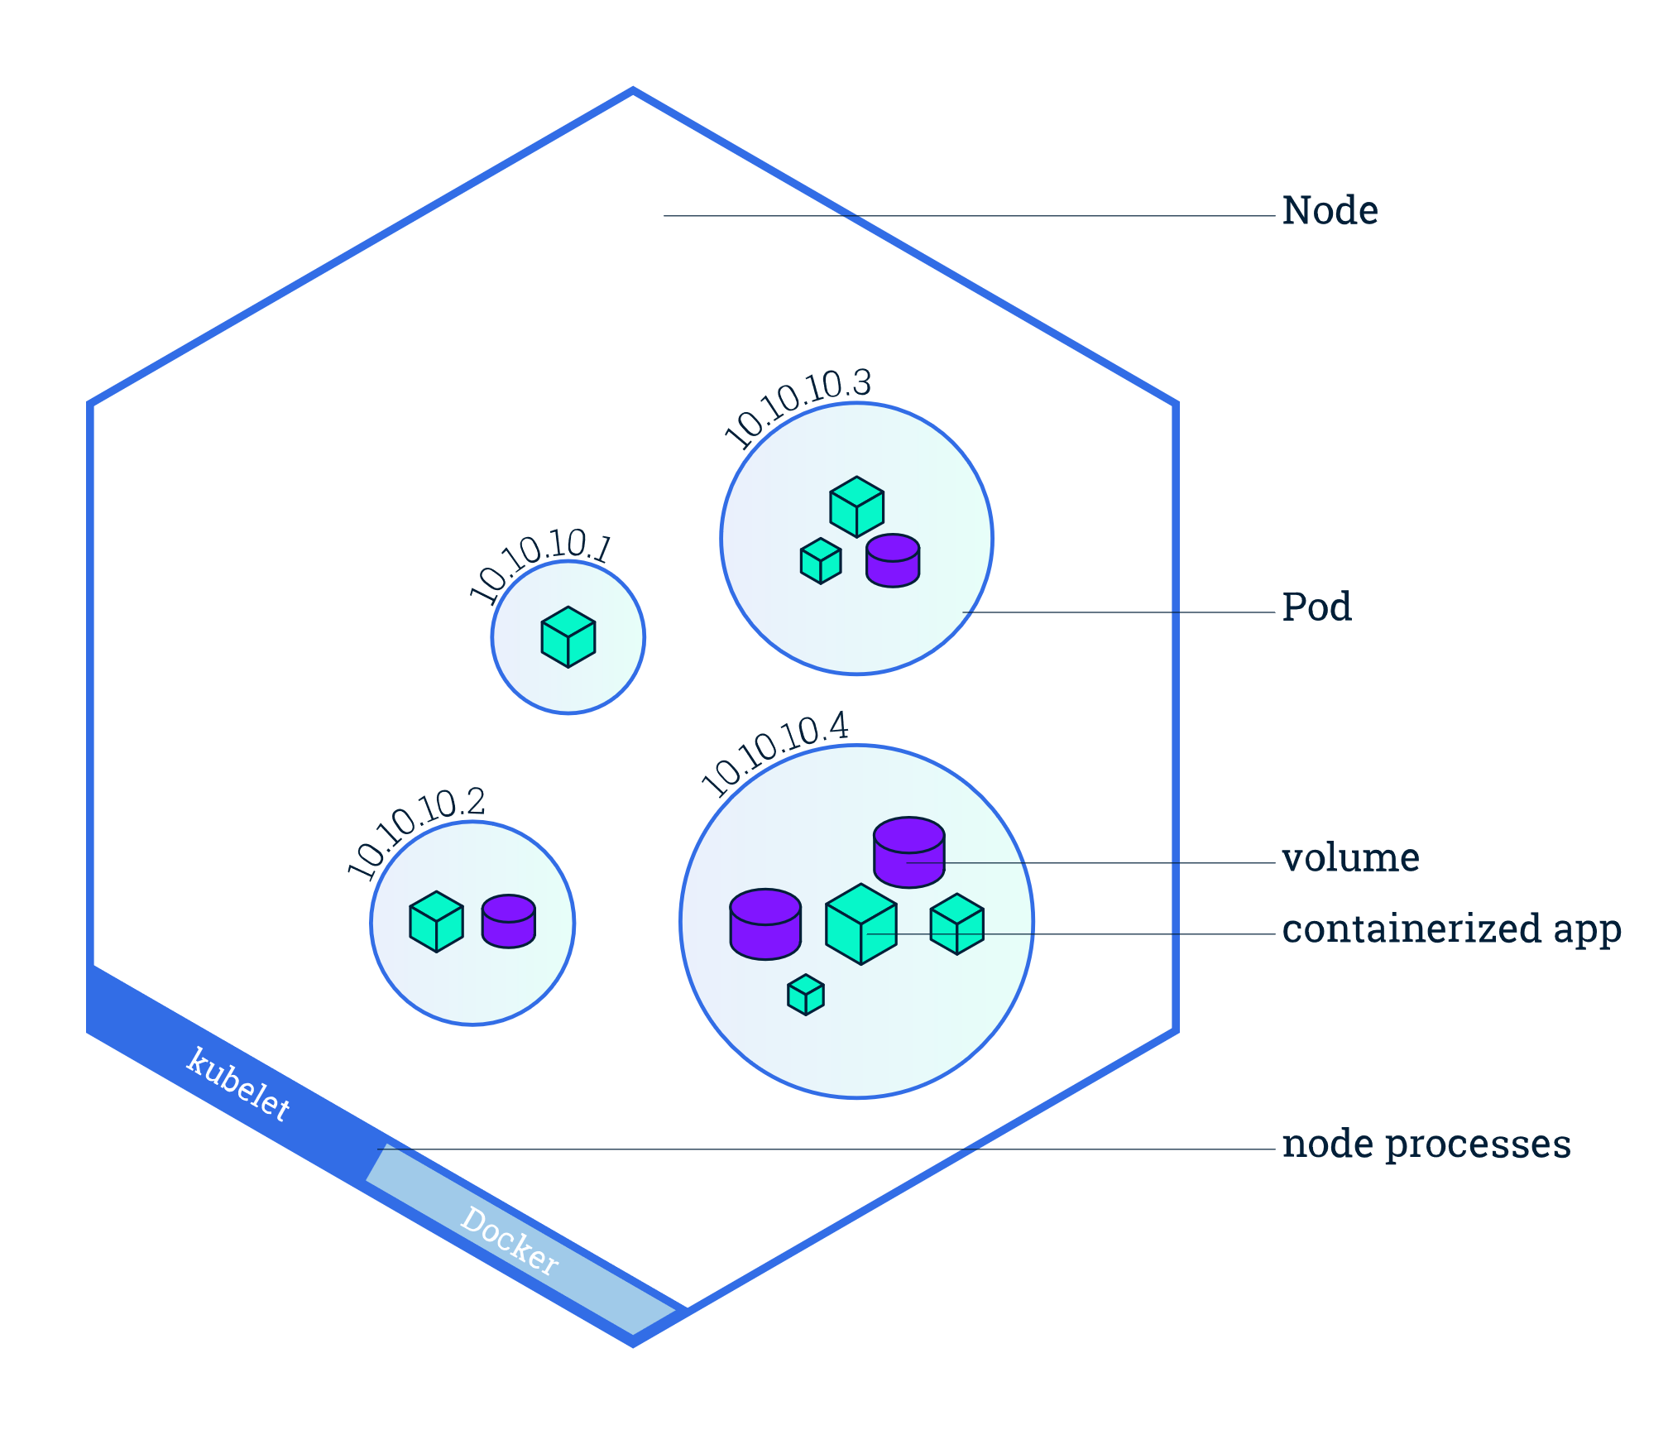

Slide 33
Kubernetes Services
Kubernetes Pods have a lifecycle. - When a worker node dies, the Pods running on the Node are also lost. A ReplicationController might then dynamically drive the cluster back to desired state via creation of new Pods to keep your application running.
A Service in Kubernetes is an abstraction which defines a logical set of Pods and a policy by which to access them. - Services enable a loose coupling between dependent Pods. - A Service is defined using YAML (preferred) or JSON, like all Kubernetes objects. - Although each Pod has a unique IP address, those IPs are not exposed outside the cluster without a Service.

Slide 34
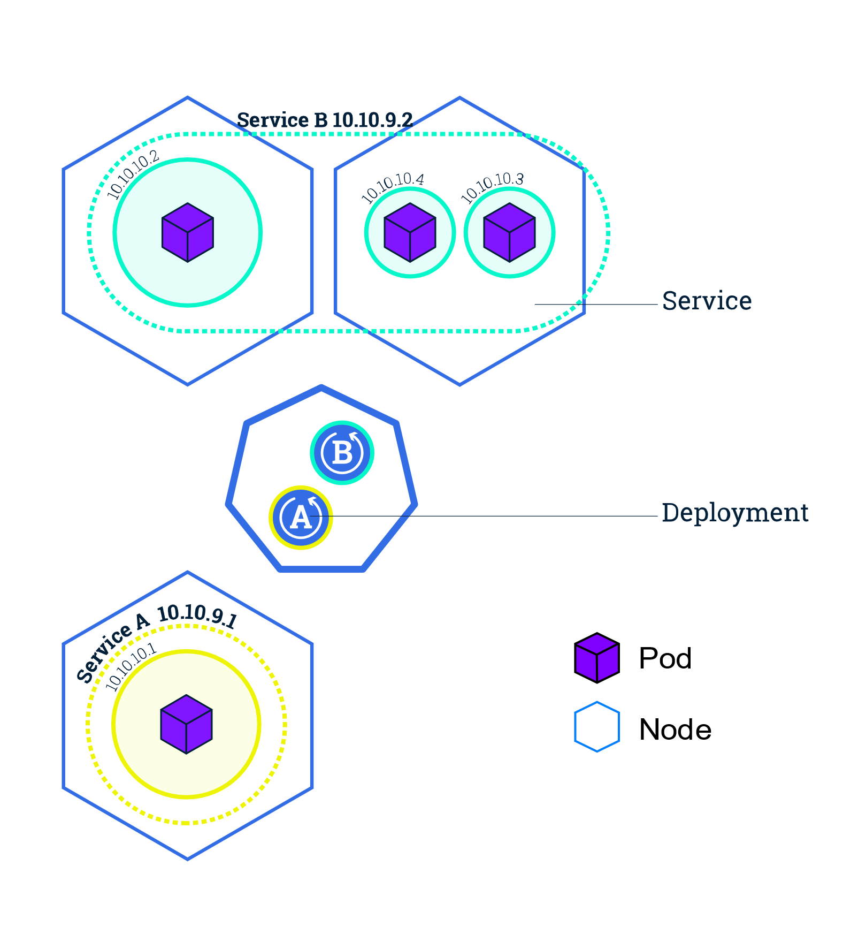

Slide 35
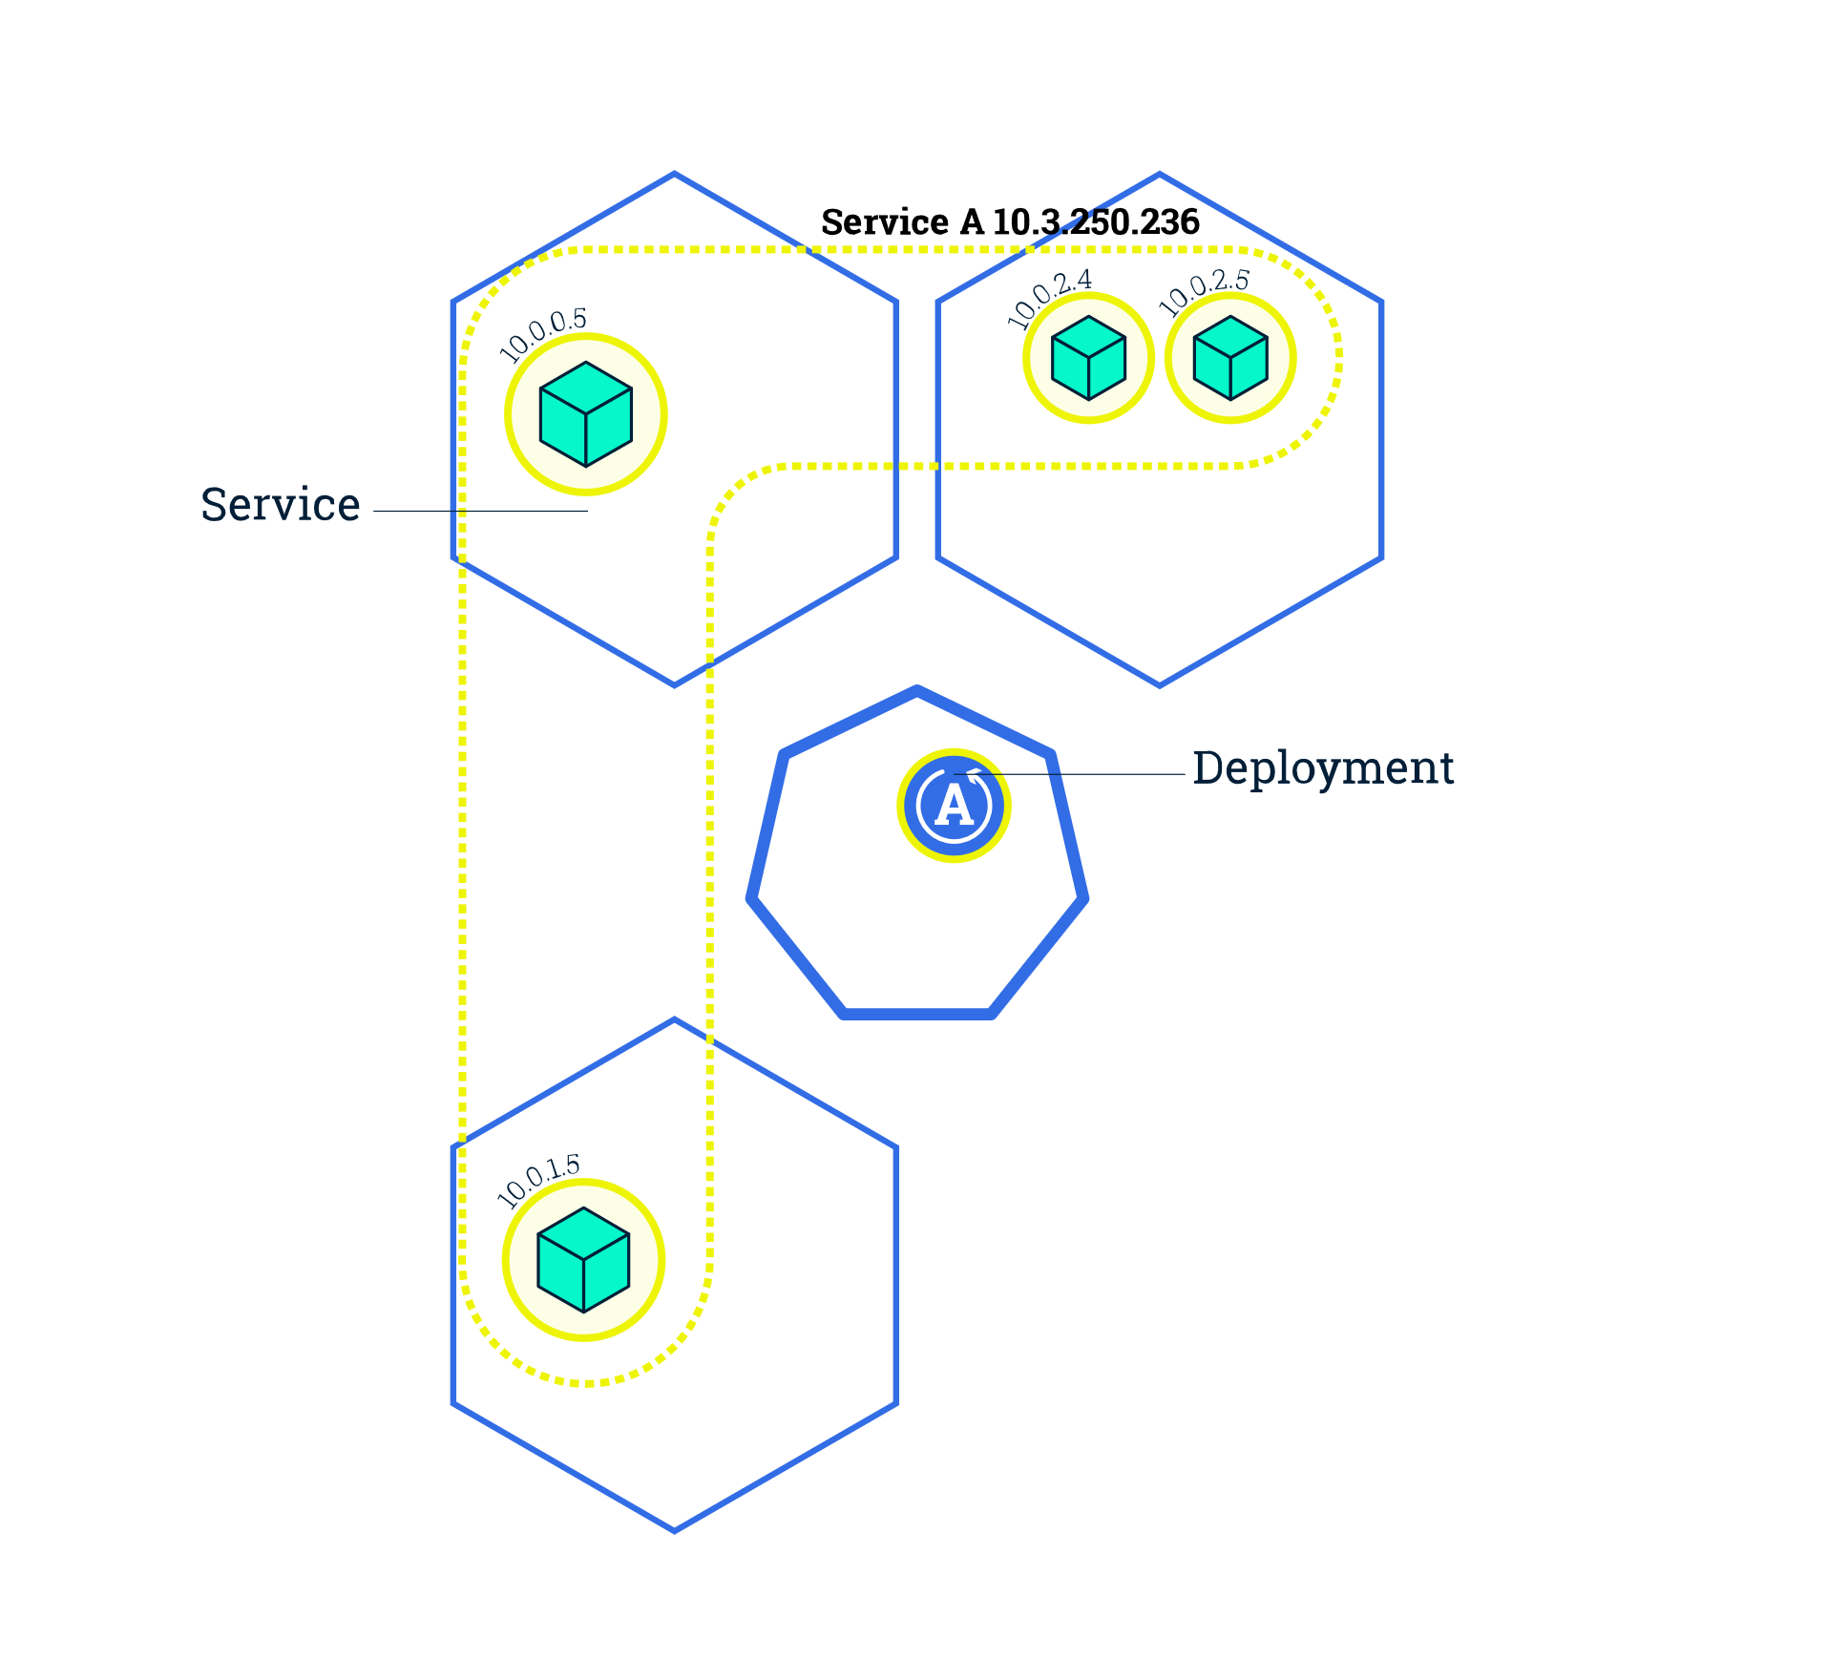
Scaling an application
The Deployment created only one Pod for running our application. When traffic increases, we will need to scale the application to keep up with user demand.

Slide 36
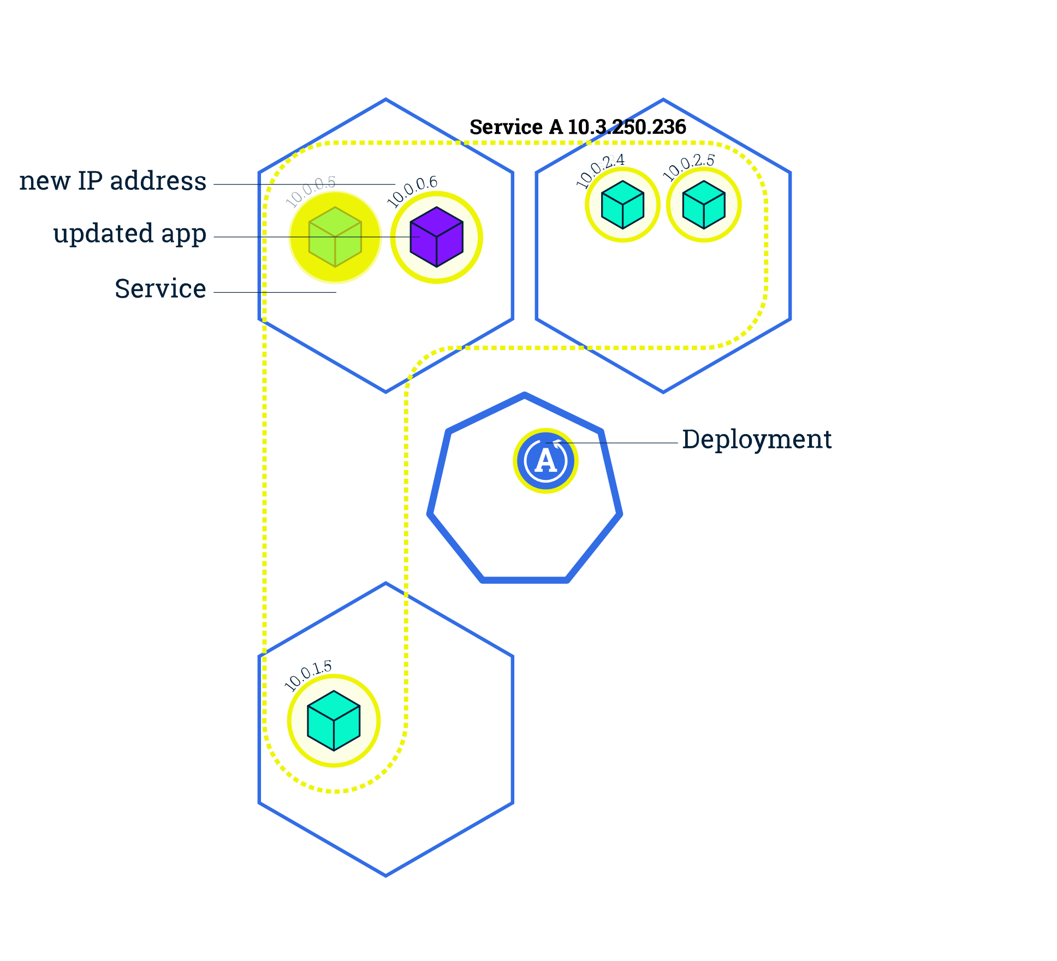
Update an application
Users expect applications to be available all the time and developers are expected to deploy new versions of them several times a day. In Kubernetes this is done with rolling updates. - allow Deployments' update to take place with zero downtime by incrementally updating Pods instances with new ones

