Slide 1
Cloud Computing
Amazon Web Services - introduction
Keke Chen

Slide 2
Infrastructure as a service
Elastic Compute Cloud (EC2)
Simple Storage Services (S3)
CloudFront
DynamoDB
Simple Queue Service
Elastic Mapreduce

Slide 3
EC2
A typical example of utility computing
functionality:
  launch instances with a variety of operating systems (windows/linux)
  load them with your custom application environment (customized AMI)
  Full root access to a blank Linux machine
  manage your network’s access permissions
  run your image using as many or few systems as you desire (scaling up/down)

Slide 4
Backyard…
Powered by Xen – Virtual Machine
  Different from Vmware & VPC
    - high performance
  Hardware contributions by Intel (VT-x/Vanderpool) and AMD (AMD-V)
  Supports “Live Migration” of a virtual machine between hosts
  We will dedicate one class to Xen...

Slide 5
Amazon Machine Images
Public AMIs: Use pre-configured, template AMIs to get up and running immediately. Choose from Fedora, Movable Type, Ubuntu configurations, and more
Private AMIs: Create an Amazon Machine Image (AMI) containing your applications, libraries, data and associated configuration settings
Paid AMIs: Set a price for your AMI and let others purchase and use it (Single payment and/or per hour)
  AMIs with commercial DBMS

Slide 6
Normal way to use EC2
For web applications
  Run your base system in minimum # of VMs
  Monitoring the system load (user traffic)
  Load is distributed to VMs
  If over some threshold → increase # of VMs
  If lower than some thresholds → decrease # of VMs
For data intensive analysis
  Estimate the optimal number of nodes (tricky!)
  Load data
  Start processing

Slide 7
Tools (most are for web apps)
Elastic Block Store: network-attached persistent storage, can be attached to each VM instance
Elastic IP address: programmatically remap public IP to any instance
Virtual private cloud: bridge private cloud and AWS resources
CloudWatch: monitoring EC2 resouces
Auto Scaling: conditional scaling
Elastic load balancing: automatically distribute incoming traffic across instances

Slide 8
Type of instances
Standard instances (micro, small, large, extra)
  E.g., small: 2GB Memory, 1EC2 Compute Unit (Xeon processor?), some GBs of instance/EBS storage (i.e., root volume)
High-CPU instances
  More CPU with same amount of memory

Slide 9
AMIs with special software
IBM DB2, Informix Dynamic Server, Lotus Web Content Management, WebSphere Portal Server
MS SQL Server, IIS/Asp.Net
Hadoop
Open MPI
Apache web server
MySQL
Oracale 11g
…

Slide 10
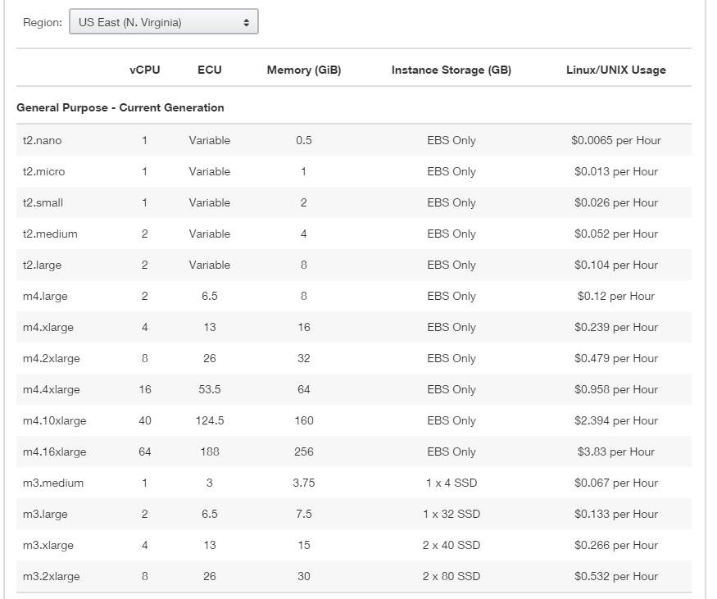

Pricing (2017)

Slide 11
Access methods
Web interface
Command line
Programming Interface
  E.g., boto python library

Slide 12
S3
Write,read,delete objects 0byte-5TB, single PUT <5GB
Namespace: buckets, keys, objects
Accessible using URLs

Slide 13
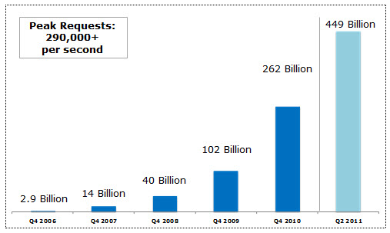
S3 scale

Slide 14









S3 namespace
Amazon S3
bucket
bucket
object
object
object
object
bucket
object
object

Slide 15






Amazon S3
mculver-images
media.mydomain.com
Beach.jpg
2005/party/hat.jpg
img1.jpg
img2.jpg
public.blueorigin.com
index.html
img/pic1.jpg

Slide 16
Accessing objects
Bucket: keke-images, key: jpg1, object: a jpg image
  accessible with
  https://keke-images.s3.amazonaws.com/jpg1
mapping your subdomain to S3
  with DNS CNAME configuration
  e.g. media.yourdomain.com → media.yourdomain.com.s3.amazonaws.com/

Slide 17
Access control
Access log
Objects are private to the user account
  Authentication
Authorization
  ACL: AWS users, users identified by email, any user …
Digital signature to ensure integrity
Encrypted access: https

Slide 18
DynamoDB
Scalable
  Dynamo architecture
Reliable
  Replicas over multiple data centers
Speed
  Fast, single-digit milliseconds
Secure
Weak schema

Slide 19
Data Model
table
  Container, similar to a worksheet in excel,
  Cannot query across domains
Item
  Item name
  item name ->(Attribute, value) pairs
  An item is stored in a domain (a row in a worksheet. Attributes are column names)
Example
  domain: “cars”
  Item 1: “car1”:{“make”:”BMW”, “year”:”2009”}

Slide 20
Primary key of table
  Single key (hash)
  Hash-range key
    A pair of attributes: first one is hash key, 2nd one is range key.
    Example: Reply(Id, datetime, …)
Data type
  Simple: string and number
  Multi-valued: string set and number set

Slide 21
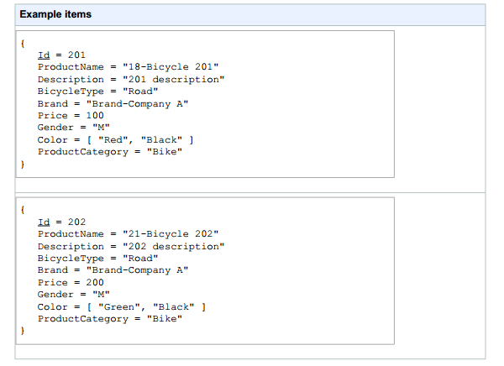
example

Slide 22
Access methods
Amazon DynamoDB is a web service that uses HTTP and HTTPS as the transport method
JavaScript Object Notation (JSON) as a message serialization format
APIs
  Java, PHP, .Net
  Boto

Slide 23
CloudFront
For content delivery: distribute content to end users with a global network of edge locations.
  “Edges”: servers close to user’s geographical location
Objects are organized into distributions
  Each distribution has a domain name
Distributions are stored in a S3 bucket

Slide 24
Edge servers
US
EU
  US and EU are partitioned to different regions
Hongkong
Japan

Slide 25
Use cases
Hosting your most frequently accessed website components
  Small pieces of your website are cached in the edge locations, and are ideal for Amazon CloudFront.
Distributing software
  distribute applications, updates or other downloadable software to end users.
Publishing popular media files
  If your application involves rich media – audio or video – that is frequently accessed

Slide 26
Simple Queue Service
Store messages traveling between computers
Make it easy to build automated workflows
Implemented as a web service
  read/add messages easily
Scalable to millions of messages a day

Slide 27
Some features
Message body : <8Kb in any format
Message is retained in queues for up to 4days
Messages can be sent and read simultaneously
  Can be “locked”, keeping from simultaneous processing
Accessible with SOAP/REST
  Simple: Only a few methods
Secure sharing

Slide 28
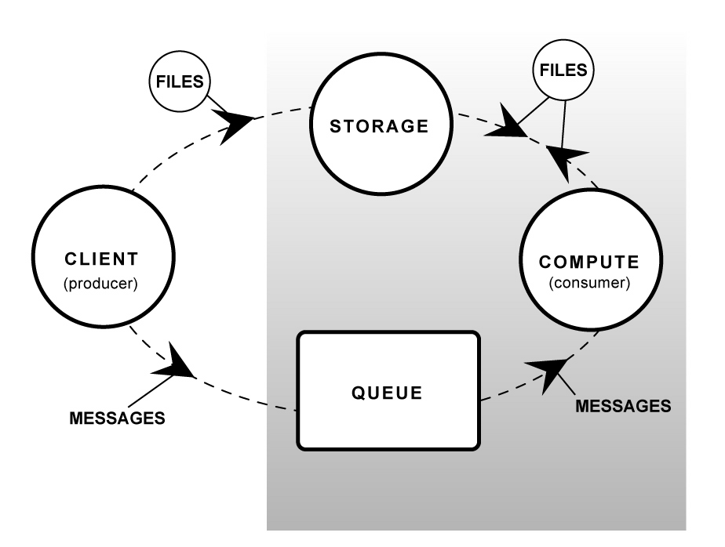
A typical workflow

Slide 29
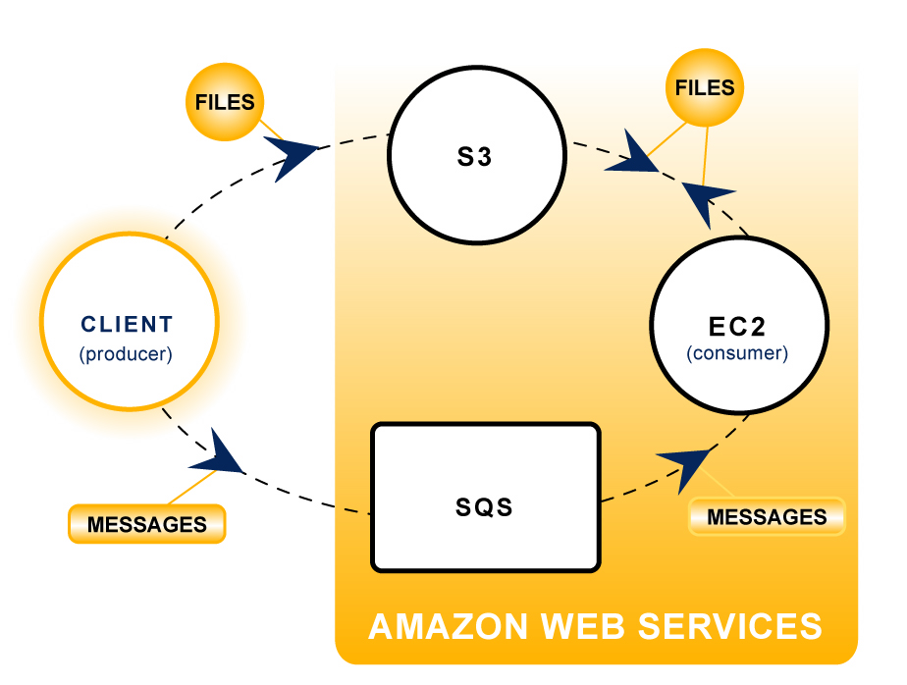
Workflow with AWS

Slide 30
Elastic Mapreduce
Based on hadoop AMI
Data stored on S3
“job flow”

Slide 31
Example
elastic-mapreduce --create --stream \
--mapper s3://elasticmapreduce/samples/wordcount/wordSplitter.py \
--input
s3://elasticmapreduce/samples/wordcount/input
--output s3://my-bucket/output
--reducer aggregate

