Slide 1
Cloud Computing
Key-Value Data Store Systems
Keke Chen

Slide 2
Outline
Frequent operations: append, squential read. Great scalability
  GFS, HDFS
Random Read/Write. Great scalability
  BigTable
  Cassandra

Slide 3
BigTable (HBase)
Structured data
  May generate from MapReduce processing
Support random R/W

Slide 4
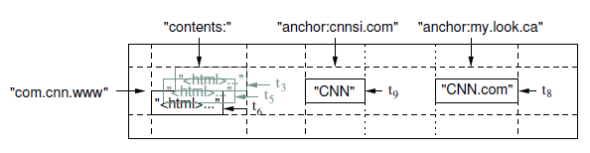
Data model
Objects are arrays of bytes
Objects are indexed by 3 dimensions
  Row
  Column and column family
  Timestamp (versions)
  <picture>
“a big sparse table”

Slide 5
Physical organization
Built on top of GFS
Rows are stored in tablets
A tablet contains multiple SSTables
SSTable: a block file with sparse index
  Data (key, value) are stored in blocks
  Block index
    sorted keys,
    Keys are partitioned to ranges
    First Key of the range ->block(s)
  Data Possibly organized in a nested way

Slide 6
Basic technical points
Use index to speed up random R/W
  Tablet servers maintain the indices
Use locking service to solve the R/W conflicts → guarantees consistency

Slide 7
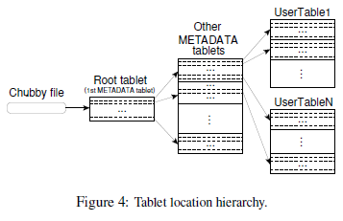
Access via chubby locking service
Through Chubby service
Chubby client
Caches locations
Metadata 128M, 1K per item ➔ 2^17 entries
Two levels ➔ 2^34 entries(tablets)

Slide 8
How it works
Chubby service handles tablet locking
Master maintains consistency
  Start up by reading Metadata from Chubby
  Check lock status
insert/delete/split/merge tablets
Tablet operations
  Each tablet contains multiple SSTables (info stored in Metadata)
  Use log to maintain consistency

Slide 9
HBASE
Open source version of BigTable
Built on top of HDFS

Slide 10
Cassandra
Use BigTable’s data model
  “Rows” and “column family”
Use Distributed Hash Table to organize/index distributed data
Impressive measures
  MySQL > 50 GB Data
  Writes Average : ~300 ms
  Reads Average : ~350 ms
  Cassandra > 50 GB Data
  Writes Average : 0.12 ms
  Reads Average : 15 ms

Slide 11
Data Model
Table is a multi dimensional map indexed by key (row key).
Columns are grouped into Column Families.
2 Types of Column Families
  Simple
  Super (nested Column Families)
Each Column has
  Name
  Value
  Timestamp

Slide 12
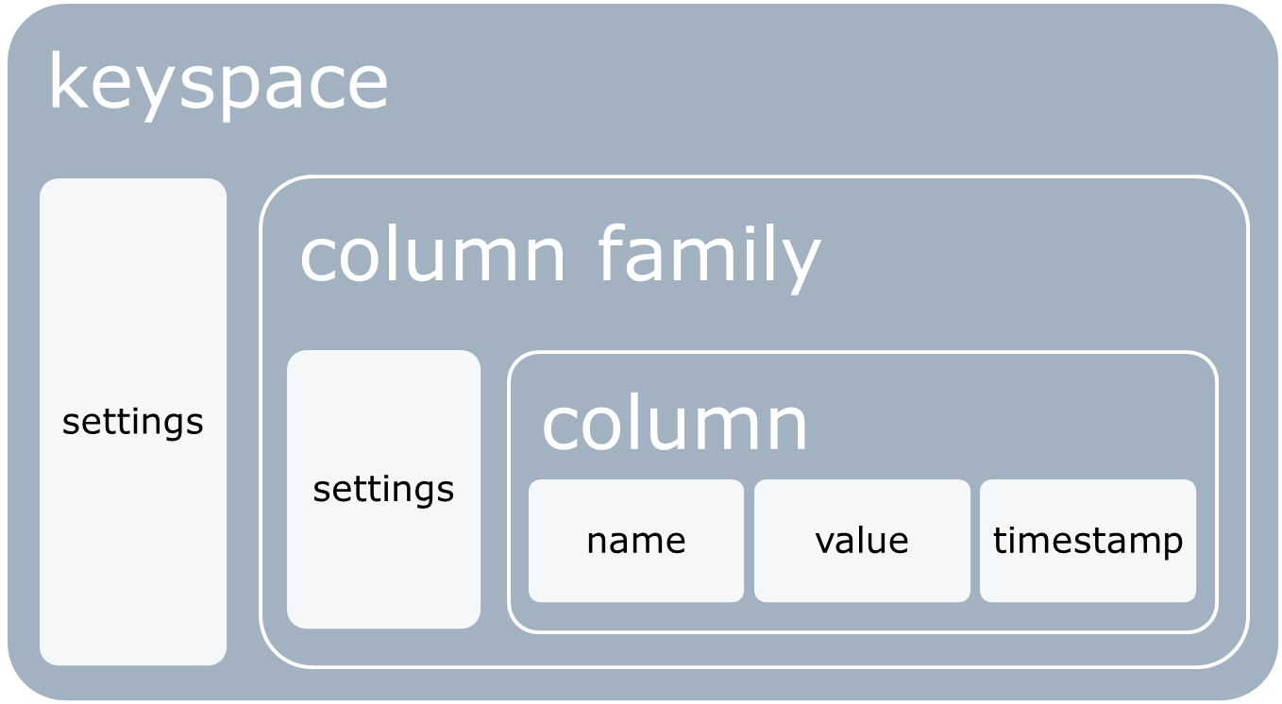
Data Model
  * Figure taken from Eben Hewitt’s (author of Oreilly’s Cassandra book) slides.

Slide 13
Architecture
Partitioning
    How data is partitioned across nodes
Replication
    How data is duplicated across nodes
Group communication
    How nodes are added, deleted to the cluster

Slide 14
Partitioning
Nodes are logically structured in Ring Topology (DHT).
Hashed value of key associated with data partition is used to assign it to a node in the ring.
Hashing rounds off after certain value to support ring structure.
Lightly loaded nodes moves position to alleviate highly loaded nodes.

Slide 15
Replication
Each data item is replicated at N (replication factor) nodes.
Different Replication Policies
  Rack Unaware – replicate data at N-1 successive nodes after its coordinator
  Rack Aware – uses ‘Zookeeper’ to choose a leader which tells nodes the range they are replicas for
  Datacenter Aware – similar to Rack Aware but leader is chosen at Datacenter level instead of Rack level.

Slide 16
Gossip protocol
Network Communication protocols inspired for real life rumour spreading.
Periodic, Pairwise, inter-node communication.
Low frequency communication ensures low cost.
Random selection of peers.
Example – Node A wish to search for pattern in data
  Round 1 – Node A searches locally and then gossips with node B.
  Round 2 – Node A,B gossips with C and D.
  Round 3 – Nodes A,B,C and D gossips with 4 other nodes ……
Round by round doubling makes protocol very robust.

Slide 17
Facebook inbox search example
Cassandra developed to address this problem.
50+TB of user messages data in 150 node cluster on which Cassandra is tested.
Search user index of all messages in 2 ways.
  Term search : search by a key word
  Interactions search : search by a user id
Latency Stat | Search Interactions | Term Search
Min | 7.69 ms | 7.78 ms
Median | 15.69 ms | 18.27 ms
Max | 26.13 ms | 44.41 ms

Slide 18
Comparison on cloud data serving systems
Paper “Benchmarking Cloud Serving Systems with YCSB”

Slide 19
methods
MySQL sharding
  Split tables by row and distribute to multiple machines
HBASE
Cassandra
PNUTS (developed by Yahoo)

Slide 20

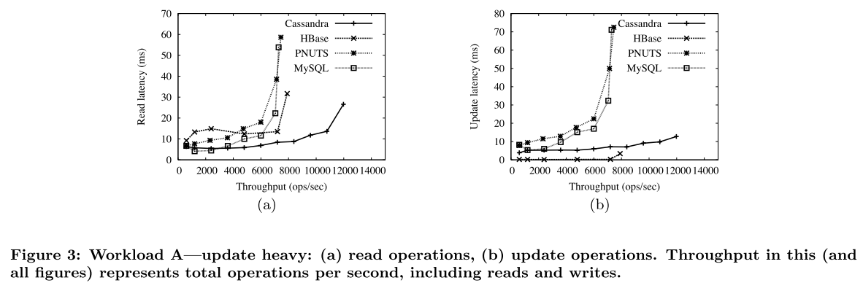
Update heavy workload

Slide 21
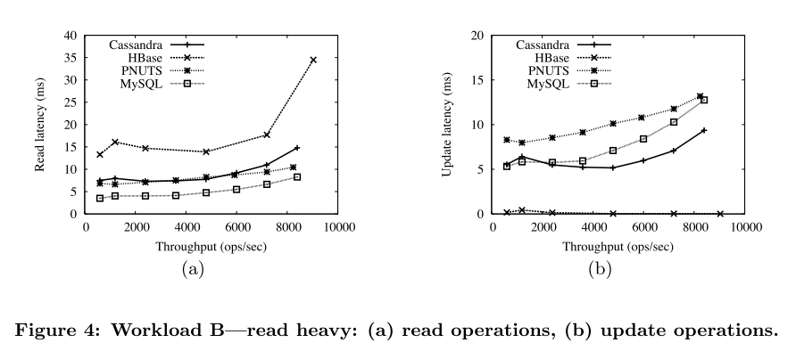
Read heavy

Slide 22
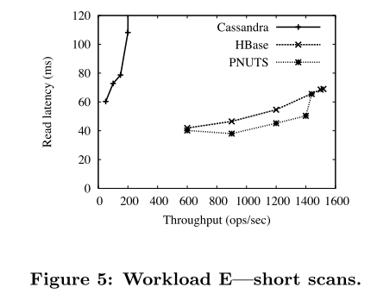
Short scan

Slide 23
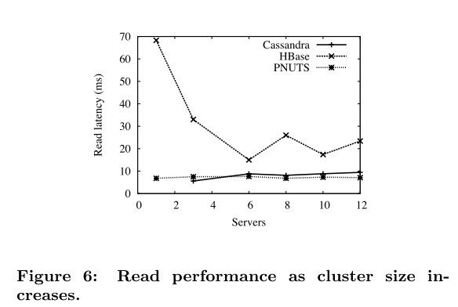
Cluster size

