Slide 1
Cloud Computing
Data Security and Privacy
Keke Chen

Slide 2
Outline
Data confidentiality
Data privacy
access pattern privacy
Integrity of cloud processing

Slide 3
Private data in cloud computing
To use cloud services, the users may have to outsource data
  Except for public services, such as maps, search engine
  Data can be relational databases, multidimensional vector data, graph data, text data, images, video…

Slide 4
Problem with outsourced data
Data confidentiality
  Threat model
    External attackers
      encryption is sufficient
    Internal attackers
      Cannot work on data encrypted with existing techniques
      New methods are needed

Slide 5
Problem
Access pattern
  queries, query results, and how the query is processed
  the user’s query might be private
  The returned data, the access path may reveal data distributions – used to compromise data confidentiality
  Threat model
    Internal attackers

Slide 6
Problem
Query correctness
  Is the returned result the correct result?
  Example:
    Outsourced database services
    content distribution network
  Threat models
    Malicious service providers
    Honest but lazy service providers

Slide 7
Normal Assumption on the attackers
Honest but curious service providers
  Honest – do what you want it to do
  Curious – want to peek at your information
  Applies to data confidentiality and access pattern
Query correctness assumes dishonest providers
  To reduce the service cost
  Intentionally change content

Slide 8
Data confidentiality
The ultimate solution: fully homomorphic encryption
    Computation on encrypted data directly, without the need to decrypt the data
    Example
      E(X) ◊ E(Y) = E(X+Y) : Pailier
      E(X) ◊ E(Y) = E(X*Y) : ElGamal, RSA
      Both ‘+’ and ‘*’: Gentry’s method (Gentry 2009)
    Problem: efficiency
      google search with encrypted keywords and FHE would increase the cost by about a trillion times

Slide 9
Data confidentiality
keyword search for encrypted documents (Song 2000)
  Basic idea
    Linear scan through the text and try to verify whether each encrypted word is matched
      Only the searched word can be correctly decrypted.
      Other words will generate random code
  Problem
    Linear scan, not efficient for large data
    Privacy of search is not preserved – the service provider knows
    Special documents might be identified

Slide 10
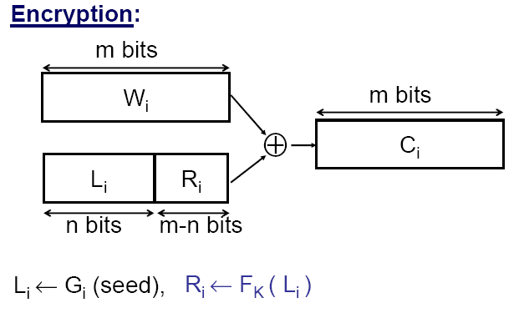
Secure keyword search
Song 2000
Seed is random, different for
each Wi
Key idea: Li and Ri are self-
verifiable
Advantage of XOR

Slide 11
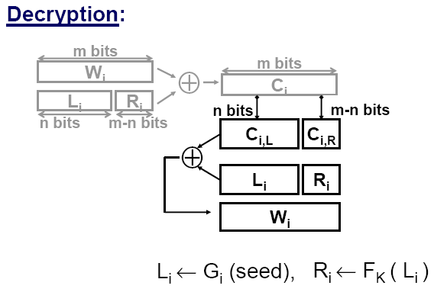

Slide 12
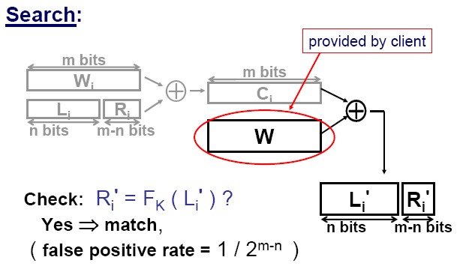
How to set K?

Slide 13
Data confidentiality
Public-key keyword search and range search (Shi 2007)
  Scenario: store encrypted data in public storage. Only authorized users can access the authorized part of the data
  Example
    Audit log: authorized users access certain days of the log (range query)
  Problem: key management
    The range of a searchable dimension is discretized
    Each value needs a pair of public-private keys
    Still linear scan

Slide 14
Data confidentiality
For many data intensive applications
  Linear scan is not sufficient
  Need indices to make search faster, for example
    OLAP
    k nearest search in geological/multimedia databases
Problem
  Indexable encrypted data

Slide 15
Data confidentiality
Indexable encryption on relational data
  Order preserving encryption
    Map a column of data to arbitrary distribution, while preserving the value order
    Able to build index on the column (order is preserved)
    Easy to translate queries to the encrypted data
  Crypto-index
    Map a column of data to buckets
    Give random ID to the buckets
    Values are represented with the bucket IDs
    Range search becomes a search on a list of bucket IDs

Slide 16
Problems with OPE and crypto-index
  Weak threat model: assume attackers have no knowledge about data distribution
  Distributional attack
    Assume the attacker knows the column distribution: easily map OPE encrypted column back to the original column
    Crypto-index: Attacking queried ranges → derive the mapping between bucket-id and real value range
  Return junk records (crypto-index)
    to hide the column distribution, have to make each bucket equi-height (i.e., same number records in each bucket)

Slide 17
Weaker data confidentiality
Privacy protection
  Do not hide the complete information
  Attackers may estimate but cannot get exact values
  Data utility is easier to preserve
Techniques
  Data perturbation
  Data anonymization

Slide 18
Data perturbation
Definition
  1. randomly change the original data
  2. the attacker cannot effectively recover the original data
  3. the desired properties are preserved
Techniques
  Single dimension: noise addition
  Multidimensional
    Geometric perturbation
    Random projection

Slide 19
Noise addition
Y = X+ R
  X: original data column, R: random noise (distribution published), Y: published data
Applications in data mining
  Reconstructing column distribution
    Rakesh Agrawal SIGMOD 2000
    Applied to privacy-preserving decision tree, naïve bayes classifier
Attacks
  Spectral filtering (Kargupta ICDM 2004)
  PCA reconstruction (Huang SIGMOD2005)

Slide 20
Geometric data perturbation
Y=RX+T+D
  R: secret rotation matrix (preserve Euclidean distances)
  T: secret random translation matrix, D: secret random noise matrix
  Distances are approximately preserved (D)
  Resilient to most attacks to rotation perturbation
Applications
  Outsourced privacy preserving data mining, applicable for many classification and clustering algorithms
Attacks
  Population based attacks (when covariance matrix is revealed)

Slide 21
Random Projection
Y=AX+D
  A: random projection, e.g., entries from N(0,1)
  Distances are approximately preserved
Applications
  Many classification and clustering algorithms
    Worse accuracy than geometric perturbation
  Good for sparse high-dimensional data (text data), i.e., sketch methods (A is randomly generated for EACH record)
Attacks
  Possibly more resilient than other two perturbation methods

Slide 22
Random Space Perturbation
y = A( E(x), 1, v)^{T}
  x is a k-D vector, E(x): order preserving encryption, v: random value
  A : (k+2)x(k+2) random invertible matrix
Properties
  Preserve half space queries, e.g., f(x)<0
  Does not preserve distance, orders, (resilient to the known attacks to OPE, GDP, etc.)
Applications: range query, data mining (linear classifier + boosting)

Slide 23
Data anonymization
anonymization problem
Governor of MA
uniquely identified
using ZipCode,
Birth Date, and Sex.
Name linked to Diagnosis
87 % of US population
Name
SSN
Visit Date
Diagnosis
Procedure
Medication
Total Charge
Name
Address
Date
Registered
Party
affiliation
Date last
voted
Zip
Birth
date
Sex
Zip
Birth
date
Sex
Quasi Identifier
Voter List
Medical Data
Sweeney, IJUFKS 2002

Slide 24
Basic problems in anonymization
Linkage between
  Records
  Attributes
  Tables
  Attacker’s prior knowledge and published data
Current research
  address possible data linkage attacks
  Propose techniques to prevent them
  A nice survey paper http://www.cs.sfu.ca/~wangk/pub/FWCY10csur.pdf

Slide 25
Differential privacy
Statistical database
  Allow users to submit aggregate queries
  But need to protect from query inference attacks
Perturb the query results
  Cynthia Dwork (http://research.microsoft.com/en-us/people/dwork/) proposed differential privacy
  A method for designing the random noise for user-specific “privacy budget” and specific aggregate functions.

Slide 26
Privacy of access pattern
Do not want the attacker know what items the user is accessing
  Known access pattern can be used to derive a lot of private information
  Example:
    AOL search log → identify real person → what sensitive keywords he/she used
naive solution: download the entire database ☺

Slide 27
Privacy of access pattern
Private information retrieval (PIR)
  Basic idea: hide the real access pattern among a lot of accesses
  Multi-server information theoretic PIR (Chor 98)
  Computational PIR – same assumption as computationally secure encryption (Kushilevitz 97)
Problem:
  High communication cost: need to transfer a lot of contents
  Most efficient solution still needs O(n^{1/2}) communication cost

Slide 28
Query correctness
check whether server faithfully returns the results
Challenge token (Sion 2005)
  put a challenge query (that the user knows the answer) among a batch of b queries
  This solution only provides a probabilistic guarantee on query correctness

Slide 29
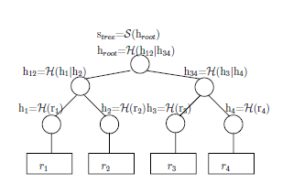
Use Merkle hash tree (Li 2006)
  Merkle hash tree:
  Integrate Merkle hash tree with B-tree index
  For each search the service provider need to provide a hash value to prove the right access path was used
  Client can verify the hash with its own merkle hash tree

Slide 30
Proof of retrievability
Problem
  Archived or backup data in the cloud, sporadically accessed
  Make sure the data is still there (not discarded by cloud provider for saving money)
  Make sure the data is not modified
Approaches
  Similar to challenge based methods

