Slide 1
DISTRIBUTED FILE SYSTEMS
DEFINITIONS:
A Distributed File System ( DFS ) is simply a classical model of a file system ( as discussed before ) distributed across multiple machines. The purpose is to promote sharing of dispersed files.
The resources on a particular machine are local to itself. Resources on other machines are remote.
A file system provides a service for clients. The server interface is the normal set of file operations: create, read, etc. on files.
17: Distributed File Systems
1

Slide 2
DISTRIBUTED FILE SYSTEMS
Definitions
Clients, servers, and storage are dispersed across machines. Configuration and implementation may vary -
  Servers may run on dedicated machines, OR
  Servers and clients can be on the same machines.
  The OS itself can be distributed (with the file system a part of that distribution.
  A distribution layer can be interposed between a conventional OS and the file system.
Clients should view a DFS the same way they would a centralized FS; the distribution is hidden at a lower level.
Performance is concerned with throughput and response time.
17: Distributed File Systems

Slide 3
DISTRIBUTED FILE SYSTEMS
Naming and Transparency
Naming is the mapping between logical and physical objects.
  In a conventional file system, it's understood where the file actually resides; the system and disk are known.
  In a transparent DFS, the location of a file, somewhere in the network, is hidden.
Location transparency -
  The name of a file does not reveal any hint of the file's physical storage location (machine, disk, or disk blocks).
17: Distributed File Systems

Slide 4
DISTRIBUTED FILE SYSTEMS
Naming and Transparency
Location independence -
  The name of a file doesn't need to be changed when the file's physical storage location changes. Dynamic, one-to-many mapping.
  Separates the naming hierarchy from the storage devices hierarchy.
Most DFSs today:
  Support location transparent systems.
17: Distributed File Systems

Slide 5
DISTRIBUTED FILE SYSTEMS
Naming and Transparency
NAMING SCHEMES:
1. Remote directories are mounted to local directories.
  So a local system seems to have a coherent directory structure.
  The remote directories must be explicitly mounted. The files are location independent.
  SUN NFS is a good example of this technique.
2. A single global name structure spans all the files in the system.
  The DFS is built the same way as a local filesystem. Location independent.
  GFS and HDFS work in this way
17: Distributed File Systems

Slide 6
DISTRIBUTED FILE SYSTEMS
Naming and Transparency
IMPLEMENTATION TECHNIQUES:
  Can Map directories or larger aggregates rather than individual files.
  A non-transparent mapping technique:
  name ----> < system, disk, cylinder, sector >
  A transparent mapping technique:
  name ----> file_identifier ----> < system, disk, cylinder, sector >
  So when changing the physical location of a file, only the file identifier need be modified. This identifier must be "unique" in the universe.
17: Distributed File Systems

Slide 7
DISTRIBUTED FILE SYSTEMS
Remote File Access
CACHING
Reduce network traffic by retaining recently accessed disk blocks in a cache, so that repeated accesses to the same information can be handled locally.
If required data is not already cached, a copy of data is brought from the server to the user.
Perform accesses on the cached copy.
Files are identified with one master copy residing at the server machine,
Copies of (parts of) the file are scattered in different caches.
Cache Consistency Problem -- Keeping the cached copies consistent with the master file.
17: Distributed File Systems

Slide 8
DISTRIBUTED FILE SYSTEMS
Remote File Access
CACHE UPDATE POLICY:
A write through cache has good reliability. But the user must wait for writes to get to the server. Used by NFS.
Delayed write - write requests complete more rapidly. Data may be written over the previous cache write, saving a remote write. Poor reliability on a crash.
17: Distributed File Systems

Slide 9
DISTRIBUTED FILE SYSTEMS
Remote File Access
FILE REPLICATION:
Duplicating files on multiple machines improves availability and performance.
Placed on failure-independent machines ( they won't fail together ).
  Replication management should be "location-opaque".
The main problem is consistency - when one copy changes, how do other copies reflect that change? Often there is a tradeoff: consistency versus availability and performance.
Atomic and serialized invalidation isn't guaranteed ( message could get lost / machine could crash. )
17: Distributed File Systems

Slide 10
DISTRIBUTED FILE SYSTEMS
SUN Network File System
OVERVIEW:
Runs on SUNOS - NFS is both an implementation and a specification of how to access remote files. It's both a definition and a specific instance.
The goal: to share a file system in a transparent way.
Uses client-server model ( for NFS, a node can be both simultaneously.) Can act between any two nodes ( no dedicated server. ) Mount makes a server file-system visible from a client.
mount server:/usr/shared client:/usr/local
Then, transparently, a request for /usr/local/dir-server accesses a file that is on the server.
The mount is controlled by: (1) access rights, (2) server specification of what's mountable.
Can use heterogeneous machines - different hardware, operating systems, network protocols.
Uses RPC for isolation - thus all implementations must have the same RPC calls. These RPC's implement the mount protocol and the NFS protocol.
17: Distributed File Systems

Slide 11
DISTRIBUTED FILE SYSTEMS
SUN Network File System
THE MOUNT PROTOCOL:
The following operations occur:
  1. The client's request is sent via RPC to the mount server ( on server machine.)
  2. Mount server checks export list containing
    file systems that can be exported,
    legal requesting clients.
    It's legitimate to mount any directory within the legal filesystem.
  3. Server returns "file handle" to client.
  4. Server maintains list of clients and mounted directories -- this is state information! But this data is only a "hint" and isn't treated as essential.
  5. Mounting often occurs automatically when client or server boots.
17: Distributed File Systems

Slide 12
DISTRIBUTED FILE SYSTEMS
SUN Network File System
THE NFS PROTOCOL:
RPC’s support these remote file operations:
  Search for file within directory.
  Read a set of directory entries.
  Manipulate links and directories.
  Read/write file attributes.
  Read/write file data.
Note:
  Open and close are conspicuously absent from this list. NFS servers are stateless. Each request must provide all information. With a server crash, no information is lost.
  Modified data must actually get to server disk before client is informed the action is complete. Using a cache would imply state information.
  A single NFS write is atomic. A client write request may be broken into several atomic RPC calls, so the whole thing is NOT atomic. Since lock management is stateful, NFS doesn't do it. A higher level must provide this service.
17: Distributed File Systems

Slide 13
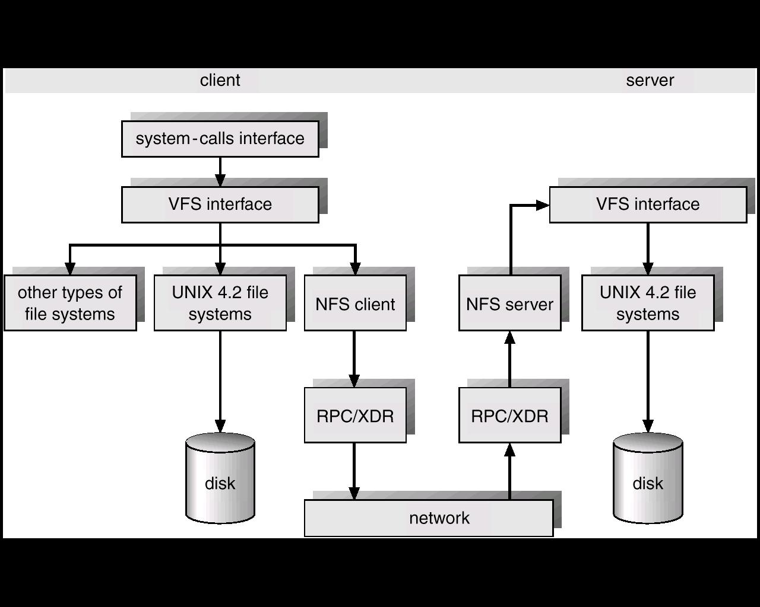
DISTRIBUTED FILE SYSTEMS
SUN Network File System
NFS ARCHITECTURE:
Follow local and remote access through this figure:
17: Distributed File Systems

Slide 14
DISTRIBUTED FILE SYSTEMS
SUN Network File System
NFS ARCHITECTURE:
1. UNIX filesystem layer - does normal open / read / etc. commands.
2. Virtual file system ( VFS ) layer -
  Gives clean layer between user and filesystem.
  Acts as deflection point by using global vnodes.
  Understands the difference between local and remote names.
  Keeps in memory information about what should be deflected (mounted directories) and how to get to these remote directories.
3. System call interface layer -
  Presents sanitized validated requests in a uniform way to the VFS.
17: Distributed File Systems

Slide 15
DISTRIBUTED FILE SYSTEMS
SUN Network File System
PATH-NAME TRANSLATION:
Break the complete pathname into components.
For each component, do an NFS lookup using the
component name + directory vnode.
After a mount point is reached, each component piece will cause a server access.
Can't hand the whole operation to server since the client may have a second mount on a subsidiary directory (a mount on a mount ).
A directory name cache on the client speeds up lookups.
17: Distributed File Systems

Slide 16
DISTRIBUTED FILE SYSTEMS
SUN Network File System
CACHES OF REMOTE DATA:
The client keeps:
  File block cache - ( the contents of a file )
  File attribute cache - ( file header info (inode in UNIX) ).
The local kernel hangs on to the data after getting it the first time.
On an open, local kernel, it checks with server that cached data is still OK.
Cached attributes are thrown away after a few seconds.
Data blocks use read ahead and delayed write.
Mechanism has:
  Server consistency problems.
  Good performance.
17: Distributed File Systems

Slide 17
DISTRIBUTED FILE SYSTEMS
Andrew File System
A distributed environment at CMU. Strongest characteristic is scalability.
OVERVIEW:
Machines are either servers or clients.
Clients see a local name space and a shared name space.
Servers
  run vice which presents a homogeneous, location transparent directory structure to all clients.
Clients ( workstations ):
  Run virtue protocol to communicate with vice.
  Have local disks (1) for local name space, (2) to cache shared data.
For scalability, off load work from servers to clients. Uses whole file caching.
NO clients or their programs are considered trustworthy.
17: Distributed File Systems

Slide 18
DISTRIBUTED FILE SYSTEMS
Andrew File System
SHARED NAME SPACE:
The server file space is divided into volumes. Volumes contain files of only one user. It's these volumes that are the level of granularity attached to a client.
A vice file can be accessed using a fid = <volume number, vnode >. The fid doesn't depend on machine location. A client queries a volume-location database for this information.
Volumes can migrate between servers to balance space and utilization. Old server has "forwarding" instructions and handles client updates during migration.
Read-only volumes ( system files, etc. ) can be replicated. The volume database knows how to find these.
17: Distributed File Systems

Slide 19
DISTRIBUTED FILE SYSTEMS
Andrew File System
FILE OPERATIONS AND CONSISTENCY SEMANTICS:
If a file is remote, the client operating system passes control to a client user-level process named Venus.
The client talks to Vice server only during open/close; reading/writing are only to the local copy.
A further optimization - if data is locally cached, it's assumed to be good until the client is told otherwise.
A client is said to have a callback on a file.
When a client encaches a file, the server maintains state for this fact.
Before allowing a write to a file, the server does a callback to anyone else having this file open; all other cached copies are invalidated.
When a client is rebooted, all cached data is suspect.
If too much storage used by server for callback state, the server can break some callbacks.
The system clearly has consistency concerns.
17: Distributed File Systems

Slide 20
DISTRIBUTED FILE SYSTEMS
Andrew File System
IMPLEMENTATION:
Deflection of open/close:
The client kernel is modified to detect references to vice files.
The request is forwarded to Venus with these steps:
Venus does pathname translation.
Asks Vice for the file
Moves the file to local disk
Passes inode of file back to client kernel.
Venus maintains caches for status ( in memory ) and data ( on local disk.)
A server user-level process handles client requests.
A lightweight process handles concurrent RPC requests from clients.
State information is cached in this process.
Susceptible to reliability problems.
17: Distributed File Systems

Slide 21
DISTRIBUTED FILE SYSTEMS
Wrap Up
In this section we have looked at how files systems are implemented across systems. Of special concern is consistency, caching, and performance.
17: Distributed File Systems

