Slide 1
Differential Privacy (1)

Slide 2
Outline
Background
Definition

Slide 3
Background
Interactive database query
  A classical research problem for statistical databases
  Prevent query inferences – malicious users submit multiple queries to infer private information about some person
  Has been studied since decades ago
Non-interactive
  publishing statistics then destroy data
  micro-data publishing

Slide 4
Background: Database Privacy
Alice
Users
(government, researchers,
marketers, …)
Collection
and
“sanitization”
Bob

You
“Census problem”
Two conflicting goals
Utility: Users can extract “global” statistics
Privacy: Individual information stays hidden
How can these be formalized?
Notes:
OLD NOTES!
This talk is about database privacy. The term can mean many things but for this talk, the example to keep in mind is a government census. Individuals provide information to a trusted government agency, which processes the information and makes some sanitized version of it available for public use.
- privacy is required by law
- ethical
- pragmatic: people won’t answer unless they trust you
There are two goals: we want users to be able to extract global statistics about the population being studied. However, for legal, ethical and pragmatic reasons, we also want to protect the privacy of the individuals who participate.
And so we have a fundamental tradeoff between privacy on one hadn and utility on the other. The extremes are easy: publishing nothing at all provides complet eprivacy, but no utility, and publishing the raw data exactly provides the most utility but no privacy.
Thus the first-order goal of this paper is to plot some middle course between the extremes; that is, to find a compromise which allows users to obtain useful information while also providing a meaningful guarantee of privacy.
This problem is not new: it is often called the "statistical database" problem. I would say a second-order goal of this paper is to change the way the problem is approached and treated in the literature…
Graphically, this is what is going on. As I said, there are two goals, utility and privacy.
Utility is easy to understand, and to explain to a user. To prove that your scheme provides a particular utility, just give an algoriithm and an analysis.
Privacy is much harder to get a handle on…

Slide 5
Database Privacy
Variations on model studied in
Statistics
Data mining
Theoretical CS
Cryptography
Different traditions for what “privacy” means
Notes:
OLD NOTES!
This talk is about database privacy. The term can mean many things but for this talk, the example to keep in mind is a government census. Individuals provide information to a trusted government agency, which processes the information and makes some sanitized version of it available for public use.
- privacy is required by law
- ethical
- pragmatic: people won’t answer unless they trust you
There are two goals: we want users to be able to extract global statistics about the population being studied. However, for legal, ethical and pragmatic reasons, we also want to protect the privacy of the individuals who participate.
And so we have a fundamental tradeoff between privacy on one hadn and utility on the other. The extremes are easy: publishing nothing at all provides complet eprivacy, but no utility, and publishing the raw data exactly provides the most utility but no privacy.
Thus the first-order goal of this paper is to plot some middle course between the extremes; that is, to find a compromise which allows users to obtain useful information while also providing a meaningful guarantee of privacy.
This problem is not new: it is often called the "statistical database" problem. I would say a second-order goal of this paper is to change the way the problem is approached and treated in the literature…
Graphically, this is what is going on. As I said, there are two goals, utility and privacy.
Utility is easy to understand, and to explain to a user. To prove that your scheme provides a particular utility, just give an algoriithm and an analysis.
Privacy is much harder to get a handle on…

Slide 6
Two types of privacy protection methods
Data sanitization
Anonymization

Slide 7
Sanitization approaches
Input perturbation
  Add noise to data
  Generalize data
Output perturbation
  Add noise to summary statistics
    Count, sum, max, min
    Means, variances
    Marginal totals
    Model parameters

Slide 8
Blending/hiding into a crowd
K-anonymity, l-diversity, etc. approaches
Adversary may have various background knowledge to breach privacy
  Privacy models often assume “the adversary’s background knowledge is given”, which is impractical

Slide 9
Classic intuition for privacy
Privacy means that anything can be learned about a respondent from the statistical database can be learned without access to the database
  A very strong definition
  Defined by T. Dalenius, 1977
Equivalent to security of encryption
  Anything about the plaintext that can be learned from a ciphertext can be learned without the ciphertext.

Slide 10
Impossibility result
The Dalenius definition cannot be achieved.
Example:
If I know Alice’s height is 2 inches higher than the average American’s height, by looking at the census database, I can find the average and then calculate Alice’s exact height. Therefore, Alice’s privacy is breached.
We need to revise the privacy definiton…
Remove Gavison def?

Slide 11
Differential Privacy
The risk to my privacy should not substantially increase as a result of participating in a statistical database.
With or without including me in the database, my privacy risk should not change much
(In contrast, the Dalenius definition requires that using the database will not increase my privacy risk, including the case that the database does not even include my record).

Slide 12
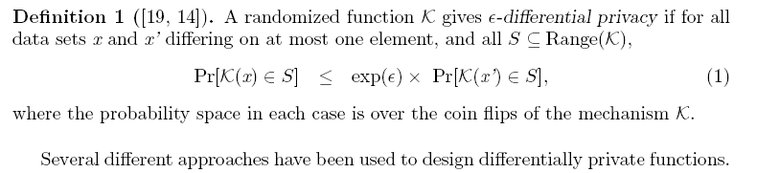
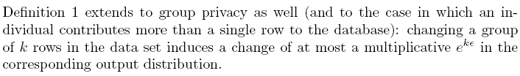
Definition
Mechanism: K(x) = f(x) + D, D is some noise.
It is an output perturbation method.

Slide 13
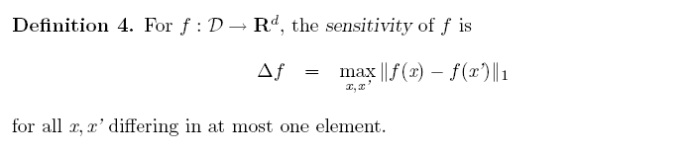
Sensitivity function
How to design the noise D? It is actually linked back to the function f(x)
Captures how great a difference must be hidden by the additive noise

Slide 14
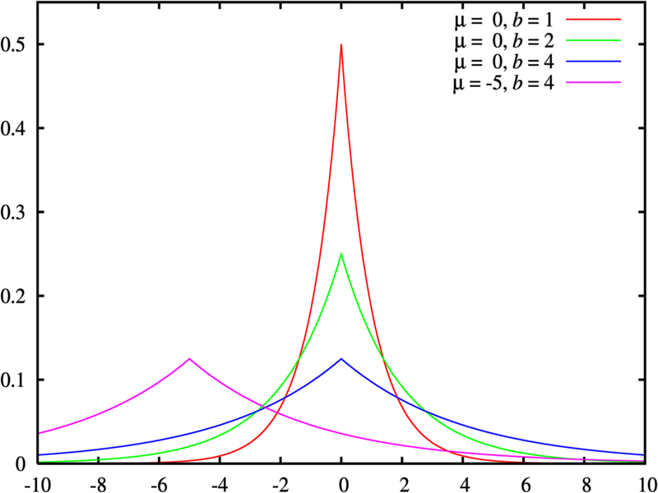
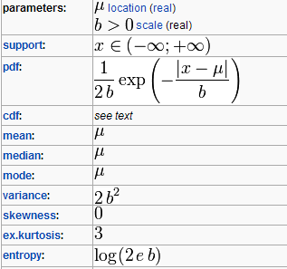
LAP distribution noise
Using laplacian distribution to generate noise.

Slide 15
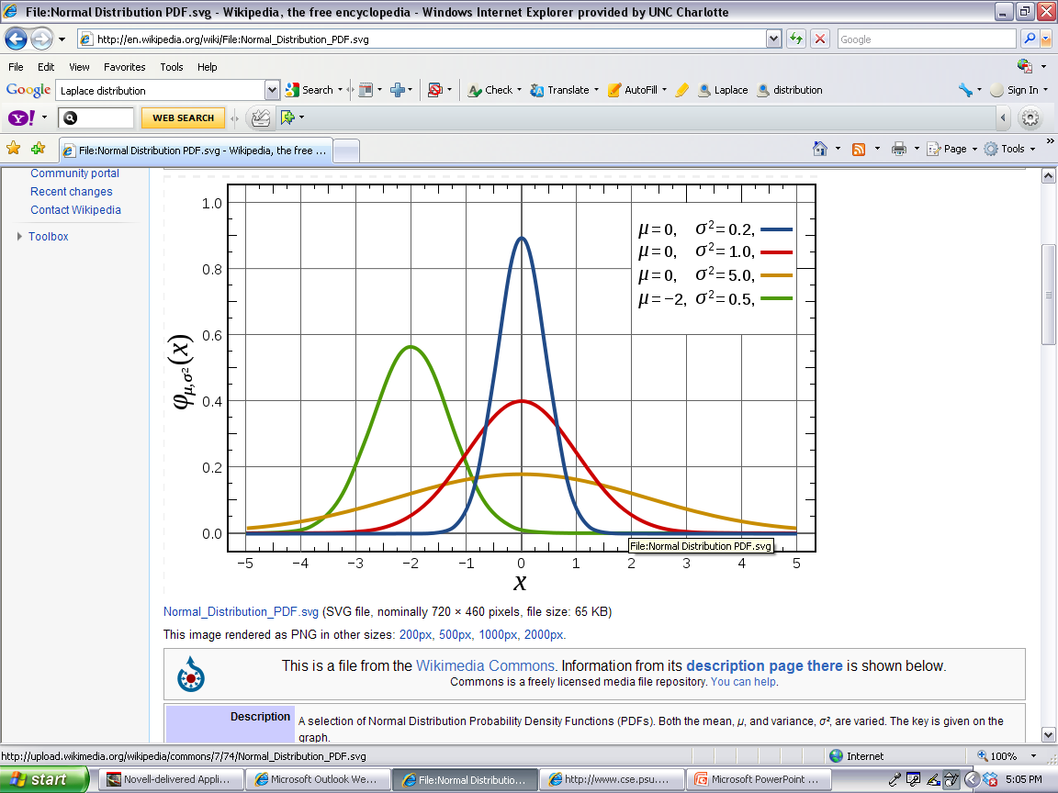
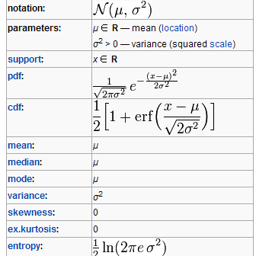
Similar to Guassian noise

Slide 16
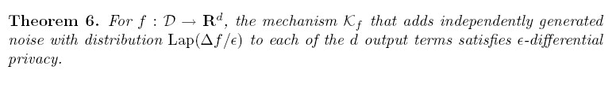
Adding LAP noise
Why does this work?

Slide 17
Proof sketch
Let K(x) = f(x) + D =r. Thus, r-f(x) has Lap distribution with the scale df/e.
Similarly, K(x’) = f(x’)+D=r, and r-f(x’) has the same distribution
P(K(x) = r) = exp(-|f(x)-r|(e/df))
P(K(x’)= r) = exp(-|f(x’)-r|(e/df))
P(K(x)=r)/P(K(x’)=r) = exp( (|f(x’)-r|-|f(x)-r|)(e/df))
apply triangle inequality <= exp( |f(x’)-f(x)|(e/df)) = exp(e)

Slide 18
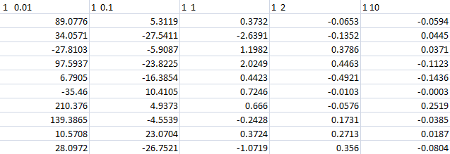
Delta_f=1, epsilon varies
Noise samples

Slide 19
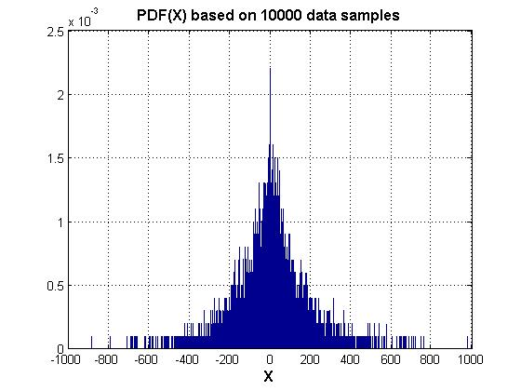
Delta_f=1 epsilon=0.01

Slide 20
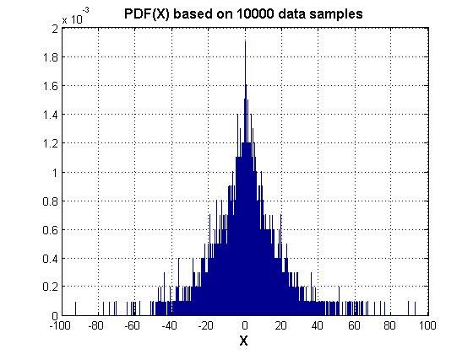
Delta_f=1 epsilon=0.1

Slide 21
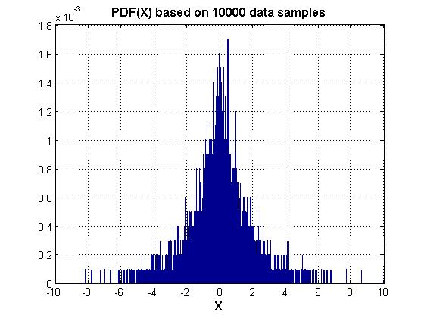
Delta_f=1 epsilon=1

Slide 22
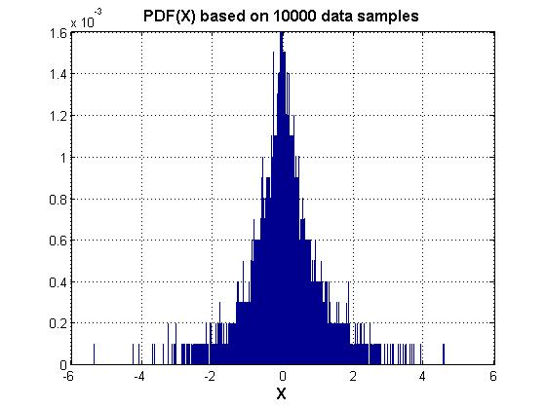
Delta_f=1 epsilon=2

Slide 23
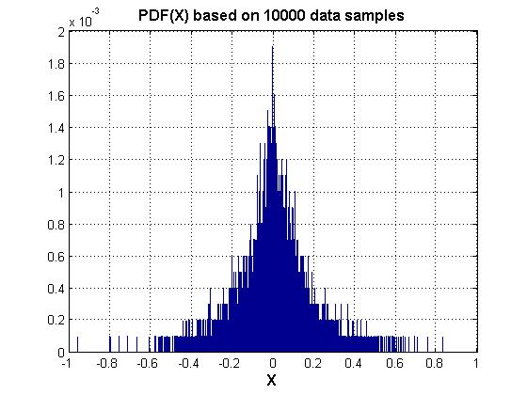
Delta_f=1 epsilon=10

Slide 24
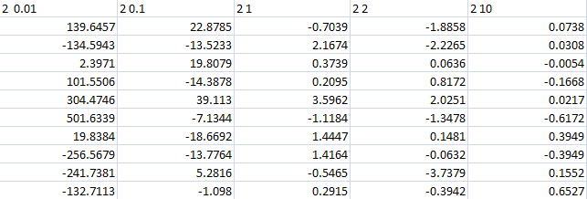
Delta_f=2, epsilon varies

Slide 25
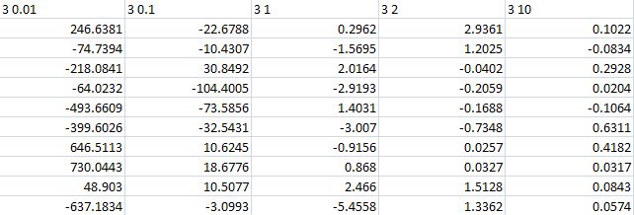
Delta_f=3, epsilon varies

Slide 26
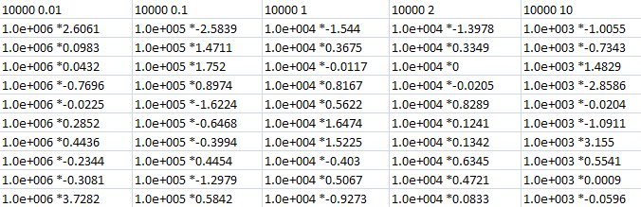
Delta_f=10000, epsilon varies

Slide 27

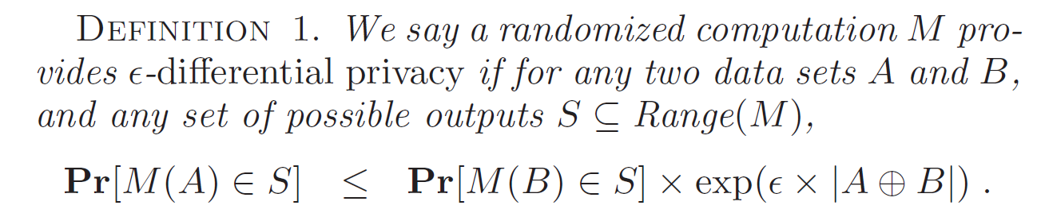
Extended definition
Let be the non-shared part of datasets A and B
The previous definition is the special case that
A and B differs only one record.
This definition is for “a group of persons” included or not included
In a dataset

Slide 28

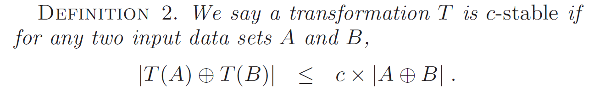
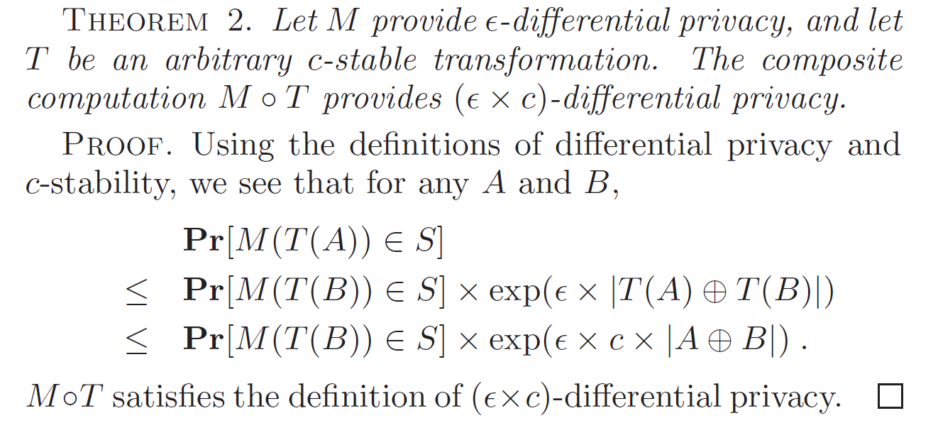
Differential privacy under transformations

Slide 29

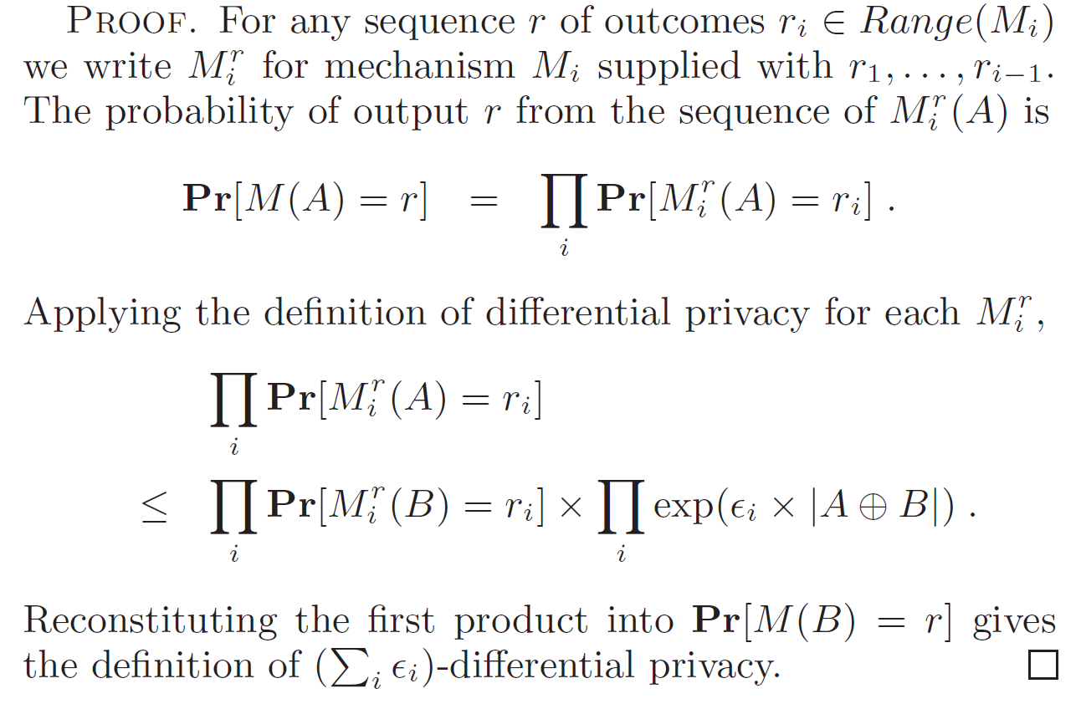
Composition (in PINQ paper)
Sequential composition

Slide 30
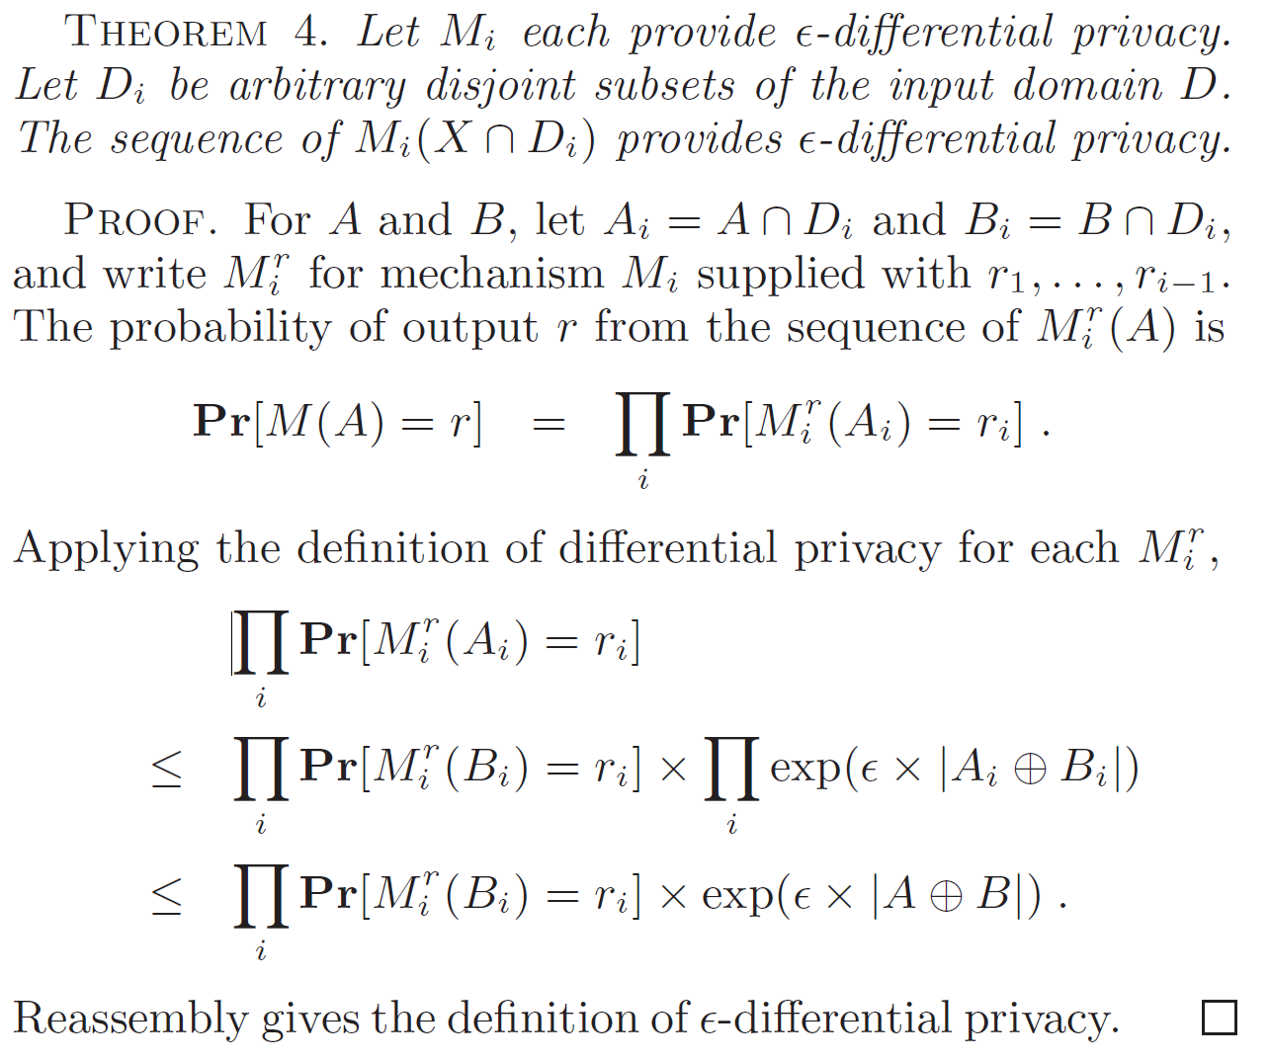
Parallel composition

