Slide 1
Cloud Computing
Energy efficient cloud computing
Keke Chen

Slide 2
Outline
Impacts of data centers’ energy consumption
energy-efficient cloud computing
  Focus on cloud-side
  Focus on scheduling of virtual machines/workloads
  Different from client-side problems

Slide 3
Environment and Energy problem
e-waste
Coal is used to generate ~41% of global electricity, ~44% in 2030
  Coal → CO2 → environment
Computing and cooling system
  61 billion kWh (kilowatt hours) in 2006, 1.5 percent of total U.S. electricity consumption that year
  Data center energy consumption: 1.3 percent of global energy usage

Slide 4
Economical impact of energy consumption
PCs – electricity bill $7 billion per year + several billions more for displays
$18.5 billions for data centers in 2005
Increasing trends
  Servers growing rate: 14% per year in US
  Increase per server consumption 16% per year
  Increase in electricity cost 12% per year

Slide 5
Existing approaches
Hardware improvement
  Circuit design – low-power CPUs
  Sleep mode
Cooling system
Power distribution
Workload distribution

Slide 6
Major factors
Energy saving
Guaranteed Performance (QoS)
  Time
  Money

Slide 7
Some approaches in detail
VM scheduling
VM consolidation
Job scheduling

Slide 8
Power-aware scheduling of VMs
Physical machines have different processor speed
  Adjustable
  Type of work
Monitor VM status to adjust processor speed
Allocate new VMs to servers having the required speed, according to the performance requirement
weakness: the correlation between performance and energy reduction is not certain

Slide 9
VM consolidation
Determine the VMs to be migrated
  Sorting all VMs in decreasing order of current utilization
  Allocate each VM to a host based on a policy of least increase of power consumption
  Reducing performance degradation
    Minimizaiton of migrations
    Highest potential growth
    Random choice

Slide 10
Application of machine learning technique
For the VM consolidation problem
Use ML techniques to reduce the performance degradation
  Predict SLA/customer satisfaction level of each job before moving them across servers
In general, predictors can be learned for optimizing server power and reducing performance impact

Slide 11
Scheduling compute-intensive jobs with unknown service times
Processor profiles in the cluster
  Some for performance critical
  Some for energy saving
Two queues
  Energy-efficient priority: Energy efficient processors are preferred in scheduling
  High performance priority: performance is preferred
Scheduling considers energy-efficient queue first

Slide 12
Summary: some research topics
Heterogeneous workloads
Heterogeneous nodes
Matching workloads to nodes
Resource monitoring
Live migration policy

Slide 13
Types of workload
Workload
  CPU, I/O, Memory, network,…
Allocating same type of workloads to one node might not be appropriate
Better to mix different types of workloads
Need methods for characterizing the workload types

Slide 14
Types of nodes
Nodes in the data center are possibly heterogeneous
  CPU, disk, memory, network.
  Different energy profile
Matching workloads and nodes

Slide 15
Machine learning techniques
Considering many types of workloads, and types of nodes
Finding optimal matching is not trivial

Slide 16
Resource monitoring
Energy consumption
Node performance
Important measures for real-time decisions

Slide 17
Overhead of live migration
Migration process consumes a large amount of energy
Data center may span multiple physical locations
Should avoid continuous workload movements – smarter policies are needed

Slide 18
A case study: Data Center Optimization
Google’s work
The modern data center (DC)
  Complex
  Numerous operating configurations and nonlinear interdependencies
Goal: learn from actual operations data to model plant performance and predict power usage effectiveness (PUE)

Slide 19
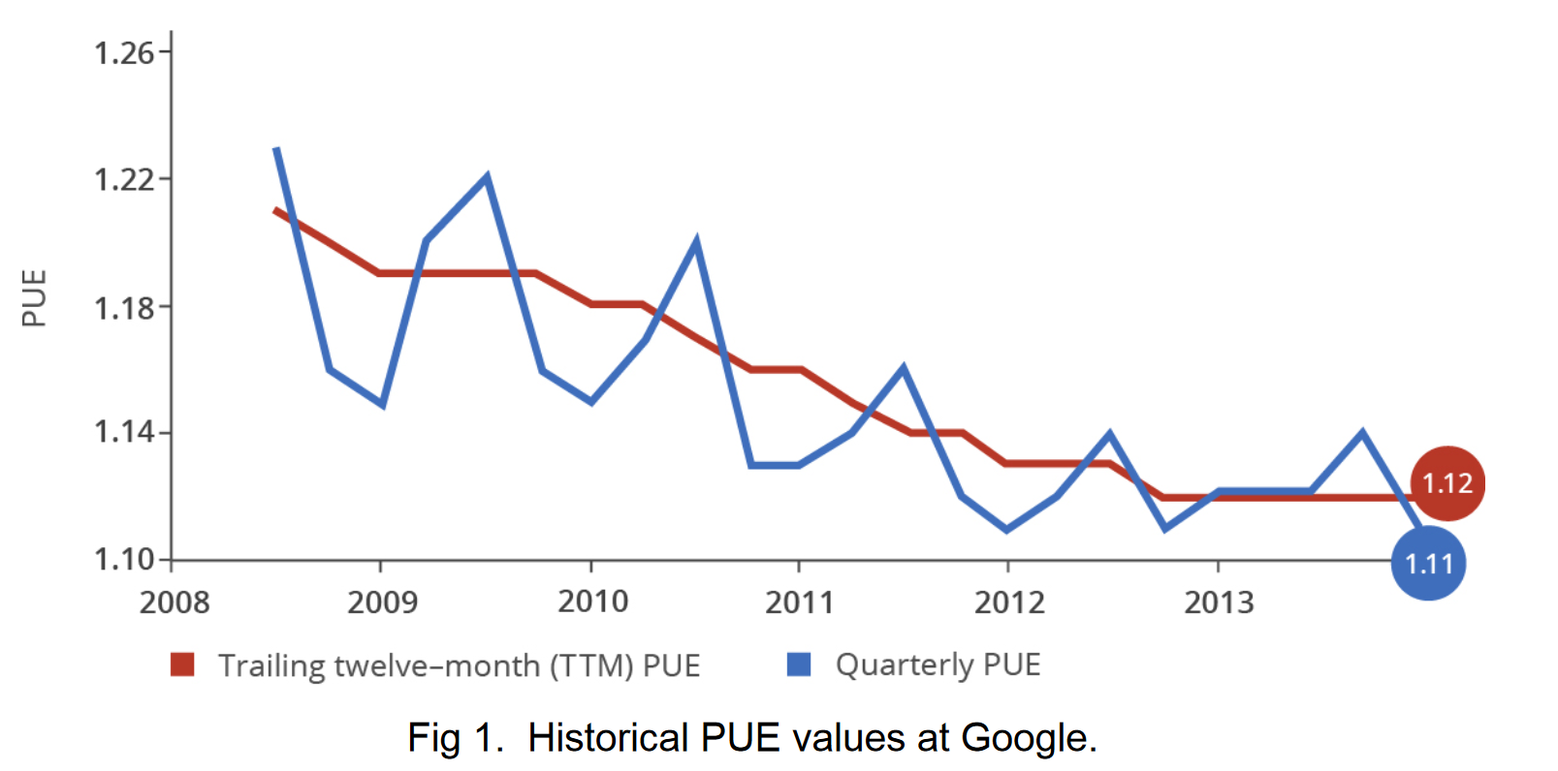
PUE

Slide 20
A typical large­scale DC generates millions of data points across thousands of sensors every day, yet this data is rarely used for applications other than monitoring purposes

Slide 21
Modeling method
Neural network
  5 hidden layers, 50 nodes per hidden layer
  19 normalized input variables
  One output variable (DC PUE)
Training data
  184,435 samples at 5 minute resolution (approximately 2 years of operational data)
  Random shuffled: 70% for training, 30% for testing

Slide 22

Features
1. Total server IT load [kW]
2. Total Campus Core Network Room (CCNR) IT load [kW]
3. Total number of process water pumps (PWP) running
4. Mean PWP variable frequency drive (VFD) speed [%]
5. Total number of condenser water pumps (CWP) running
6. Mean CWP variable frequency drive (VFD) speed [%]
7. Total number of cooling towers running
8. Mean cooling tower leaving water temperature (LWT) setpoint [F]
9. Total number of chillers running
10. Total number of drycoolers running
11. Total number of chilled water injection pumps running
12. Mean chilled water injection pump setpoint temperature [F]
13. Mean heat exchanger approach temperature [F]
14. Outside air wet bulb (WB) temperature [F]
15. Outside air dry bulb (DB) temperature [F]
16. Outside air enthalpy [kJ/kg]
17. Outside air relative humidity (RH) [%]
18. Outdoor wind speed [mph]
19. Outdoor wind direction [deg]

Slide 23
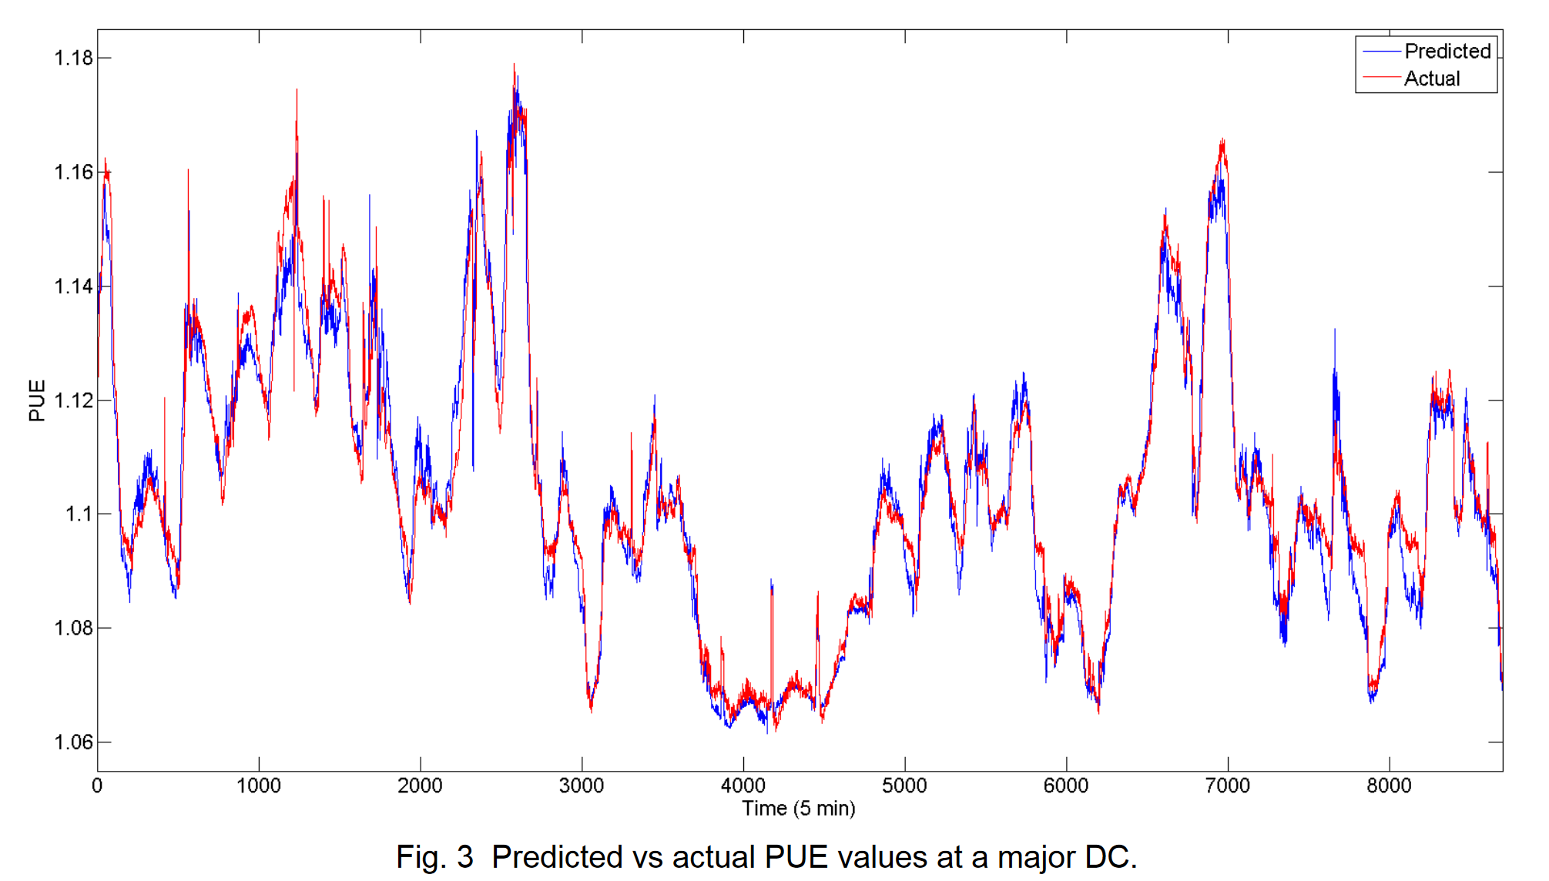
result

Slide 24
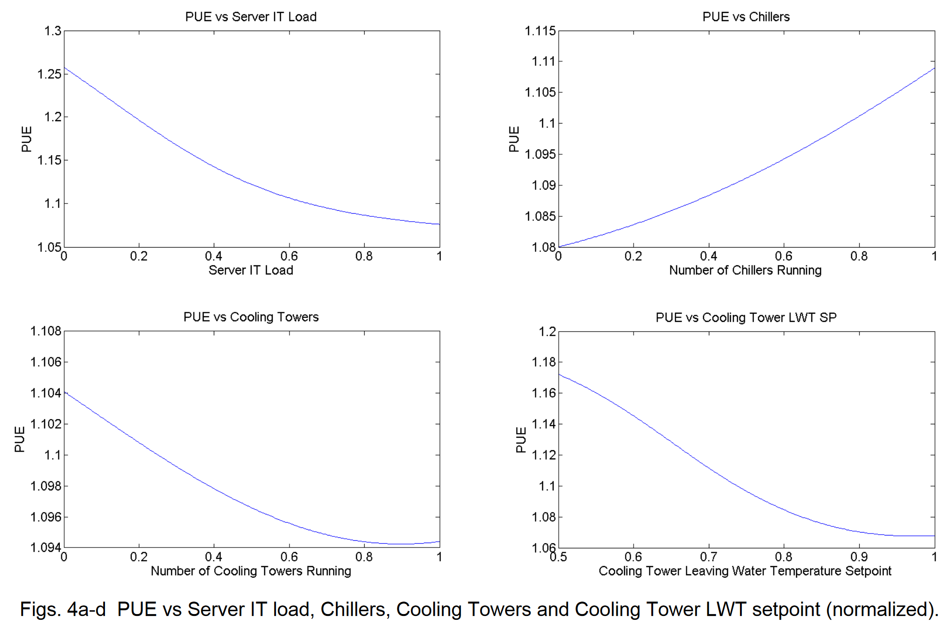
analysis

