Slide 1

Cloud computing lectures:
Programming with Google App Engine
Keke Chen
Notes:
Enter Title of Presentation Here
Google Confidential

Slide 2
Outline
Setup google app engine
Start your first GAE project
Go through some sample applications
Notes:
Enter Title of Presentation Here
Google Confidential

Slide 3
Preparation
Have your gmail account
go to https://cloud.google.com/appengine/
create your first app, and follow the right panel tutorial.
Setup google cloud sdk, locally in your VM: https://cloud.google.com/sdk/docs/

Slide 4
Setup app engine environment
export CLOUD_SDK_REPO="cloud-sdk-$(lsb_release -c -s)“
echo "deb http://packages.cloud.google.com/apt $CLOUD_SDK_REPO main" | sudo tee -a /etc/apt/sources.list.d/google-cloud-sdk.list
curl https://packages.cloud.google.com/apt/doc/apt-key.gpg | sudo apt-key add –
sudo apt-get update && sudo apt-get install google-cloud-sdk
sudo apt-get install google-cloud-sdk-app-engine-python google-cloud-sdk-datastore-emulator
gcloud init

Slide 5
Download the example
git clone https://github.com/GoogleCloudPlatform/python-docs-samples.git
Many samples require extra libraries to be installed. If there is a requirements.txt, you will need to install the dependencies with pip.
pip install -t lib -r requirements.txt
check the readme file for the examples: https://github.com/GoogleCloudPlatform/python-docs-samples/blob/master/appengine/standard/README.md

Slide 6
The hello_world example
Go to python-docs-samples/appengine/standard/helloworld

Slide 7
Configuration file
app.yaml
  A standard file format for configuration
  A set of API designed to access the configuration
  http://www.yaml.org/
  Don’t need to know much about yaml
  Check GAE’s typical configurations
Notes:
Enter Title of Presentation Here
Google Confidential

Slide 8
App.yaml
runtime: python27
threadsafe: true
api_version: 1
handlers:
- url: /.*
script: main.app
Use the “app” object
in main.py
Notes:
Enter Title of Presentation Here
Google Confidential

Slide 9
Libraries
webapp (webapp2) – the python web app framework
  https://webapp2.readthedocs.io/

Slide 10
What webapp does
Wraps the CGI functions
  API for handling request/response
Python Web Server Gateway Interface (WSGI)
  A framework for developing CGI programs with Python
Notes:
Enter Title of Presentation Here
Google Confidential

Slide 11
main.py
import webapp2
class MainPage(webapp2.RequestHandler):
def get(self):
self.response.headers['Content-Type'] = 'text/plain'
self.response.write('Hello, webapp World!')
app = webapp2.WSGIApplication(
[('/', MainPage)],
debug=True)
Notes:
Enter Title of Presentation Here
Google Confidential

Slide 12
Start development server
How to test, in the project directory
dev_apps.py app.yaml --port port_number
The default port is 8080. You can use browser to access http://localhost:port

Slide 13
Upload app to GAE
gcloud app deploy --project your-project-id
Find your project-id from the GAE dashboard on the web

Slide 14
Check the simple Angular exmaple
Check python-docs-samples/appengine/standard/angular
Angular is a javascript framework for interactive web UI

Slide 15
Check app.yaml
runtime: python27
threadsafe: true
api_version: 1
handlers:
- url: /rest/.*
script: main.APP
- url: /(.+)
static_files: app/\1
upload: app/.*
- url: /
static_files: app/index.html
upload: app/index.html

Slide 16
Using datastore (model.py)
from google.appengine.ext import ndb
class Guest(ndb.Model):
first = ndb.StringProperty()
last = ndb.StringProperty()

Slide 17
How angular code interacts with services
Check app/js/app.js
  $http.get('rest/query’)
Check main.py
APP = webapp2.WSGIApplication([
('/rest/query', QueryHandler),
('/rest/insert', InsertHandler),
('/rest/delete', DeleteHandler),
('/rest/update', UpdateHandler),
], debug=True)

Slide 18
Check the guestbook example
git clone https://github.com/GoogleCloudPlatform/appengine-guestbook-python.git

Slide 19
Handling forms with webapp
self.response.out.write("""
<html>
<body>
<form action="/sign" method="post">
<div><textarea name="content" rows="3" cols="60"></textarea></div>
<div><input type="submit" value="Sign Guestbook"></div>
</form>
</body>
</html>""")
Notes:
Enter Title of Presentation Here
Google Confidential

Slide 20
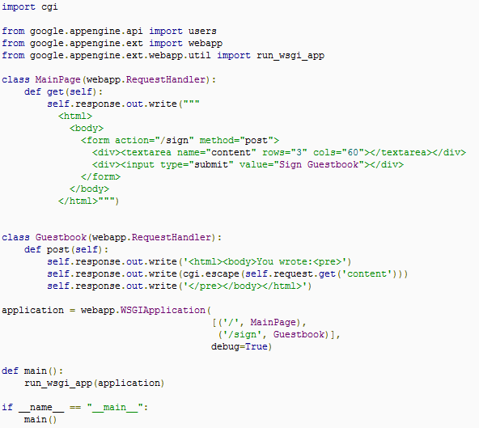

Slide 21
Use users service
Use the google account service
Notes:
Enter Title of Presentation Here
Google Confidential

Slide 22
Using users service
user = users.get_current_user()
if user:
self.response.headers['Content-Type'] = 'text/plain'
self.response.out.write('Hello, ' + user.nickname())
else:
self.redirect(users.create_login_url(self.request.uri))
Notes:
Enter Title of Presentation Here
Google Confidential

Slide 23
Datastore for storing objects
ndb.Model
  Example
  class Greeting(ndb.Model):
  """A main model for representing an individual Guestbook entry."""
  author = ndb.StructuredProperty(Author)
  content = ndb.StringProperty(indexed=False)
  date = ndb.DateTimeProperty(auto_now_add=True)
Query
  Exmaple
greetings_query = Greeting.query(
ancestor=guestbook_key(guestbook_name)).order(-Greeting.date)
greetings = greetings_query.fetch(10)
Notes:
Enter Title of Presentation Here
Google Confidential

Slide 24
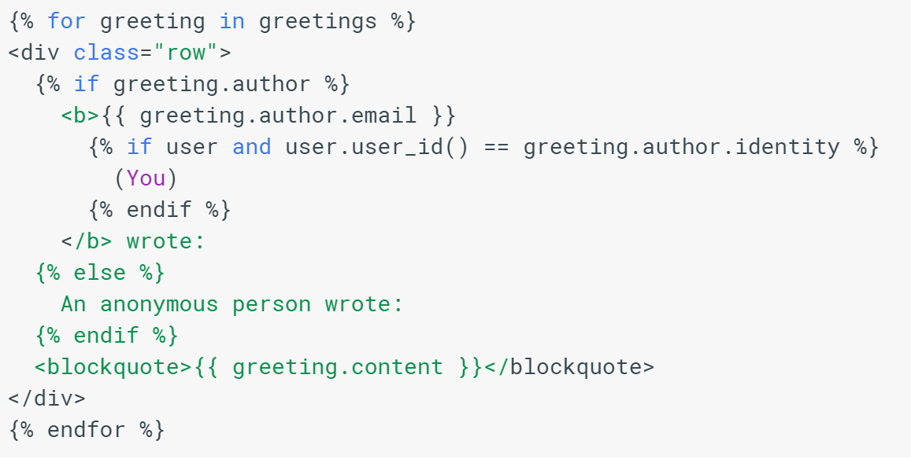
Use templates
Templates are used to generate the similar webpages with different variables
Notes:
Enter Title of Presentation Here
Google Confidential

Slide 25
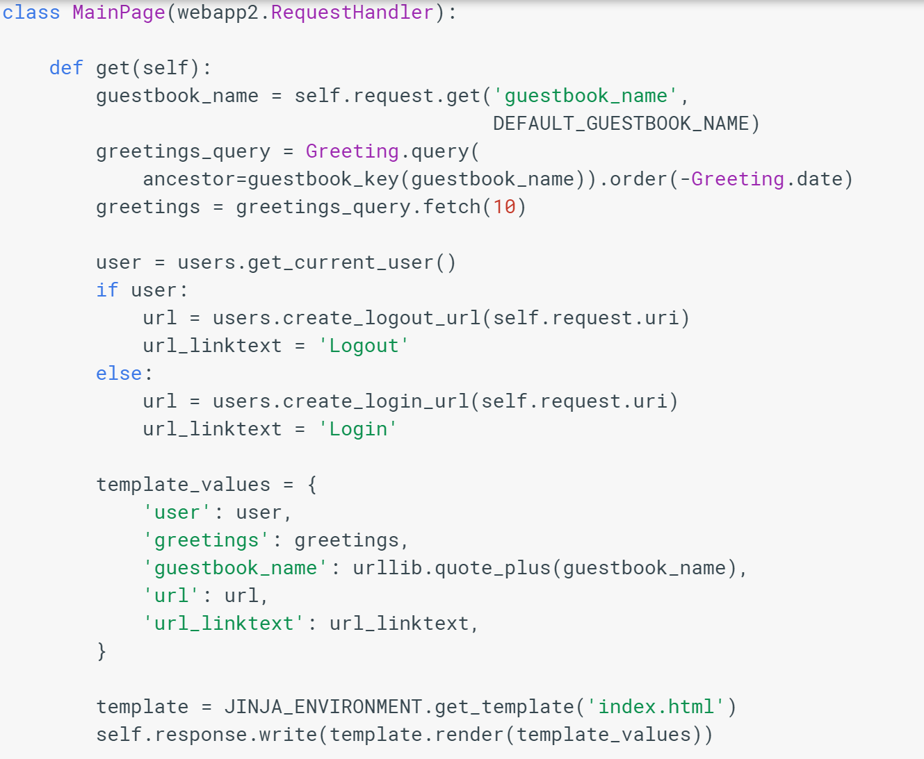
Entity group
Passing parameters

Slide 26

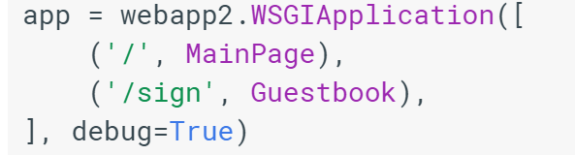

Slide 27
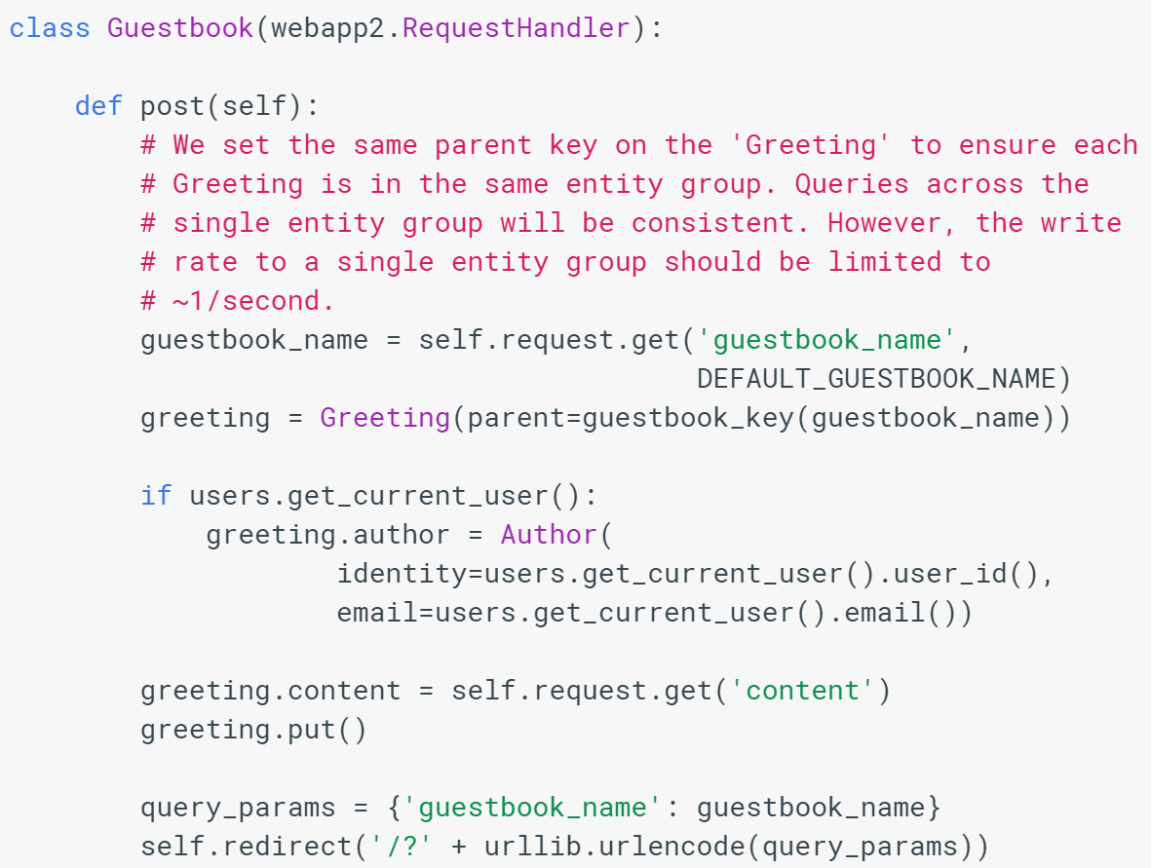

Slide 28
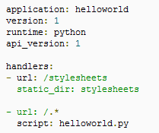
Use stylesheet
Change app.yaml
Include the code for using stylesheet
Notes:
Enter Title of Presentation Here
Google Confidential

Slide 29
A tutorial video
https://www.youtube.com/watch?v=bfgO-LXGpTM
  this is the older version. The latest tool should follow the earlier slides

