Slide 1
CEG7380 Cloud Computing
Syllabus and Introduction
Keke Chen

Slide 2
Outline
Syllabus
  Scope of this course
  Prerequisites
  Resources
  Assignments and grading
Introduction

Slide 3
Scope of this course
Understand the basic concepts in cloud computing
Get familiar with
  Tools
  Systems
  Programming with the cloud
Some recent topics in cloud computing

Slide 4
Major topics:
Infrastructure: concepts and techniques in cloud computing
Processing large data with the cloud
Using clouds
Security and privacy in the cloud
Research topics

Slide 5
Prerequisites
Some programming skills
  Java, python, shell
  Comfortable with learning new programming frameworks
  * Note: You will need to spend a significant amount of time studying the programming materials after classes
Sufficient knowledge about
  Data structure and databases
  Operating systems
  Distributed systems

Slide 6
Assignments and Grading
Reading papers (2-4) (15%)
Some projects (3~4) (50%)
  Help you master the concepts
  Learn to use tools and systems
Final exam (35%)

Slide 7
Resources
updated reference list
AWS access
  Free tier for new users or resources provided by AWS Educate (check https://goo.gl/iLZXHU)
Local installations: using Virtual Machine (e.g., VirtualBox) if your current OS is not linux.
Pilot
  Slides, assignments, links

Slide 8
Tentative Schedule
Introduction
Parallel/distributed data processing
  Distributed file systems (GFS, HDFS)
  MapReduce, spark, pig
  cloud data management
Cloud infrastructures
  Virtualization
  AWS, Eucalyptus, OpenStack
  Docker
  Google AppEngine, MS Azure
Cloud security and privacy
Other topics

Slide 9
In projects, we will learn to use
Distributed and parallel data processing: Hadoop/MapReduce, spark
AWS, virtualization tools (e.g., docker)
Cloud-scale data management tools
Algorithms about security and privacy
Note: we may have new topics for this semester

Slide 10
Cloud Computing
Introduction
Keke Chen

Slide 11
Outline
What is cloud computing?
Anatomy of cloud computing
Key applications
Cloud economics

Slide 12
What is cloud computing?
NIST definition of cloud computing
Cloud computing is a model for enabling convenient, on-demand network access to
a shared pool of configurable computing resources (e.g., networks, servers, storage, applications, and services) that can be
rapidly provisioned and released with
minimal management effort or service provider interaction.
The term “Cloud Computing” was first used by Google

Slide 13
Related Technologies
Utility Computing: pay-as-you-use computing
  First discussed in 1960s
  Illusion of infinite resources
  No up-front cost
  Fine-grained billing (e.g. hourly)
Software as a Service (SaaS)
  delivering applications over the Internet (services computing)

Slide 14
Related Technologies
Grid computing
  Highly distributed resources
  Resource provisioning
  Load balancing
  Parallel/distributed processing

Slide 15
Related Technologies
Virtualization
  Abstract away the details of physical hardware
  provide virtualized ones to applications
  Allow resource management much easier
    Pool all resources in the cluster
    Split resources to units (Virtual machines)
    Low costs of allocation and migration

Slide 16
Related Technologies
Autonomic Computing
  Definition: computer systems capable of self-management
  In cloud computing: automatic resource provisioning, consolidation

Slide 17


Cloud Economics
Pay by use instead of provisioning for peak
Capacity
Demand
Capacity
Demand
Time
Time
Static data center
Data center in the cloud
Unused resources

Slide 18
Example
Setup:
  A peak period needs 10 servers to process requests
  Assume your service is going to run for 1 year
Private cluster: one-time investment
  Servers $1500 x 10 = $15000
  Power/AC costs about $200/year/server => $2000
  Administrator: $50000 ☺
Public cloud:
  Rush hours: 10 hours/day, which needs 10 nodes/hour
  Other hours: 14hours need 2 nodes/hour
  Total: 128 hour.nodes x $0.1/hour.node =$12.8/day
  One year cost = $4672

Slide 19

Economics of Cloud Users
Risk of over-provisioning: underutilization
Capacity
Unused resources
Demand
Time
Static data center

Slide 20

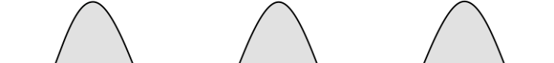
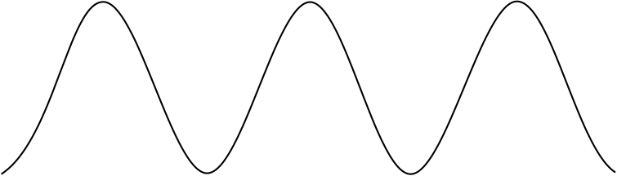


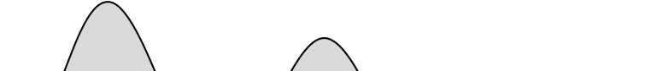

Economics of Cloud Users
Heavy penalty for under-provisioning
Capacity
Demand
Capacity
1
2
3
Time (days)
Demand
Lost revenue
1
2
3
Time (days)
Capacity
Demand
1
2
3
Time (days)
Lost users

Slide 21
Cloud Economics for Cloud Providers
5-7x economies of scale
Extra benefits
  Amazon: utilize off-peak capacity
  Microsoft: sell .NET tools
  Google: reuse existing infrastructure
Resource | Cost in Medium DC | Cost in Very Large DC | Ratio
Network | $95 / Mbps / month | $13 / Mbps / month | 7.1x
Storage | $2.20 / GB / month | $0.40 / GB / month | 5.7x
Administration | ≈140 servers/admin | >1000 servers/admin | 7.1x

Slide 22
In general, with Cloud, you can…
Lower the barrier of computing resource provisioning
  No upfront cost
Instant scalable up/down
  Reduce operational costs
Low maintenance cost
  Service providers maintain the hardware/systems
Highly scalable
  enable big data processing

Slide 23
Best for Small-medium size businesses/personal uses
Imagine what you need to do to startup an Internet company before the cloud computing era
  - Plan your computing resources
  - Purchase the resources
  - Hire people to setup a cluster
  - Install software for development and production
  - Hire people to maintain the cluster (software and hardware)

Slide 24

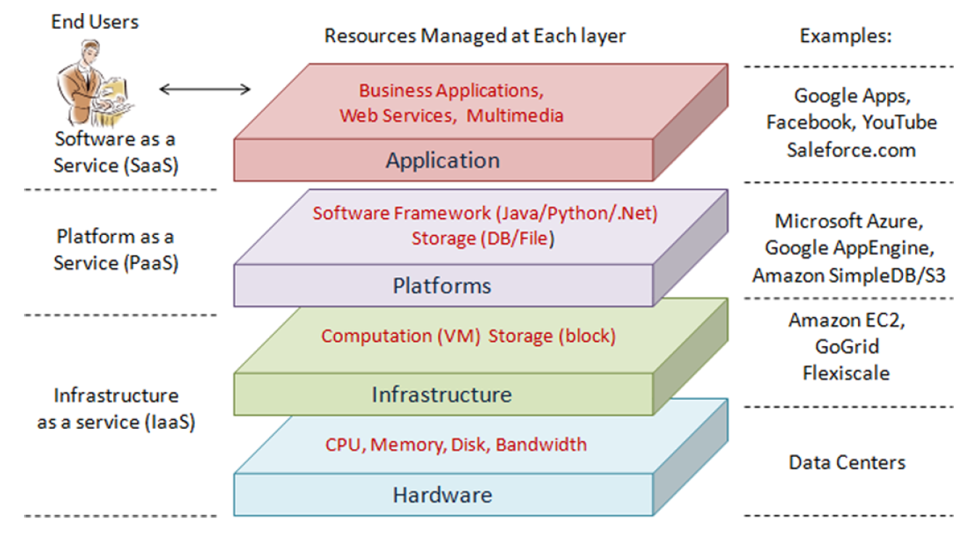
Achitecture: Layered cloud model

Slide 25
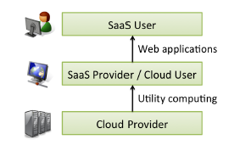
Users and cloud providers

Slide 26
Types of cloud
Public clouds
  by independent service providers
  Users have concerns on data security and privacy…
Private clouds
  Not much different from traditional internal computing clusters
  Typically used by big companies
Hybrid clouds
  Private + public
  Address the concerns on data security and privacy
Virtual Private Clouds
  Provided by public cloud providers
  Using VPN to isolate from the public cloud

Slide 27
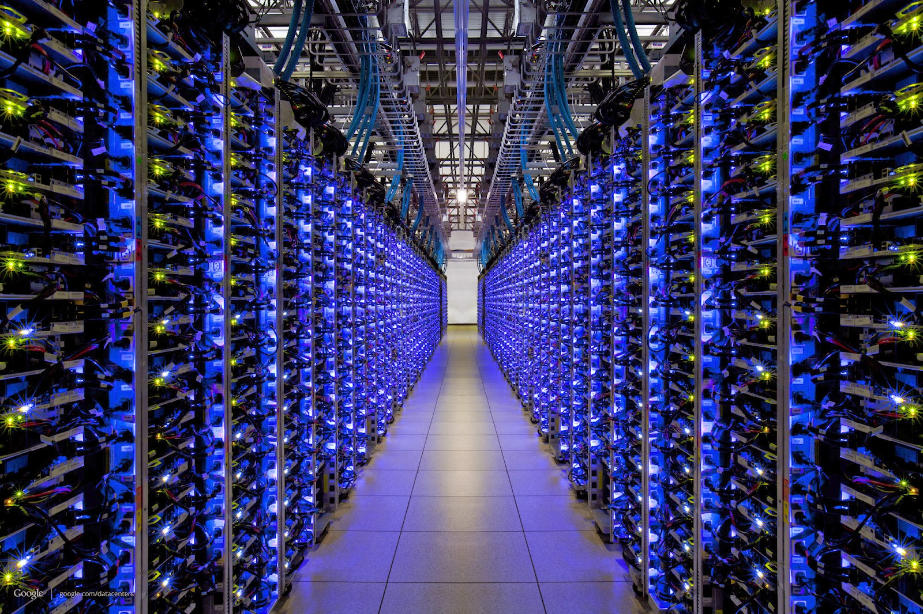
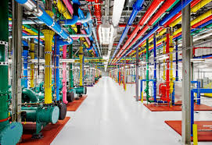
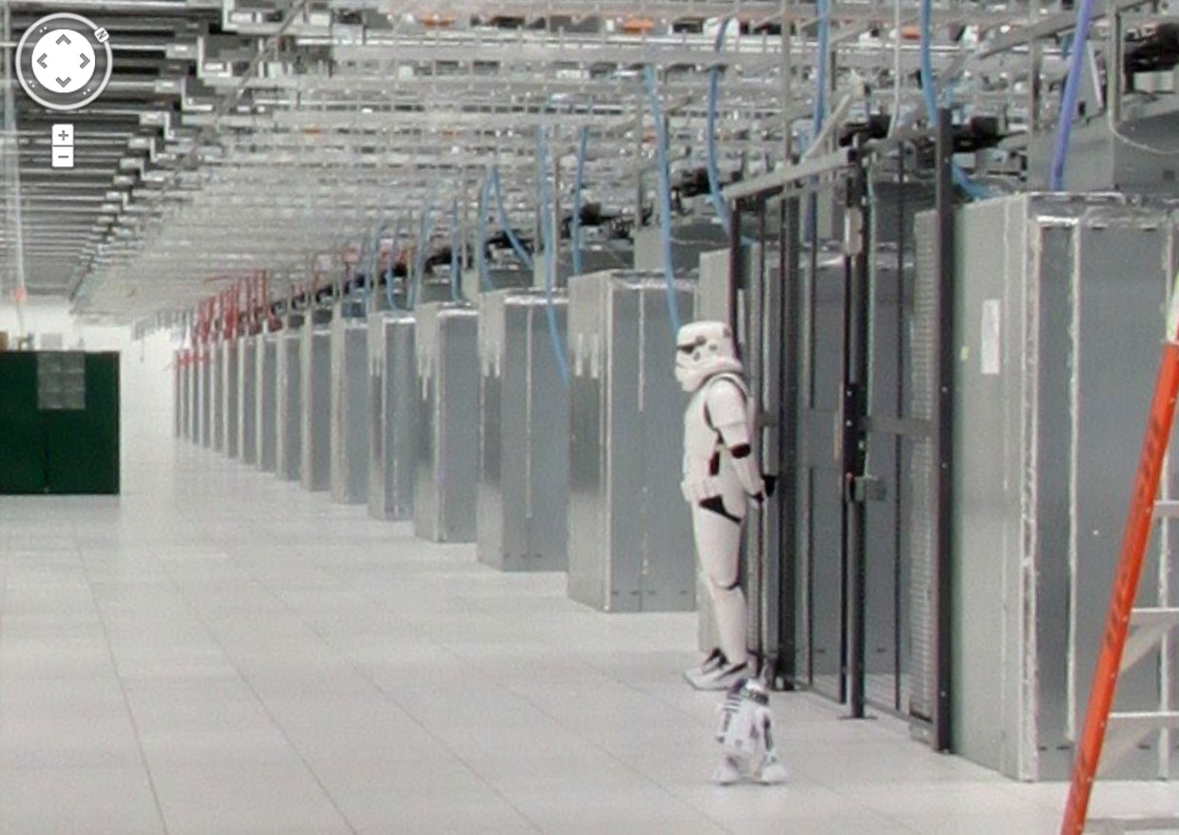
A typical cloud…
Consists of multiple data centers

Slide 28
Cloud Killer Apps
Mobile and web applications
Batch processing
  Data analytics (big data)
  E.g., OLAP, data mining, machine learning
High-performance computing
  Special needs, such as
    Large-memory
    Many-core GPGPU etc

Slide 29
Summary
Cloud
  A pool of virtualized resources
  You can request at anytime, in any amount (certainly within a practical bound)
  Scale up/down anytime
  Only pay for what you use
  You share resources with others (multi-tenancy)

