Slide 1
Linux Containers and Docker

Slide 2
introduction
Linux containers (LXC) are “lightweight” VMs
Docker is a commoditized LXC technique that dramatically simplifies the use of LXC

Slide 3
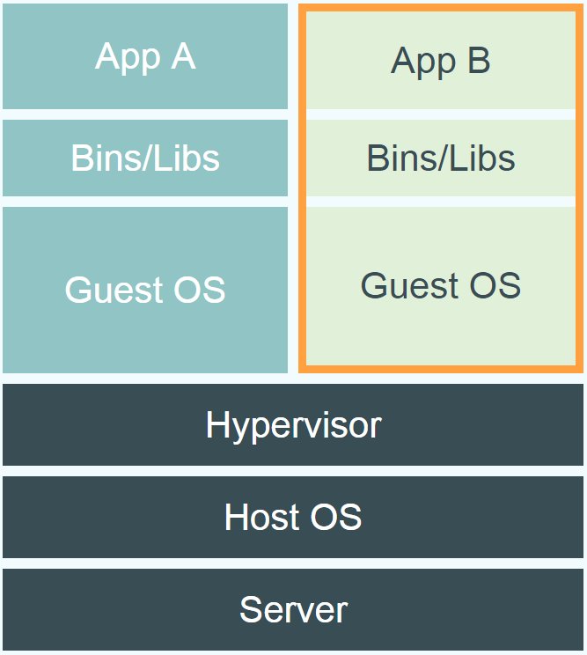
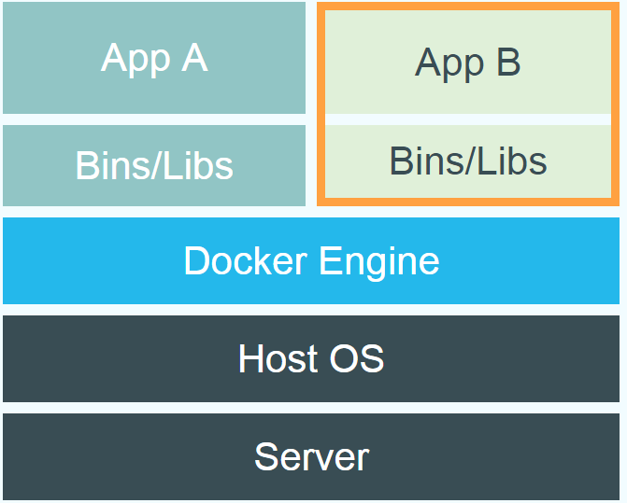
Comparison between LXC/docker and VM

Slide 4
Container technique
Linux kernel provides the “control groups” (cgroups) functionality (cgroup-tools)
allows limitation and prioritization of resources (CPU, memory, block I/O, network, etc.) without the need for starting any VM
Introduced in 2008 (kernel 2.6.24)
“namespace isolation” functionality
The “unshare” command
allows complete isolation of an applications' view of the operating environment, including process trees, networking, user IDs and mounted file systems.
Possible to have a new “init” process for each container

Slide 5
Unique features
Containers running in the user space
Each container has
Own process space
Own network interface
Own /sbin/init (coordinates the rest of the boot process and configures the environment for the user)
Run stuff as root
Share kernel with the host
No device emulation. The system software and devices are provided by the image

Slide 6
Check the namespace isolation…
Check the results of
pid, mnt, net, uts, ipc, user
Pid namespace
Type “ps aux| wc –l” in host and the container
Mnt namespace
Type “wc –l /proc/mounts” in both
Net namespace
Install net-tools
Type “ifconfig”

Slide 7
hostname namespace
“hostname”
ipc namespace
Type “ipcs”
User namespace
UID 0-1999 in the first container mapped to UID 10000 – 11999 in host
UID 0-1999 in the 2nd container mapped to UID 12000 – 13999 in host

Slide 8
What cgroups can do
Resource limiting – groups can be set to not exceed a configured memory limit, which also includes the file system cache
Prioritization – some groups may get a larger share of CPU utilization or disk I/O throughput
Accounting – measures a group's resource usage, which may be used, for example, for billing purposes
Control – freezing groups of processes, their checkpointing and restarting

Slide 9
Resource isolation with cgroups
Memory
Cpu
Blkio
devices

Slide 10
Memory cgroup
keeps track pages used by each group:
file (read/write/mmap from block devices; swap)
anonymous (stack, heap, anonymous mmap)
active (recently accessed)
inactive (candidate for eviction)
each page is charged to a group
pages can be shared
Individual (per-cgroup) limits and out-of-memory killer

Slide 11
CPU cgroup
keep track of user/system CPU time
set relative weight per group
pin groups to specific CPU(s)
Can be used to reserve CPUs for some apps

Slide 12
Blkio cgroup
keep track IOs for each block device
read vs write; sync vs async
set relative weights
set throttle (limits) for each block device
read vs write; bytes/sec vs operations/sec

Slide 13
Devices cgroup
controls read/write/mknod permissions
typically:
allow: /dev/{tty,zero,random,null}...
deny: everything else
maybe: /dev/net/tun, /dev/fuse, /dev/kvm, /dev/dri...
fine-grained control for GPU, virtualization, etc

Slide 14
Almost no overhead
processes are isolated, but run straight on the host
CPU performance = native performance
memory performance = a few % shaved off for (optional) accounting
network performance = small overhead; can be reduced to zero

Slide 15
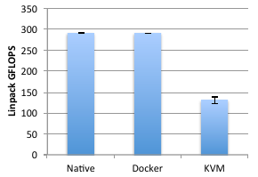
Performance
Networking
Linear algebra

Slide 16
What is docker
Open Source engine to commoditize LXC
using copy-on-write for quick provisioning
allowing to create and share images
standard format for containers
standard, reproducible way to easily build trusted images (Dockerfile, Stackbrew...)

Slide 17
Docker history
2013-03: Releases as Open Source
2013-09: Red Hat collaboration (Fedora, RHEL, OpenShift)
2014-03: 34th most starred GitHub project
2014-05: JAX Innovation Award (most innovative open technology)

Slide 18
the Docker engine runs in the background
manages containers, images, and builds
HTTP API (over UNIX or TCP socket)
embedded CLI talking to the API

Slide 19
Setup docker
Check the website for Linux, windows, OSX
The “getting start” tutorial
Samples of commands
> docker run hello-world
> docker run -t -i ubuntu bash

Slide 20
Building docker image
With run/commit commands
1) docker run ubuntu bash
2) apt-get install this and that
3) docker commit <containerid> <imagename>
4) docker run <imagename> bash
5) git clone git://.../mycode
6) pip install -r requirements.txt
7) docker commit <containerid> <imagename>
8) repeat steps 4-7 as necessary
9) docker tag <imagename> <user/image>
10) docker push <user/image>

Slide 21
Base Image
ubuntu:latest
run
Container
cid1
base image
cmd → new state
New Image
iid1
commit
Container
cid1
run
Container
cid2
Container
cid3
Container
cid4

Slide 22
Run/commit
Pros
Convenient, nothing to learn
Can roll back/forward if needed
Cons
Manual process
Iterative changes stack up
Full rebuilds are boring, error-prone

Slide 23
Authoring image with a dockerfile
A sample dockerfile
FROM ubuntu
RUN apt-get -y update
RUN apt-get install -y g++
RUN apt-get install -y erlang-dev erlang-manpages erlang-base-hipe ...
RUN apt-get install -y libmozjs185-dev libicu-dev libtool ...
RUN apt-get install -y make wget
RUN wget http://.../apache-couchdb-1.3.1.tar.gz | tar -C /tmp -zxf-
RUN cd /tmp/apache-couchdb-* && ./configure && make install
RUN printf "[httpd]\nport = 8101\nbind_address = 0.0.0.0" >
/usr/local/etc/couchdb/local.d/docker.ini
EXPOSE 8101
CMD ["/usr/local/bin/couchdb"]
Run the command to build:
docker build -t your_account/couchdb .

Slide 24
Minimal learning curve
Rebuilds are easy
Caching system makes rebuilds faster
Single file to define the whole environment!

Slide 25
Around docker
Docker Images: Docker Hub
Vagrant: «Docker for VMs»
Automated Setup
Puppet, Chef, Ansible, ...
Docker Ecosystem
skydock / skydns
fig

Slide 26
Docker Hub
Public repository of Docker images
https://hub.docker.com/
docker search [term]
Automated: Has been automatically built from Dockerfile
Source for build is available on GitHub

Slide 27
Docker use cases
Development Environment
Environments for Integration Tests
Quick evaluation of software
Microservices
Multi-Tenancy
Unified execution environment (dev → test → prod (local, VM, cloud, ...)

Slide 28
Dev-> test->production
code in local environment
(« dockerized » or not)
each push to the git repo triggers a hook
the hook tells a build server to clone the code and run
« docker build » (using the Dockerfile)
the containers are tested (nosetests, Jenkins...),
and if the tests pass, pushed to the registry
production servers pull the containers and run them
for network services, load balancers are updated

