Slide 1
Cloud Computing
Mapreduce (1)
Keke Chen

Slide 2
Outline
Goals
Programming model
Examples
Working mechanism
Using hadoop mapreduce

Slide 3
Goals
Understand the mapreduce programming model
  Learn from some simple examples
Understand how it works with the GFS (or HDFS)

Slide 4
Background
Processing large datasets
Computations are conceptually straightforward
Parallel and distributed solutions are required
  Data are distributed
  Parallelized algorithms
  Failures are norm
  Easiness of programming

Slide 5
Distributed Data Infrastructure
We will discuss more details about this topic (e.g., DFS)
So far you understand a big dataset is split into “chunks”, replicated and distributed to “many nodes”
Replication is used as the basic method to maintain reliability

Slide 6
Design ideas
Simple and powerful interface for programming
  Application developers do not need to care about data management, failure handling, and algorithms coordinating distributed servers.

Slide 7
Mapreduce programming model
Long history in programming language
  Commonly used in functional programming (starting from 1930’s, lambda calculus)
Map function and reduce function
  Applications need to encode the logic in these two functions
  Complicated jobs might be implemented with multiple MapReduce programs

Slide 8
Basic ideas
key1
Map1
reduce1
Key n
Source
data
Map i
reduce2
key1
Map m
Reduce n
Key n
(key, value)
“indexing”

Slide 9
Example:
WordCount
  Count the frequency of words in a large collection of document (e.g., billions of web pages)
(“I”, 1)
(“love”, 1)
(“cloud”,1)
(“computing”, 1)
(“cloud”, 1)
…
…
Doc1: I love Cloud Computing
Doc2: Cloud computing is quite
Complicated
Doc3: people have concerns on
public clouds
Map1
Reducer i
Map 2
(“people”, 1)
…
(“cloud”,3 )
…
Map 3
(“cloud”,1 )
…

Slide 10
Map function
How it works
  Input data: tuples (e.g., tagged documents in a text file)
  Apply user-defined function to process data and generate (key, value) pairs
  Output (key, value) pairs (e.g., (word, 1))
Under the hood:
  The data file is split and sent to different distributed maps (which is determined by the system)
  The number of map processes is determined by the amount of input data
  Results are grouped by keys and stored to the local linux file system of the map (possibly apply local “reduce”)

Slide 11
Reduce function
How it works
  Group mappers’ output (key, value) tuples by key (e.g., by words)
  Apply a user defined function to process each group of tuples (e.g., simple sum by keys)
  Output: (key, aggregates)
Under the hood
  Each reduce handles a number of keys
  Reduce pulls the results of assigned keys from maps’ results
  Each reduce generates one result file in the GFS (or HDFS)
  User can define the number of reducers

Slide 12
Summary of the ideas
Mapper generates some kind of index for the original data
Reducer apply group/aggregate based on that index
Flexibility
  Developers are free to generate all kinds of different indices based on the original data
  Thus, many different types jobs can be done based on this simple framework

Slide 13
More examples
document indexing
  Map
    Input: documents (DocID, document),
    Output: (word, (DocID, position) )
    Break down documents to words
  Reduce
    Input: list of (word, (DocID, position) ) with the same word
    Output: (word, list of (DocID, position) )

Slide 14
Example: grep
Find keywords from a set of files
Use Maps only
  Input: (file, keyword)
  Output (list of positions)

Slide 15
Example: count URL access frequency
Work on the log of web page requests
  (session ID, URL)…
Map
  Input: URLs
  Output: (URL, 1)
Reduce
  Input (URL, 1)
  Output (URL, counts)
  Note: example 1’s workload is on maps, while example 2’s workload is on reduces

Slide 16
Example: reverse web-link graph
Each source page has links to target pages, find out (target, list (sources))
Map
  Input (src URL, page content)
  Output (tgt URL, src URL)
Reduce
  Output (tgt URL, list(src URL))
page
Target urls

Slide 17
More examples
Can implement more complicated algorithms
  Sort
  PageRank
  Join tables
  matrix computation, machine learning and data mining algorithms, e.g., the Mahout library

Slide 18
Implementation
Based on GFS/HDFS
  Holds all assumptions that GFS/HDFS holds
  Main tasks: handle job scheduling and failures
Assume there are
  M map processes
  R reduce processes

Slide 19
Map implementation
Chunk(block)
A Map Process
K1~ki
Ki+1-kj
…
…
…
R parts in map’s local storage
Map processes are allocated to be close to the chunks as possible
One node can run a number of map processes. It depends on the setting.

Slide 20
Reducer implementation
Mapper1 output
Mapper2 output
Mappern output
K1~ki
Ki+1-kj
…
K1~ki
Ki+1-kj
…
K1~ki
Ki+1-kj
…
R Reducers
…
- R final output files stored in the user designated directory

Slide 21
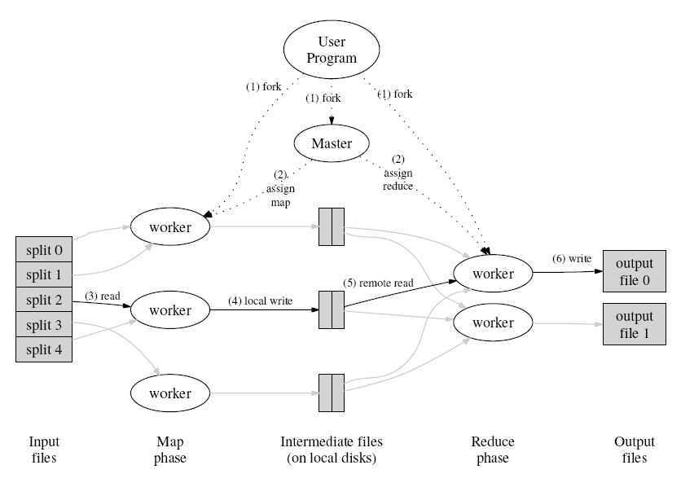
Overview of Hadoop/MapReduce
Jobtracker
tasktracker

Slide 22
Master Data Structure
Stores the state of the workers (maps, reduces)
For each finished map
  Stores the locations and sizes of the R file regions

Slide 23
Fault Tolerance
Worker failure
  Map/reduce fails → reassign to other workers
  Node failure → redo all tasks in other nodes
    Chunk replicas make it possible
Master failure
  Log/checkpoint
  Master process and GFS master server

Slide 24
Features
Locality
  Move computation close to data
Granularity of M and R
  Master needs to make O(M+R) scheduling and store O(M*R) states.
  Normally, M is much larger than R
backup tasks for “straggler”:
  The whole process is often delayed by a few workers, because of various reasons (network, disk I/O, node failure…)
  As close to completion, master starts multiple workers for each in-progress job
    Without vs. with backup tasks: 44% longer

Slide 25
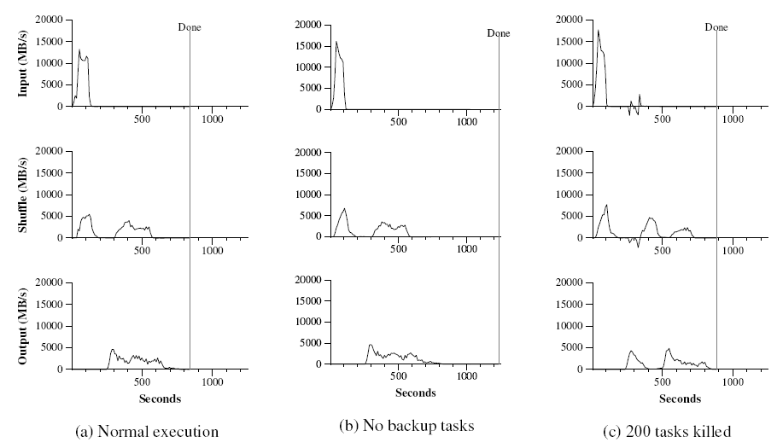
Experiment: effect of backup tasks, reliability (example: sorting)

