Slide 1
Cloud Computing
Mapreduce (3)
Keke Chen

Slide 2
Outline
Single-node hadoop
More complicated MapReduce examples

Slide 3
Using hadoop system
Preparation
  Download putty.exe (windows)
    http://www.chiark.greenend.org.uk/~sgtatham/putty/download.html
  Use ssh directly on mac and linux

Slide 4
HDFS commands
home directory in HDFS
  /user/your_account_name
Examples:
  - hadoop fs –ls HDFS_directory
  - hadoop fs –put local_file HDFS_file
  hadoop fs –get HDFS_file local_file
  Other: -cat, -mkdir, -rm, -rmr

Slide 5
Test run mapreduce
Upload a text file
2. hadoop jar hadoop_examples_jar_file wordcount your_hdfs_files hdfs_output_dir
3. hadoop fs –ls hdfs_output_dir
Example programs:
share/hadoop/mapreduce/ hadoop-mapreduce-examples-2.9.0.jar

Slide 6
Sample Source code directory
src/hadoop-mapreduce-project/hadoop-mapreduce-examples/src/main/java/org/apache/hadoop/examples/WordCount.java

Slide 7
Example: PageRank
Graph representation
PageRank Definition
MapReduce PageRank

Slide 8



Graph Representation
G = (V, E)
Typically represented as adjacency lists:
  Each node is associated with its neighbors (via outgoing edges)
2
1: 2, 4
2: 1, 3, 4
3: 1
4: 1, 3
1
3
4

Slide 9
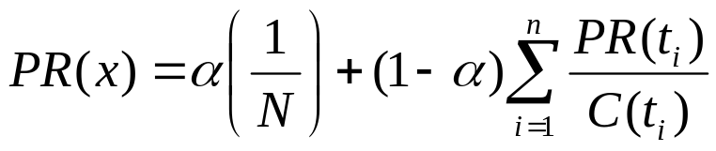






PageRank defined
Given page x with inlinks t₁…t_{n}, where
  C(t) is the out-degree of t
  α is probability of random jump
  N is the total number of nodes in the graph
t₁
X
t₂
…
t_{n}

Slide 10

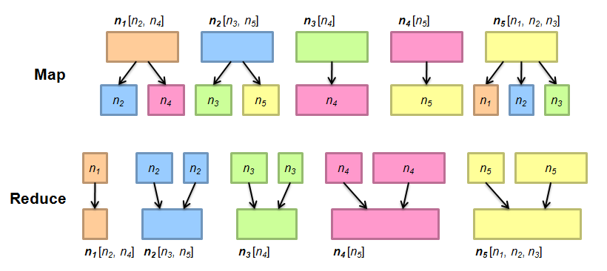
PageRank in MapReduce

Slide 11
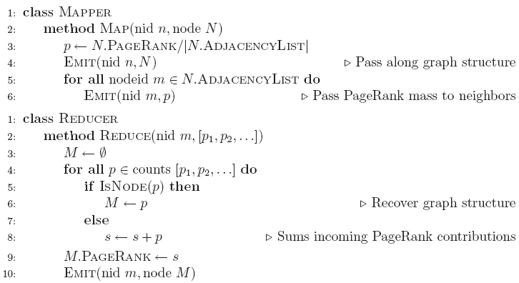

Slide 12
Example: k-means clustering
Clustering problem description:
  We have a dataset of multidimensional points
  We want to group them by the similarity between them (the number of groups, k, might be given)
  The similarity is defined by the Euclidean distance
Good survey:
  AK Jain etc. Data Clustering: A Review, ACM Computing Surveys, 1999

Slide 13
Kmeans illustration
Randomly select k centroids
Assign cluster label of each point according to the distance to the centroids

Slide 14
kmeans
Recalculate the centroids
Reclustering
Repeat, until the cluster labels do not change, or the changes of centroids are very small

Slide 15
Summary of kmeans
1) Determine the value of k
2) Determine the initial k centroids
3) Repeat until converge
- Determine membership: Assign each point to the closest centroid
- Update centroid position: Compute the average of the assigned members

Slide 16
The setting
The dataset is stored in HDFS
We use a MapReduce kMeans to get the clustering result
  Implement each iteration in one MapReduce process
    Pass the k centroids to the Maps
    Map: assign a label to each record according to the distances to the k centroids <cluster id, record>
    Reduce: calculate the mean for each cluster, and replace the centroid with the new mean

Slide 17
Mapper
public static class KMMapper extends Mapper<…> {
private int ncluster, ndim;
private double [][] centers;
public void setup(Mapper.Context context){
Configuration conf = context.getConfiguration()
centers = load_centers(conf);
}
public void map(…) throws IOException, InterruptedException {
// read each line (i.e., each record), parse it, the distances from this
// record to the centers, and output the record and the cluster id.
}

Slide 18
Reducer
public static class KMReducer extends Reducer<…> {
public void reduce(…) throws IOException, InterruptedException
{
// key is the cluster id, values are the records in the cluster
// compute the average of the records and output label and the average (i.e., the new centroid)
}
} //ReduceClass

Slide 19
Single iteration
In main() function
Configuration conf = new Configuration();
Job job = new Job(conf, “kmeans");
conf.set(“centroids”, “your_centroid_file_at_HDFS”);
job.setJarByClass(KMeans.class);
job.setOutputKeyClass(Text.class);
job.setOutputValueClass(Text.class);
job.setMapperClass(KMMapper.class);
//job.setCombinerClass(KMCombiner.class);
job.setReducerClass(KMReducer.class);
job.setNumReduceTasks(num_reduce);
FileInputFormat.setInputPaths (job, input);
FileOutputFormat.setOutputPath (job, new Path(output_path ));
System.exit(job.waitForCompletion(true)?0:1);

Slide 20
The complete iterative process
public static void main (String[] args){
// initialize…
for (int i=0; i<niteration; i++){
System.out.println("start iteration" + String.valueOf(i));
// run job
// copy the generated centroids to the designated centroid file
// check whether it converges, if converges, break
}
return 0;
}

Slide 21
Project 1

