Slide 1
Cloud Computing
Open source cloud infrastructures
Keke Chen

Slide 2
Outline
Eucalyptus
OpenStack

Slide 3
Most popular open-source AWS equivalence
Eucalyptus
  Started by UCSB researchers, now a company
OpenStack
  Started by NASA, now an open source platform

Slide 4
Eucalyptus
Compatible to AWS APIs (EC2, S3, mainly)
  Thus, Boto library can be used, too
  A good example for understanding how AWS works

Slide 5
Paper “The Eucalyptus Open-source Cloud-computing System”
  How VM instances are managed
  How to provide virtual network (like elastic IP)
  How to provide data storage (like S3)
  A very brief description, but we can get something

Slide 6
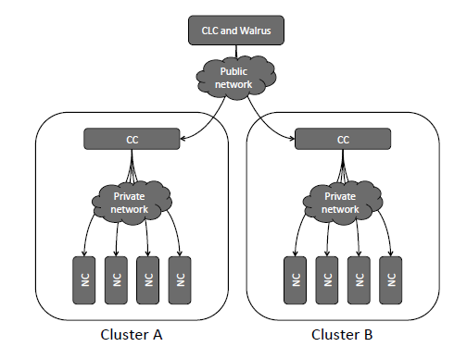

System Design
Data center
CLC: cloud controller Walrus: storage controller similar to S3
CC: cluster controller NC: node controller

Slide 7
Components: Node Controller
Make queries to discover physical resources
  # of cores
  Size of memory
  Available disk space
  State of VM instances
Propagate the information to Cluster Controller
  DescribeResource
  DescribeInstances
Run/terminate instances
  CLC→CC→ NC → hypervisor (Xen)

Slide 8
Node controller
Start an instance
  Copy instance image from walrus or local cache
  Create endpoint in the virtual network overlay
  Instruct hypervisor to boot the instance
Stop an instance
  Instruct hypervisor to terminate the VM
  Tear down the virtual network endpoint
  Clean up the files associated with the instance

Slide 9
Cluster Controller
Gather/report information of NCs
  Through the interface provided by NCs
  Report the summary to CLC
Schedule incoming instance “run” requests to specific NCs
Control the virtual network overlay

Slide 10
Virtual network overlay
VM instance interconnectivity (between different nodes/networks)
  Not very well mentioned in Xen
  Connectivity, isolation and performance
At least one of a set of VMs be exposed externally
  Map the public IP to that instance
Restricted communication
  VMs in the same set can talk to each other
  VMs from different sets should be isolated

Slide 11
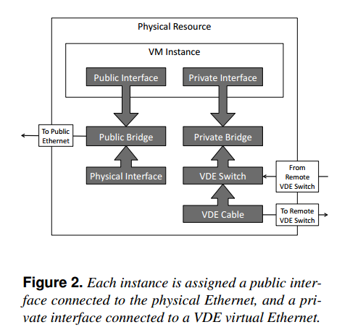
Virtual network overlay
Each VM has a private IP; one VM in the set also has a public IP
VLAN tag defines the subnet – to isolate sets of VMs
Cluster Controller serves as the router between VM subnets
  - CC uses Linux iptable control traffics
  - Use iptable Network Address Translation (NAT) to define the map from
  Public IP to private IP

Slide 12
Storage Controller (Walrus)
Provide SOAP/REST interfaces
  Compatible with S3 – you can use S3 tools
Use Walrus to stream data in/out of the cloud
Store VM images (same as AMI)
  Root file system, kernel image, ramdisk image
No locking for object writes
  Conflict writes – late write overwrites the earlier

Slide 13
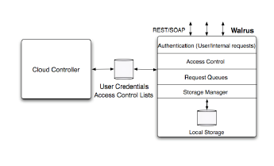
Provides the same tool Amazon uses
  Generate AMI
Maintains a cache of images
Authentication is applied when NC accesses images

Slide 14
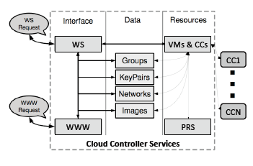
Cloud Controller
A collection of web services
  Resource services
  Data services
  Interface services

Slide 15
Cloud Controller: resource services
Receive user requests
Interact with CCs to allocate/deallocate
System Resource State (SRS) is maintained by querying CCs
  CCs will collect information from NCs
Follows a “transactional” operation
  Reservation, VM creation → commit
  Or errors → rollback
Realizing SLAs

Slide 16
Cloud Controller: data services
Handles the creation, modification, interrogation, and storage of stateful system and user data
  There is a system database…
Users can query the services
  Discover resource info (images, clusters)
  Manipulate abstract parameters(keypairs, security groups, network definitions)
  Recall some of AWS interfaces…

Slide 17
Cloud Controller: interface services
  User-visible interfaces
  Programmatic interfaces (SOAP/REST)
  Web interface
Handling authentication
Provide system management tools

Slide 18
OpenStack

Slide 19
OpenStack
Originated at NASA, with Rackspace
Driven by an open community process
Multiple hypervisors: Xen, KVM, ESXi, Hyper-V
First release: Oct 2010

Slide 20
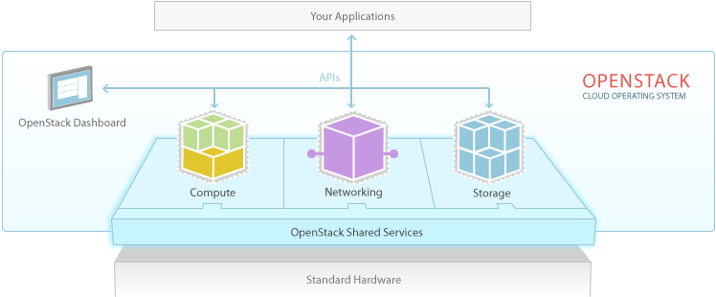

Slide 21
Components
Nova – Compute (equivalent to EC2)
Swift – object storage (S3)
Glance - Image service (AMI)
Neutron - Networking (virtual network)
Cinder - Block storage (Elastic block storage)
Keystone – Authentication
Horizon - Dashboard (AWS web console)
-- mostly implemented with python

Slide 22
Features
Amazon AWS Interface Compatibility
Flexible Clustering and Availability Zones
Access Control List (ACL) with policies management
Network Management, Security Groups, Traffic Isolation
Cloud Semantics and Self-Service Capability
  Image registration and image attribute manipulation
Bucket-Based Storage Abstraction (S3-Compatible)
Block-Based Storage Abstraction (EBS-Compatible)
Hypervisor support: Xen, KVM, VMware Vsphere, LXC, UML and MS HyperV

Slide 23
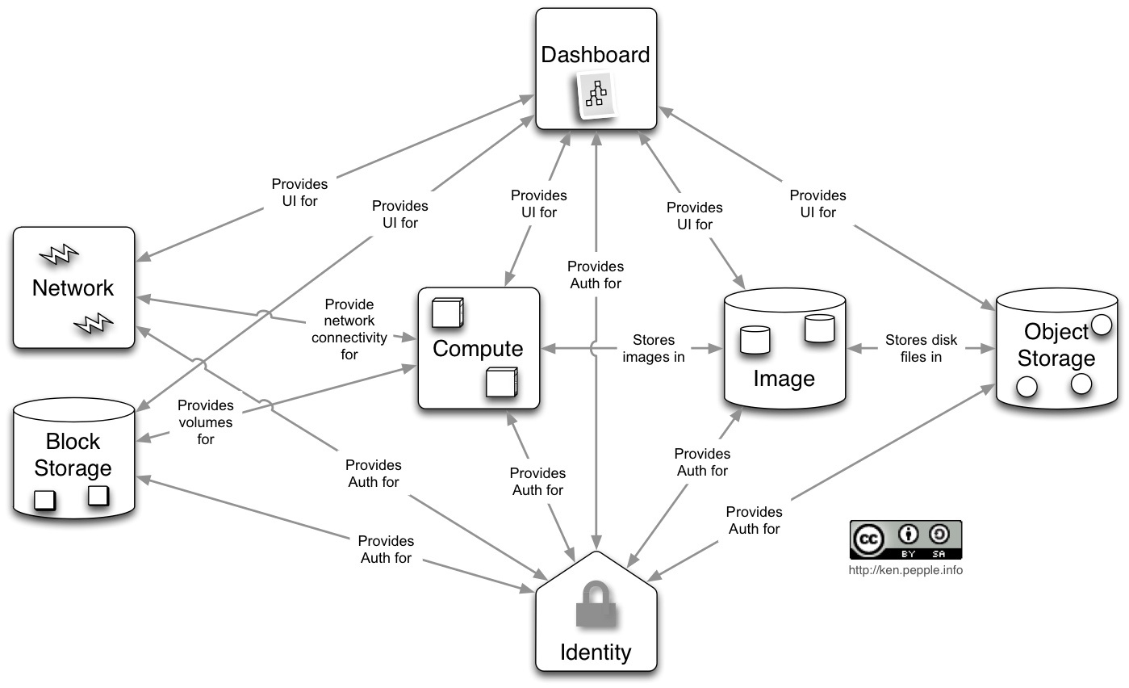

Slide 24
Fastest Growing Global
Open Source Community
COMPANIES
COUNTRIES
231
121
INDIVIDUAL MEMBERS
10,149
TOTAL CONTRIBUTORS
AVERAGE MONTHLY
CONTRIBUTORS
CODE CONTRIBUTIONS
1,036
238
70,137
As of July 2013
Notes:
More than 10k members! You should join!
Of the total contributors, 800-900 are still active, which shows that people stick around.
Even had downloads from Antarctica!

Slide 25
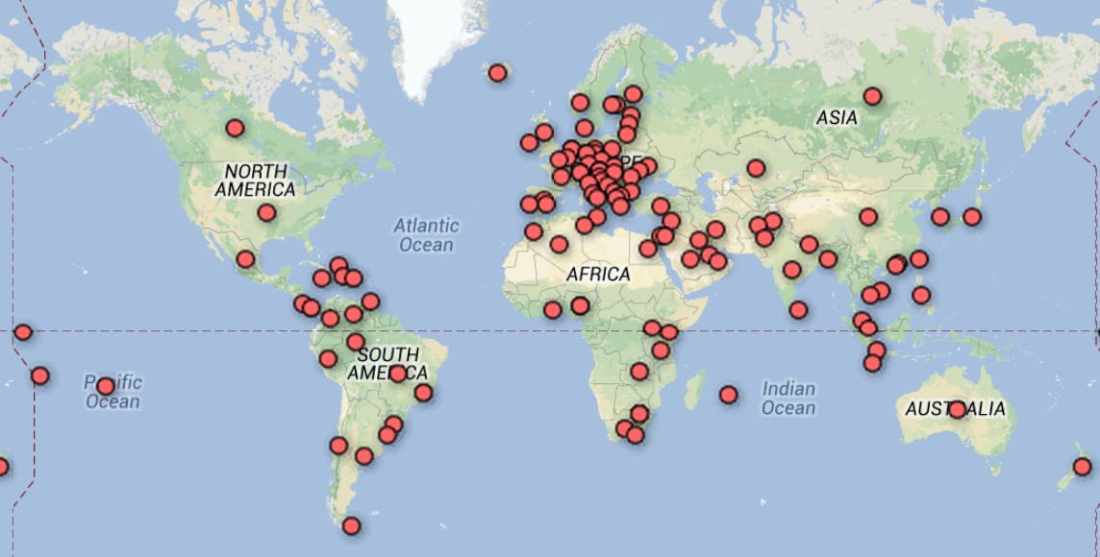
Global Community
Countries with members

Slide 26
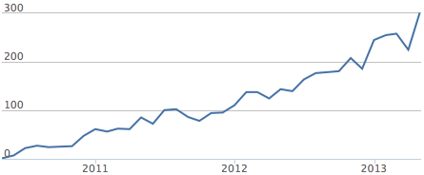
Developer Growth
Contributors per month (ohloh)

Slide 27
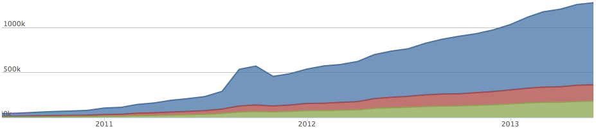

1 Million+ Lines of Code
Lines of code (ohloh)
Notes:
We’re also deleting hundreds of thousands of lines as well
Eg last 12 months:
Added 2,936,791 lines
Removed 1,594,506

Slide 28
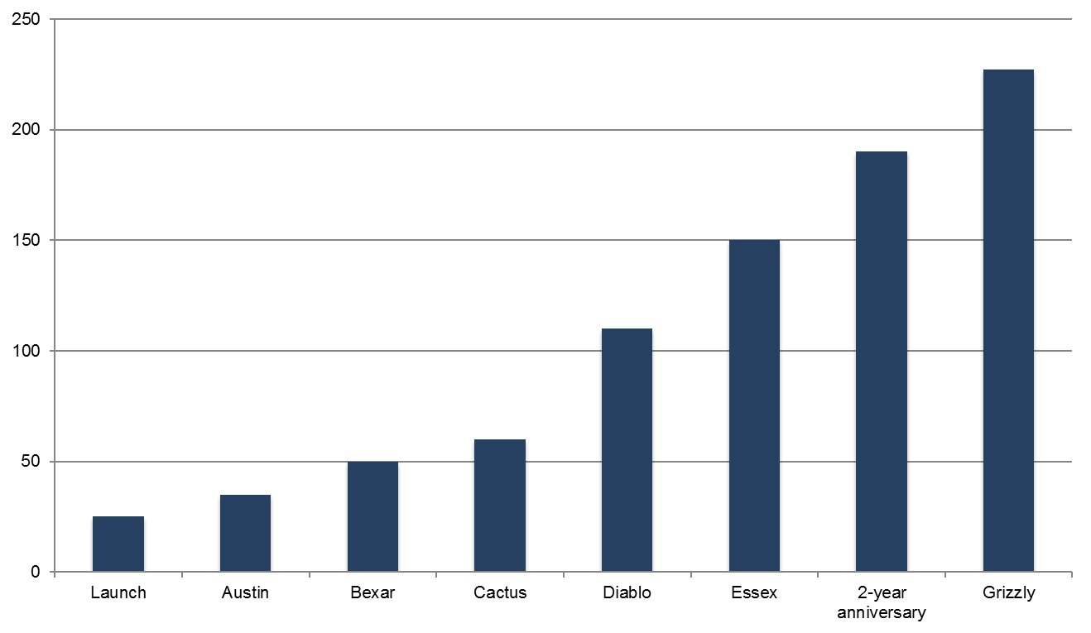
Ecosystem Growth
Participating Companies

