Slide 1
PIG AND PIG LATIN: AN INTRODUCTION

Slide 2
Outline
Map-Reduce and the need for Pig Latin
Pig Latin example
Salient features
Implementation

Slide 3

Data Processing Renaissance
Internet companies swimming in data
Data analysis is “inner loop” of product innovation
Data analysts are skilled programmers

Slide 4
Data Warehousing …?
Scale
Often not scalable enough
Prohibitively expensive at web scale
  Up to $200K/TB
$ $ $ $
Little control over execution method
Query optimization is hard
  Parallel environment
  Little or no statistics
  Lots of UDFs
SQL

Slide 5
The Map-Reduce Appeal
Scalable due to simpler design
  Only parallelizable operations
  No transactions
Scale
$
Runs on cheap commodity hardware
SQL
Procedural Control- a processing “pipe”

Slide 6
Disadvantages
1. Extremely rigid data flow
M
R
Other flows constantly hacked in
M
M
R
M
Join, Union
Split
Chains
2. Common operations must be coded by hand
  Join, filter, projection, aggregates, sorting, distinct
3. Semantics hidden inside map-reduce functions
  Difficult to maintain, extend, and optimize

Slide 7
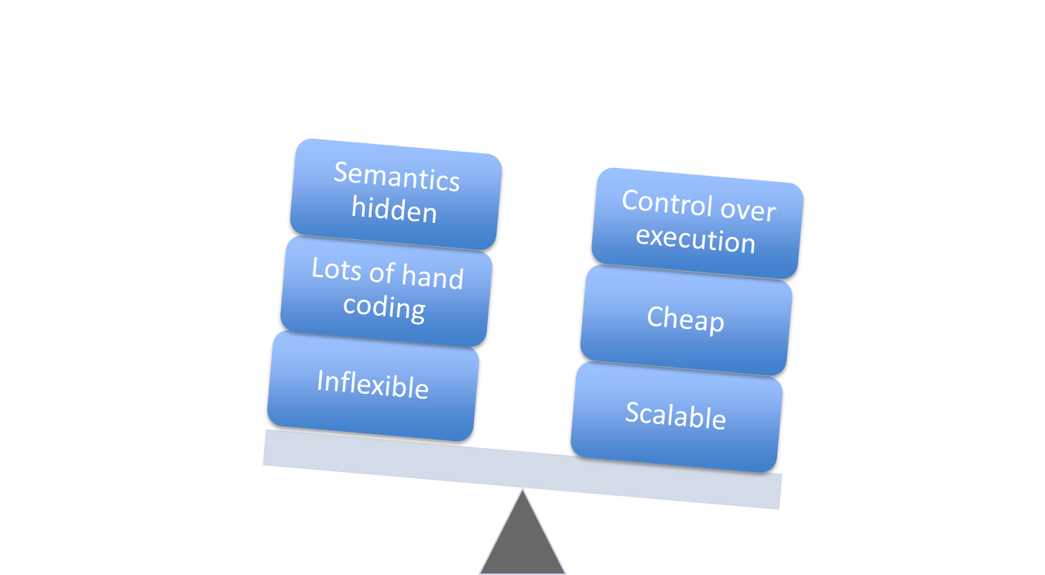
Pros And Cons
Need a high-level, general data flow language

Slide 8
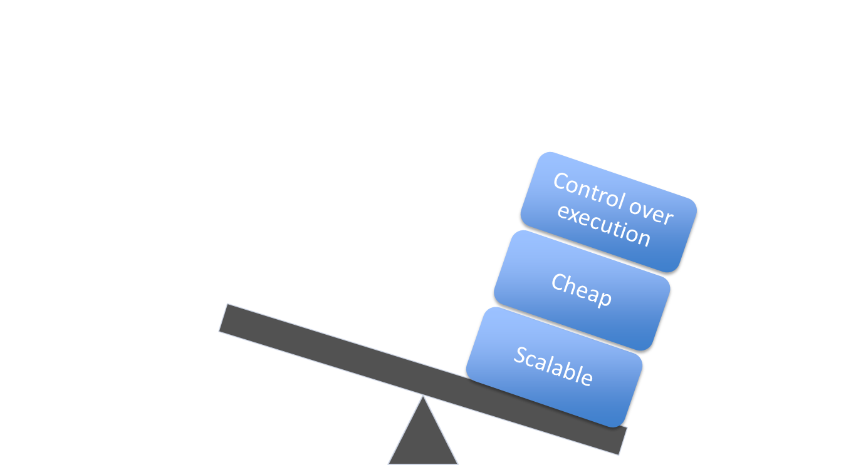
Enter Pig Latin
Need a high-level, general data flow language
Pig Latin

Slide 9
Outline
Map-Reduce and the need for Pig Latin
Pig Latin example
Salient features
Implementation

Slide 10
Example Data Analysis Task
Find the top 10 most visited pages in each category
Visits
Url Info
User | Url | Time
Amy | cnn.com | 8:00
Amy | bbc.com | 10:00
Amy | flickr.com | 10:05
Fred | cnn.com | 12:00
Url | Category | PageRank
cnn.com | News | 0.9
bbc.com | News | 0.8
flickr.com | Photos | 0.7
espn.com | Sports | 0.9

Slide 11
Data Flow
Load Visits
Group by url
Foreach url
generate count
Load Url Info
Join on url
Group by category
Foreach category
generate top10 urls

Slide 12
In Pig Latin
visits = load ‘/data/visits’ as (user, url, time);
gVisits = group visits by url;
visitCounts = foreach gVisits generate url, count(visits);
urlInfo = load ‘/data/urlInfo’ as (url, category, pRank);
visitCounts = join visitCounts by url, urlInfo by url;
gCategories = group visitCounts by category;
topUrls = foreach gCategories generate top(visitCounts,10);
store topUrls into ‘/data/topUrls’;

Slide 13
Outline
Map-Reduce and the need for Pig Latin
Pig Latin example
Salient features
Implementation

Slide 14
Quick Start and Interoperability
visits = load ‘/data/visits’ as (user, url, time);
gVisits = group visits by url;
visitCounts = foreach gVisits generate url, count(urlVisits);
urlInfo = load ‘/data/urlInfo’ as (url, category, pRank);
visitCounts = join visitCounts by url, urlInfo by url;
gCategories = group visitCounts by category;
topUrls = foreach gCategories generate top(visitCounts,10);
store topUrls into ‘/data/topUrls’;
Operates directly over files

Slide 15
Quick Start and Interoperability
visits = load ‘/data/visits’ as (user, url, time);
gVisits = group visits by url;
visitCounts = foreach gVisits generate url, count(urlVisits);
urlInfo = load ‘/data/urlInfo’ as (url, category, pRank);
visitCounts = join visitCounts by url, urlInfo by url;
gCategories = group visitCounts by category;
topUrls = foreach gCategories generate top(visitCounts,10);
store topUrls into ‘/data/topUrls’;
Schemas optional;
Can be assigned dynamically

Slide 16
User-Code as a First-Class Citizen
visits = load ‘/data/visits’ as (user, url, time);
gVisits = group visits by url;
visitCounts = foreach gVisits generate url, count(urlVisits);
urlInfo = load ‘/data/urlInfo’ as (url, category, pRank);
visitCounts = join visitCounts by url, urlInfo by url;
gCategories = group visitCounts by category;
topUrls = foreach gCategories generate top(visitCounts,10);
store topUrls into ‘/data/topUrls’;
User-defined functions (UDFs) can be used in every construct
  Load, Store
  Group, Filter, Foreach

Slide 17
Nested Data Model
Pig Latin has a fully-nestable data model with:
  Atomic values, tuples, bags (lists), and maps
More natural to programmers than flat tuples
Avoids expensive joins
See paper
finance
yahoo ,
email
news

Slide 18
Outline
Map-Reduce and the need for Pig Latin
Pig Latin example
Novel features
Implementation

Slide 19

Implementation
SQL
user
automatic
rewrite +
optimize
Pig
Pig is open-source.
http://pig.apache.org/
or
or
Hadoop Map-Reduce
cluster

Slide 20
Compilation into Map-Reduce
Map₁
Every group or join operation forms a map-reduce boundary
Load Visits
Group by url
Reduce₁
Map₂
Foreach url
generate count
Load Url Info
Join on url
Reduce₂
Map₃
Other operations pipelined into map and reduce phases
Group by category
Reduce₃
Foreach category
generate top10(urls)

