Slide 1

Pig Latin Syntax

Slide 2

Pig Latin Example
Table urls: (url,category, pagerank)
Find for each suffciently large category, the average pagerank of high-pagerank urls in that category
SQL:
SELECT category, AVG(pagerank)
FROM urls WHERE pagerank > 0.2
GROUP BY category HAVING COUNT(*) > 10^6
Pig Latin:
good_urls = FILTER urls BY pagerank > 0.2;
groups = GROUP good_urls BY category;
big_groups = FILTER groups BY COUNT(good_urls)>10^6;
output = FOREACH big_groups GENERATE category, AVG(good_urls.pagerank);

Slide 3
Outline
 System Overview
 Pig Latin (The Language)
 Data Structures
 Commands
 Pig (The Compiler)
 Logical & Physical Plans
 Optimization
 Efficiency
 Pig Pen (The Debugger)
 Conclusion
8

Slide 4
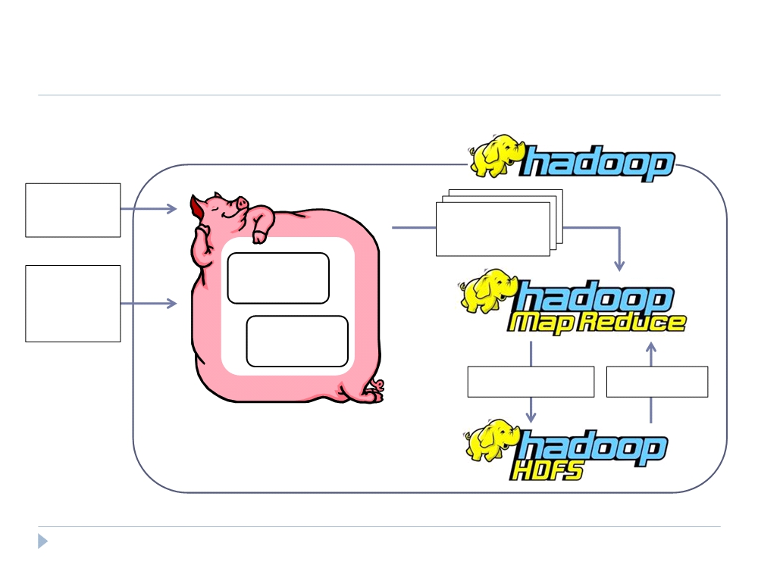
Big Picture
Pig
Pig Latin
Script
Map-Reduce
Statements
User-
Compile
Defined
Functions
Optimize
Write Results Read Data
10

Slide 5
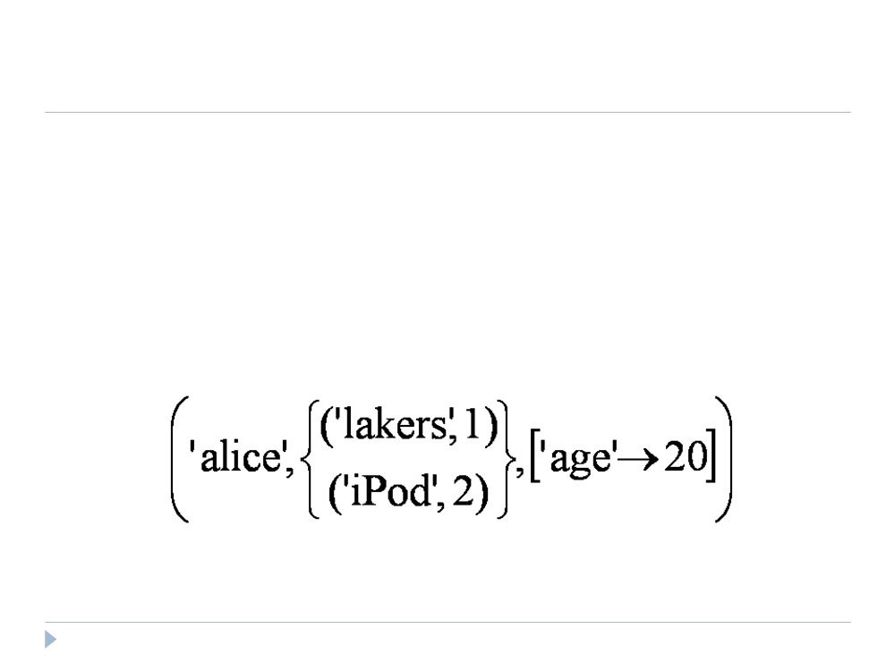
Data Model
 Atom - simple atomic value (ie: number or string)
 Tuple
 Bag
 Map
11

Slide 6
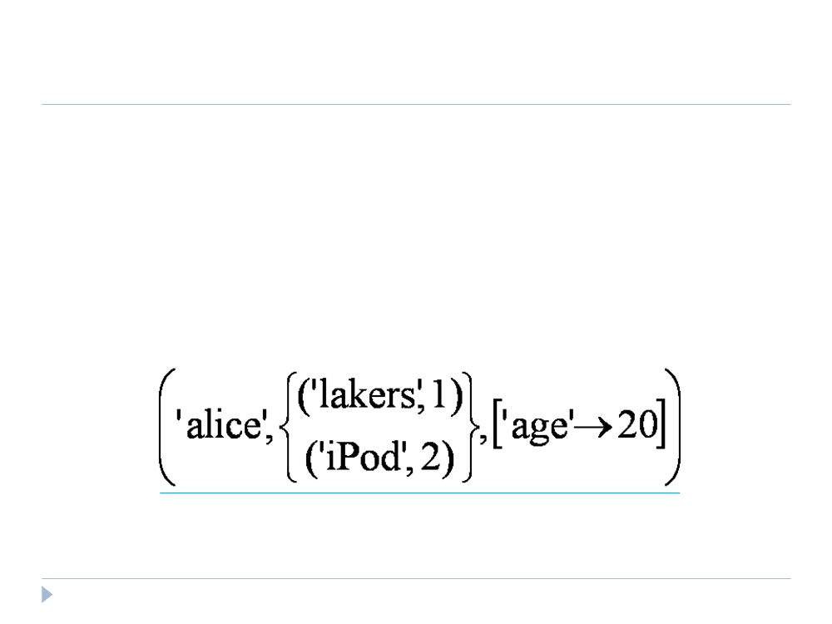
Data Model
 Atom
 Tuple - sequence of fields; each field any type
 Bag
 Map
12

Slide 7
Data Model
 Atom
 Tuple
 Bag - collection of tuples
 Duplicates possible
 Tuples in a bag can have different field lengths and field types
 Map
13

Slide 8
Data Model
 Atom
 Tuple
 Bag
 Map - collection of key-value pairs
 Key is an atom; value can be any type
14

Slide 9
Data Model
 Control over dataflow
Ex 1 (less efficient)
spam_urls = FILTER urls BY isSpam(url);
culprit_urls = FILTER spam_urls BY pagerank > 0.8;
Ex 2 (most efficient)
highpgr_urls = FILTER urls BY pagerank > 0.8;
spam_urls = FILTER highpgr_urls BY isSpam(url);
 Fully nested
 More natural for procedural programmers (target user) than
normalization
 Data is often stored on disk in a nested fashion
 Facilitates ease of writing user-defined functions
 No schema required
15

Slide 10
Data Model
 User-Defined Functions (UDFs)
 Ex: spam_urls = FILTER urls BY isSpam(url);
 Can be used in many Pig Latin statements
 Useful for custom processing tasks
 Can use non-atomic values for input and output
 Currently must be written in Java
16

Slide 11
Speaking Pig Latin
 LOAD
 Input is assumed to be a bag (sequence of tuples)
 Can specify a deserializer with “USING‟
 Can provide a schema with “AS‟
newBag = LOAD ‘filename’
<USING functionName() >
<AS (fieldName1, fieldName2,…)>;
Queries = LOAD ‘query_log.txt’
USING myLoad()
AS (userID,queryString, timeStamp)
17

Slide 12
Speaking Pig Latin
 FOREACH
 Apply some processing to each tuple in a bag
 Each field can be:
 A fieldname of the bag
 A constant
 A simple expression (ie: f1+f2)
 A predefined function (ie: SUM, AVG, COUNT, FLATTEN)
 A UDF (ie: sumTaxes(gst, pst) )
newBag =
FOREACH bagName
GENERATE field1, field2, …;
18

Slide 13
Speaking Pig Latin
 FILTER
 Select a subset of the tuples in a bag
newBag = FILTER bagName
BY expression ;
 Expression uses simple comparison operators (==, !=, <, >, …)
and Logical connectors (AND, NOT, OR)
some_apples =
FILTER apples BY colour != ‘red’;
 Can use UDFs
some_apples =
FILTER apples BY NOT isRed(colour);
19

Slide 14
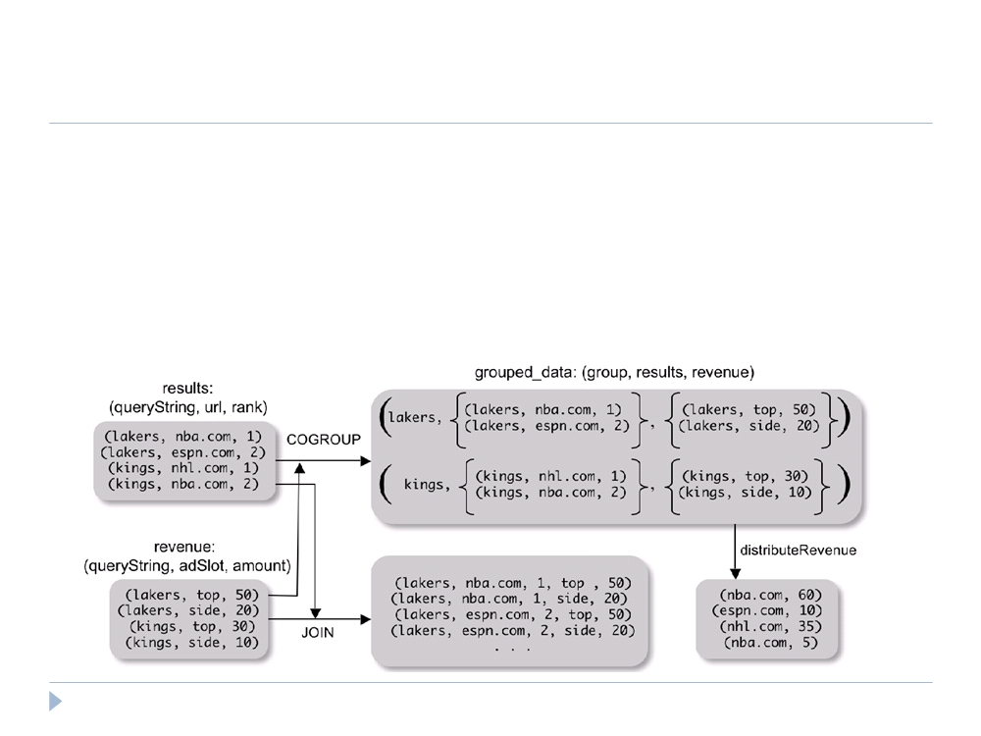
Speaking Pig Latin
 COGROUP
 Group two datasets together by a common attribute
 Groups data into nested bags
grouped_data = COGROUP results BY queryString,
revenue BY queryString;
20

Slide 15
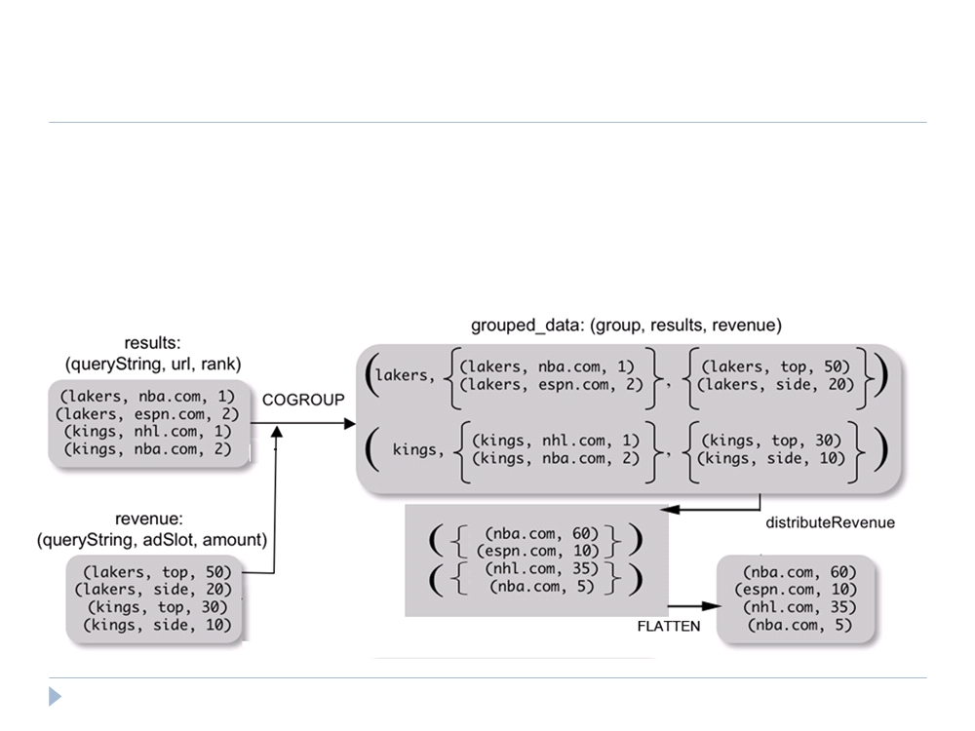
Speaking Pig Latin
 Why COGROUP and not JOIN?
url_revenues =
FOREACH grouped_data GENERATE
FLATTEN(distributeRev(results, revenue));
21

Slide 16
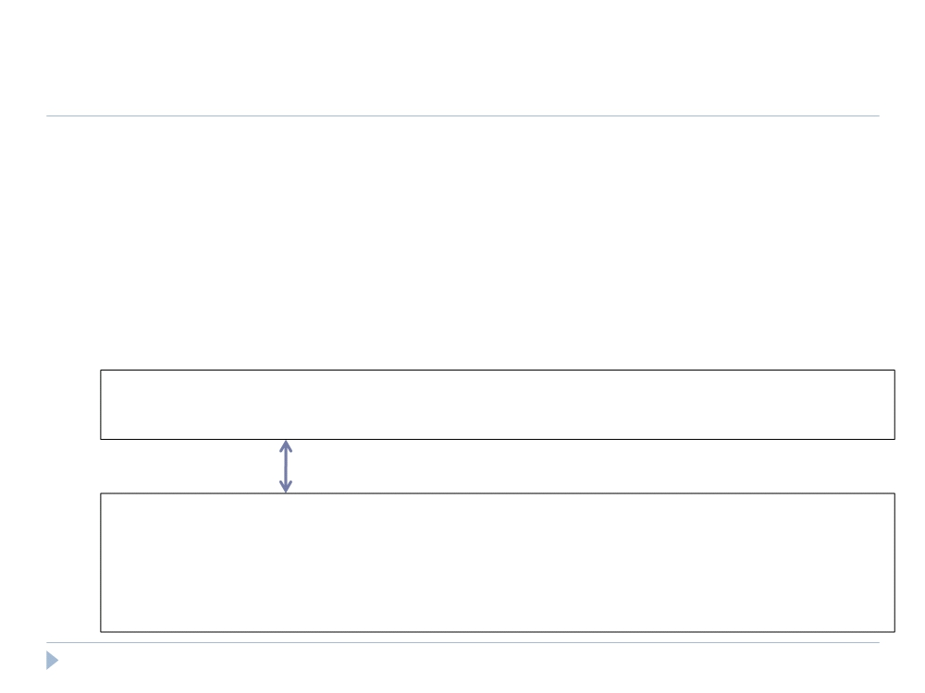
Speaking Pig Latin
 Why COGROUP and not JOIN?
 May want to process nested bags of tuples before taking the
cross product.
 Keeps to the goal of a single high-level data transformation per
pig-latin statement.
 However, JOIN keyword is still available:
JOIN results BY queryString,
revenue BY queryString;
Equivalent
temp = COGROUP results BY queryString,
revenue BY queryString;
join_result = FOREACH temp GENERATE
FLATTEN(results), FLATTEN(revenue);
22

Slide 17
Speaking Pig Latin
 STORE (& DUMP)
 Output data to a file (or screen)
STORE bagName INTO ‘filename’
<USING deserializer ()>;
 Other Commands (incomplete)
 UNION - return the union of two or more bags
 CROSS - take the cross product of two or more bags
 ORDER - order tuples by a specified field(s)
 DISTINCT - eliminate duplicate tuples in a bag
 LIMIT - Limit results to a subset
23

Slide 18
Compilation
 Pig system does two tasks:
 Builds a Logical Plan from a Pig Latin script
 Supports execution platform independence
 No processing of data performed at this stage
 Compiles the Logical Plan to a Physical Plan and Executes
 Convert the Logical Plan into a series of Map-Reduce statements to
be executed (in this case) by Hadoop Map-Reduce
24

Slide 19
Compilation
 Building a Logical Plan
 Verify input files and bags referred to are valid
 Create a logical plan for each bag(variable) defined
25

Slide 20
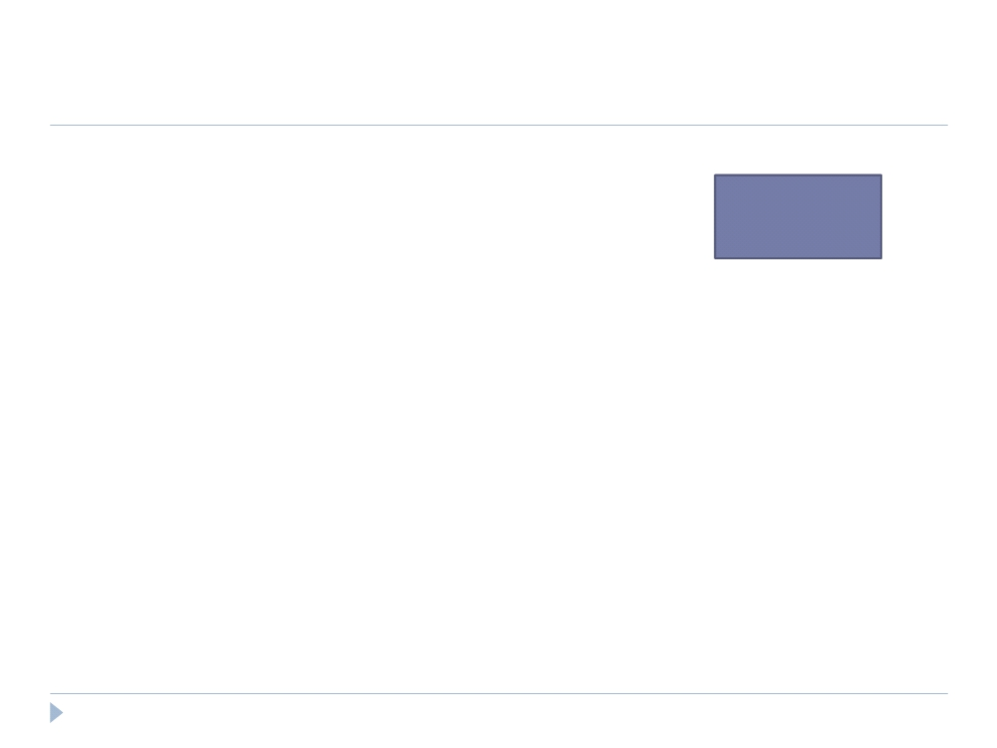
Compilation
 Building a Logical Plan Example
A = LOAD ‘user.dat’ AS (name, age, city);
Load(user.dat)
B = GROUP A BY city;
C = FOREACH B GENERATE group AS city,
COUNT(A);
D = FILTER C BY city IS ‘kitchener’
OR city IS ‘waterloo’;
STORE D INTO ‘local_user_count.dat’;
26

Slide 21
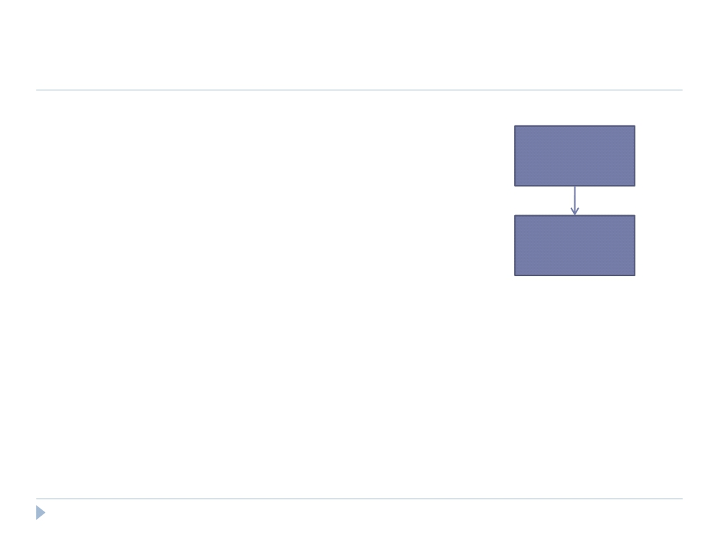
Compilation
 Building a Logical Plan Example
A = LOAD ‘user.dat’ AS (name, age, city);
Load(user.dat)
B = GROUP A BY city;
C = FOREACH B GENERATE group AS city,
COUNT(A);
D = FILTER C BY city IS ‘kitchener’
Group
OR city IS ‘waterloo’;
STORE D INTO ‘local_user_count.dat’;
27

Slide 22
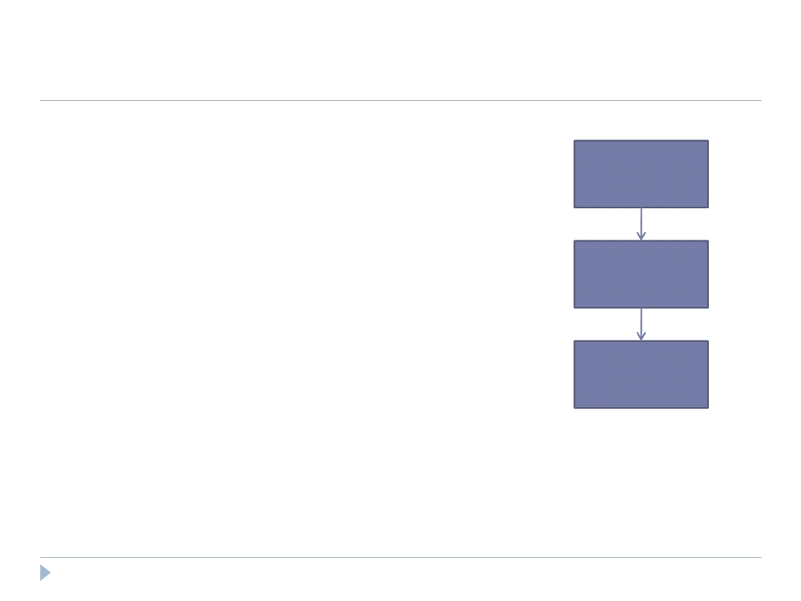
Compilation
 Building a Logical Plan Example
A = LOAD ‘user.dat’ AS (name, age, city);
Load(user.dat)
B = GROUP A BY city;
C = FOREACH B GENERATE group AS city,
COUNT(A);
D = FILTER C BY city IS ‘kitchener’
Group
OR city IS ‘waterloo’;
STORE D INTO ‘local_user_count.dat’;
Foreach
28

Slide 23
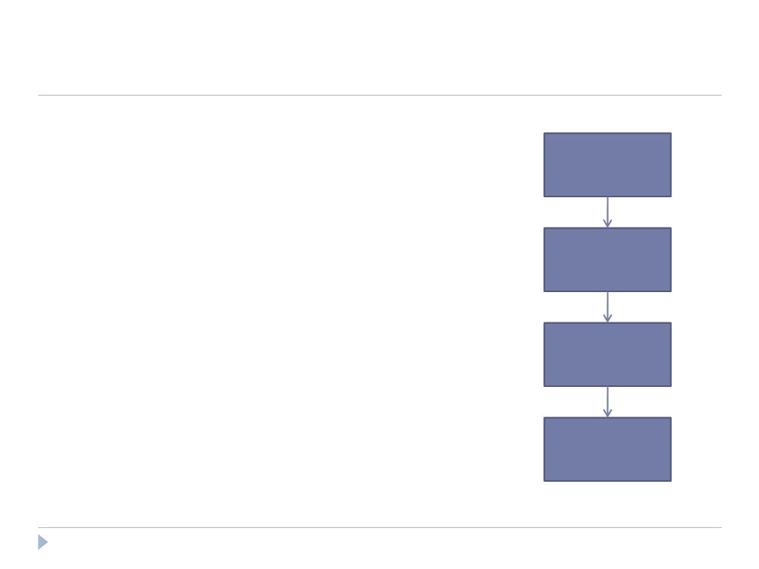
Compilation
 Building a Logical Plan Example
A = LOAD ‘user.dat’ AS (name, age, city);
Load(user.dat)
B = GROUP A BY city;
C = FOREACH B GENERATE group AS city,
COUNT(A);
D = FILTER C BY city IS ‘kitchener’
Group
OR city IS ‘waterloo’;
STORE D INTO ‘local_user_count.dat’;
Foreach
Filter
29

Slide 24
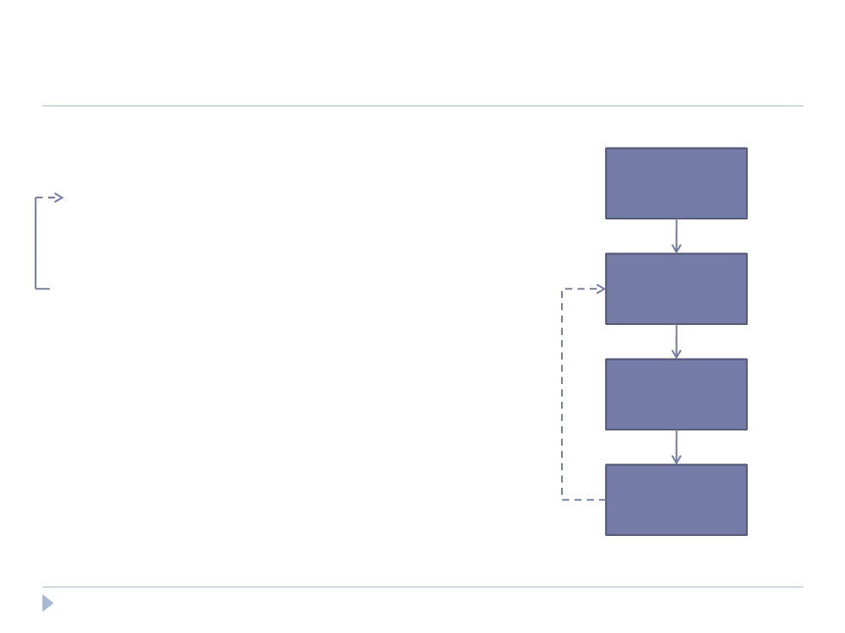
Compilation
 Building a Logical Plan Example
A = LOAD ‘user.dat’ AS (name, age, city);
Load(user.dat)
B = GROUP A BY city;
C = FOREACH B GENERATE group AS city,
COUNT(A);
D = FILTER C BY city IS ‘kitchener’
Filter
OR city IS ‘waterloo’;
STORE D INTO ‘local_user_count.dat’;
Group
Foreach
30

Slide 25
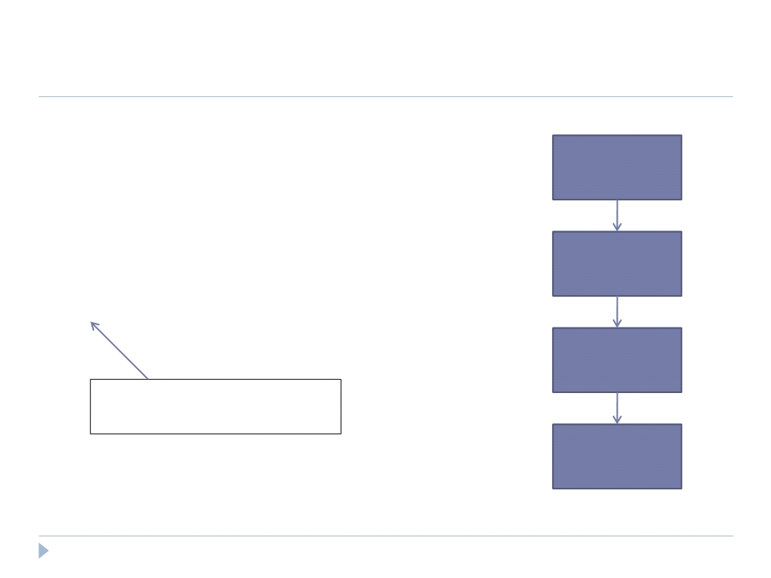
Compilation
 Building a Physical Plan
A = LOAD ‘user.dat’ AS (name, age, city);
Load(user.dat)
B = GROUP A BY city;
C = FOREACH B GENERATE group AS city,
COUNT(A);
D = FILTER C BY city IS ‘kitchener’
Filter
OR city IS ‘waterloo’;
STORE D INTO ‘local_user_count.dat’;
Group
Only happens when output is
specified by STORE or DUMP
Foreach
32

Slide 26
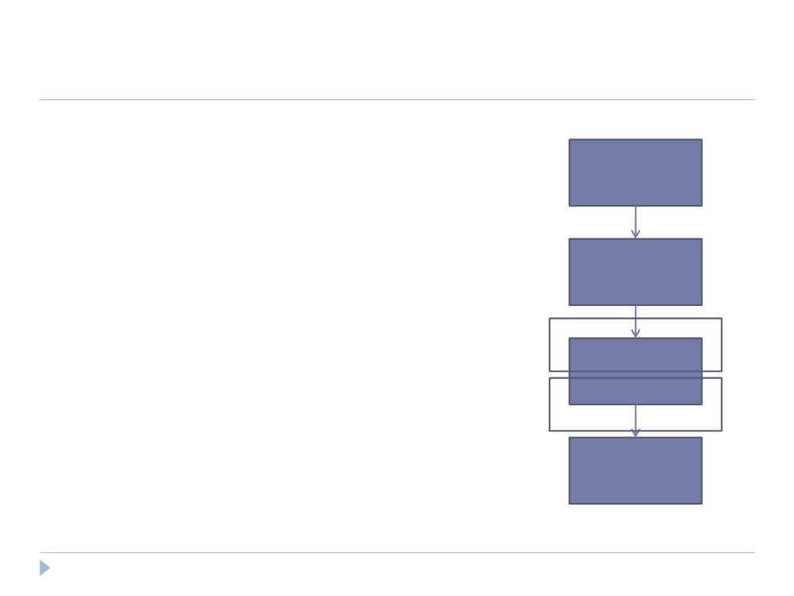
Compilation
 Building a Physical Plan
 Step 1: Create a map-reduce job for each
COGROUP
Load(user.dat)
Filter
Map
Group
Reduce
Foreach
33

Slide 27
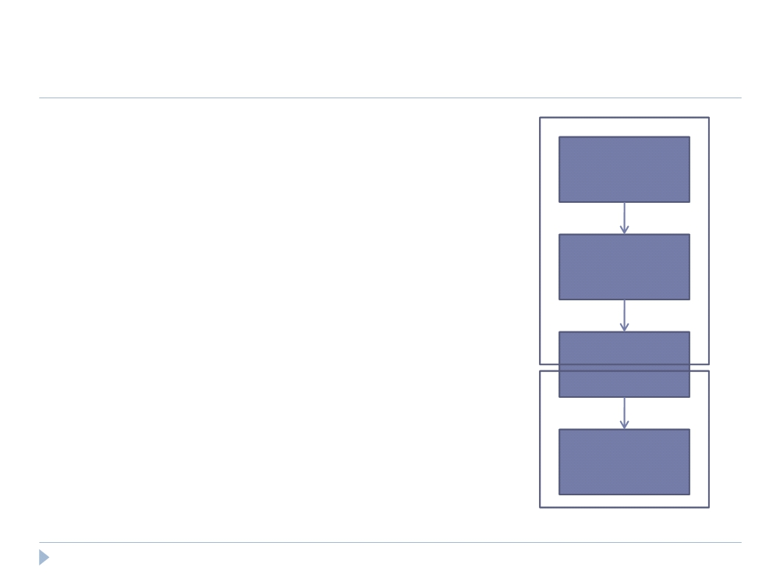
Compilation
 Building a Physical Plan
 Step 1: Create a map-reduce job for each
COGROUP
Load(user.dat)
 Step 2: Push other commands into the
map and reduce functions where Map
Filter
possible
 May be the case certain commands
Group
require their own map-reduce
job (ie: ORDER needs separate map-
Reduce
reduce jobs)
Foreach
34

Slide 28
Compilation
 Efficiency in Execution
 Parallelism
 Loading data - Files are loaded from HDFS
 Statements are compiled into map-reduce jobs
35

Slide 29
Compilation
 Efficiency with Nested Bags
 In many cases, the nested bags created in each tuple of a COGROUP
statement never need to physically materialize
 Generally perform aggregation after a COGROUP and the
statements for said aggregation are pushed into the reduce function
 Applies to algebraic functions (ie: COUNT, MAX, MIN, SUM, AVG)
36

Slide 30
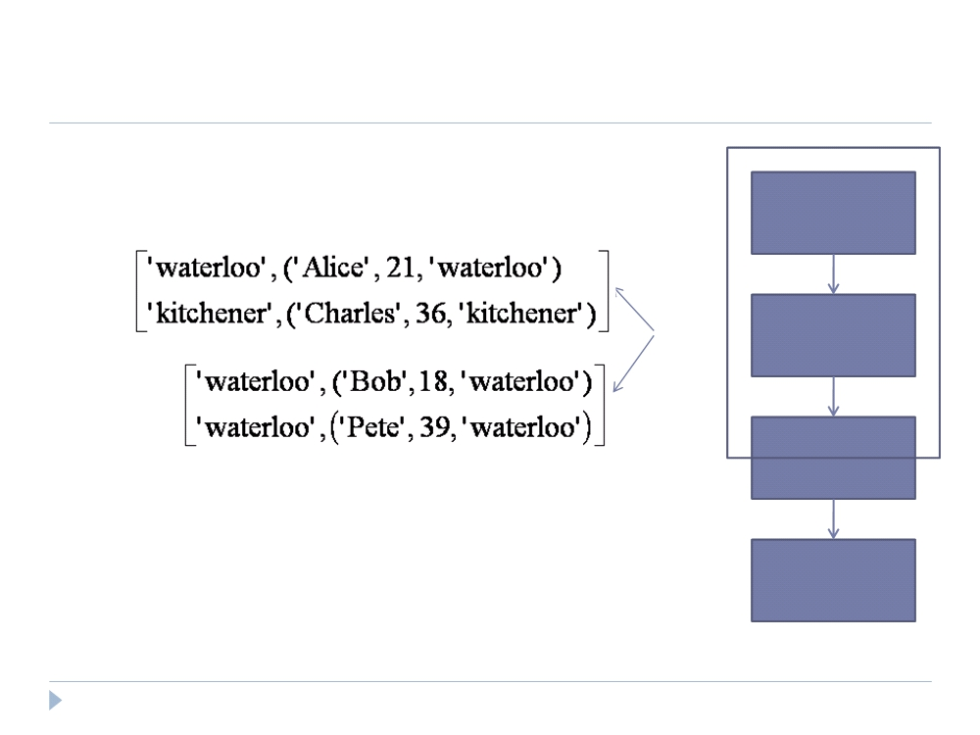
Compilation
 Efficiency with Nested Bags
Load(user.dat)
Map
Filter
Group
Foreach
37

Slide 31
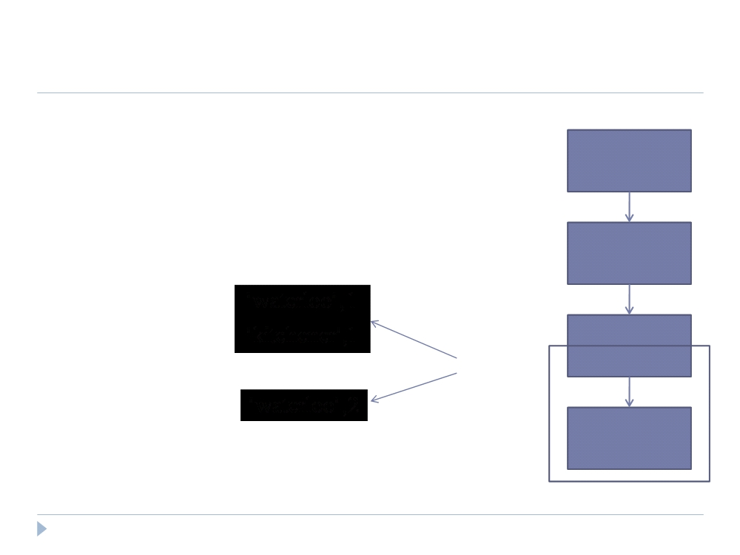
Compilation
 Efficiency with Nested Bags
Load(user.dat)
Filter
Group
Combine
Foreach
38

Slide 32
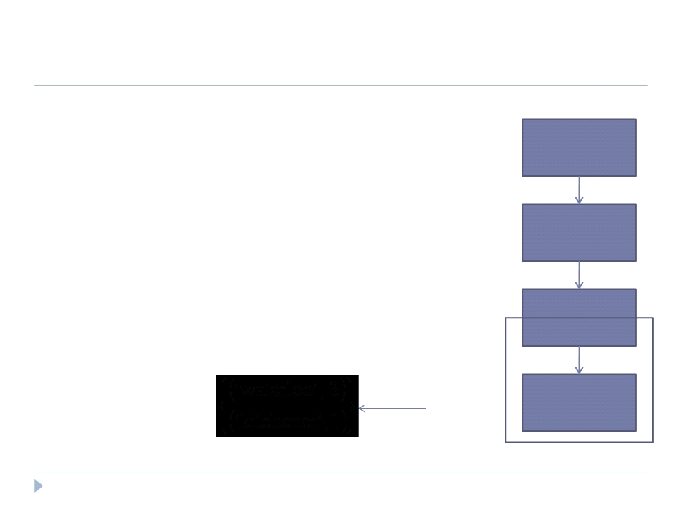
Compilation
 Efficiency with Nested Bags
Load(user.dat)
Filter
Group
Reduce
Foreach
39

Slide 33
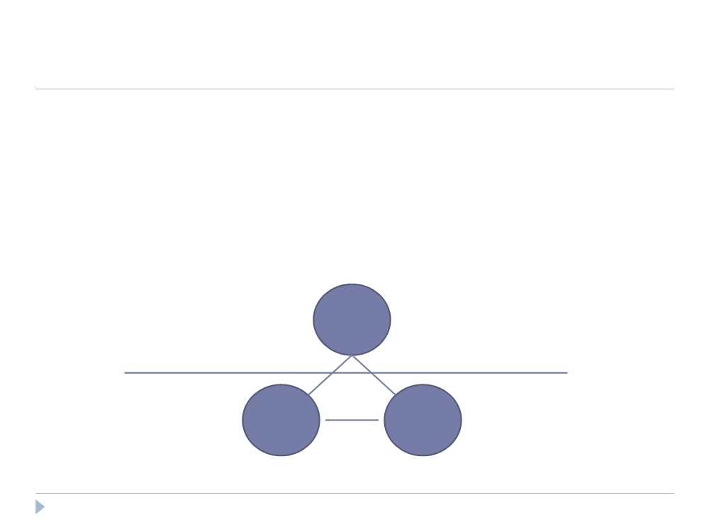
Compilation
 Efficiency with Nested Bags
 Why this works:
◻ COUNT is an algebraic function; it can be structured as a tree of sub-
functions with each leaf working on a subset of the data
Reduce
SUM
Combine
COUNT
COUNT
40

Slide 34
Compilation
 Efficiency with Nested Bags
 Pig provides an interface for writing algebraic UDFs so they can take
advantage of this optimization as well.
 Inefficiencies
 Non-algebraic aggregate functions (ie: MEDIAN) need entire bag to
materialize; may cause a very large bag to spill to disk if it doesn‟t fit
in memory
 Every map-reduce job requires data be written and replicated to the
HDFS (although this is offset by parallelism achieved)
41

Slide 35
Conclusion
 Pig is a data processing environment in Hadoop that is
specifically targeted towards procedural programmers
who perform large-scale data analysis.
 Pig-Latin offers high-level data manipulation in a
procedural style.
 Pig-Pen is a debugging environment for Pig-Latin
commands that generates samples from real data.
47

