Slide 1
Cloud Computing
Resource provisioning
Keke Chen

Slide 2
Outline
For Web applications
  statistical Learning and automatic control for datacenters
For data intensive applications
  towards Optimal Resource Provisioning for running MapReduce Programs in the Cloud

Slide 3
Resource provisioning for web applications
Check HotCloud09 paper:
Statistical Machine Learning Makes Automatic Control Practical for Internet datacenters
  - Peter Bodik et al. UC Berkeley

Slide 4
Motivation
Cloud applications often need to satisfy SLAs
  About web applications
  Add more servers in face of larger demand
  Additional resources come at a cost
Guarantee SLAs and minimize the cost in automatic resource provisioning

Slide 5
Current status
Unrealistic performance models
  Linear or simple queueing models
  Jeopardize SLAs
Previous attempts at automatic control failed to demonstrate robustness
  Changes in usage pattern
  Hardware failures
  Sharing resources with other applications

Slide 6
Proposed method
Using novel learning techniques to adapt to the changes in the system

Slide 7

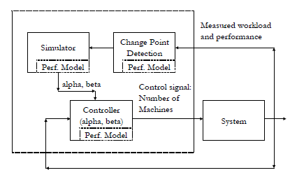
Framework illustration

Slide 8
The components in the framework
Statistical performance models
  Predicting system performance for future configurations and workloads
Find a policy that minimizes the resource usage
  Control policy simulator
  Comparing different policies for adding/removing resources
Online training and change point detection
  Adjust models when changes are observed

Slide 9

Example:
Predict the next 5 mins of workload using a simple linear regression on the most recent 15 mins
Predicted workload as input to performance model that estimates the number of servers required
  - intertwined with other factors: mixed workload, size of data, changes to apps
Servers are added/removed use a formula
Alpha/beta → add/remove
how fast…

Slide 10
Key problems
Learning the performance model
  {workload, # servers} → fraction of requests lower than SLAs
  Collect data and train a model
Detecting changes
  Changes → preformance model not accurate
  Caused by software upgrades, hardware failures, or changes in the environment
  Evaluated by model fitness
Quick online learning

Slide 11
Key problems
Control policy simulator
  Determines how fast to add/remove servers
  More factors involved
  Use real workloads to simulate and check combinations of alpha and beta

Slide 12
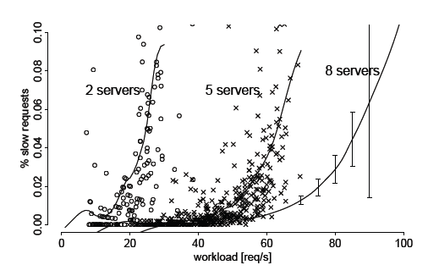
Performance model

Slide 13
Experiments
Cloudstone web 2.0 benchmark
Deployed on Amazon EC2
3 days of real workload data from ebates.com

Slide 14
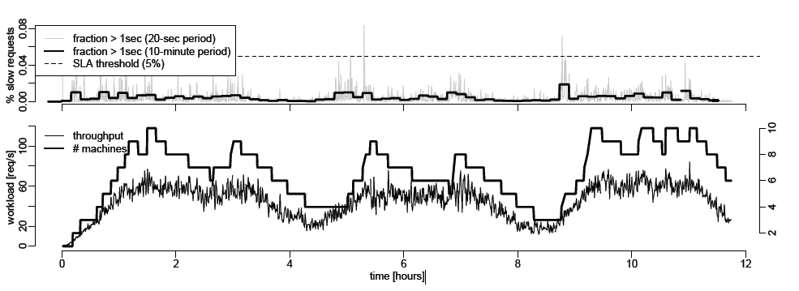
3 day result

Slide 15
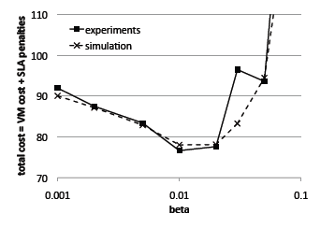
Cost vs. Beta value

Slide 16
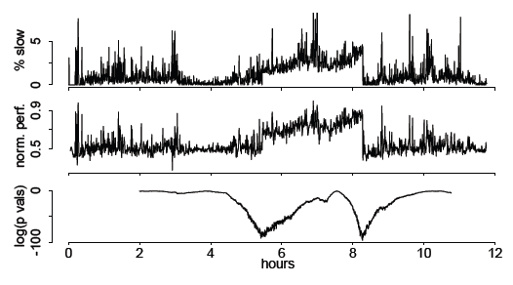

Slide 17
For data intensive computing
Towards Optimal Resource Provisioning for Running MapReduce Programs in Public Clouds, IEEE Cloud 2011

Slide 18
Problem for data intensive computing
With a budget, what is the best resource provisioning strategy that minimizes the time to finish the job?
With a deadline, what is the best strategy that minimizes the budget?
What are good tradeoffs between budget and deadline for a job?

Slide 19
Specific to hadoop/mapreduce
Public cloud
  The user starts the hadoop cluster and fully occupies it.
  Normally, one user, one job
  Need to decide how many nodes the job really needs

Slide 20
The cost model of MapReduce is the key, which is a function of
  Input data
  Available resources (VM nodes)
  Complexity of the processing algorithm

Slide 21
MapReduce Sequential Processing
Map Task
Read → Map→ Partition/sort→ Combine
block
HDFS
Local
disk
HDFS
Pull data
Reduce Task
file
Copy → Sort → Reduce→ WriteBack
- HDFS: Hadoop distributed file system
Each map/reduce task is executed in a map/reduce slot
“Combine” is an optional step

Slide 22
MapReduce parallel processing
⎡M/m⎤ rounds of Map Processes
Map Process
Map Process
Map Process
Intermediate
Results
Reduce
Process
m Map Slots
Map Process
Map Process
Map Process
r Reduce Slots
Reduce Process
Map Process
Map Process
Map Process
Time
- Each slot is a resource unit, e.g., two slots per core for a typical configuration.
M: the number of data blocks
m: the number of Map slots; r: the number of Reduce slots
Once a map result is ready, the reduces will pull data from the map

Slide 23

MapReduce Cost Model
Overall model
is the cost of Map task
is the cost of Reduce task
is the cost of managing Map and Reduce tasks
M: the number of data blocks; a map task processes one block → number of
Map tasks
m: the number of Map slots
R: the number of Reduce tasks, often the same as r *
r: the number of Reduce slots
* the system evenly distributes the work to R reduces. So it is not necessary
to make multiple rounds of reduces.

Slide 24
Cost of Map Task:
Processing one data block – size b
sequential components
  Read data: i(b), linear to b
  Map function: f(b), normally linear to b, output size: o(b)
  Partition/sort: use hash function, linear to o(b),
  Combiner: cost is often linear to o(b), dramatically reduce the data to << o(b)
b is fixed before running the job, so we can consider is almost constant.

Slide 25
Cost of Reduce Task:
Input data
  Assume k keys are uniformly distributed to R reduces
  Each reduce gets b_{r} = M*o_{m}(b) * k/R data
Sequential components
  Pull data: b_{r}
  MergeSort: b_{r} log b_{r}
  Reduce function: g(b_{r}), generate o_{r} (b_{r}) often much smaller than b_{r}
  Write back: o_{r} (b_{r})
All map outputs

Slide 26
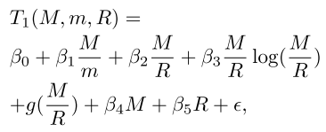
Complete cost model
Assume M/m is an integer, R=r
Management cost is linear to M and R
Total cost is
- βi are the parameters to be determined
- g() is the cost function of reduce
- ε is the error, to capture the error caused by missing factors

Slide 27
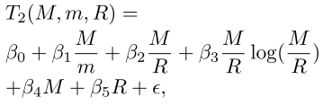
Factors in the model
g()
  Common complexity: O(M/R) or O(M/R log (M/R)) Merged to corresponding components
  Other complexity, needs to have an individual item in the cost model
With/without “Combiner” the model is the same; only the β parameters will be different.

Slide 28
Steps for instantiating the model for a real application
Determine the complexity g()
Determine β parameters with linear regression (e.g., for the T2 model) on small input cases of (M, m, R)
With different M, m, R settings, the items M/m, M/R, M/R log(M/R), M, and R
form a matrix X. Let y be the corresponding times T2
→ Solve the linear regression problem: y = βX

Slide 29
Optimizing resource with the cost model
What we have:
  Input data is known – M becomes a constant
    b: size of data block; total size of data = M*b
    T2 is further simplified to T3(m, R),
  Total number of slots m+r, i.e., m+R
  Total number of compute nodes (VMs)
  Price for renting a node per hour is u
  Total cost: u*v*T3(m, R)
γ: slots per node

Slide 30
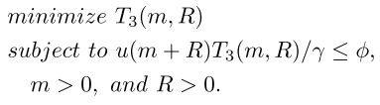
Sample optimization problems
With a budget φ, what is the configuration to minimize the job time?
* If there is no solution, the budget might be impractical

Slide 31

Optimization problems
With a deadline τ, what is the configuration to minimize the budget
* If there is no solution, the deadline might be impractical.

Slide 32
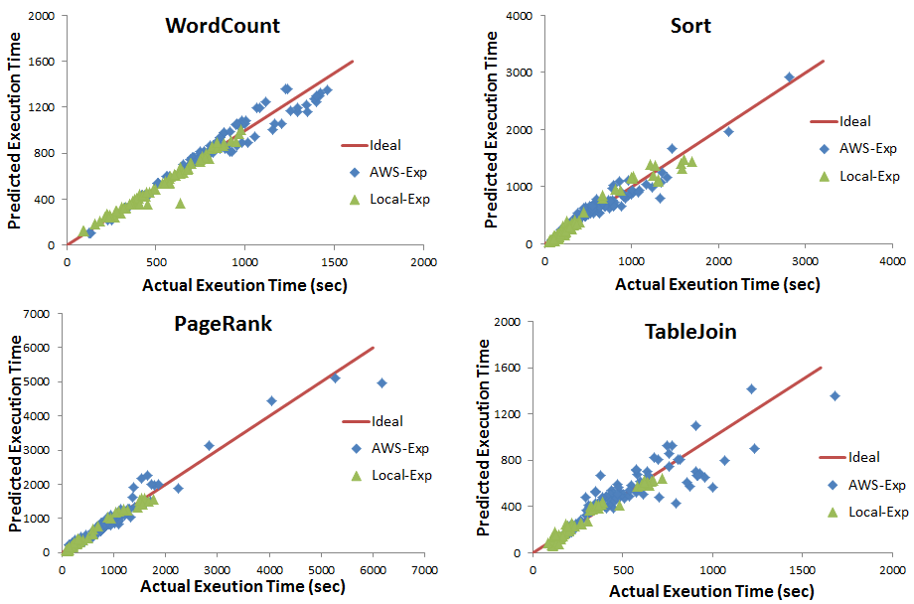
Results
Goodness of fit

Slide 33
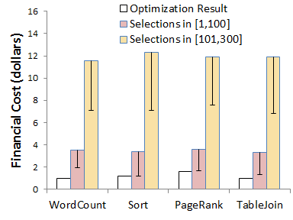
Optimization result
Time constraint: 0.5 hours
# of map/reduce slots

Slide 34
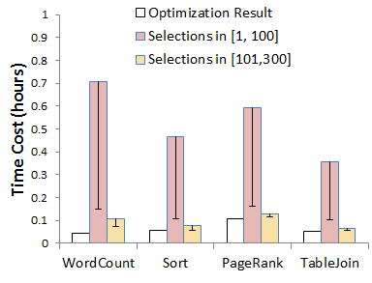
Financial budget: $10

