Slide 1
Cloud Computing
Cloud Security– an overview and IAM
Keke Chen

Slide 2
Outline
Introduction
Infrastructure security
Data security
Identity and access management

Slide 3
Introduction
Many security problems in non-cloud environment are still applicable
We focus on cloud-specific problems
Reference book
  “cloud security and privacy”

Slide 4
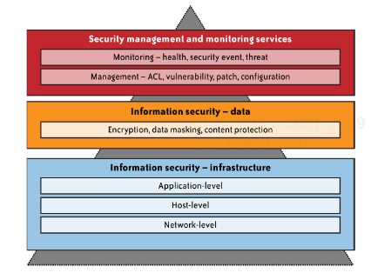
overview

Slide 5
Infrastructure security
Infrastructure
  IaaS, PaaS, and SaaS
Focus on public clouds
  No special security problems with private clouds – traditional security problems only
Different levels
  Network level
  Host level
  Application level

Slide 6
Network level
confidentiality and integrity of data-in-transit
  Amazon had security bugs with digital signature on SimpleDB, EC2, and SQS accesses (in 2008)
Less or no system logging /monitoring
  Only cloud provider has this capability
  Thus, difficult to trace attacks
Reassigned IP address
  Expose services unexpectedly
  spammers using EC2 are difficult to identify
Availability of cloud resources
  Some factors, such as DNS, controlled by the cloud provider.
Physically separated tiers become logically separated
  E.g., 3 tier web applications

Slide 7
Host level (IaaS)
Hypervisor security
  “zero-day vulnerability” in VM, if the attacker controls hypervisor
Virtual machine security
  Ssh private keys (if mode is not appropriately set)
  VM images (especially private VMs)
  Vulnerable Services

Slide 8
Application level
SaaS application security
  In an accident, Google Docs access control failed. All users can access all documents

Slide 9
Data Security
Data-in-transit
Data-at-rest
Data processing
Data lineage
Data provenance
Data remanence

Slide 10
Data-in-transit
  Confidentiality and integrity
  The Amazon digital signature problem
Data-at-rest & processing data
  Possibly encrypted for static storage
  Cannot be encrypted for most PaaS and SaaS (such as Google Apps) – prevent indexing or searching
    Research on indexing/searching encrypted data
    Fully homomorphic encryption?

Slide 11
Data lineage
Definition: tracking and managing data
For audit or compliance purpose
Data flow or data path visualization
Time-consuming process even for inhouse data center
  Not possible for a public cloud

Slide 12
Data provenance
Origin/ownership of data
  Verify the authority of data
  Trace the responsibility
  e.g., financial and medical data
Difficult to prove data provenance in a cloud computing scenario

Slide 13
Data remanence
Data left intact by a nominal delete operation
  In many DBMSs and file systems, data is deleted by flagging it.
Lead to possible disclosure of sensitive information
Department of Defense: National Industrial security program operating manual
  Defines data clearing and sanitization

Slide 14
Provider’s data and its security
The provider collects a huge amount of security-related data
  Data possibly related to service users
  If not managed well, it is a big threat to users’ security

Slide 16
Identity and Access Management
Traditional trust boundary reinforced by network control
  VPN, Intrusion detection, intrusion prevention
Loss of network control in cloud computing
Have to rely on higher-level software controls
  Application security
  User access controls - IAM

Slide 17
IAM components
  Authentication
  Authorization
  Auditing
IAM processes
  User management
  Authentication management
  Authorization management
  Access management – access control
  Propagation of identity to resources
  Monitoring and auditing

Slide 18
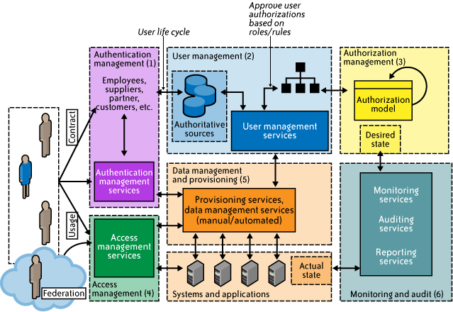

Slide 19
IAM standards and specifications
avoid duplication of identity, attributes, and credentials and provide a single sign-on user experience
  SAML(Security Assertion Markup Lang)
automatically provision user accounts with cloud services and automate the process of provisioning and deprovisioning
  SPML (service provisioning markup lang).
provision user accounts with appropriate privileges and manage entitlements
  XACML (extensible access control markup lang).
authorize cloud service X to access my data in cloud service Y without disclosing credentials
  Oauth (open authentication).

Slide 20
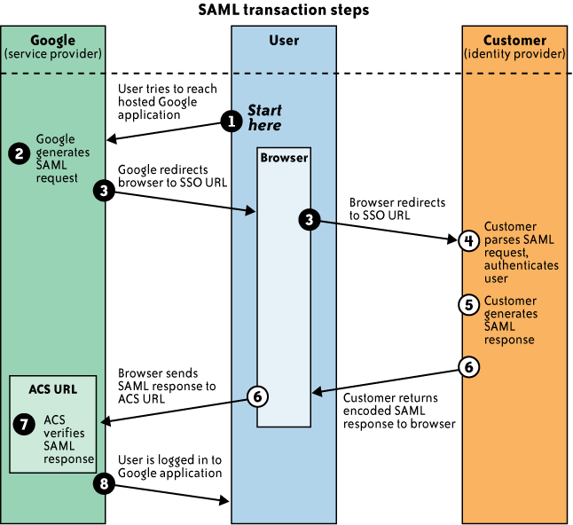
Security Assertion Markup Language (SAML, pronounced sam-el[1]) is an XML-based, open-standard data format for exchanging authentication and authorization data between parties, in particular, between an identity provider and a service provider.
Google Account Example:
ACS: Assertion Consumer Service. SSO : single sign-on

Slide 21
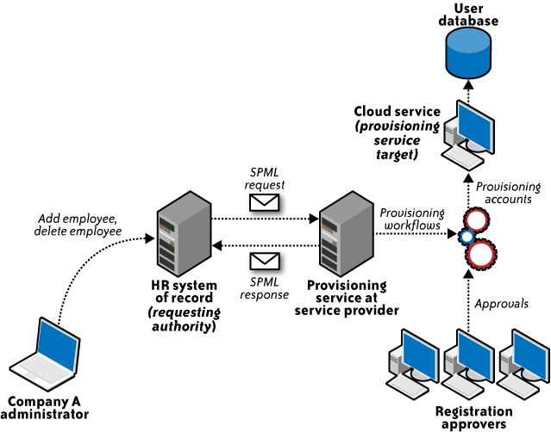
SPML example:
What happens when an account is created?

Slide 22
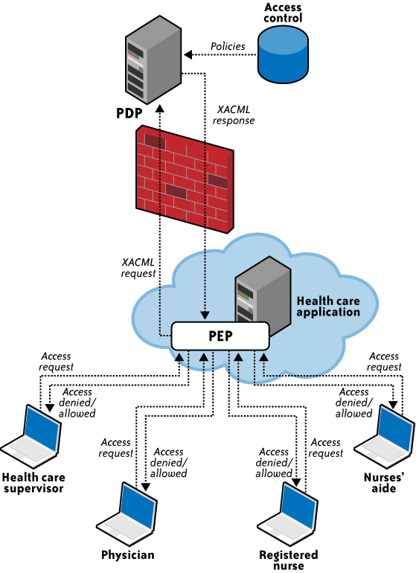
XACM Examples:
How does your access is verified?
PEP: policy enforcement point
(app interface)
PDP: policy decision point

Slide 23
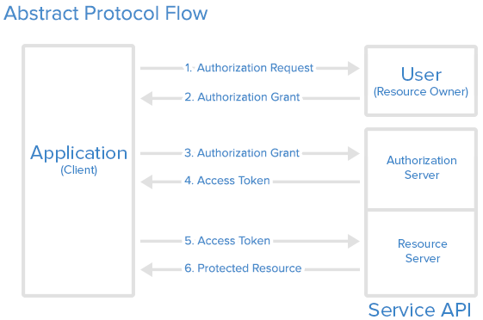
OAUTH workflow

Slide 24
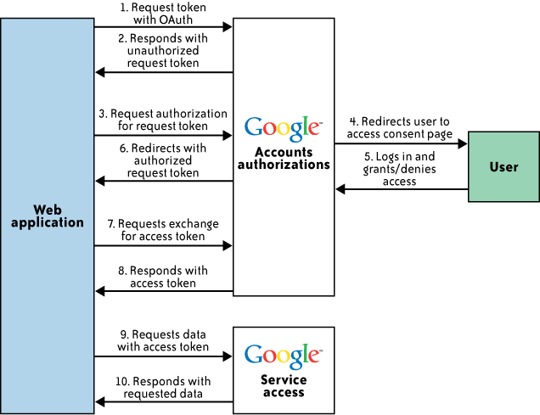
OAuth example:
Authorize the third party to
Access your data/credential

Slide 25
IAM practice- Identity federation
Dealing with heterogeneous, dynamic, loosely coupled trust relationships
Enabling “Login once, access different systems within the trust boundary”
  Single sign-on (SSO)
  Centralized access control services
  Yahoo! OpenID

