Slide 1
SQL SELECT Syntax Supported by Spark-SQL

Slide 2
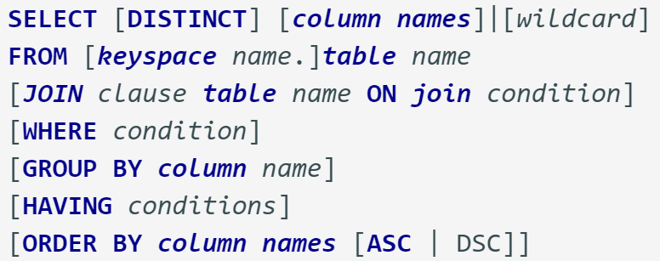
Select statement

Slide 3
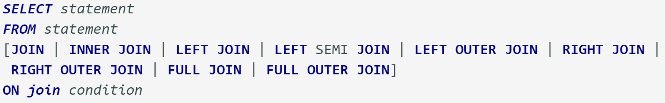
JOIN syntax

Slide 4
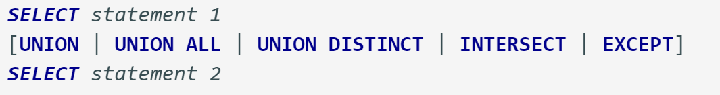
Set operations

