Slide 1
Threat Modeling for Cloud Computing
(some slides from Dr. Ragib Hasan)
Keke Chen

Slide 2
Threats, vulnerabilities, and enemies
Goal
Learn the cloud computing threat model by examining the assets, vulnerabilities, entry points, and actors in a cloud
Technique
Apply different threat modeling schemes

Slide 3
Threat Model
A threat model helps in analyzing a security problem, design mitigation strategies, and evaluate solutions
Steps:
  Identify attackers, assets, threats and other components
  Rank the threats
  Choose mitigation strategies
  Build solutions based on the strategies

Slide 4
Threat Model
Basic components
    Assets / potentially attacked targets
    Attacker modeling
      Choose what attacker to consider
      Attacker motivation and capabilities
    Vulnerabilities / threats

Slide 5
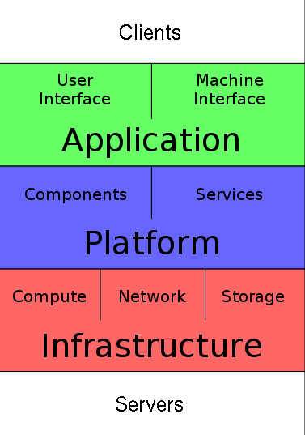
Recall: Cloud Computing Stack

Slide 6
Recall: Cloud Architecture
SaaS / PaaS Provider
Client
Cloud Provider
(IaaS)

Slide 7
Assets
Confidentiality:
  Data stored in the cloud
  Configuration of VMs running on the cloud
  Identity of the cloud users
  Location of the VMs running client code

Slide 8
Assets
Integrity
  Data stored in the cloud
  Computations performed on the cloud

Slide 9
Assets
Availability
  Cloud infrastructure
  SaaS / PaaS

Slide 10
Types of attackers
Insider?
  Malicious employees at client
  Malicious employees at Cloud provider
  Cloud provider itself
Outsider?
  Intruders
  Network attackers?

Slide 11
Attacker Capability: Insiders
At client
  Learn passwords/authentication information
  Gain control of the VMs
At cloud provider
  Log client communication

Slide 12
Attacker Capability: Cloud Provider
What can the attacker do?
  Can read unencrypted data
  Can possibly peek into VMs, or make copies of VMs
  Can monitor network communication, application patterns

Slide 13
Attacker motivation: Cloud Provider
Why?
  Gain information about client data
  Gain information on client behavior
  Use the information to improve services
  Sell the information to gain financial benefits

Slide 14
Attacker Capability: Outside attacker
What can the attacker do?
  Listen to network traffic (passive)
  Insert malicious traffic (active)
  Probe cloud structure (active)
  Launch DoS

Slide 15
Attacker goals: Outside attackers
Intrusion
Network analysis (network security)
Man in the middle: public key example
Cartography: making map (original meaning); inference based on linked events/objects
Req. pk_B
Req. pk_B
A
M
B
Pk_A: public key by A
Pk_B: public key by B
Pk_A’,Pk_B’: false public keys by M
Ret. Pk_B’
Ret. Pk_B
Pk_B’(m)
Pk_B(m’)
A
M
B
Pk_A(r’)
Pk_A’(r)

Slide 16
Types of threads: organizing the threats using STRIDE
Spoofing identity
Tampering with data
Repudiation (refuse to do with, dispute)
Information disclosure
Denial of service
Escalation of privilege

Slide 17
Spoofing identity
illegally obtaining access and use of another person’s authentication information
  Man in the middle
  URL phishing
  Email address spoofing (email spam)

Slide 18
Tampering with data
Malicious modification of the data
Often hard and costly to detect
  you might not find the modified data until some time has passed;
  once you find one tampered item, you’ll have to thoroughly check all the other data on your systems

Slide 19
Repudiation
a legitimate transaction will be disowned by one of the participants
  You sign a document first; and refused to confirm the signature
  Need a trusted third party to mitigate

Slide 20
Information/data disclosure
an attacker can gain access, without permission, to data that the owner doesn’t want him or her to have.

Slide 21
Denial of service
an explicit attempt to prevent legitimate users from using a service or system. It involves the overuse of legitimate resources.
You can stop all such attacks by removing the resource used by the attacker, but then real users can’t use the resource either.

Slide 22
Escalation of privilege
an unprivileged user gains privileged access.
  E.g. unprivileged user who contrives a way to be added to the Administrators group

Slide 23
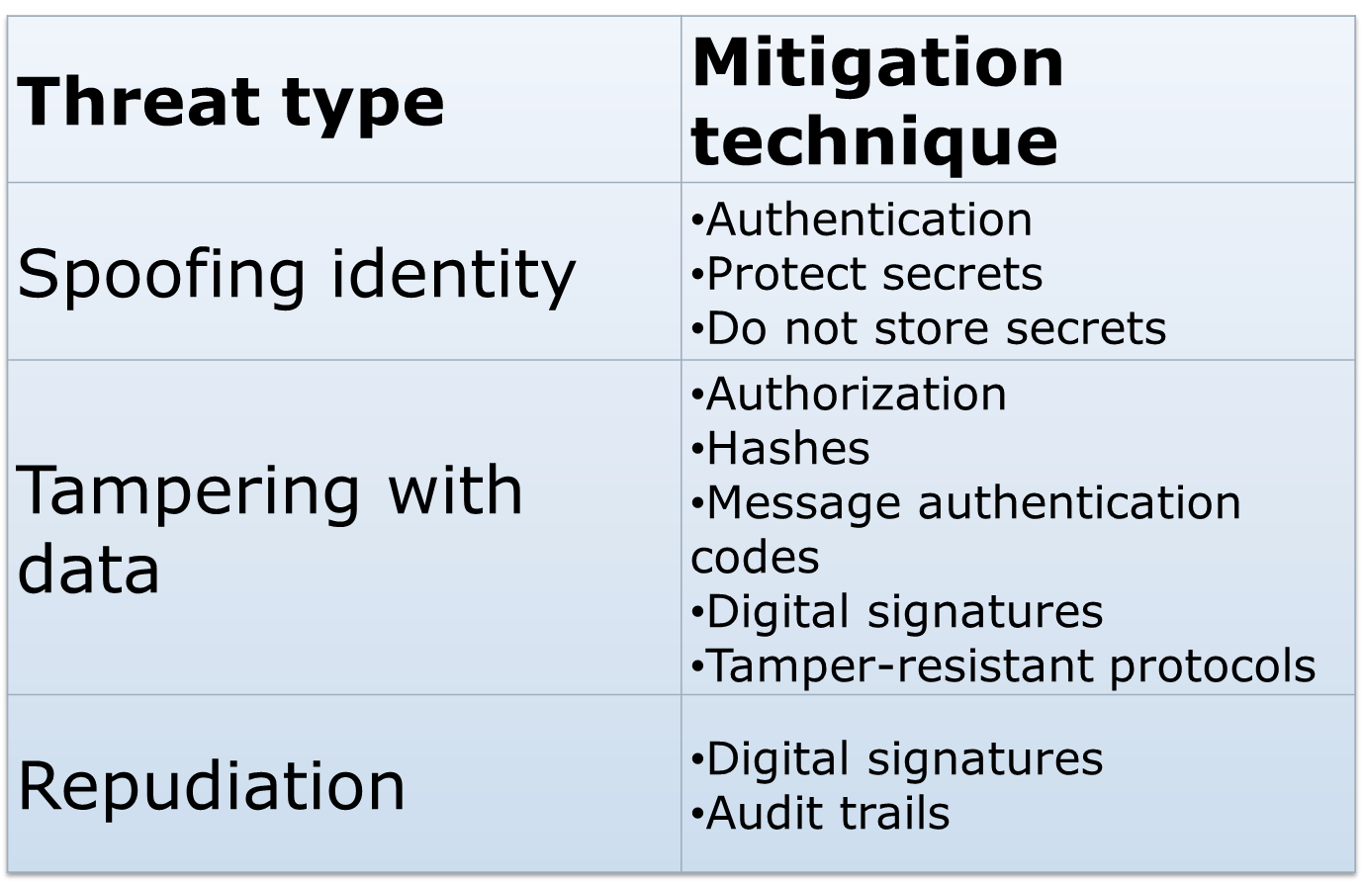
Mitigation techniques

Slide 24
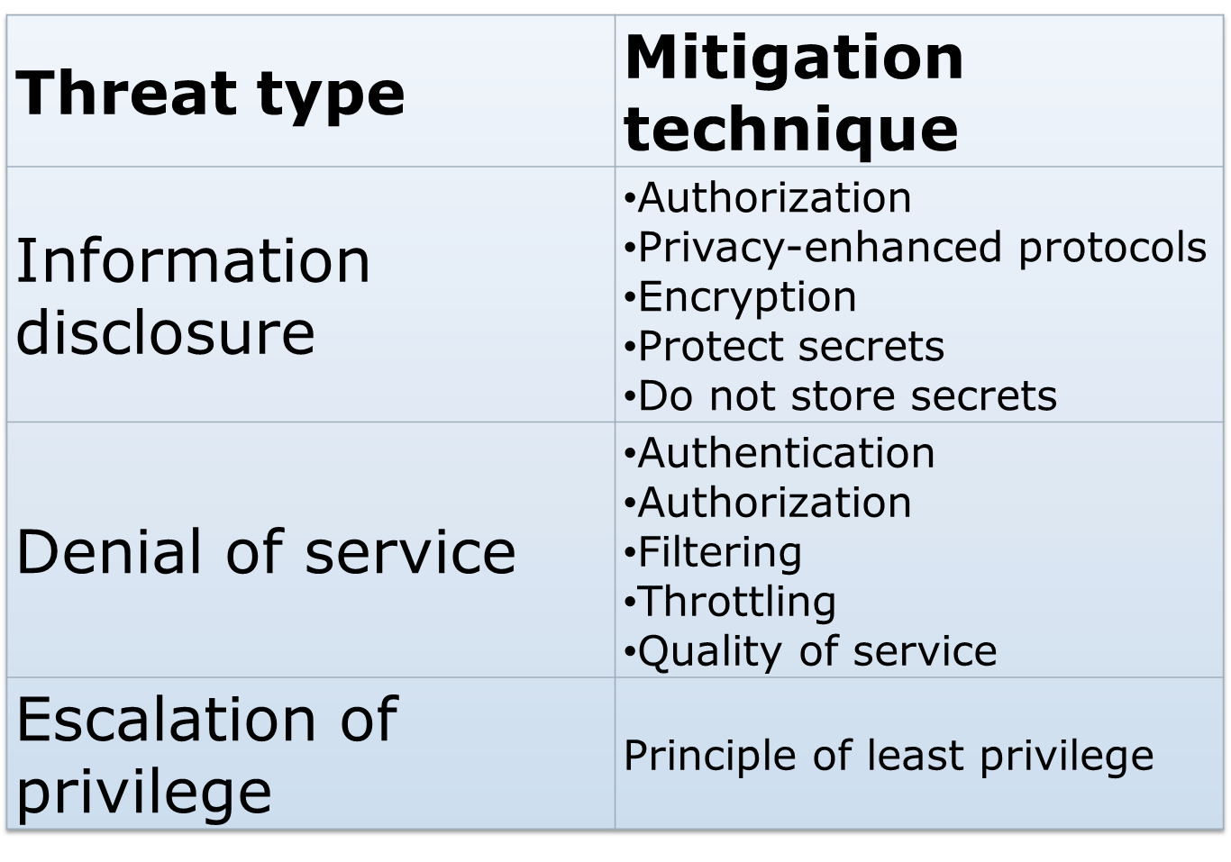
Typical threats (contd.)

Slide 25
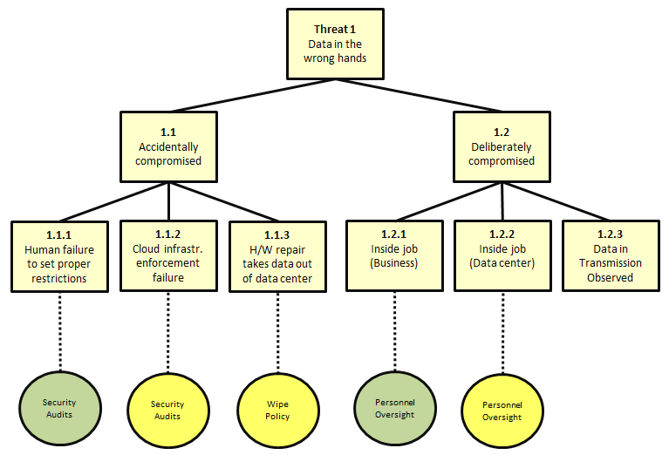
Threat tree: a thread analysis and modeling method

