Slide 1
Cloud Computing
Using AWS
Keke Chen

Slide 2
Outline
Using EC2
  Preparation
  Use web console
  Use aws command line tools
  Use boto
Using S3
  Use boto

Slide 3
Preparation
Sign up for AWS
  New users can use the “free-tier”
  Need credit card
  Make sure you shutdown instances after you finish experiments

Slide 4
Methods for accessing EC2
  Web console
  Command line tools
  boto python library

Slide 5

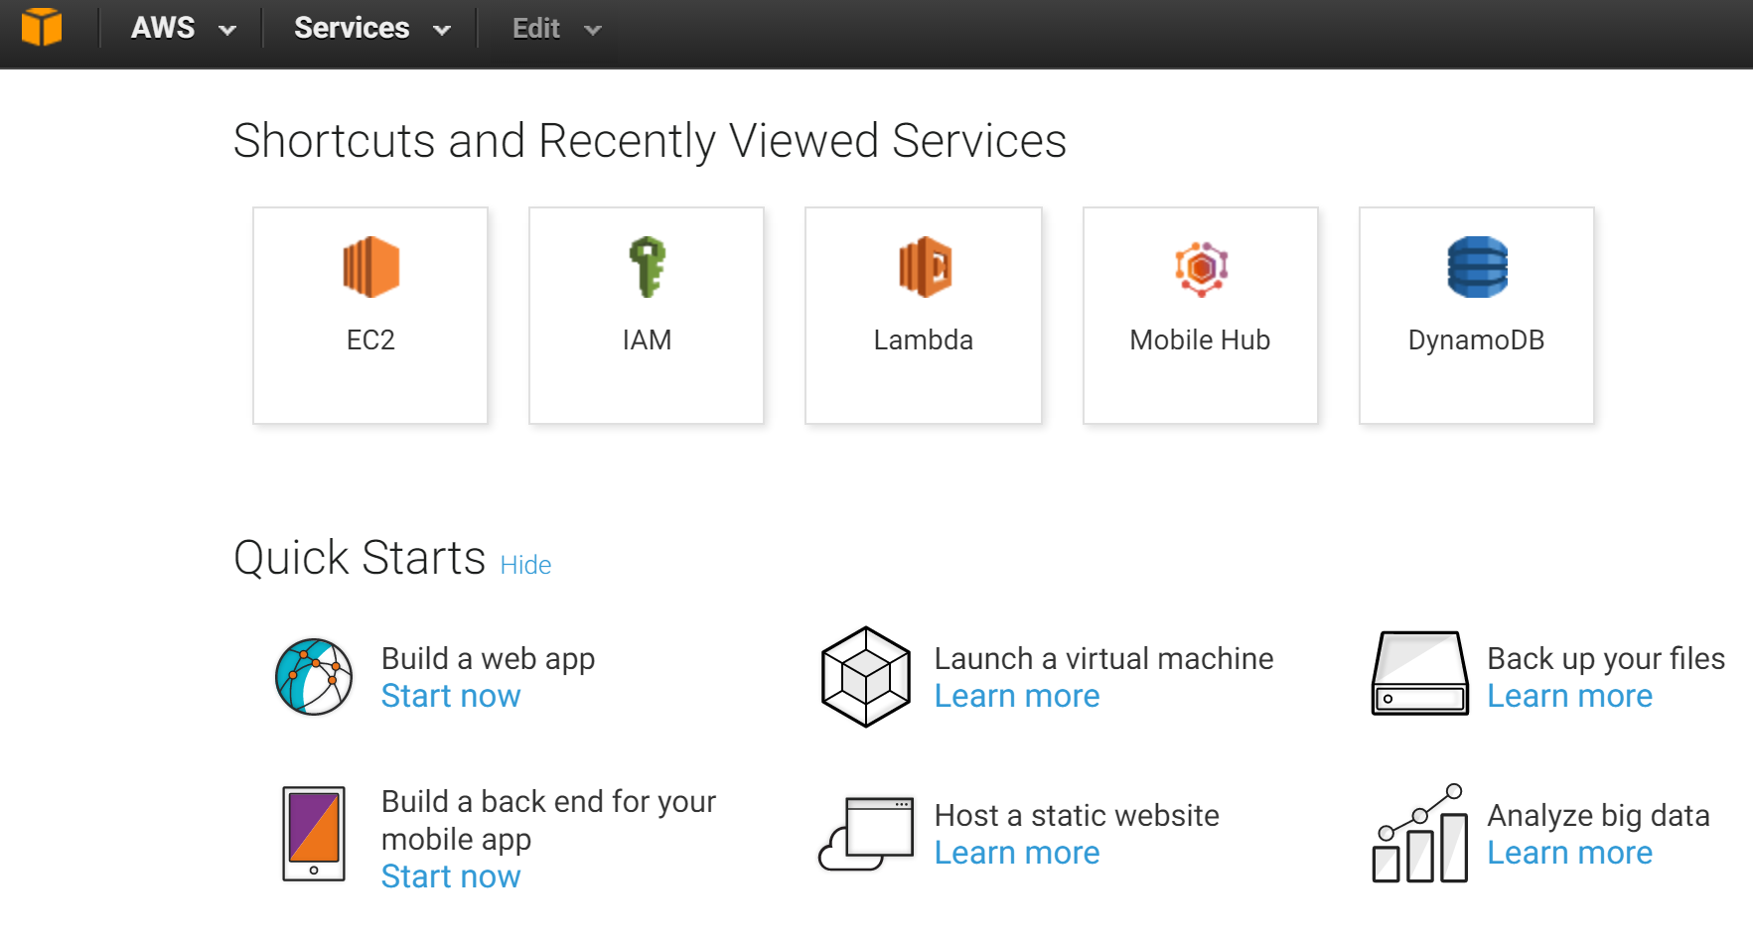
Web console

Slide 6
Methods for accessing EC2
  Web console
  Command line tools
  boto python library

Slide 7
preparation
If you haven’t installed “pip” install it: sudo apt-get install python-pip
Install aws commandline tool:
sudo pip install awscli
Check the usage of “aws”: aws help
Configure aws
keke@ubuntu:~$ aws configure
AWS Access Key ID [None]: XXXXXXXX
AWS Secret Access Key [None]: XXXXXXXX
Default region name [None]: us-east-1
Default output format [None]: json

Slide 8
preparation
1. The AWS credentials file – located at ~/.aws/credentials on Linux, OS X, or Unix, or atC:\Users\USERNAME \.aws\credentials on Windows. This file can contain multiple named profiles in addition to a default profile.
2.The CLI configuration file – typically located at ~/.aws/config on Linux, OS X, or Unix, or atC:\Users\USERNAME \.aws\config on Windows. This file can contain a default profile, named profiles, and CLI specific configuration parameters for each.

Slide 9
Preparation (skip)
Optional: Setup env variables, or put them in .profile or .bashrc
$ export AWS_ACCESS_KEY_ID=Your_key_id
$ export AWS_SECRET_ACCESS_KEY=your_secret_key
$ export AWS_DEFAULT_REGION=us-east-1

Slide 10
preparation
Create a security group
  A virtual firewall that you can define the access rules
  Use the command “aws ec2 create-security-group”
  Allow ssh access
>aws ec2 create-security-group --group-name \ mysg --description "My security group"
>aws ec2 authorize-security-group-ingress \
--group-name mysg --protocol tcp --port 22 --cidr 0.0.0.0/0

Slide 11
preparation
Create a keypair
  mykey.pem will be your private key for accessing the instances
>aws ec2 create-key-pair --key-name mykey \
--query 'KeyMaterial‘ --output text > mykey.pem
>chmod 400 mykey.pem

Slide 12
Ready to start!
Ami-cd0f5cb6 is a free-tier ubuntu. You can find other free-tier images, too
The free-tier Ubuntu image
aws ec2 run-instances --image-id ami-cd0f5cb6
--security-group-ids sg-xxxx --count 1
--instance-type t2.micro --key-name mykey
--subnet-id subnet-xxxxx
Find your sg id
aws ec2 describe-security-groups
Ignore it, then use the “default”
It appears the free tier
Instance run in the EC2-VPC
Mode. You will need the subnet-id
find it from the web “dashboard”
Use “aws ec2 describe-instances” to check the instance status and
information

Slide 13
keke@ubuntu:~$ aws ec2 describe-instances --instance-id i-0ba55e94f545cb293 --output text
RESERVATIONS 720301998817 r-00fff697944b7ce23
INSTANCES 0 x86_64 False xen ami-2d39803a i-0ba55e94f545cb293 t2.micro kchen 2016-10-21T03:14:16.000Z ip-172-31-57-62.ec2.internal 172.31.57.62 ec2-54-152-44-32.compute-1.amazonaws.com 54.152.44.32 /dev/sda1 ebs True subnet-6e61b543 hvm vpc-b8b3b0df
BLOCKDEVICEMAPPINGS /dev/sda1
EBS 2016-10-21T03:14:18.000Z True attached vol-04b2506c63d9a9e38
MONITORING disabled
NETWORKINTERFACES 12:28:fc:41:5f:0c eni-f64bb80a 720301998817 ip-172-31-57-62.ec2.internal 172.31.57.62 True in-use subnet-6e61b543 vpc-b8b3b0df
ASSOCIATION amazon ec2-54-152-44-32.compute-1.amazonaws.com 54.152.44.32
ATTACHMENT 2016-10-21T03:14:16.000Z eni-attach-86e6bc37 True 0 attached
GROUPS sg-0a9e8170 mysg2
PRIVATEIPADDRESSES True ip-172-31-57-62.ec2.internal 172.31.57.62
ASSOCIATION amazon ec2-54-152-44-32.compute-1.amazonaws.com 54.152.44.32
PLACEMENT us-east-1a default
SECURITYGROUPS sg-0a9e8170 mysg2
STATE 16 running

Slide 14
Connect to the instance
> ssh –i your_pem_file ubuntu@public_ip_address

Slide 15
Clean up
Terminate the instance
keke@ubuntu:~$ aws ec2 terminate-instances --instance-ids i-0ba55e94f545cb293
{
"TerminatingInstances": [
{
"InstanceId": "i-0ba55e94f545cb293",
"CurrentState": {
"Code": 32,
"Name": "shutting-down"
},
"PreviousState": {
"Code": 16,
"Name": "running"
}
}
]
}

Slide 16
Boto library
Install
sudo pip install boto3
*Boto3 will use aws commandline’s configuration
Recommend to use “ipython” that has nice syntax color and can show command hints if you forget the command
sudo pip install ipython

Slide 17
Use boto to access EC2
Create ec2 resource
>Import boto3
>ec2 = boto3.resource('ec2')
Create instance
>ec2.create_instances(ImageId='ami-2d39803a', \
InstanceType='t2.micro', MaxCount=1, MinCount=1, KeyName='kchen')
Check status
> for i in ec2.instances.all(): print i.id, i.state
i-0ba55e94f545cb293 {u'Code': 48, u'Name': 'terminated'}
i-088a18335ecebac14 {u'Code': 16, u'Name': 'running'}
i-038d212ac85205ee4 {u'Code': 0, u'Name': 'pending'}

Slide 18
Retrieve information of instance
> ins=ec2.Instance(id='i-088a18335ecebac14')
Recommend to use “ipython” that can show all items you can access

Slide 19
Terminate instances
> ins.terminate()
Terminate all
> for i in ec2.instances.all(): i.terminate()

Slide 20
S3 – quick review
Objects are organized in a two-level directory
  Bucket
    container of objects
    Global unique name
  Key
    Like file names
    Unique in the same bucket
  Object
    Indexed by (bucket, key)
    http://bucket.s3.amazonaws.com/key

Slide 21
Use S3
Web console
CLI
APIs

Slide 22
S3 CLI
Check “aws s3 help” for details
S3Uri: s3://mybucket/mykey
Bucket operations
  aws s3 mb mybucket
  aws s3 rb mybucket
  aws s3 sync local_directory s3://mybucket/
  aws s3 ls mybucket
File operations
  aws s3 cp local_dir s3Uri
  or s3Uri local_dir or s3Uri1 s3Uri2
  aws s3 mv has a similar syntax
  aws s3 rm s3Uri

Slide 23
S3 APIs
Language | API Style | Tools
Java | REST | Java compiler and runtime that supports JDK 1.4.2 or later.
C# | REST | A C# compiler and runtime environment that supports .Net Version 2.0 (e.g., Visual C# 2005 or 2008 Express Edition).
Perl | REST | Perl 5 with CPAN Digest::SHA1, Bundle::LWP, and XML::Simple modules (go to http://www.perl.org and http://www.cpan.org).
PHP | REST | The PHP example uses the base installation of PHP5.
Python | REST | Boto3

Slide 24
Get resource
>s3= boto3.resource(‘s3’)

Slide 25
Create bucket
s3.create_bucket(Bucket='mybucket')
Or with more configuration
s3.create_bucket(Bucket='mybucket', \
CreateBucketConfiguration={ 'LocationConstraint': 'us-east-1'})

Slide 26
Store data
> s3.Object('mybucket', 'hello.txt')\
.put(Body=open('/tmp/hello.txt', 'rb'))

Slide 27
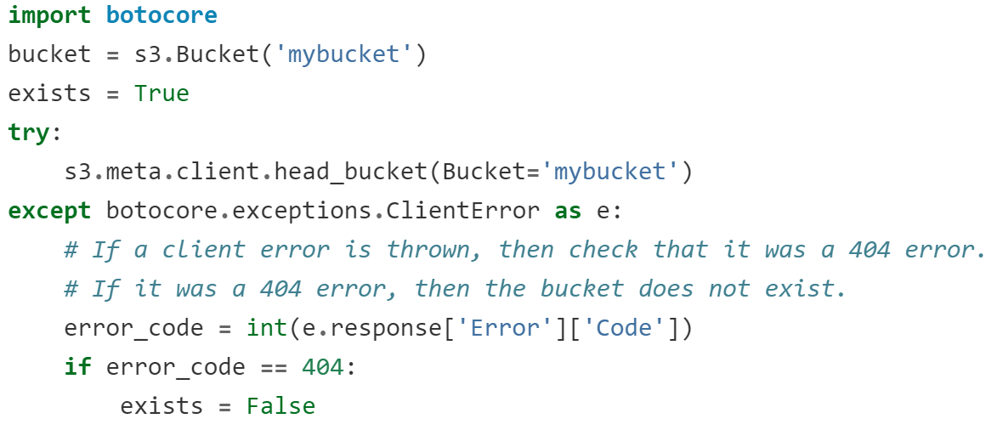
Validating bucket before accessing it

Slide 28
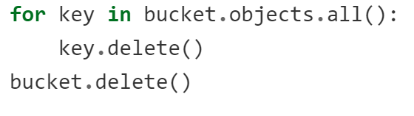
Delete bucket

Slide 29
Access control
bucket.Acl().put(ACL='public-read')
obj.Acl().put(ACL='public-read')
Check grants
acl = bucket.Acl()
for grant in acl.grants:
print(grant['Grantee']['DisplayName'], grant['Permission'])
Individual grant
bucket.Acl.put(GrantRead='emailAddress=user@domain.tld')

Slide 30
Key metadata
key.put(Metadata={'meta1': 'This is my metadata value'})
print(key.metadata['meta1'])

