Slide 1
Virtualization

Slide 2
concepts
Virtualization deals with “extending or replacing an existing interface so as to mimic the behavior of another system”
Virtual system examples: virtual private network, virtual memory, virtual machine

Slide 3
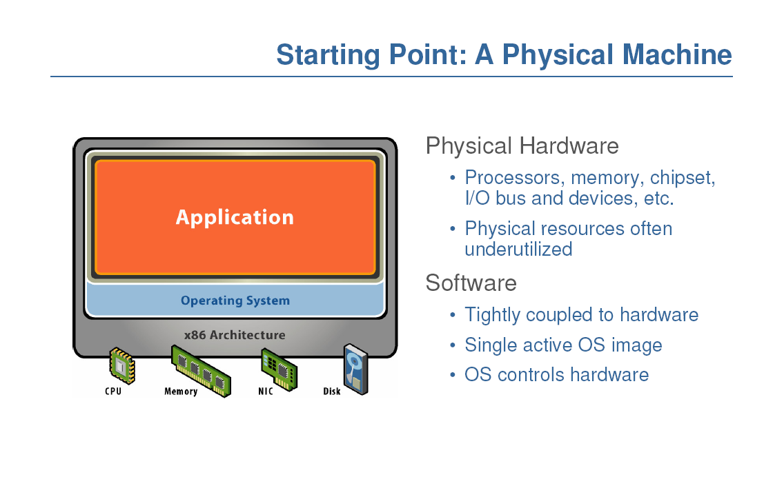

Slide 4
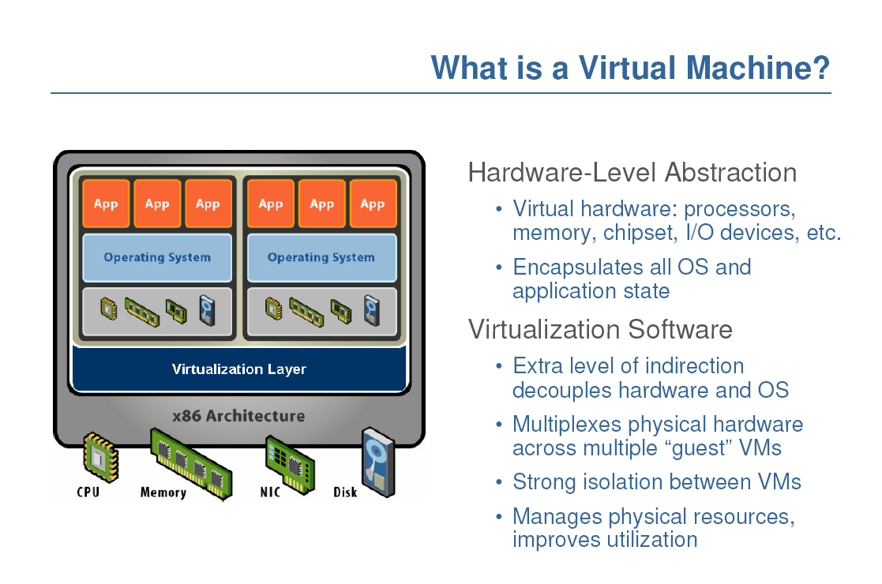

Slide 5
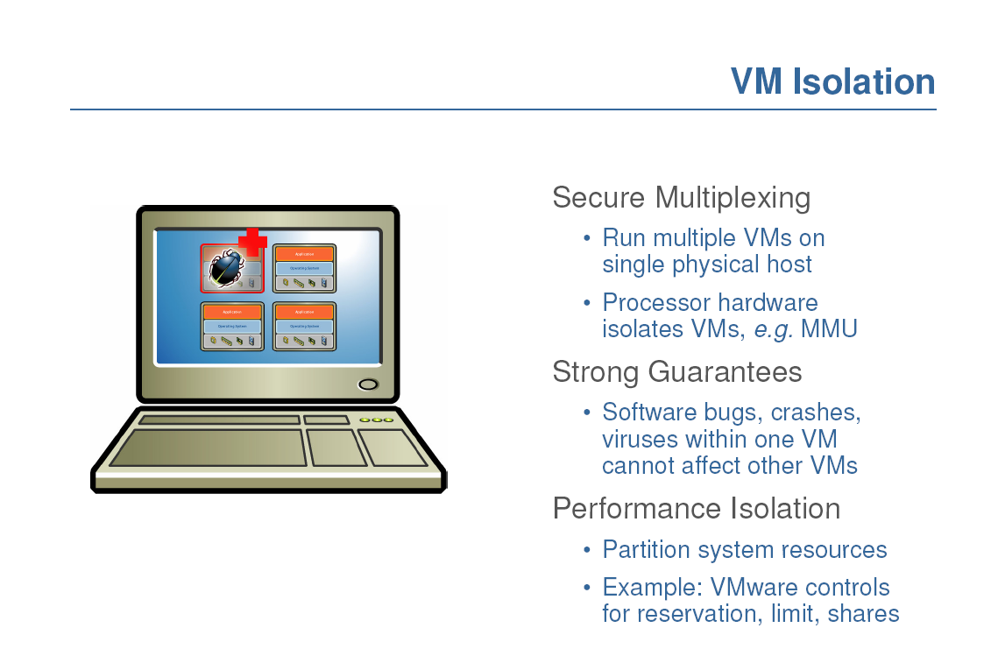

Slide 6
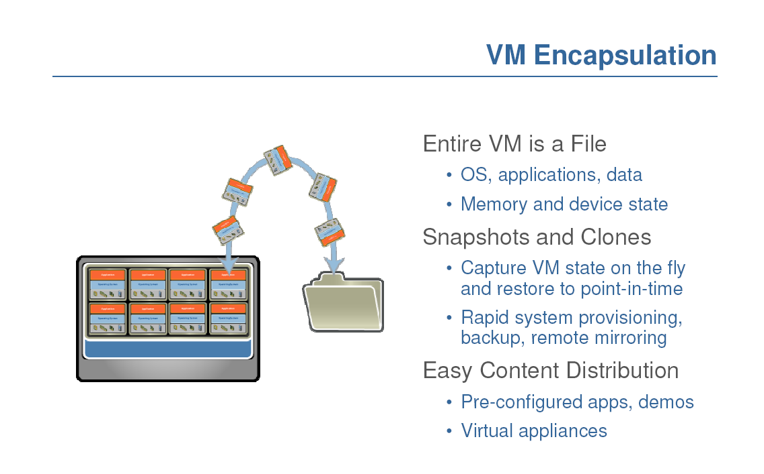

Slide 7
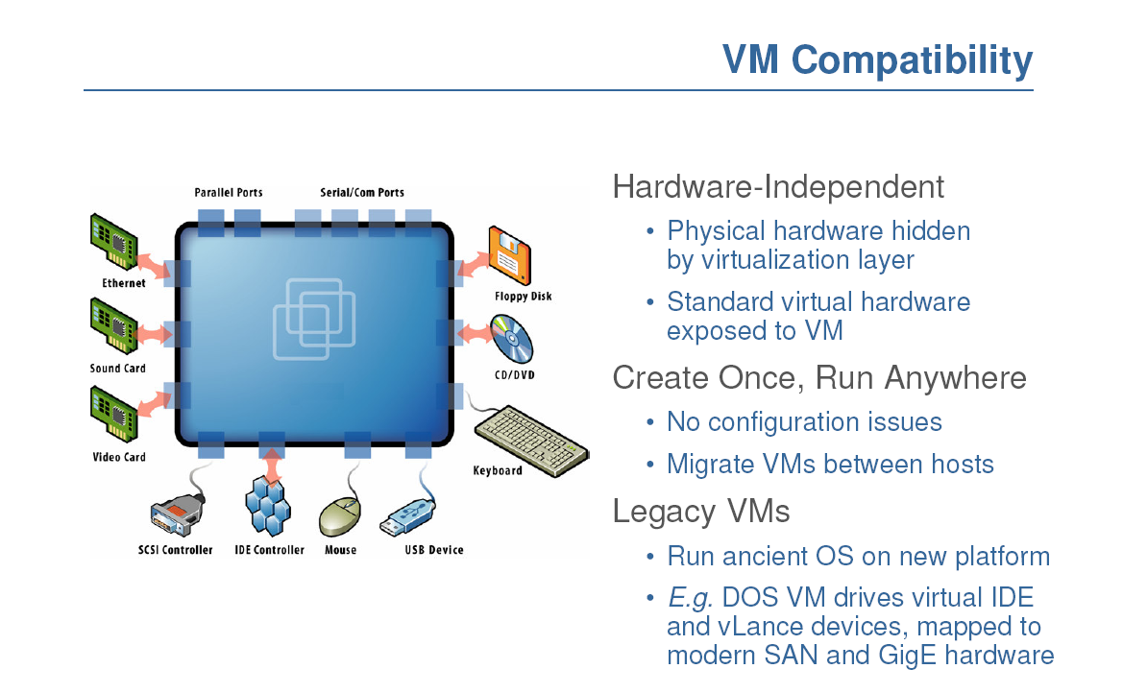
Notes:
Hardware and low-level systems software change quickly
High-level software (middleware, applications) changes more slowly

Slide 8
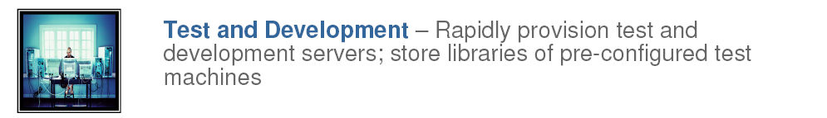
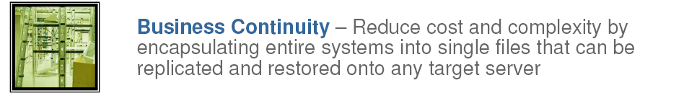
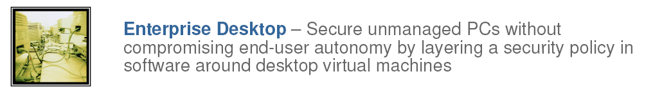

Slide 9
Run legacy software on non-legacy hardware
Run multiple operating systems on the same hardware
Create a manageable upgrade path
Manage outages (expected and unexpected) dynamically

Slide 10
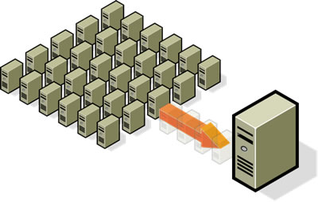
In data center
Reduce costs by consolidating services onto the fewest number of physical machines
http://www.vmware.com/img/serverconsolidation.jpg

Slide 11

Non-virtualized Data Centers
Too many servers for too little work
High costs and infrastructure needs
Maintenance
Networking
Floor space
Cooling
Power
Disaster Recovery

Slide 12
Dynamic Data Center
Virtualization helps us break the “one service per server” model
Consolidate many services into a fewer number of machines when workload is low, reducing costs
Conversely, as demand for a particular service increases, we can shift more virtual machines to run that service
We can build a data center with fewer total resources, since resources are used as needed instead of being dedicated to single services
Notes:
Or sitting and waiting until the next spike in demand

Slide 13
VM workload multiplexing
Separate VM sizing
VM multiplexing
s₃
s₂
s₁
We expect s₃ < s₁ + s_{2.} Benefit of multiplexing !
Multiplex VMs’ workload on same physical server
Aggregate multiple workload. Estimate total capacity need based on aggregated workload
Performance level of each VM be preserved

Slide 14
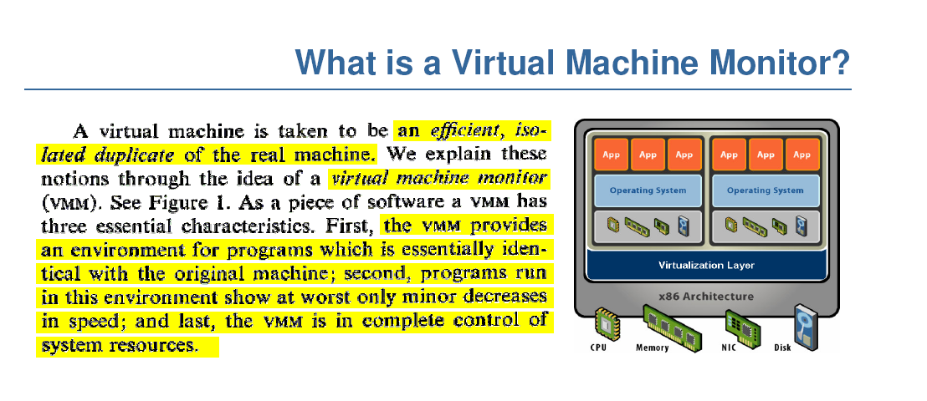
So, it is just like Java VM, right?

Slide 16
History
Introduced by IBM in the 1960s
To boost utilization of large, expensive mainframe systems
Gave away to C/S in 80s and 90s
Become hot again
Servers are cheap and powerful
Become the key component of cloud computing

Slide 17
Basic concepts
Virtualize resources
CPU
Memory
Network
Disk
Key: the layer between hardware and guest OSs – hypervisor software
Partitioning, isolating, and scheduling resources between guest Oss

Slide 18
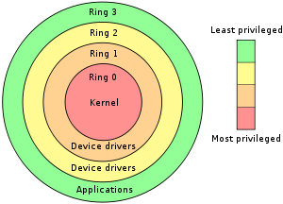
Preliminary (normal OS)
Protection rings
APPS
User space (lower privilege: ring 3)
System call/ trap
Kernel space (high privilege: ring 0)
Have rights to access some special CPU instructions
OS
(supervisor mode)
interrupt
Hardware

Slide 19
x86 virtualization
APPS
User space (ring 3)
System call/ trap
Privilege (ring 1/2)
Have rights to access some special instructions
OS (VM)
Hypervisor
Privilege: ring 0
Have rights to access
some special instructions
interrupt
Hardware

Slide 20
Virtualization Approaches
Container-based virtualization*
Full Virtualization
Paravirtualization
Hardware-assisted Virtualization

Slide 21
Container virtualization
vm1
vm2
Vm_k
User space (ring 3)
OS
Hardware

Slide 22
Container virtualization
User-space virtual machines
All guests share the same filesystem tree.
Same kernel on all virtual machines
Unprivileged VMs can’t mount drives or change network settings
Provide extra-level of security
Native Speeds, no emulation overhead
OpenVZ, Virtuozzo, Solaris Containers, FreeBSD Jails, Linux-Vserver

Slide 23
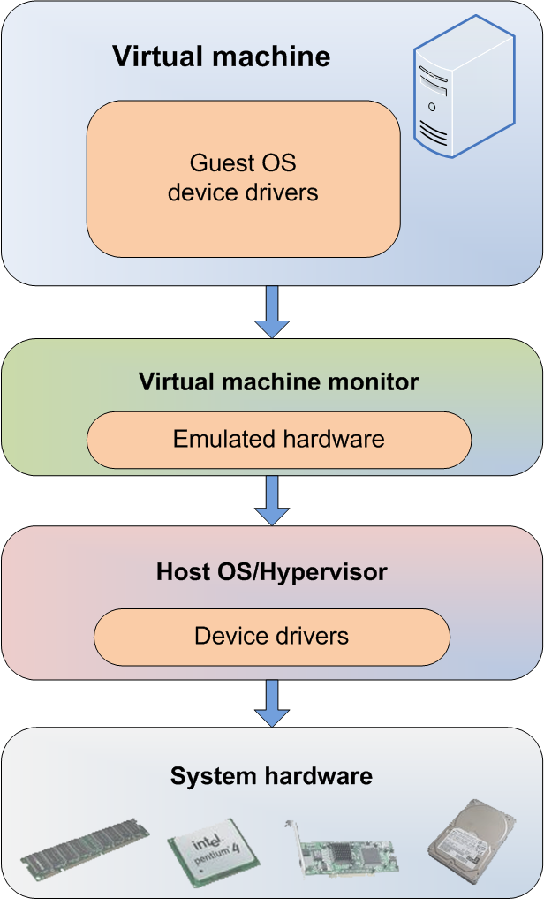
Full Virtualization
Everything is virtualized
Full hardware emulation
Emulation = latency

Slide 24
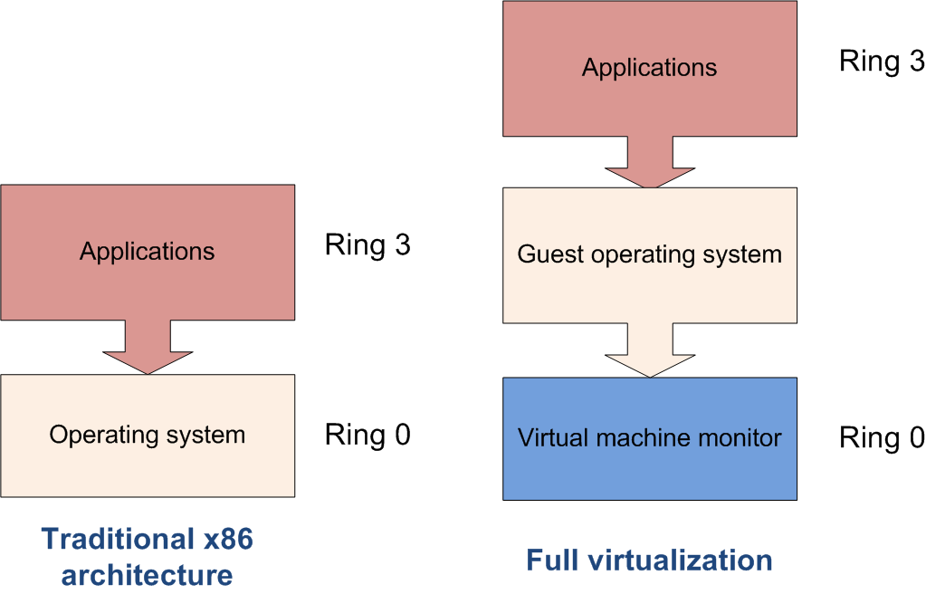
Privileged Instructions
Privileged instructions: OS kernel and device driver access to system hardware
Trapped and emulated by VMM
Notes:
http://en.wikipedia.org/wiki/Ring_%28computer_security%29
Privilege rings for the x86 available in protected mode
Microsoft's Ring-1 design structure as part of their NGSCB initiative and hypervisors embedded in firmware such as Intel VT-x (formerly Vanderpool).

Slide 25
Full virtualization
Runs unmodified guests
Simulates bios, communicates with VMs through ACPI emulation, BIOS emulation, sometimes custom drivers
Guests cannot access hardware
Generally worst performance, but often acceptable
VMWare, Xen HVM, KVM, Microsoft VM, Parallels, virtualbox

Slide 26
Pros and Cons – Full Virtualization
Pros
Disaster recovery, failover
Virtual appliance deployment
Legacy code on non-legacy hardware
Cons – LATENCY of core resources
RAM performance reduced 25% to 75%
Disk I/O degraded from 5% to 20%
Network performance decreased up to 10%
CPU privileged instruction dings nearing 1% to 7%

Slide 27
Paravirtualization
vm1
vm2
User space (ring 3)
vmk
hypervisor
monitor
OS
Hardware

Slide 28
Paravirtualization
Do not try to emulate everything
Work as a guard
Pass safe instructions directly to CPU and device
Guests have some exposure to the hardware
Better performance
Need to slightly modify guest OS, but no need to modify applications
Xen, Sun Logical Domains

Slide 29
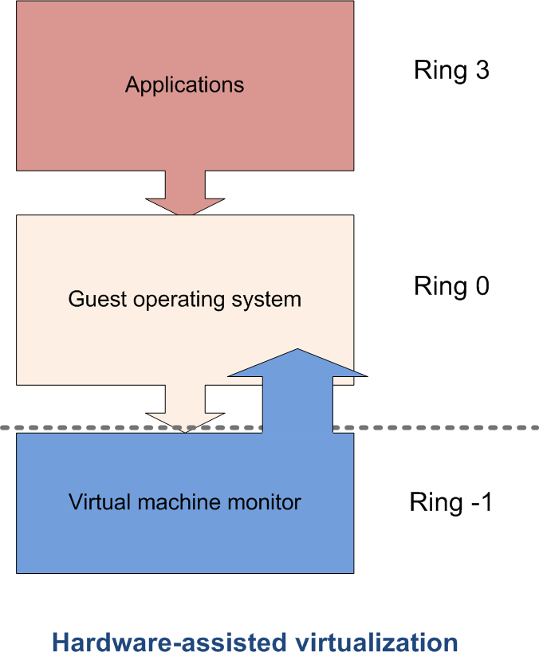
Hardware-assisted Virtualization
Server hardware is virtualization aware
Hypervisor and VMM load at privilege Ring -1 (firmware)
Removes CPU emulation bottleneck
Memory virtualization coming in quad core AMD and Intel CPUs (VT-x)

Slide 30
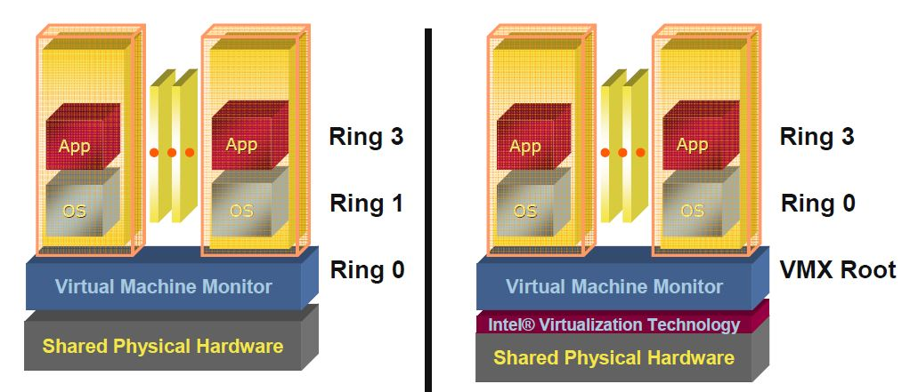
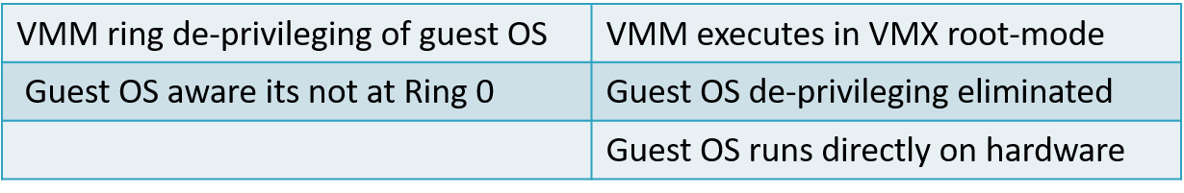
Pre VT-x Pre VT-x Post VT-x
30

Slide 31







Evolution of Software solutions*
1st Generation: Full virtualization (Binary rewriting)
Software Based
VMware and Microsoft
2nd Generation: Paravirtualization
Cooperative virtualization
Modified guest
VMware, Xen
3rd Generation: Silicon-based (Hardware-assisted) virtualization
Unmodified guest
VMware and Xen on virtualization-aware hardware platforms
Virtual
Machine
Virtual
Machine
…
Dynamic Translation
VM
…
VM
Virtual
Machine
Virtual
Machine
Hypervisor
…
Operating System
Hypervisor
Hardware
Hardware
Hardware
Time
Virtualization Logic
*This slide is from Intel® Corporation

Slide 32
Sample architecture - Xen
paravirtualization
http://www.cl.cam.ac.uk/research/srg/netos/papers/2003-xensosp.pdf

Slide 33
Components
Domain 0: hyperviser
Modified GuestOS: e.g., XenoLinux, XenoXp

Slide 34
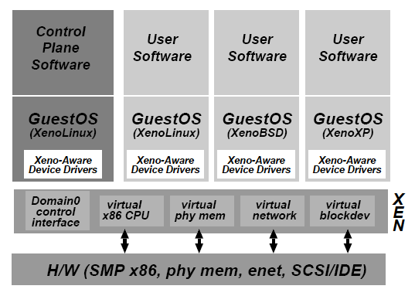
System architecture

Slide 35
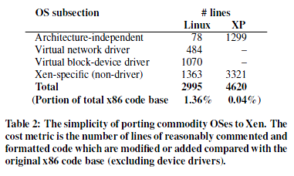
Cost of porting a guest OS to Xen
Linux kernel 2.4

Slide 36
Xen: performance evaluation (in the 2003 paper)
Hardware
Dell 2650 dual processor
2.4 GHz Xeon server
2GB RAM
3 Gb Ethernet NIC
1 Hitachi DK32eJ 146 GB 10k RPM SCSI disk
Linux 2.4.21 (native)

Slide 37
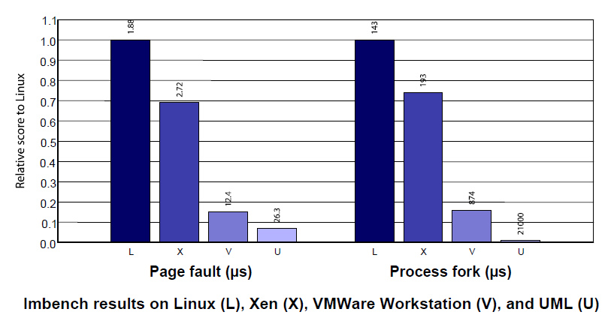
MMU (memory management) performance

Slide 38
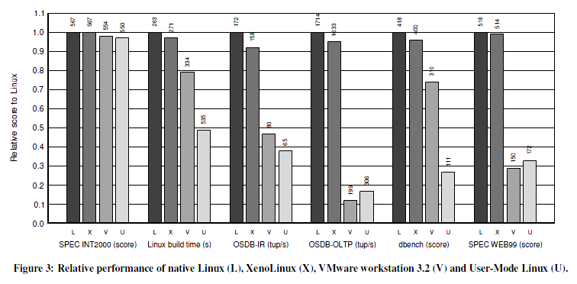
Various benchmarks

Slide 39
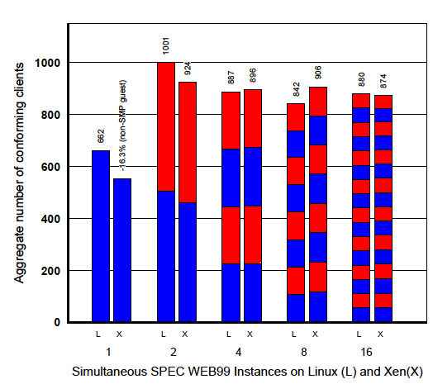
Concurrent virtual machines
Multiple Apache processes in Linux
vs.
One Apache process in each guest OS
*Higher values are better
Requires both high throughput
and bounded latency

Slide 40
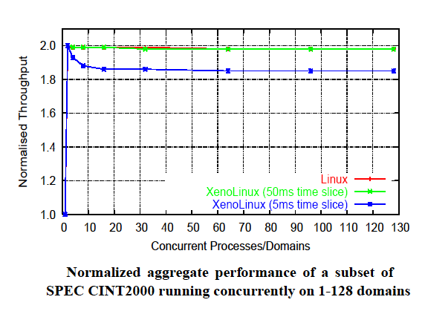
Performance

Slide 41
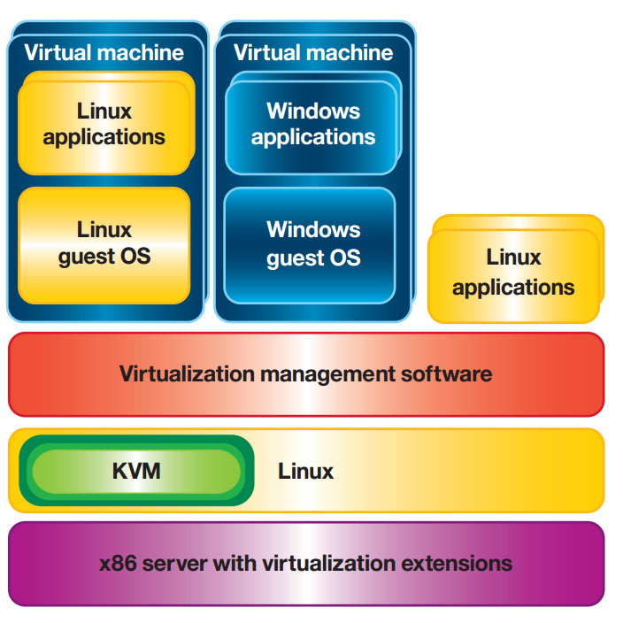
Other recent developments
Kernel based virtual machine (KVM)
A part of the linux kernel (vs. Xen as a standalone hypervisor), loaded as a module
KVM turns the Linux kernel into a bare-metal hypervisor, creating virtual machines as Linux processes (in the new “guest mode” (traditionally, only the kernel+user modes)

Slide 42
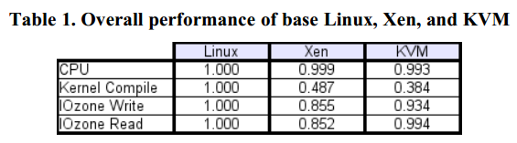
Performance evaluation (2008)

Slide 43
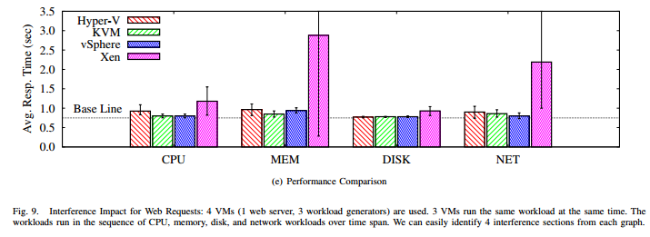
2013

Slide 44
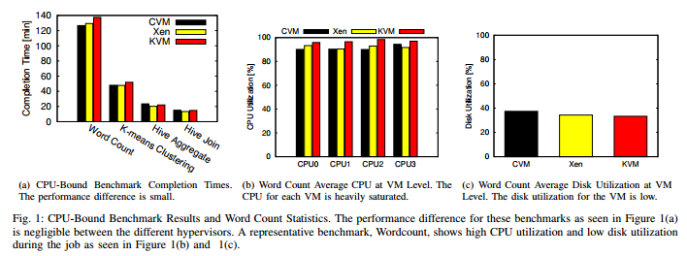
Hadoop workloads (2013)

