Slide 1
Cloud Computing
Web Services

Slide 2
outline
Web service protocols: SOAP and related protocols
REST web service

Slide 3
Web server vs. web services
Web server implements the HTTP request-response protocol
Web services are service interfaces defined with certain standards
  Similar to RPC
  May/may not be provided by web servers

Slide 4
Recall the basic request-response protocol
Message definition
  WS uses XML and the SOAP protocol
Operations -> services
  Service description (with WSDL)
  Similar idea to interface-based programming, and RPC stubs
New stuffs
  Allow client to find/discover services

Slide 5
SOAP
How XML is to be used to represent the contents
How a pair of single messages can be combined to produce request/reply
How the recipients of message should process the XML elements
How the underlying protocols are used to communicate SOAP messages.
Developed from XML-RPC

Slide 6
SOAP message
“envelop”: Header + body
Programmers do not normally need to be concerned. SOAP APIs have been implemented in many programming languages
envelope
header
header element
header element
body
body element
body element

Slide 7
SOAP example
Without header
env:envelope
xmlns:env =namespace URI for SOAP envelopes
env:body
m:exchange
xmlns:m = namespace URI of the service description
m:arg1
m:arg2
Hello
World

Slide 8
Reliably SOAP message delivery: WS-ReliableMessaging
  Provide semantics
    At-least-once
    At-most-once
    Exactly-once
  Message ordering
    In-order

Slide 9
WSDL
A type of interface description
  Contract between client and server
Main elements of WSDL
definitions
types
message
interface
bindings
services
target namespace
document style
request-reply style
how
where
abstract
concrete

Slide 10
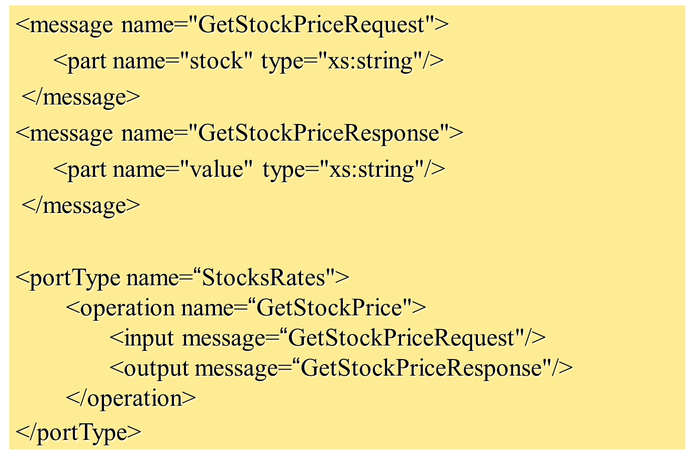
WSDL example
Relationship with SOAP
  Soap messages encode instances of the methods defined by WSDL

Slide 11
SOAP messages for the WSDL example
Request message
<?xml version="1.0"?>
<soap:Envelope
xmlns:soap="http://www.w3.org/2001/12/soap-envelope"
soap:encodingStyle="http://www.w3.org/2001/12/soap-encoding">
<soap:Body xmlns:m="http://www.example.org/stock">
<m:GetStockPriceRequest>
<m:Stock>IBM</m:Stock>
</m:GetStockPriceRequest>
</soap:Body>
</soap:Envelope>

Slide 12
Response message
<?xml version="1.0"?>
<soap:Envelope
xmlns:soap="http://www.w3.org/2001/12/soap-envelope"
soap:encodingStyle="http://www.w3.org/2001/12/soap-encoding">
<soap:Body xmlns:m="http://www.example.org/stock">
<m:GetStockPriceResponse>
<m:Value>150.00</m:Value>
</m:GetStockPriceResponce>
</soap:Body>
</soap:Envelope>

Slide 13
WS discovery
Universal Description Discovery and Integration service (UDDI)
  Data structures
  Lookup
  Publication
  Registries

Slide 14

UDDI data structure
businessEntity
businessServices
human readable
businessServices
information
about the publisher
businessServices
bindingTemplate
human readable
bindingTemplate
information
URL
about a
bindingTemplate
tModel
family of services
information
about the
tModel
service interfaces
URL
service interfaces
tModel
key
URL
key
service descriptions
key

Slide 15
Web Service Composition
flight booking
a
flight booking
b
Client
Travel Agent
Service
hire car booking
a
hire car booking
b
hotel booking
a
hotel booking
b

Slide 16
The travel agent example
1. The client asks the travel agent service for information about a set of services; for example, flights, car hire and hotel bookings.
2. The travel agent service collects prices and availability information and sends it to the client, which chooses one of the following on behalf of the user:
(a) refine the query, possibly involving more providers to get more information, then repeat step 2;
(b) make reservations;
(c) quit.
3. The client requests a reservation and the travel agent service checks availability.
4. Either all are available;
or for services that are not available;
either alternatives are offered to the client who goes back to step 3;
or the client goes back to step 1.
5. Take deposit.
6. Give the client a reservation number as a confirmation.
7. During the period until the final payment, the client may modify or cancel reservations

Slide 17
What is REST
REST is a term coined to describe an architecture style of networked systems. REST is an acronym standing for Representational State Transfer.

Slide 18
Rest – An architectural Style
Elements
Components – Proxy , gateway etc
Connectors – client , server etc
Data – resource , representation etc
REST
Ignores component implementation details.
Focus on roles of components,their interactions and their
interpretation of data elements.

Slide 19
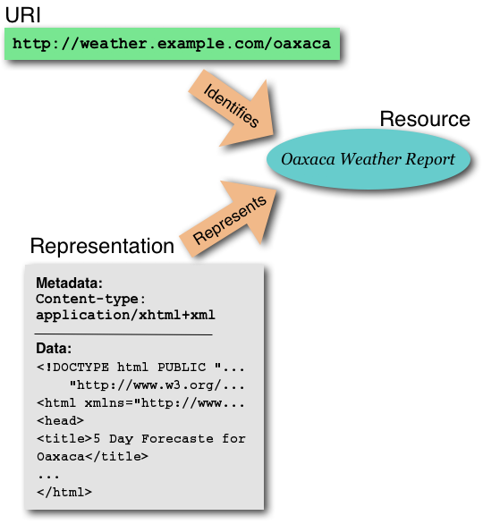
Resource
URI-Uniform Resource Identifier (or URL)
Web Page (HTML Page)

Slide 20
Why is it called Representational State Transfer ?
Client
http://weather.example.com/oaxaca
Resource
OaxacaWeather.html

Slide 21
"Representational State Transfer is intended to evoke an image of how a well-designed Web application behaves: a network of web pages (a virtual state-machine), where the user progresses through an application by selecting links (state transitions), resulting in the next page (representing the next state of the application) being transferred to the user and rendered for their use."
Roy Fielding.

Slide 22
REST - An Architectural Style of Networked System
Underlying Architectural model of the world wide web.
Guiding framework for Web protocol standards.
Numerous REST based web services

Slide 23
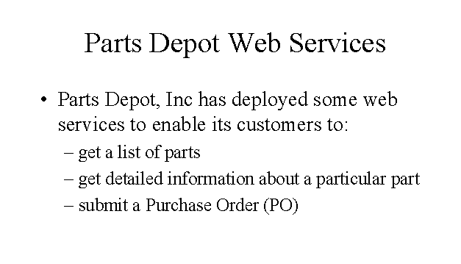
Example

Slide 24
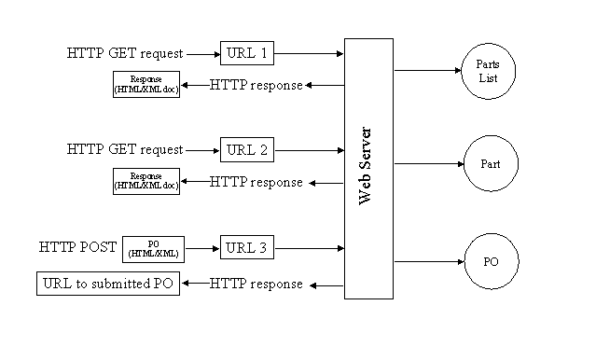
REST way of Implementing the web services

Slide 25
Service – Get parts list
The web service makes available a URL to a parts list resource
Client uses : http://www.parts-depot.com/parts
Document Client receives :
<?xml version="1.0"?>
<p:Parts xmlns:p="http://www.parts-depot.com" xmlns:xlink="http://www.w3.org/1999/xlink">
<Part id="00345" xlink:href="http://www.parts-depot.com/parts/00345"/>
<Part id="00346" xlink:href="http://www.parts-depot.com/parts/00346"/>
<Part id="00347" xlink:href="http://www.parts-depot.com/parts/00347"/>
<Part id="00348" xlink:href="http://www.parts-depot.com/parts/00348"/>
</p:Parts>

Slide 26
Service – Get detailed part data
The web service makes available a URL to each part resource.
Client uses : http://www.parts-depot.com/parts/00345
Document Client receives :
<?xml version="1.0"?>
<p:Part xmlns:p="http://www.parts-depot.com" xmlns:xlink="http://www.w3.org/1999/xlink">
<Part-ID>00345</Part-ID>
<Name>Widget-A</Name>
<Description>This part is used within the frap assembly</Description>
<Specification xlink:href="http://www.parts-depot.com/parts/00345/specification"/> <UnitCost currency="USD">0.10</UnitCost>
<Quantity>10</Quantity>
</p:Part>

Slide 27
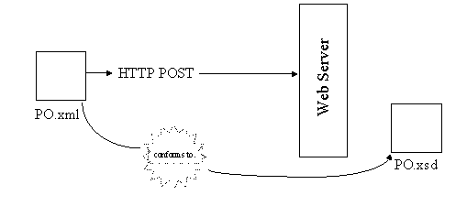
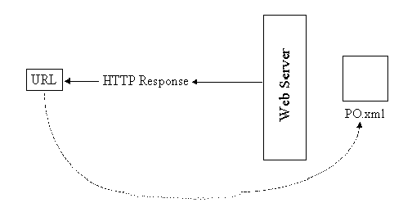
Service – Submit purchase order (PO)
The web service makes
available a URL to submit a PO.
1)The client creates a PO instance
document (PO.xml)
2)Submits the PO.xml(HTTP POST)
3)PO service reponds with a URL
to the submitted PO.

Slide 28
Characteristics of a REST based network
Client-Server: a pull-based interaction style(Client request data from servers as and when needed).
Stateless: each request from client to server must contain all the information necessary to understand the request, and cannot take advantage of any stored context on the server.
Cache: to improve network efficiency, responses must be capable of being labeled as cacheable or non-cacheable.
Uniform interface: all resources are accessed with a generic interface (e.g., HTTP GET, POST, PUT, DELETE).
Named resources - the system is comprised of resources which are named using a URL.
Interconnected resource representations - the representations of the resources are interconnected using URLs, thereby enabling a client to progress from one state to another.

Slide 29
Principles of REST web service design
1.Identify all the conceptual entities that we wish to expose as services. (Examples we saw include resources such as : parts list, detailed part data, purchase order)
2. Create a URL to each resource.
3. Categorize our resources according to whether clients can just receive a representation of the resource (using an HTTP GET), or whether clients can modify (add to) the resource using HTTP POST, PUT, and/or DELETE).
4. All resources accessible via HTTP GET should be side-effect free. That is, the resource should just return a representation of the resource. Invoking the resource should not result in modifying the resource.
5.Put hyperlinks within resource representations to enable clients to drill down for more information, and/or to obtain related information.
6. Design to reveal data gradually. Don't reveal everything in a single response document. Provide hyperlinks to obtain more details.
7. Specify the format of response data using a schema (DTD, W3C Schema, RelaxNG, or Schematron). For those services that require a POST or PUT to it, also provide a schema to specify the format of the response.
8. Describe how our services are to be invoked using either a WSDL document, or simply an HTML document.

Slide 30
Summary
REST – Is an architectural style.
It is the architectural style of the WEB
Resource
http://www.ics.uci.edu/~fielding/pubs/dissertation/rest_arch_style.htm

