Slide 1
Assignment A5a Low-Fidelity Paper Prototype Project HelpingGrads, CSCC10 2020 Summer Table of Contents 5.1 Hierarchical Task Analysis 2 5.2 Usability Testing Script 3 5.3 Low-Fidelity Paper Prototype 4 with Facilitation & Observation notes off-side, outside Slideshow

Slide 2
A5.1 Hierarchical Task Analysis

Slide 3
A5.2 Usability Testing Script
Scenario: You are a 4th year undergraduate student who is in interested in applying to graduate school, but you are not familiar with the process. You heard from a friend that there is a website that can help by providing you with resources and advice on how to prepare all the documents needed for your application such as the personal statement, resume and letters of recommendation. You decide to check out the website.
Can you show me how you would do the following tasks using this app:
1. One required document for your application is a personal statement or a letter of intent. However, you are not sure how to write one and you want to learn. How would you go about finding the information you need using this prototype?
2. After learning how to write a personal statement, you have finally finished writing your own and would like someone to edit it. Due to the COVID-19 pandemic you can’t go to the writing center at school. How could you get help with this using the prototype?
3. You got your personal statement edited, completed a final draft, and submitted your application. Now you would like to help others you are struggling through the application process. What would you do to achieve this using the prototype?
Please think aloud as you interact with the paper prototype.

Slide 4
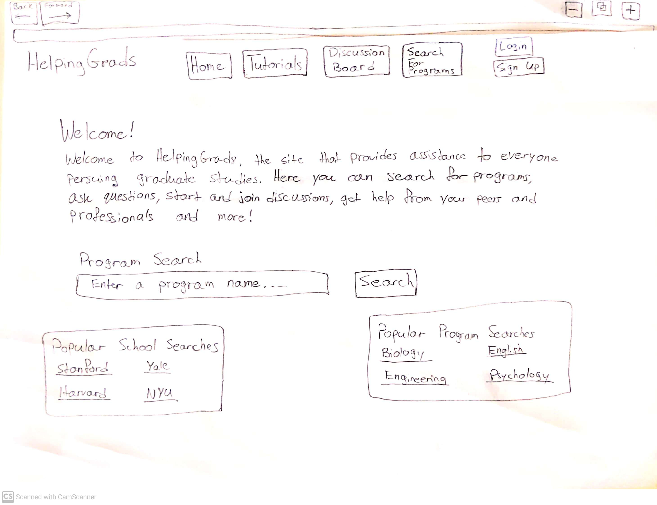
A5.3 Low-Fidelity Paper Prototype
Task 1. One required document for your application is a personal statement or a letter of intent. However, you are not sure how to write one and you want to learn. How would you go about finding the information you need using this prototype?
EXPECTED USER ACTION
Click [Blogs]
OBSERVED ACTION
Clicked on forum
Clicked
USER QUOTES
Sees navigation bar and different bars
DESIGN IMPLICATIONS for A5b Results
Notes:
Blogs button should have a different title.
Wording of task

Slide 5
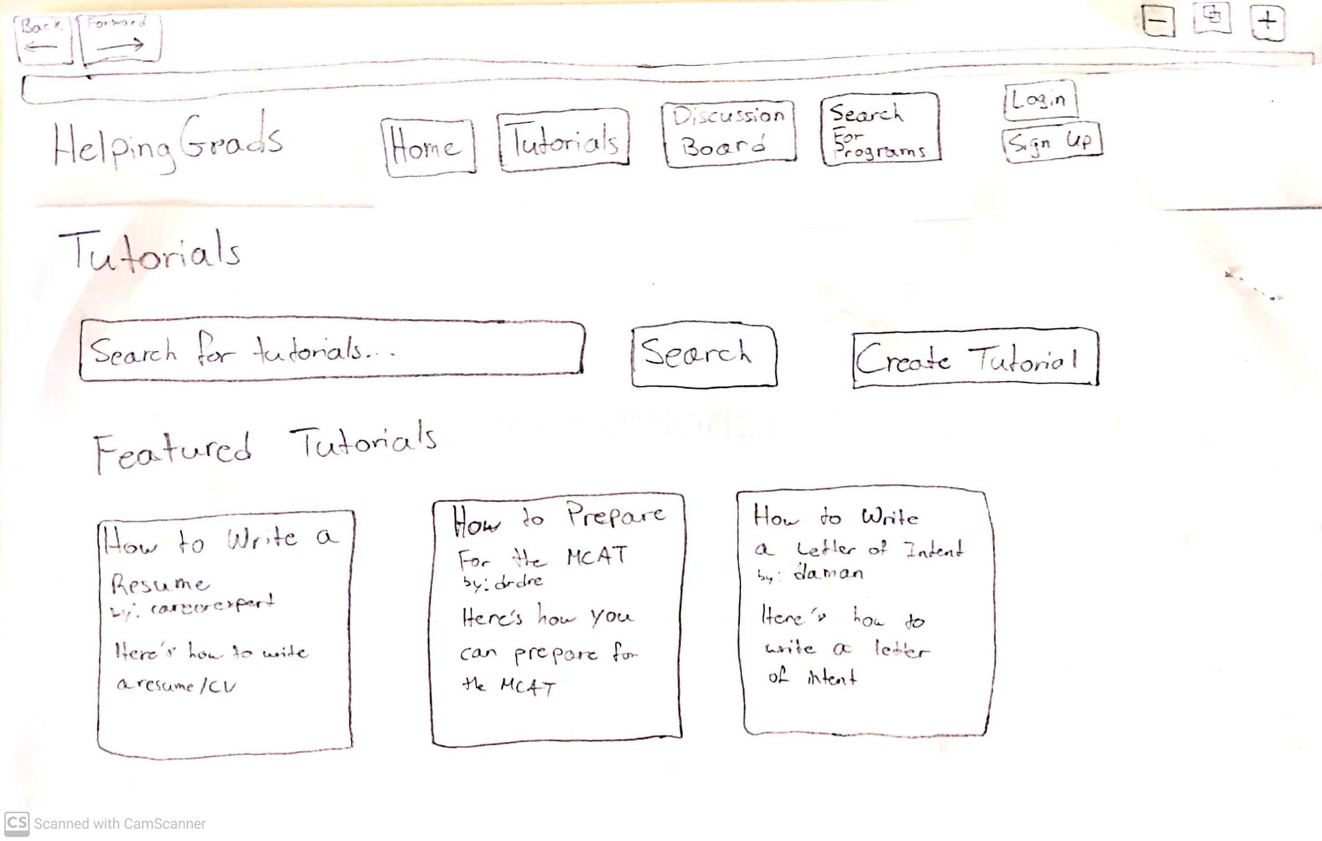
EXPECTED USER ACTION
Enter a search along the lines of [How to write a personal statement]
Click [SEARCH]
OBSERVED ACTION
USER QUOTES
DESIGN IMPLICATIONS for A5b Results
Task 1. One required document for your application is a personal statement or a letter of intent. However, you are not sure how to write one and you want to learn. How would you go about finding the information you need using this prototype?

Slide 6
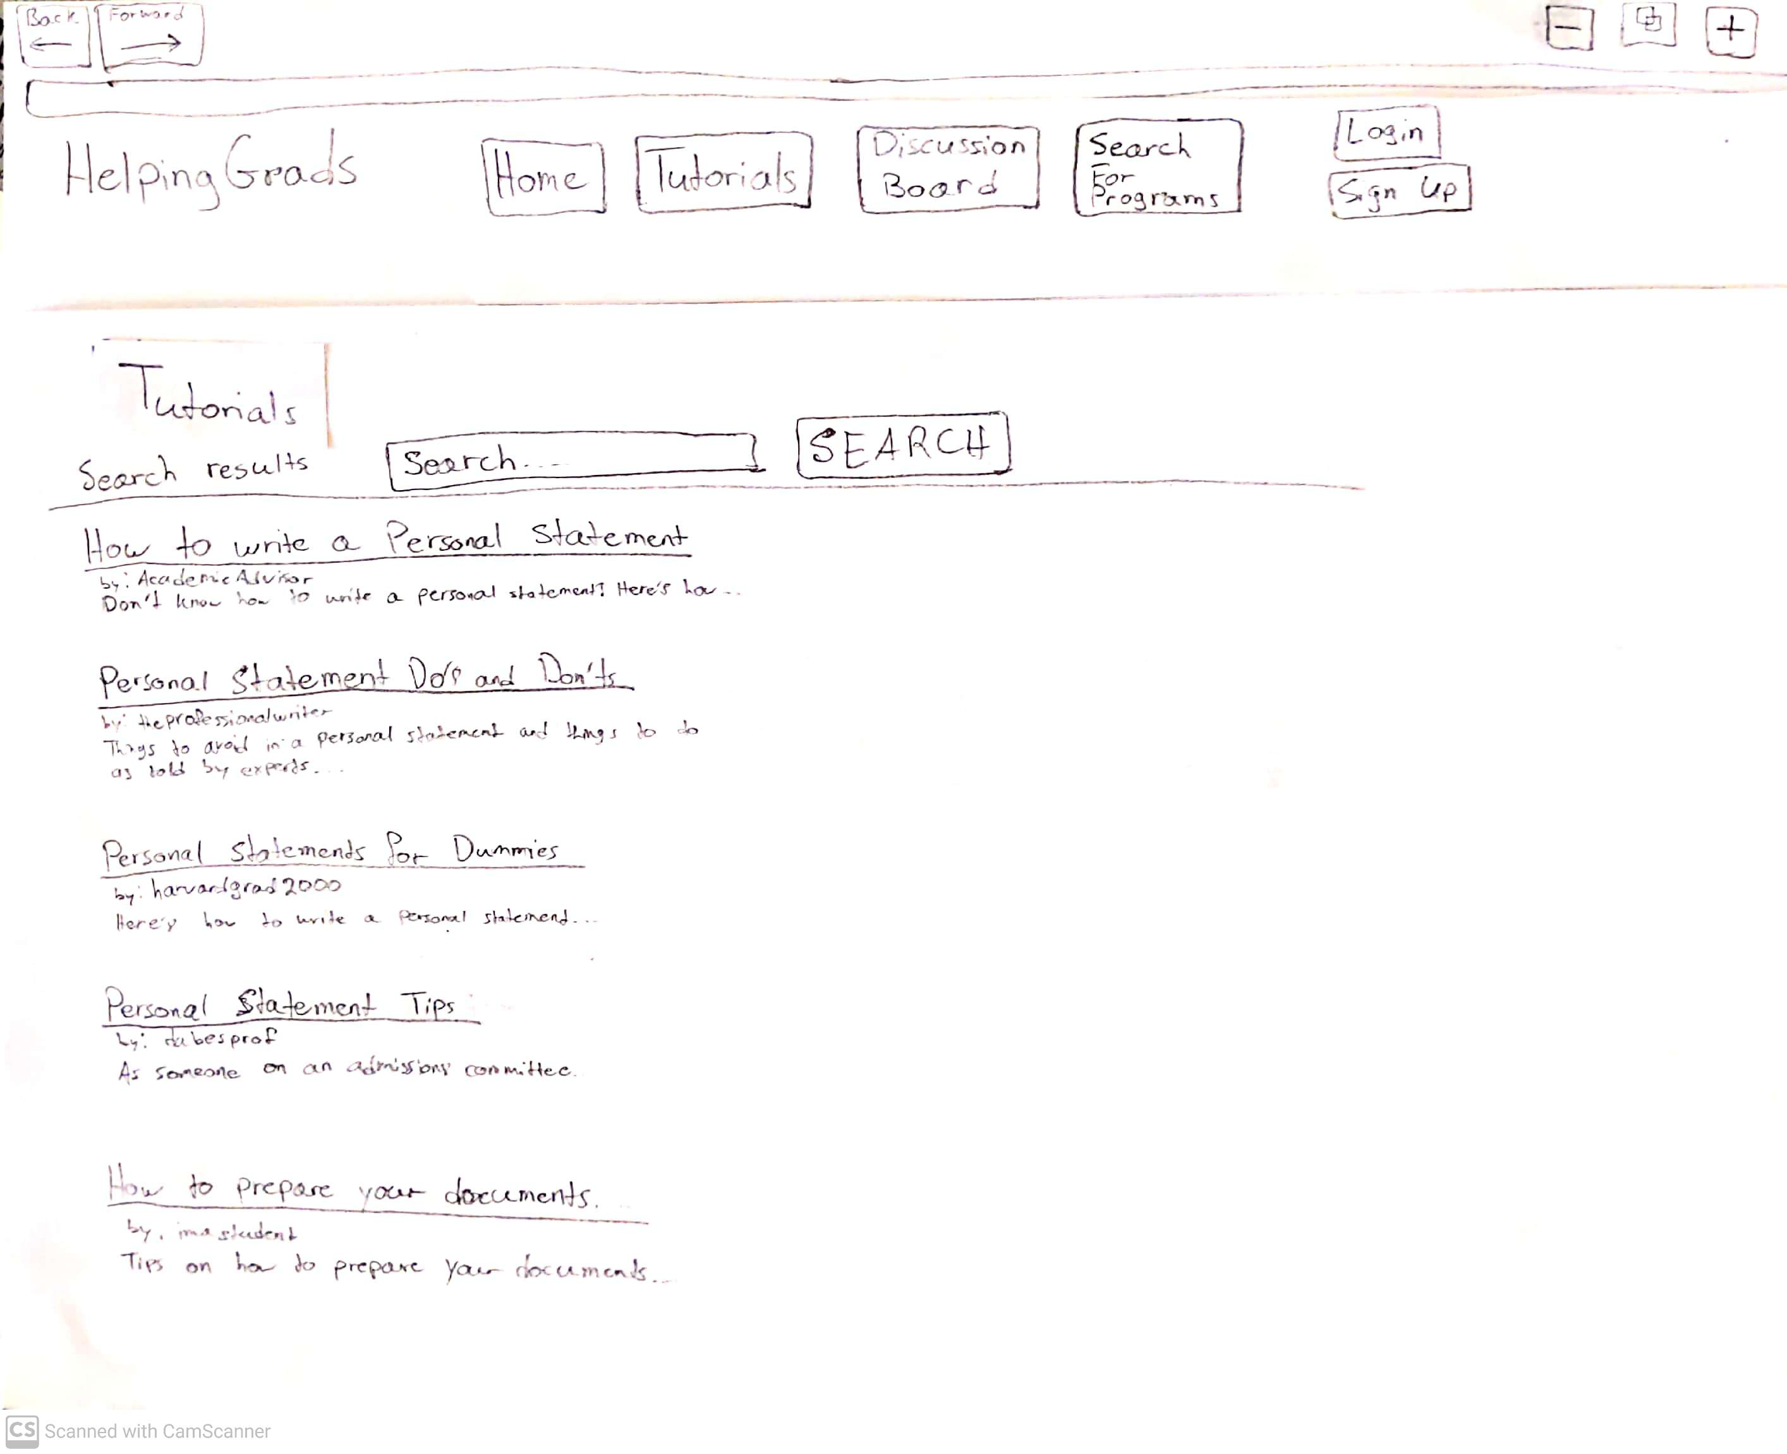
EXPECTED USER ACTION
Click [On a search result] NOTE it’s good practice to ask users “What do you expect to happen next?”
OBSERVED ACTION
USER QUOTES
DESIGN IMPLICATIONS for A5b Results
[NEXT] button is an Action Button you can program in Powerpoint for navigation.
Task 1. One required document for your application is a personal statement or a letter of intent. However, you are not sure how to write one and you want to learn. How would you go about finding the information you need using this prototype?

Slide 7
EXPECTED USER ACTION
Click [Forum] NOTE it’s good practice to ask users “What do you expect to happen next?”
OBSERVED ACTION
USER QUOTES
DESIGN IMPLICATIONS for A5b Results
[NEXT] button is an Action Button you can program in Powerpoint for navigation.
Task 2. After learning how to write a personal statement, you have finally finished writing your own and would like someone to edit it. Due to the COVID-19 pandemic you can’t go to the writing center at school. How could you get help with this using the prototype?

Slide 8
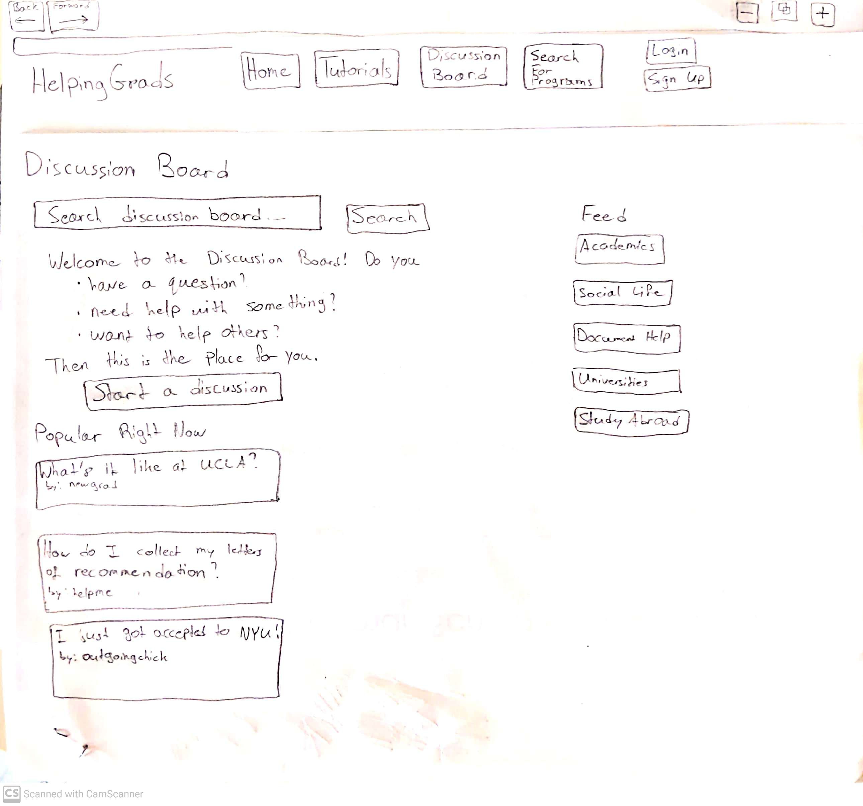
EXPECTED USER ACTION
Click [Ask a Question] NOTE it’s good practice to ask users “What do you expect to happen next?”
OBSERVED ACTION
USER QUOTES
DESIGN IMPLICATIONS for A5b Results
[NEXT] button is an Action Button you can program in Powerpoint for navigation.
Task 2. After learning how to write a personal statement, you have finally finished writing your own and would like someone to edit it. Due to the COVID-19 pandemic you can’t go to the writing center at school. How could you get help with this using the prototype?

Slide 9
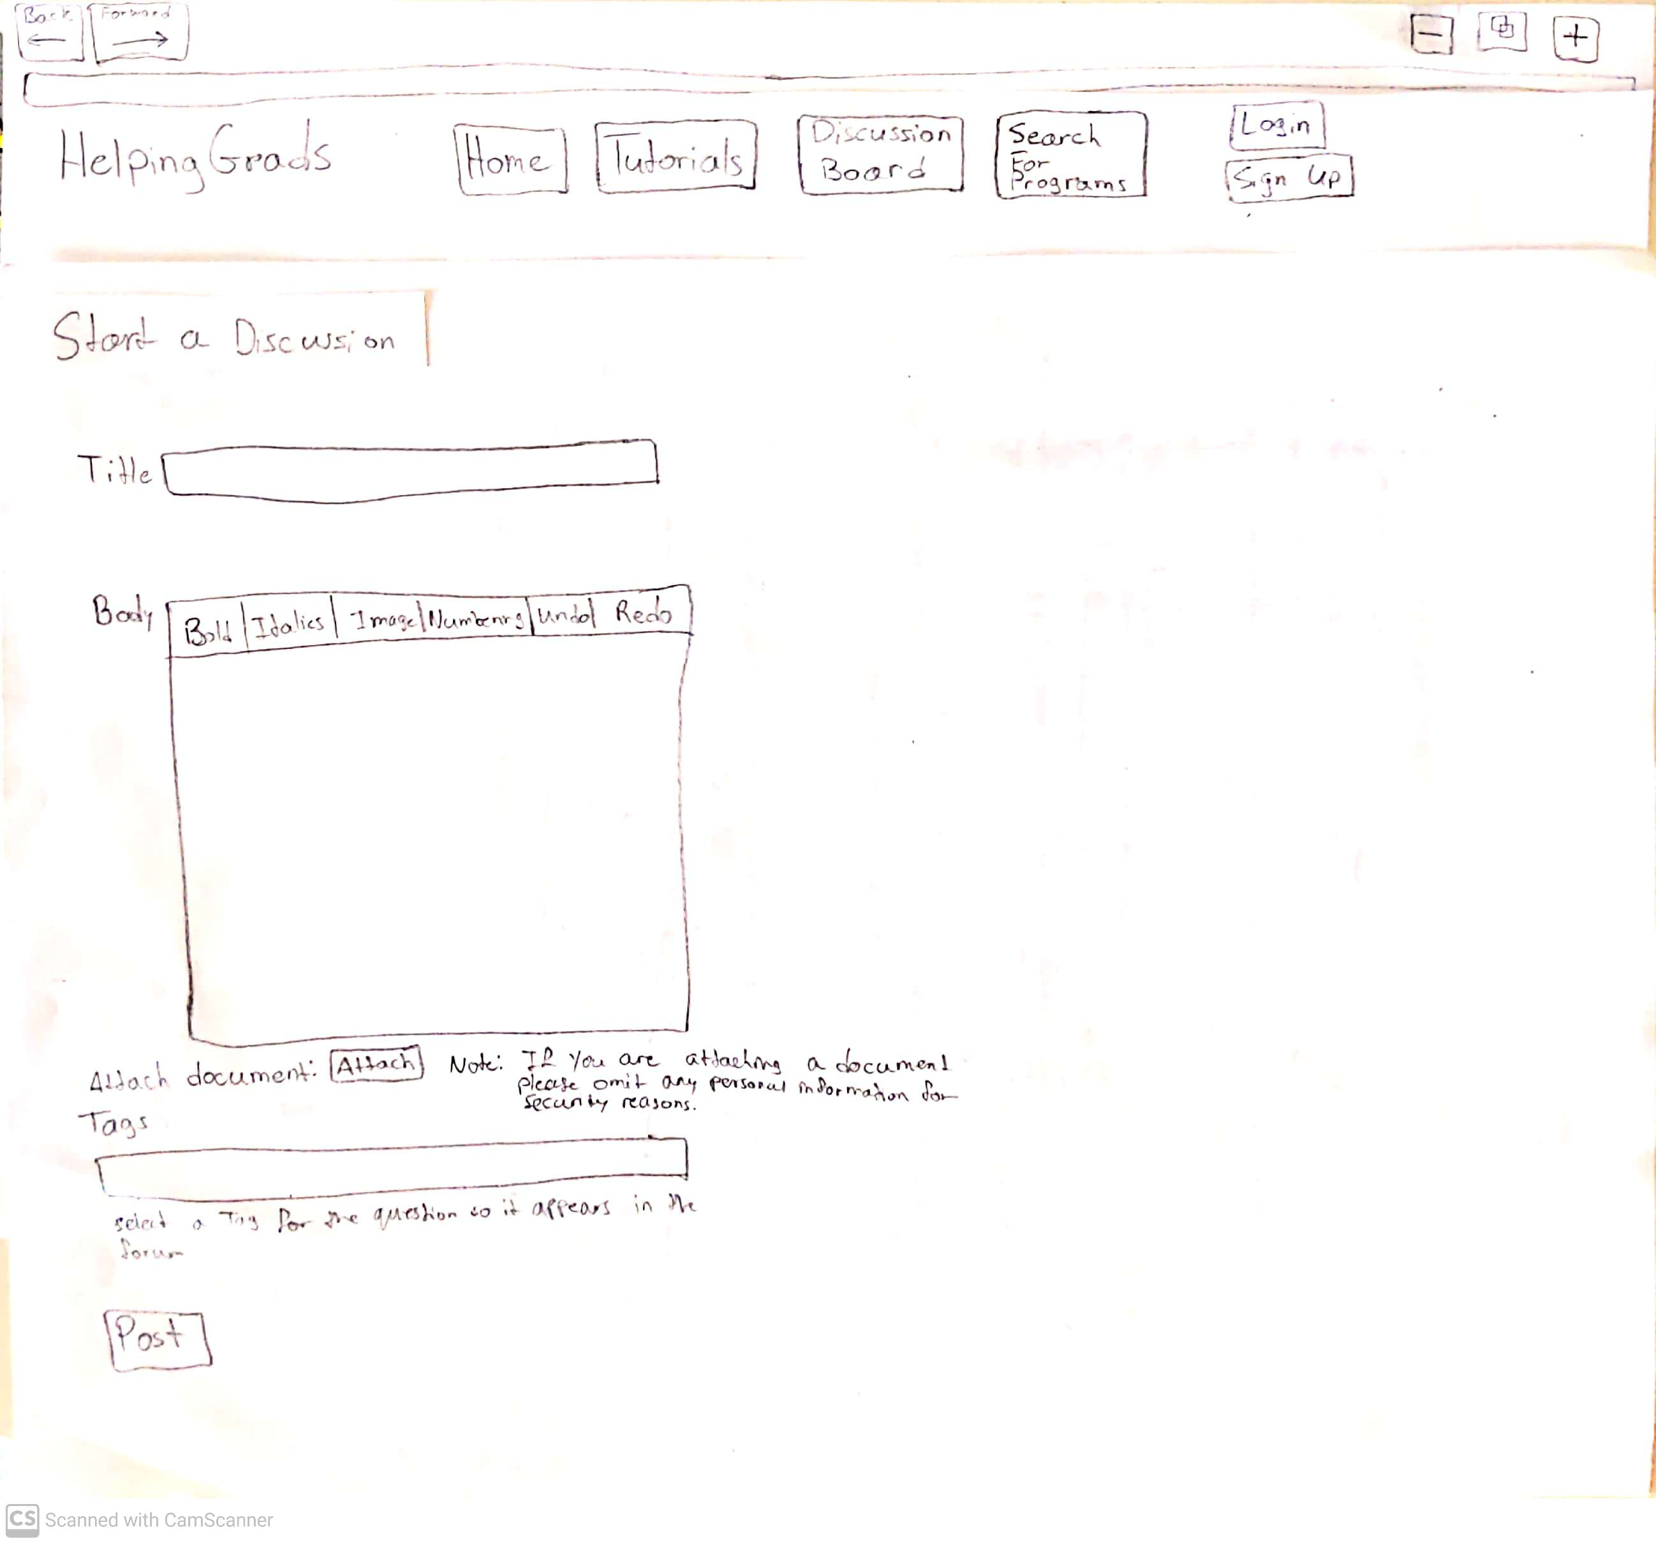
EXPECTED USER ACTION
Enter text in [Title]
Enter text in [Body]
Click [Attach]
Enter text in [Tags]
Click [Post] NOTE it’s good practice to ask users “What do you expect to happen next?”
OBSERVED ACTION
USER QUOTES
DESIGN IMPLICATIONS for A5b Results
[NEXT] button is an Action Button you can program in Powerpoint for navigation.
Task 2. After learning how to write a personal statement, you have finally finished writing your own and would like someone to edit it. Due to the COVID-19 pandemic you can’t go to the writing center at school. How could you get help with this using the prototype?

Slide 10
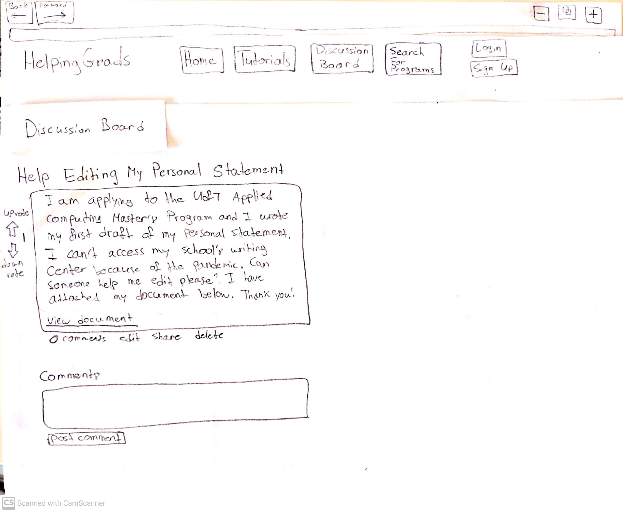
EXPECTED USER ACTION
Click [Blogs] NOTE it’s good practice to ask users “What do you expect to happen next?”
OBSERVED ACTION
USER QUOTES
DESIGN IMPLICATIONS for A5b Results
[NEXT] button is an Action Button you can program in Powerpoint for navigation.
Task 3. You got your personal statement edited, completed a final draft, and submitted your application. Now you would like to help others who are struggling through the application process. What would you do to achieve this using the prototype?

Slide 11
EXPECTED USER ACTION
Click [Create Blog] NOTE it’s good practice to ask users “What do you expect to happen next?”
OBSERVED ACTION
USER QUOTES
DESIGN IMPLICATIONS for A5b Results
[NEXT] button is an Action Button you can program in Powerpoint for navigation.
Task 3. You got your personal statement edited, completed a final draft, and submitted your application. Now you would like to help others who are struggling through the application process. What would you do to achieve this using the prototype?

Slide 12
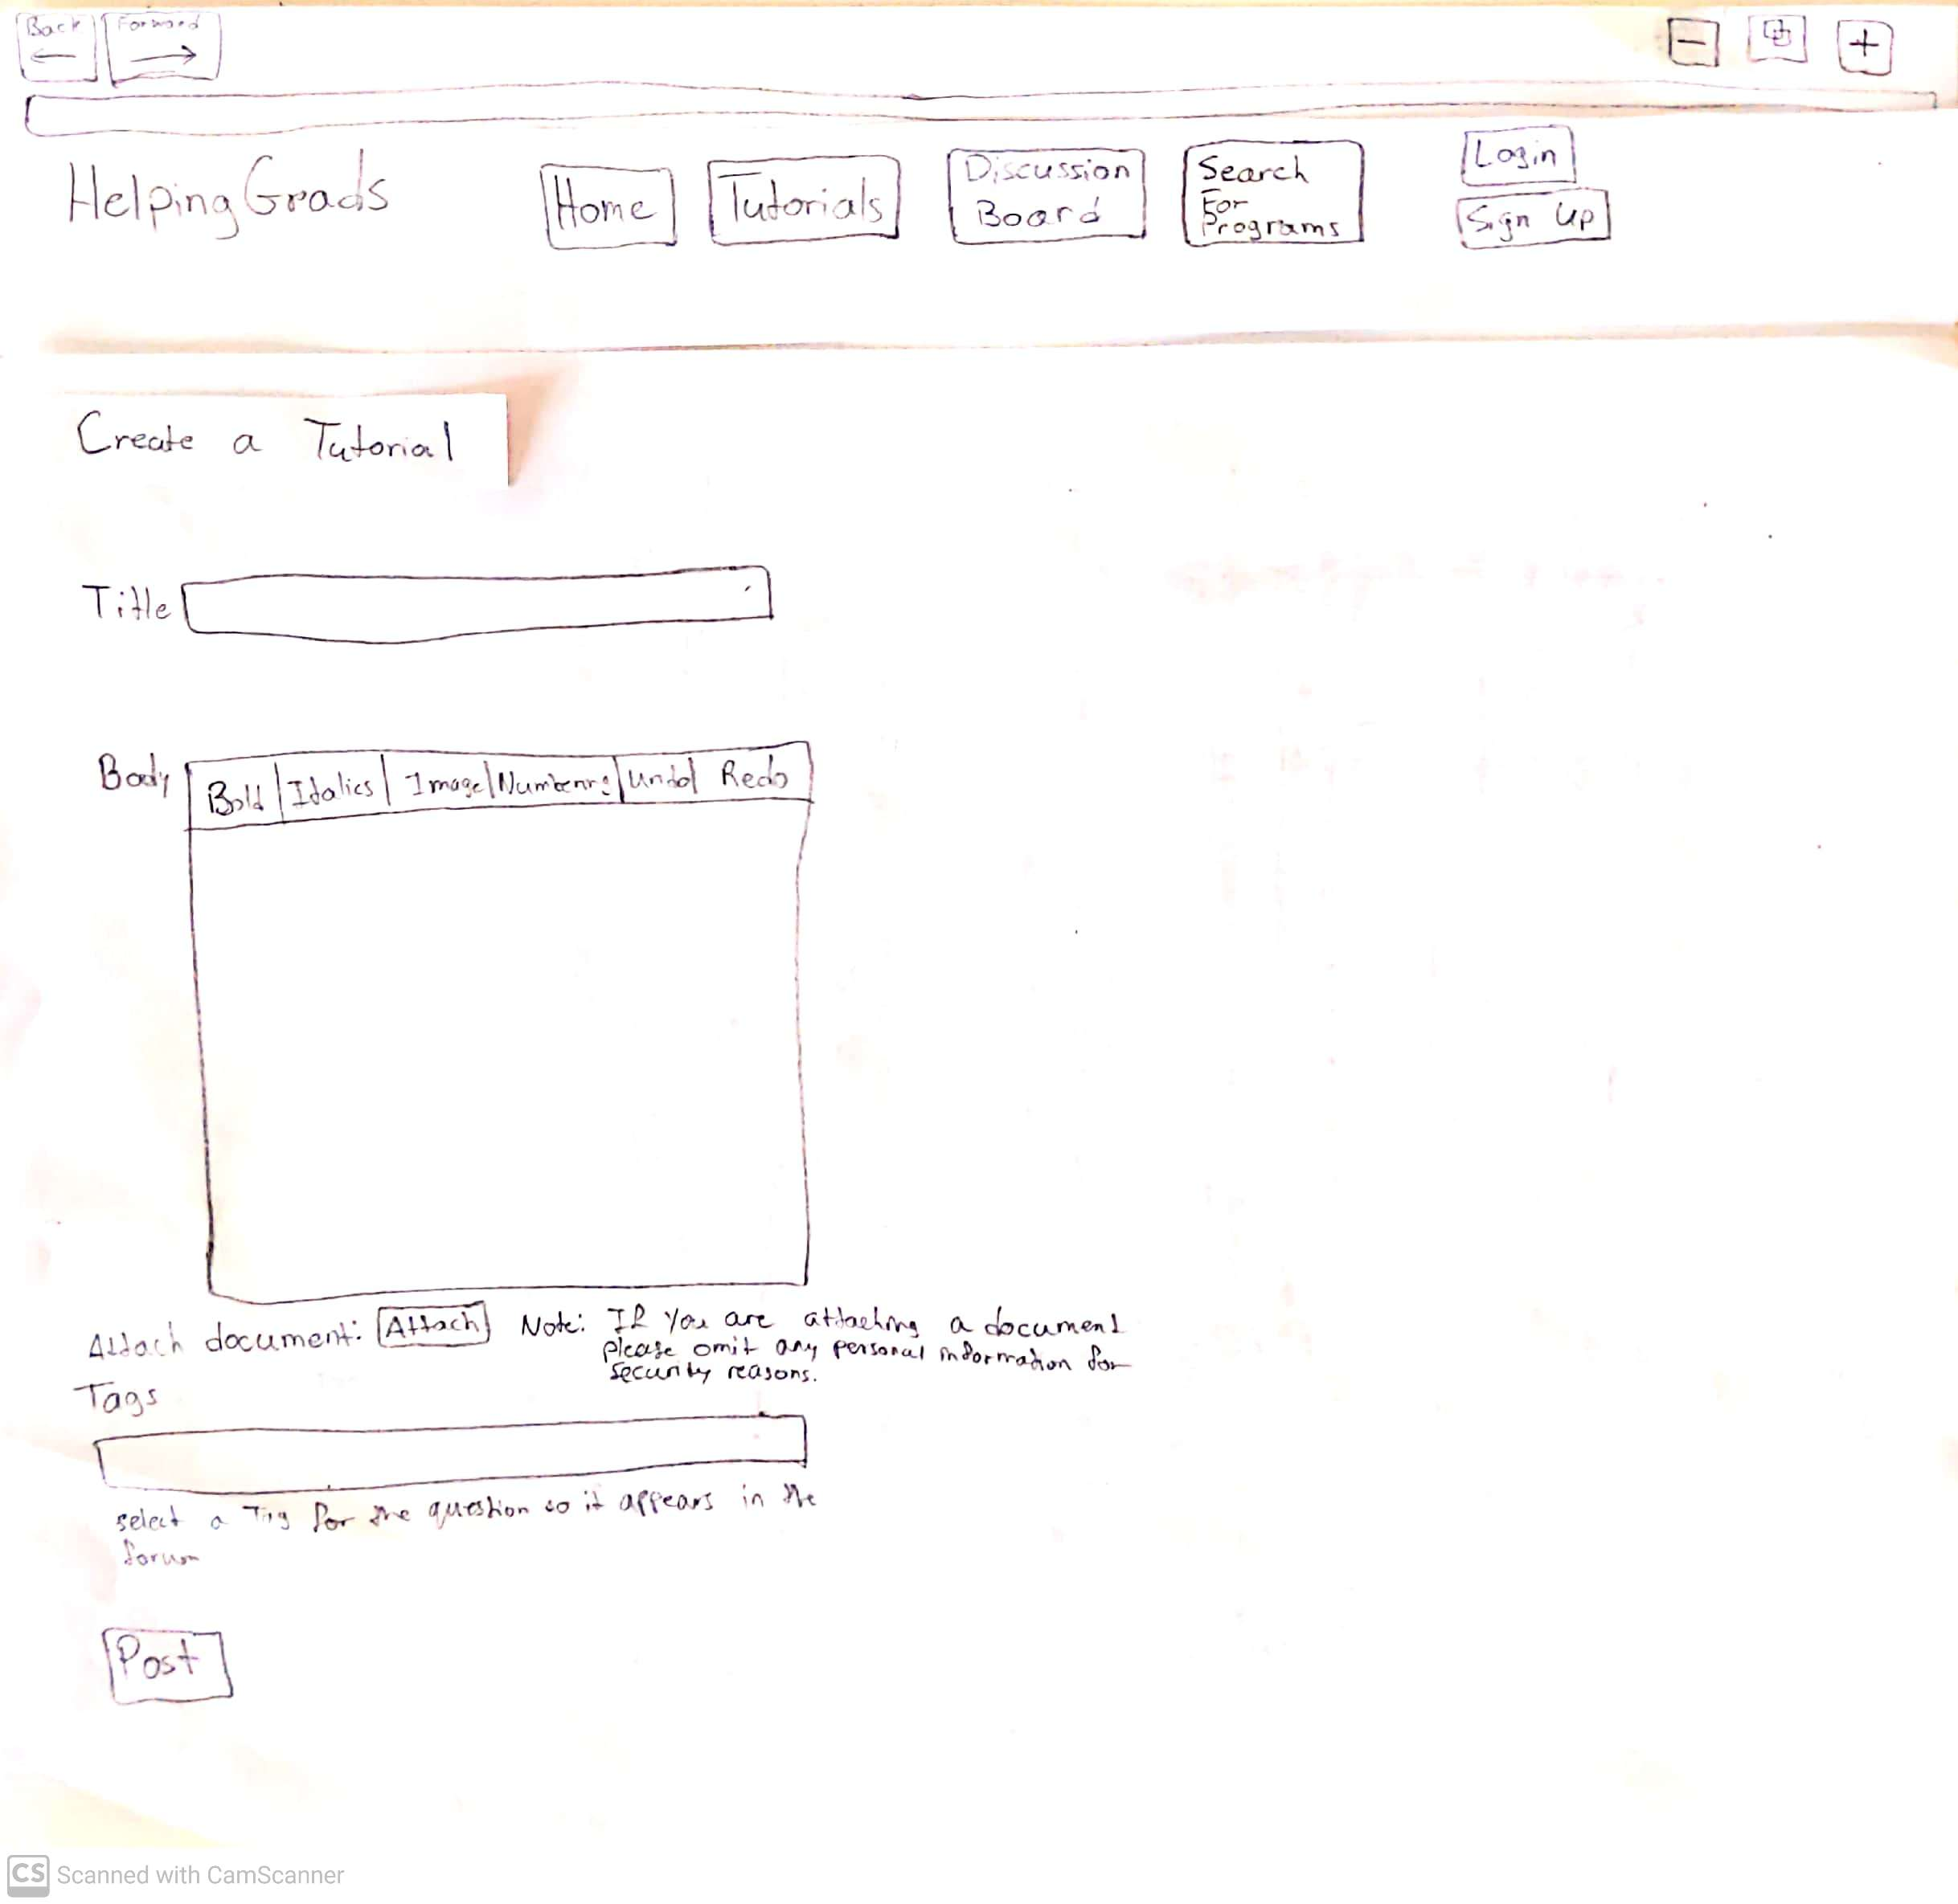
EXPECTED USER ACTION
Enter text in [Title]
Enter text in [Body]
Enter text in [Tags]
Click [Post] NOTE it’s good practice to ask users “What do you expect to happen next?”
OBSERVED ACTION
USER QUOTES
DESIGN IMPLICATIONS for A5b Results
[NEXT] button is an Action Button you can program in Powerpoint for navigation.
Task 3. You got your personal statement edited, completed a final draft, and submitted your application. Now you would like to help others who are struggling through the application process. What would you do to achieve this using the prototype?

