Slide 1

RedScope Capstone Project
Lab-only Red-Team Assessment with Detection and Remediation Focus
Shamanth R Singh
Network foothold and post-exploitation
Ajit Mohan
Scope, web exploit summary, coordination
Saiteja Kacham
ML detector and evasion work
Madhurjya Deka
Remediation and business impact
Speaker: Ajit Mohan

Slide 2

Project Objective and Why It Matters
Objective
Why It Matters
Simulate a realistic attacker path in a safe lab environment
Identify how web and network weaknesses can lead to broader compromise
Test detection logic, including ML-based detection
Translate technical findings into business risk and remediation priorities
Security gaps rarely exist in isolation
Attackers chain small weaknesses
Detection must be validated, not assumed
Remediation must be risk-based and business-aligned
Speaker: Ajit Mohan

Slide 3

Scope and Rules of Engagement
In Scope
Out of Scope
Lab-only environment — controlled assets and test systems
Web exploitation assessment
Network compromise simulation
Post-exploitation observation
ML detector and evasion testing
Remediation and risk mapping
Real public systems
Unauthorised access
Credential abuse outside lab
Destructive payloads
Persistence beyond test intent
All activity was conducted in a controlled, isolated lab environment only.
Speaker: Ajit Mohan

Slide 4
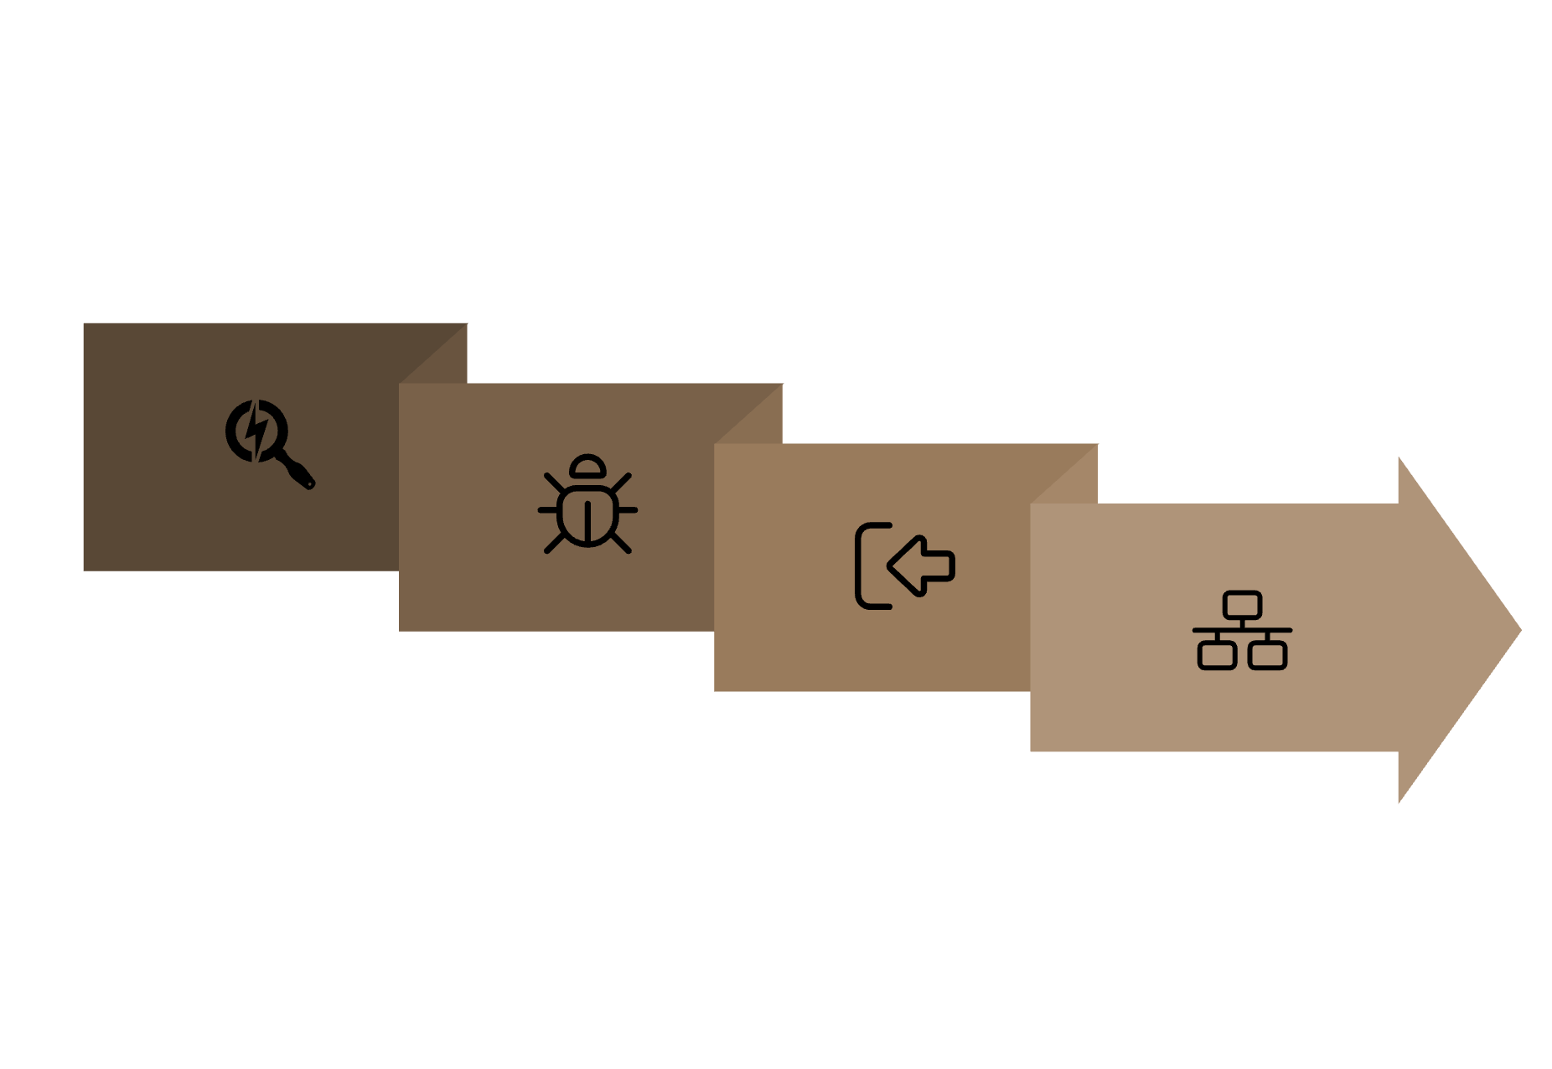
End-to-End Attack Chain Overview
RedScope Assessment Flow — eight sequential phases from reconnaissance to business impact mapping.
App Weakness
Network Foothold
Recon
Initial Access
Each phase builds on the previous, demonstrating how a single weakness can chain into a broader compromise — and where defenders can intervene at every stage.
Handoff: Ajit Mohan to Shamanth R

Slide 5

Web Exploit Summary
Web Exploitation Focus
Surface Identification
Input and Auth Analysis
Chaining Validation
Identify exposed web attack surface across the lab environment
Analyse input handling and authentication-related weaknesses
Validate whether weaknesses can be chained for greater impact
Documentation
Defensive Lessons
Document findings with severity and reproducibility ratings
Capture defensive lessons from the web layer
Key Learning: Web weaknesses become more serious when they enable movement into deeper systems.
Speaker: Shamanth R Singh

Slide 6

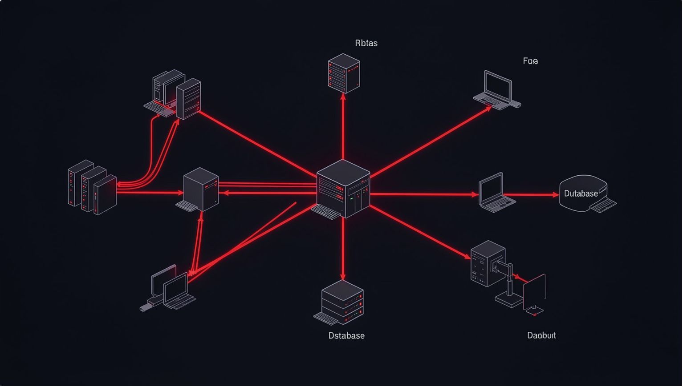
Transition: Web Layer to Network Context
From Web Layer to Network Context
Initial Weakness Creates Opportunity
A web-layer finding opens the door to the internal network
Network Exposure Determines Blast Radius
Reachable systems define how far an attacker can move
Privilege Boundaries Become Critical
Least privilege limits what an attacker can do post-access
Monitoring Must Capture Lateral Movement
Detection must extend beyond the web perimeter
Segmentation Reduces Attacker Options
Proper segmentation contains the impact of initial compromise
Speaker: Shamanth R Singh

Slide 7

Network Foothold and Post-Exploitation
Network Foothold Analysis
Post-Exploitation View
Understand what access is possible after initial compromise
Identify reachable systems and exposed services
Evaluate segmentation and privilege boundaries
Observe attacker-like behaviour in a controlled lab
Map potential paths to sensitive assets
What could an attacker see?
What could they access?
What traces would defenders need?
Which controls limit impact?
Speaker: Shamanth R Singh

Slide 8
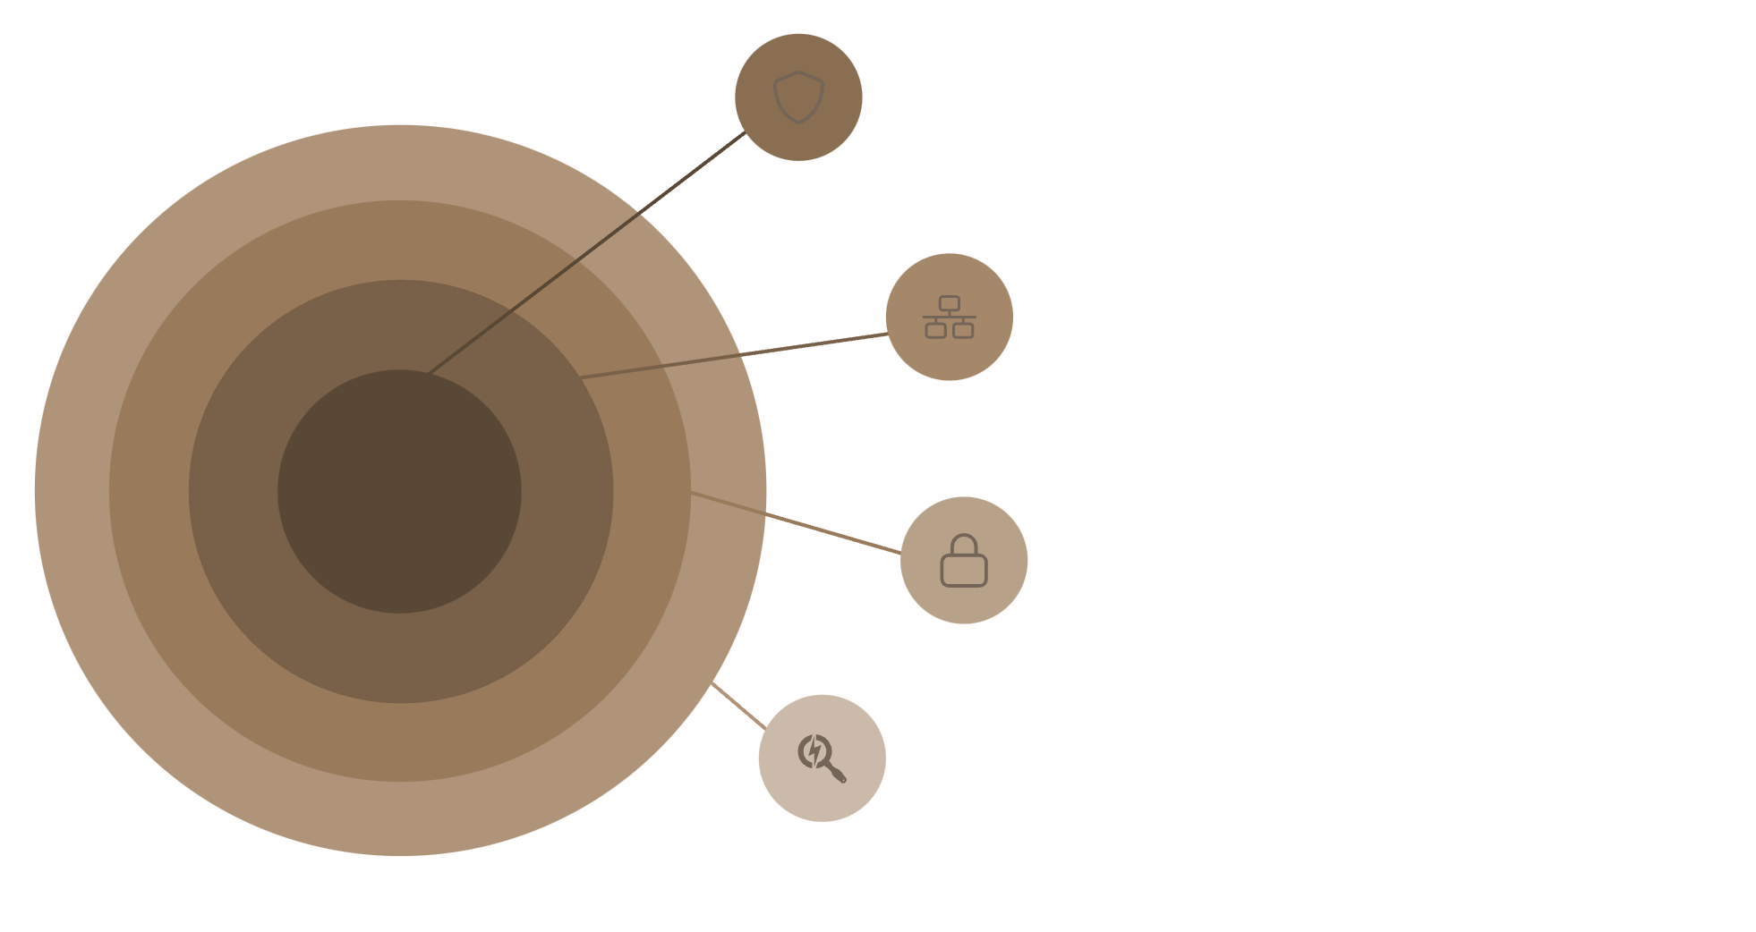
Post-Exploitation Findings and Defensive Lessons
Defensive Lessons
Contain Access
Initial access must be contained quickly
Network segmentation limits blast radius
Least privilege reduces movement options
Logging must cover authentication, service access, and unusual behaviour
Detection should focus on behaviour, not only signatures
Stop initial access fast.
Network Segmentation
Limit lateral movement and blast radius.
Least Privilege
Reduce available escalation and options.
Behavioral Logging
Security Principle: Assume compromise. Design controls to limit movement and detect abnormal activity.
Detect via auth and service activity.
Handoff: Shamanth R to Saiteja Kacham

Slide 9




ML Detector: Purpose and Approach
ML Detection Objective
Why ML?
Detect suspicious or attacker-like behaviour
Learn from patterns in security-related data
Classify activity as benign or suspicious
Evaluate detector performance
Understand limitations under adversarial conditions
Pattern Recognition
Can identify patterns beyond static rules
High-Volume Analysis
Helps analyse high-volume signals efficiently
Careful Validation
Requires careful validation and tuning
Speaker: Saiteja Kacham

Slide 10
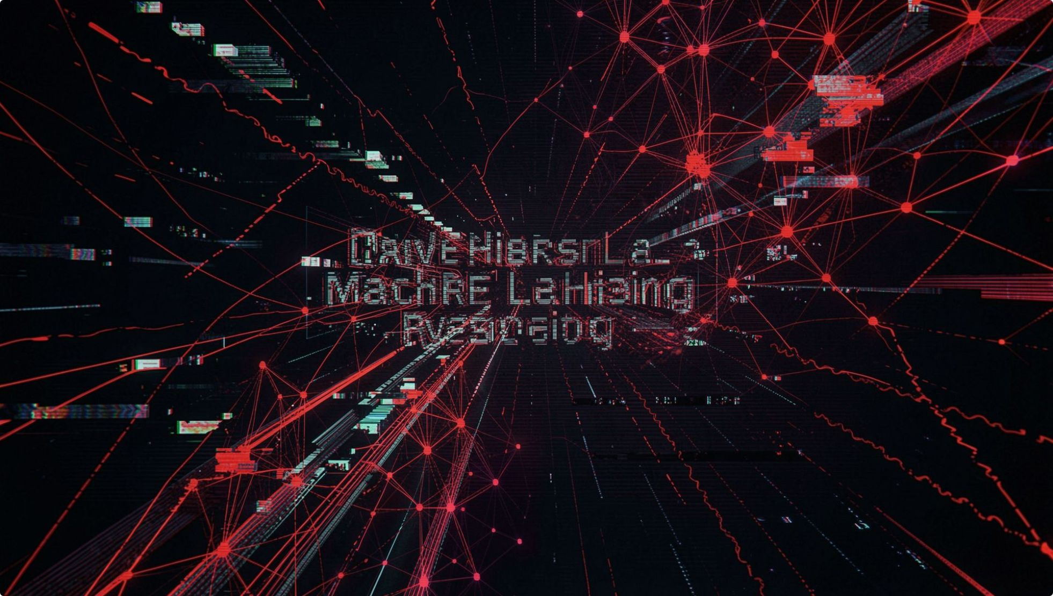

ML Evasion and Detection Limitations
Evasion Testing Focus
Understand how attackers may alter behaviour to avoid detection
Test whether small changes reduce detection confidence
Identify blind spots in the detector
Improve model robustness through adversarial testing
Recommend layered detection strategies
Important Point: ML should complement security controls, not replace them.
Speaker: Saiteja Kacham

Slide 11
Risk Summary: Technical Findings to Business Impact
Each technical finding maps directly to a business risk. Understanding this chain is essential for prioritising remediation investment.
Technical Finding
Business Risk
Impact Level
Web weakness
Unauthorised access and data exposure
High
Network foothold
Lateral movement and wider compromise
High
Weak segmentation
Larger blast radius across systems
High
Limited logging
Delayed detection and investigation
Medium
ML evasion possibility
False negatives and missed alerts
Medium
Speaker: Madhurjya Deka

Slide 12
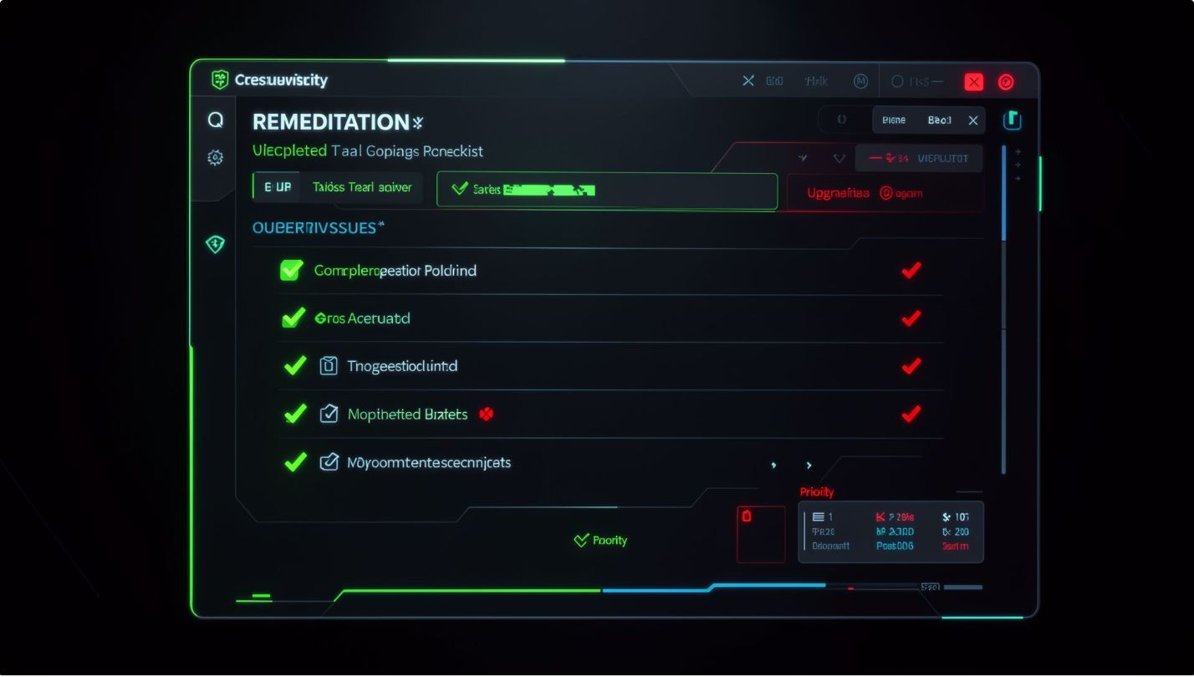
Remediation Strategy
Recommended Remediation Priorities
01
Fix Web Application Vulnerabilities
Address identified weaknesses at the web layer first
02
Strengthen Authentication and Session Controls
Harden login flows and session management
03
Apply Least Privilege Across Systems
Restrict access rights to the minimum required
04
Enforce Network Segmentation
Isolate systems to contain potential compromise
05
Improve Logging, Alerting, and ML Validation
Harden exposed services, expand coverage, and test detection adversarially
06
Build an Incident Response Playbook
Prepare structured response procedures for identified scenarios
Speaker: Madhurjya Deka

Slide 13

Business Impact and Value of RedScope
Business Impact
Value of the Project
Reduces likelihood of unauthorised access
Limits blast radius after initial compromise
Improves detection and response readiness
Helps prioritise remediation investment
Supports security awareness across technical and business teams
RedScope connects offence, detection, and remediation into one practical security lifecycle.
Offence
Detection
Remediation
Realistic attack simulation
ML-aware validation
Business-aligned priorities
Speaker: Madhurjya Deka

Slide 14
Key Takeaways
1
Safe, Lab-Only Assessment
RedScope is a controlled, integrated security assessment conducted entirely within a lab environment
2
Web Weaknesses as Entry Points
Web vulnerabilities can become the starting point for broader, chained compromise
3
Segmentation and Least Privilege Are Critical
These two controls are the most effective at limiting attacker movement post-access
4
ML Detection Must Be Validated
ML is useful but must be tested against evasion to understand its real-world limits
5
Remediation by Business Impact
Prioritise fixes based on the business risk each finding represents
6
Prevention + Detection + Response
Security is strongest when all three pillars work together in an integrated lifecycle
Speaker: Shamanth R Singh

Slide 15
Thank You
Questions?
Suggested Q&A Areas
Lab-Only Rationale
Scope Control
ML Inclusion
Why was the project conducted in a lab-only environment?
How was scope defined and controlled throughout the assessment?
Why include ML detection in a red-team assessment?
Remediation Priorities
Enterprise Applicability
What were the main remediation priorities identified?
How can this model apply to real enterprise environments?
Speaker: Shamanth R Singh — with all team members answering their respective sections
SHAMANTH R SINGH
AJITH MOHAN
SAITEJA KACHAM
MADHURJYA DEKA

