Slide 1



HR ANALYTICS
CAPSTONE PROJECT
Presented By-
Isha C, Ishita M, Khushi V, Nikita J, Shamaparvin S

Slide 2
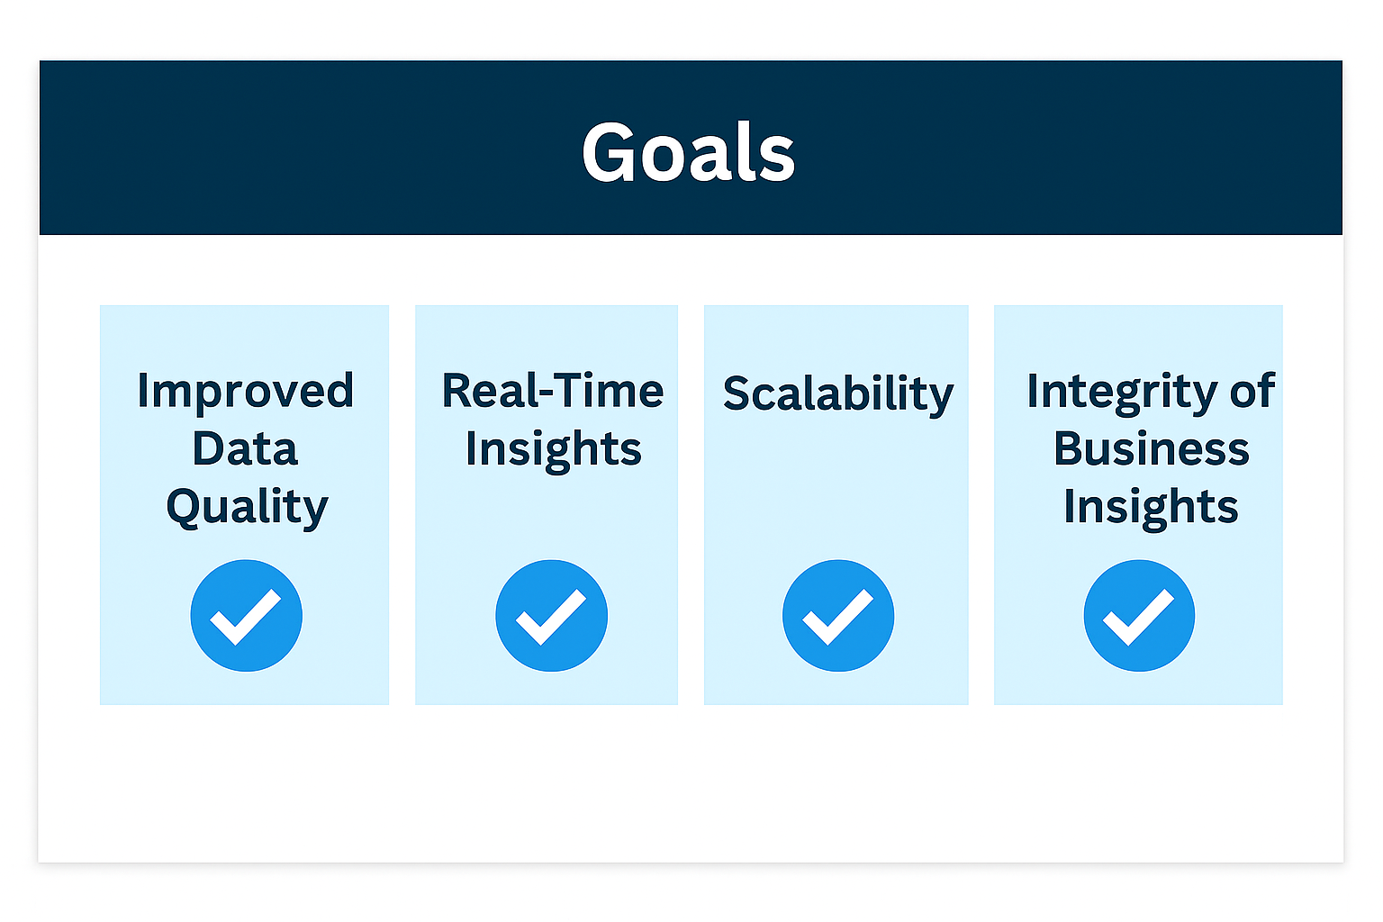
Goals
Problem Statement
No insights on workforce performance and employee behavior.
No consolidated HR KPIs for strategic decisions.
No visibility into department-wise, role-wise, or location-wise trends.
Difficulty identifying risks like high attrition or skill gaps.
Lack of actionable intelligence for workforce planning and policy decisions.

Slide 3

Business Requirements
Employee Attrition Trend
Performance and Training Insights
Hiring and Requirement Efficiency
Salary and Compensation Insights
Workforce Distribution
Promotional and Growth Analysis
Notes:
Employee attrition em performance

Slide 4
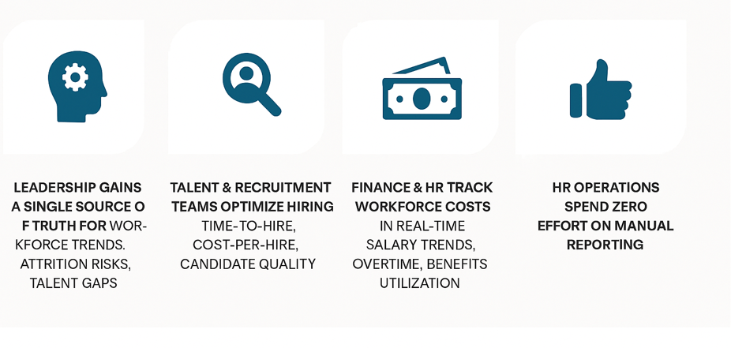
Business Value
Notes:
Employee attrition em performance

Slide 5
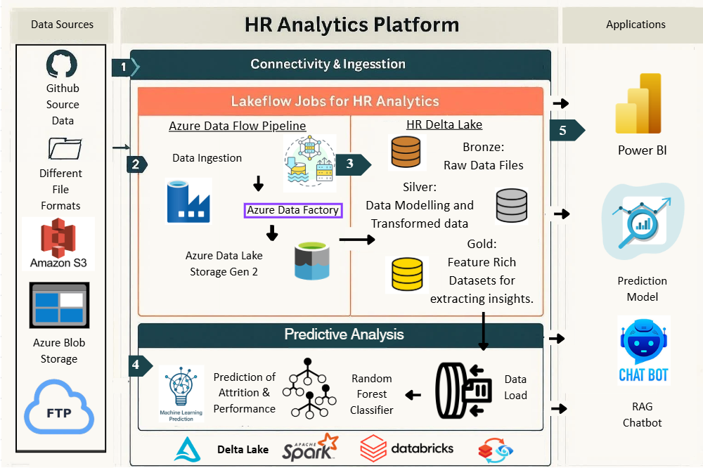
Architecture

Slide 6
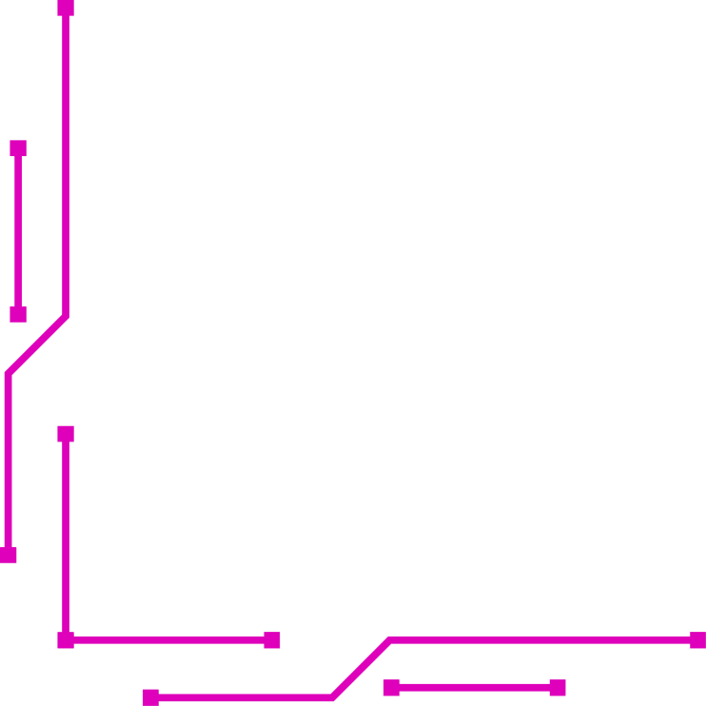


HR ANALYTICS
DEMONSTRATION

Slide 7
POWER BI

Slide 8
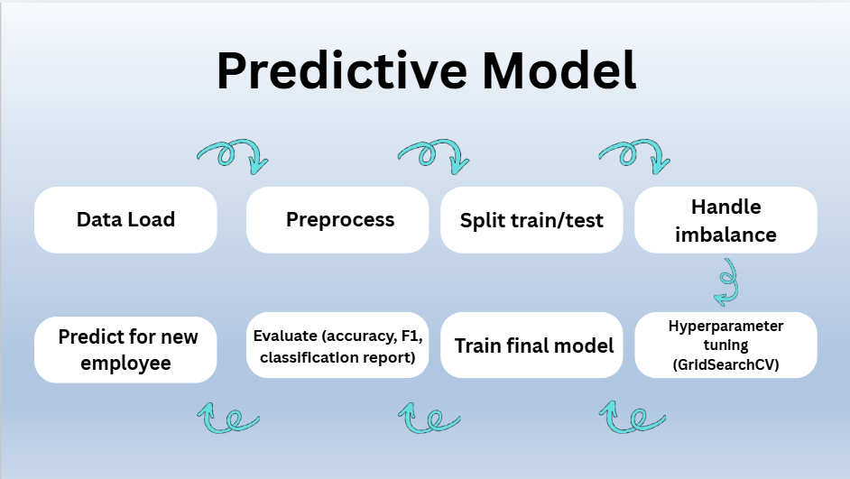

Slide 9
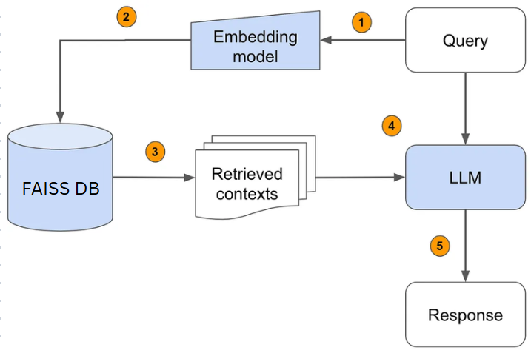
Retrieval-Augmented Generation Architecture

Slide 10
Conclusion
Successfully achieved data analysis and predictive analysis, fulfilling client needs with end-to-end automated project

Slide 11
The End

