Slide 1
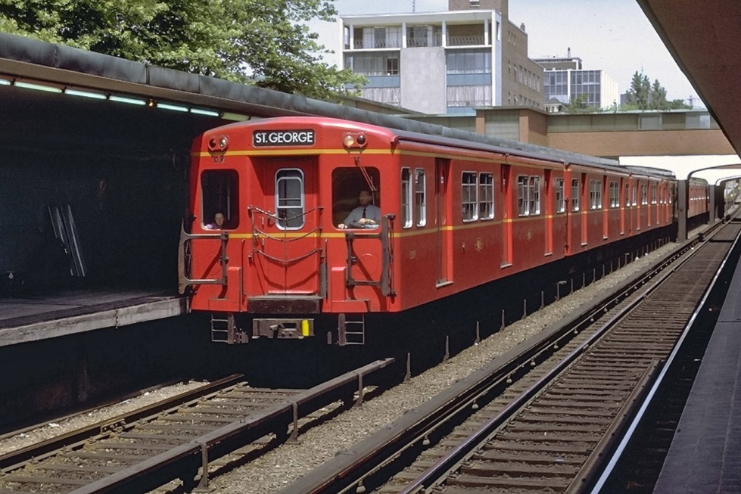
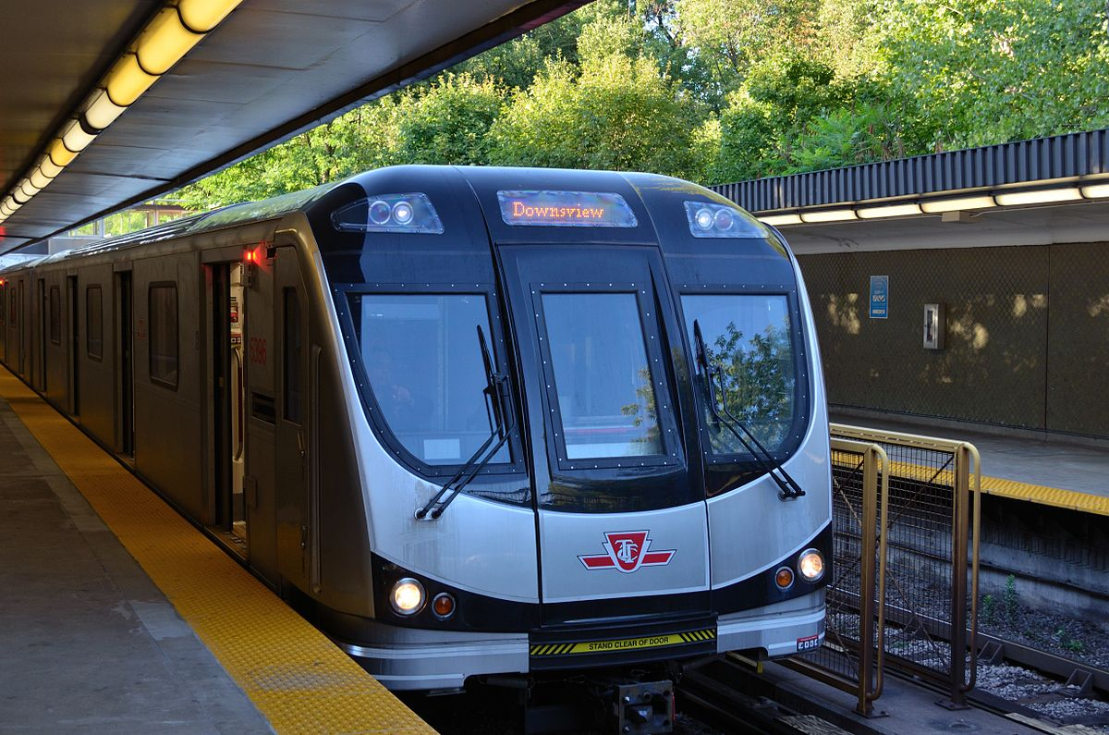
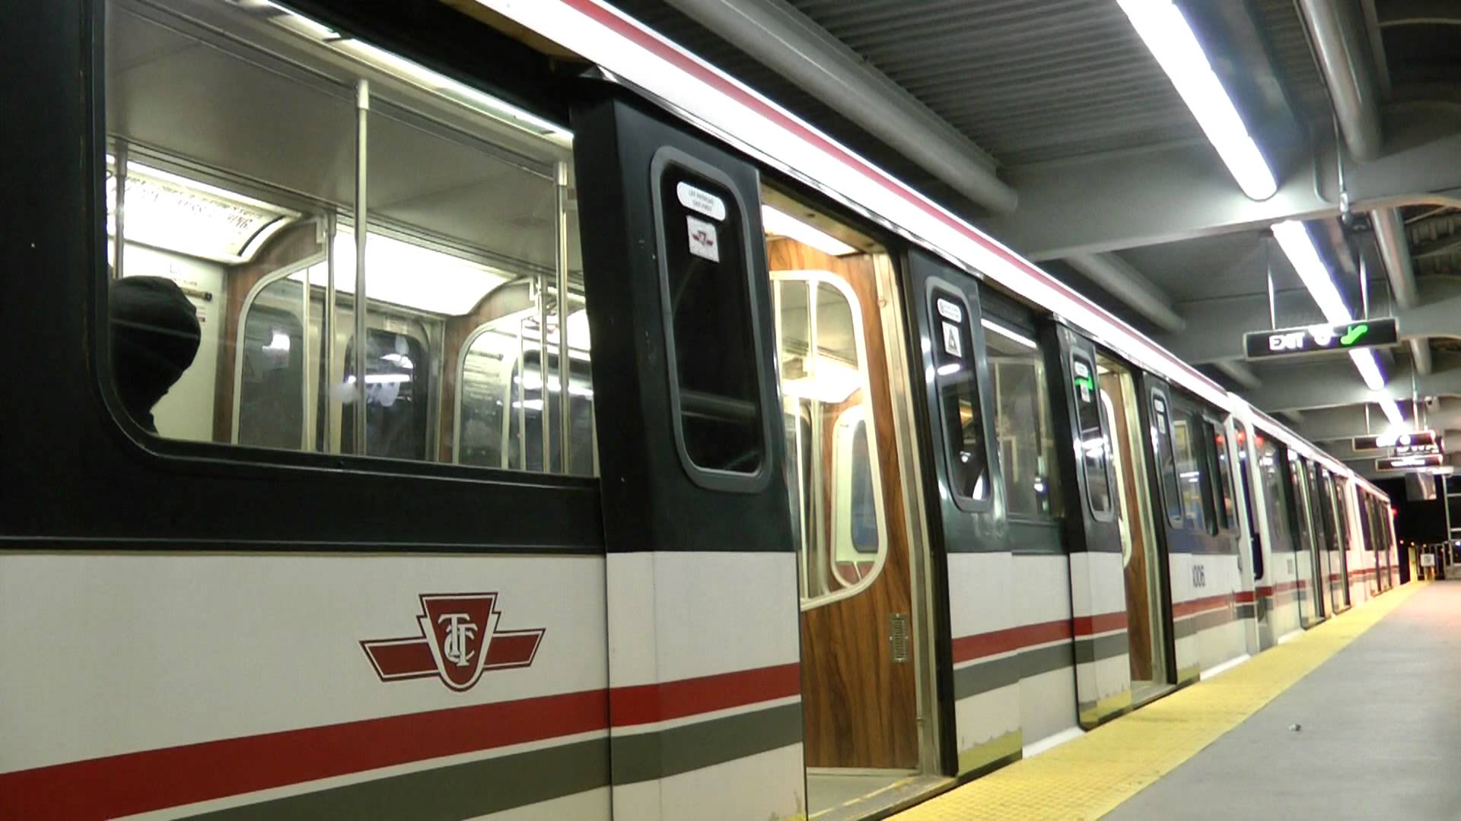
Signals and Train Control Engineering
DLU Log Decoder
By: Mark Karlov

Slide 2
Presentation Outline
Presentation Contents
Objective / Problem Statement
Project Goal
Resources
Understanding Raw DLU Logs
Program Overview – Frontend
Program Overview – Backend
Design Challenges
Demonstration
Current Status
Future Enhancements
Questions

Slide 3
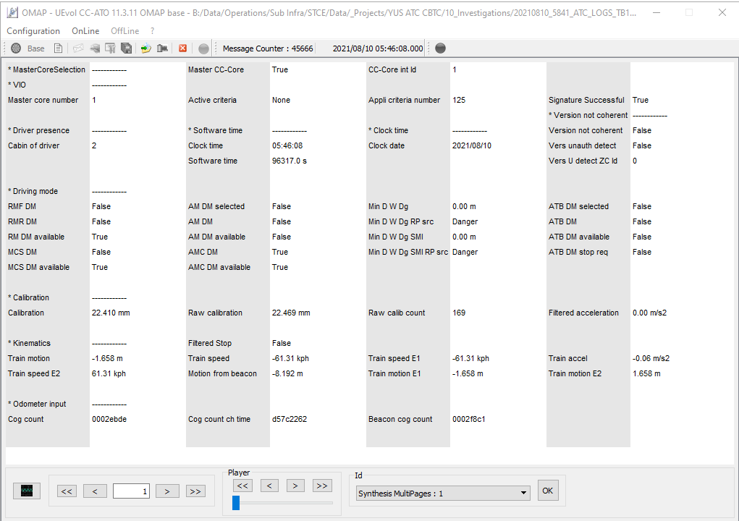
Objective / Problem Statement
OMAP is needed to analyze raw DLU logs
OMAP has a terrible UX design for side-by-side parameter comparison
# of Parameters: 1800 - 3100
# of Pages: 30 - 53

Slide 4
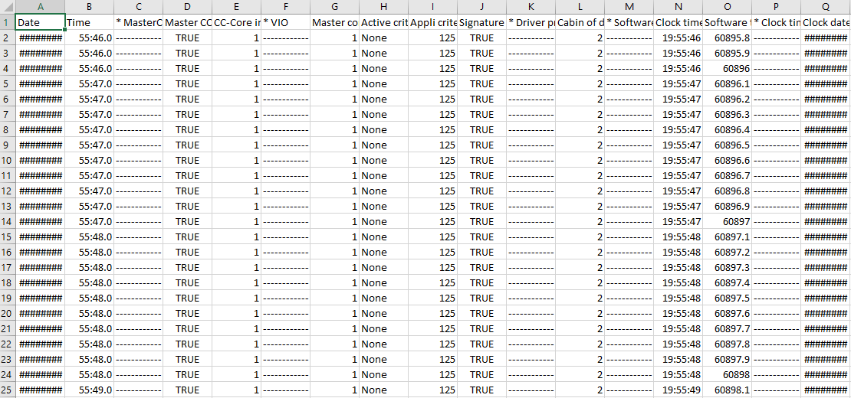
Objective / Problem Statement
OMAP offers a way to extract ALL data to a processed .txt file
This process is very SLOW, and sometimes inaccurate
# of Records:
3500 - 6000

Slide 5

Project Goal
Create a GUI that allows users to
Add, remove, upload files
Search and select specific parameters to analyze
Create a Backend that
Decodes raw DLU logs into processed .txt files
Parses processed .txt files based on
Parameter selection
Change from previous record

Slide 6

Benefit to TTC
This program allows users to
Observe parameter change
Observe selective parameters
This means that
Engineers can analyze data faster
Engineers can short-circuit to the problem source faster

Slide 7
Resources
Richard Tam & Edward W. Chan
OMAP
ATO/ATP Base Files
Compressed DLU Logs
Vim
HTML, CSS, JS, C++, Bash

Slide 8
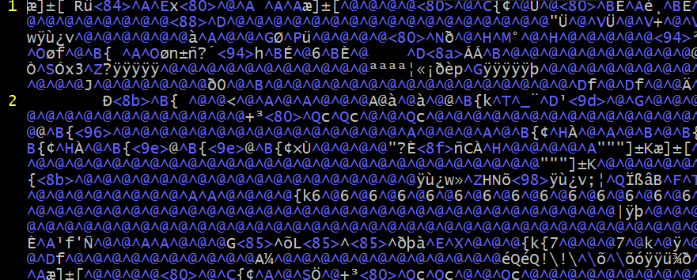
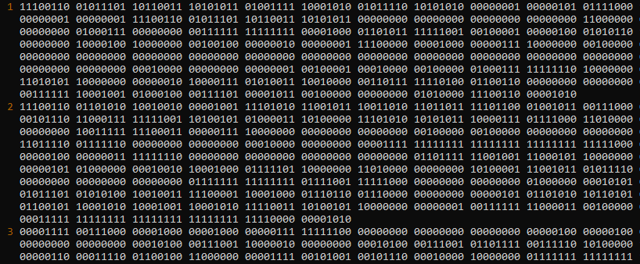
Understanding Raw DLU Logs
Raw DLU Logs are decompressed DLU logs
Binary charset
Under UTF-8 encoding, each character represents a byte
UTF-8 Byte to Binary Representation

Slide 9
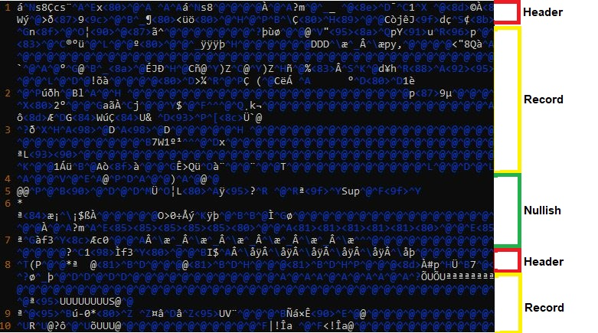
Understanding Raw DLU Logs
3 repeating components in-order:
Header Byte Sequence (HBS)
(31 Bytes)
→ Timestamp
Record Byte Sequence (RBS)
(1262-2522 Bytes)
→ Record Data
Nullish Byte Sequence (NBS)
(Variable Length)
→ Record Delimiter OR
→ Corrupt Data

Slide 10
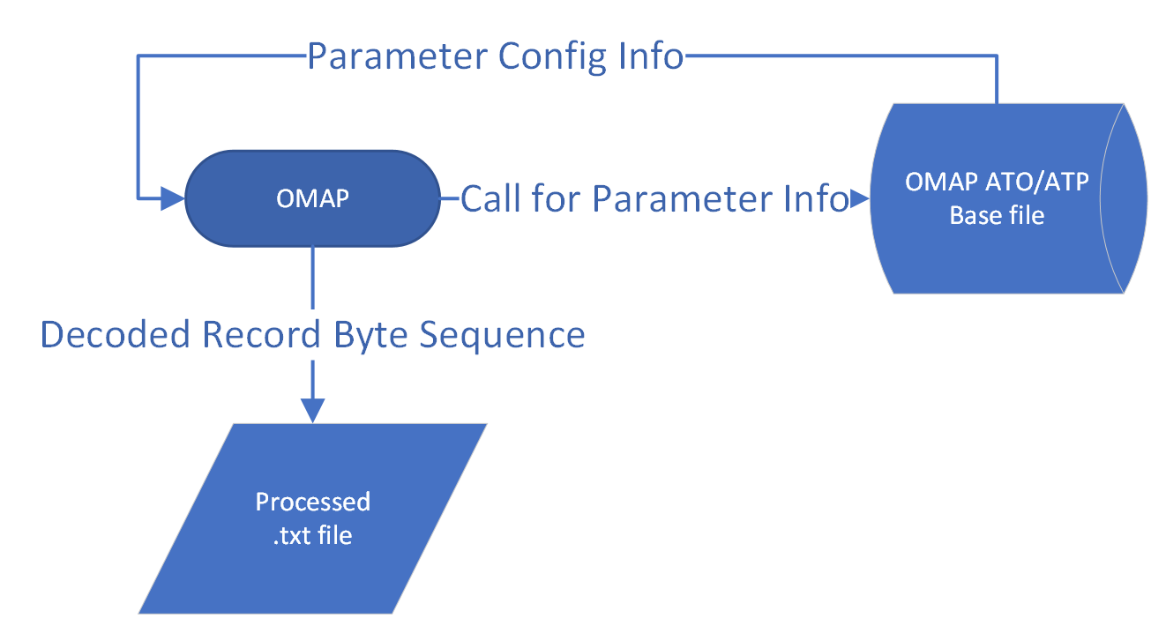
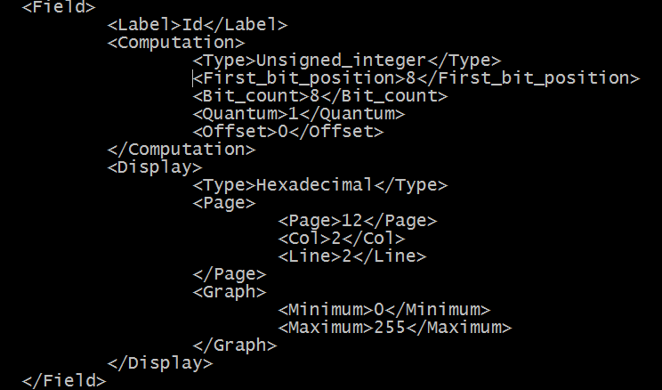
OMAP’s Base Configuration files
Decoded RBS: A binary stream converted to a
delimited string, correspondent to each parameter
RBS: 01010100 00010100 01111000 10110000…
First_bit_position: 8 , Bit_count: 8
Bit-Set: 00010100
Display-Type: Hexadecimal
String Value: 0x14
Now, We Can Reverse-Engineer OMAP’s Decoding Algorithm

Slide 11
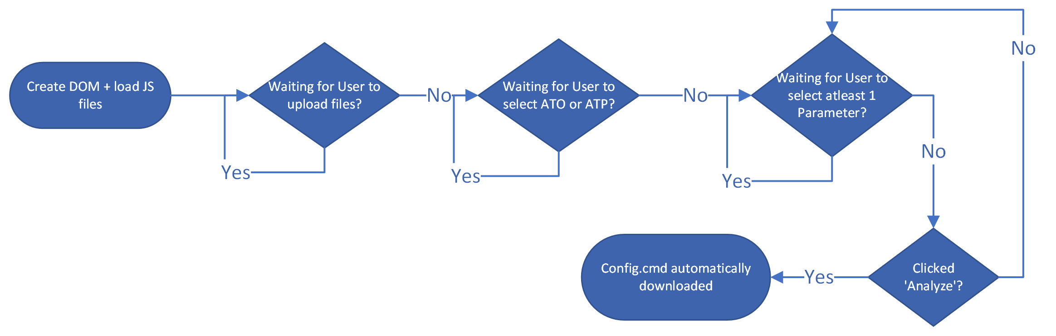
High-Level Overview - Frontend

Slide 12
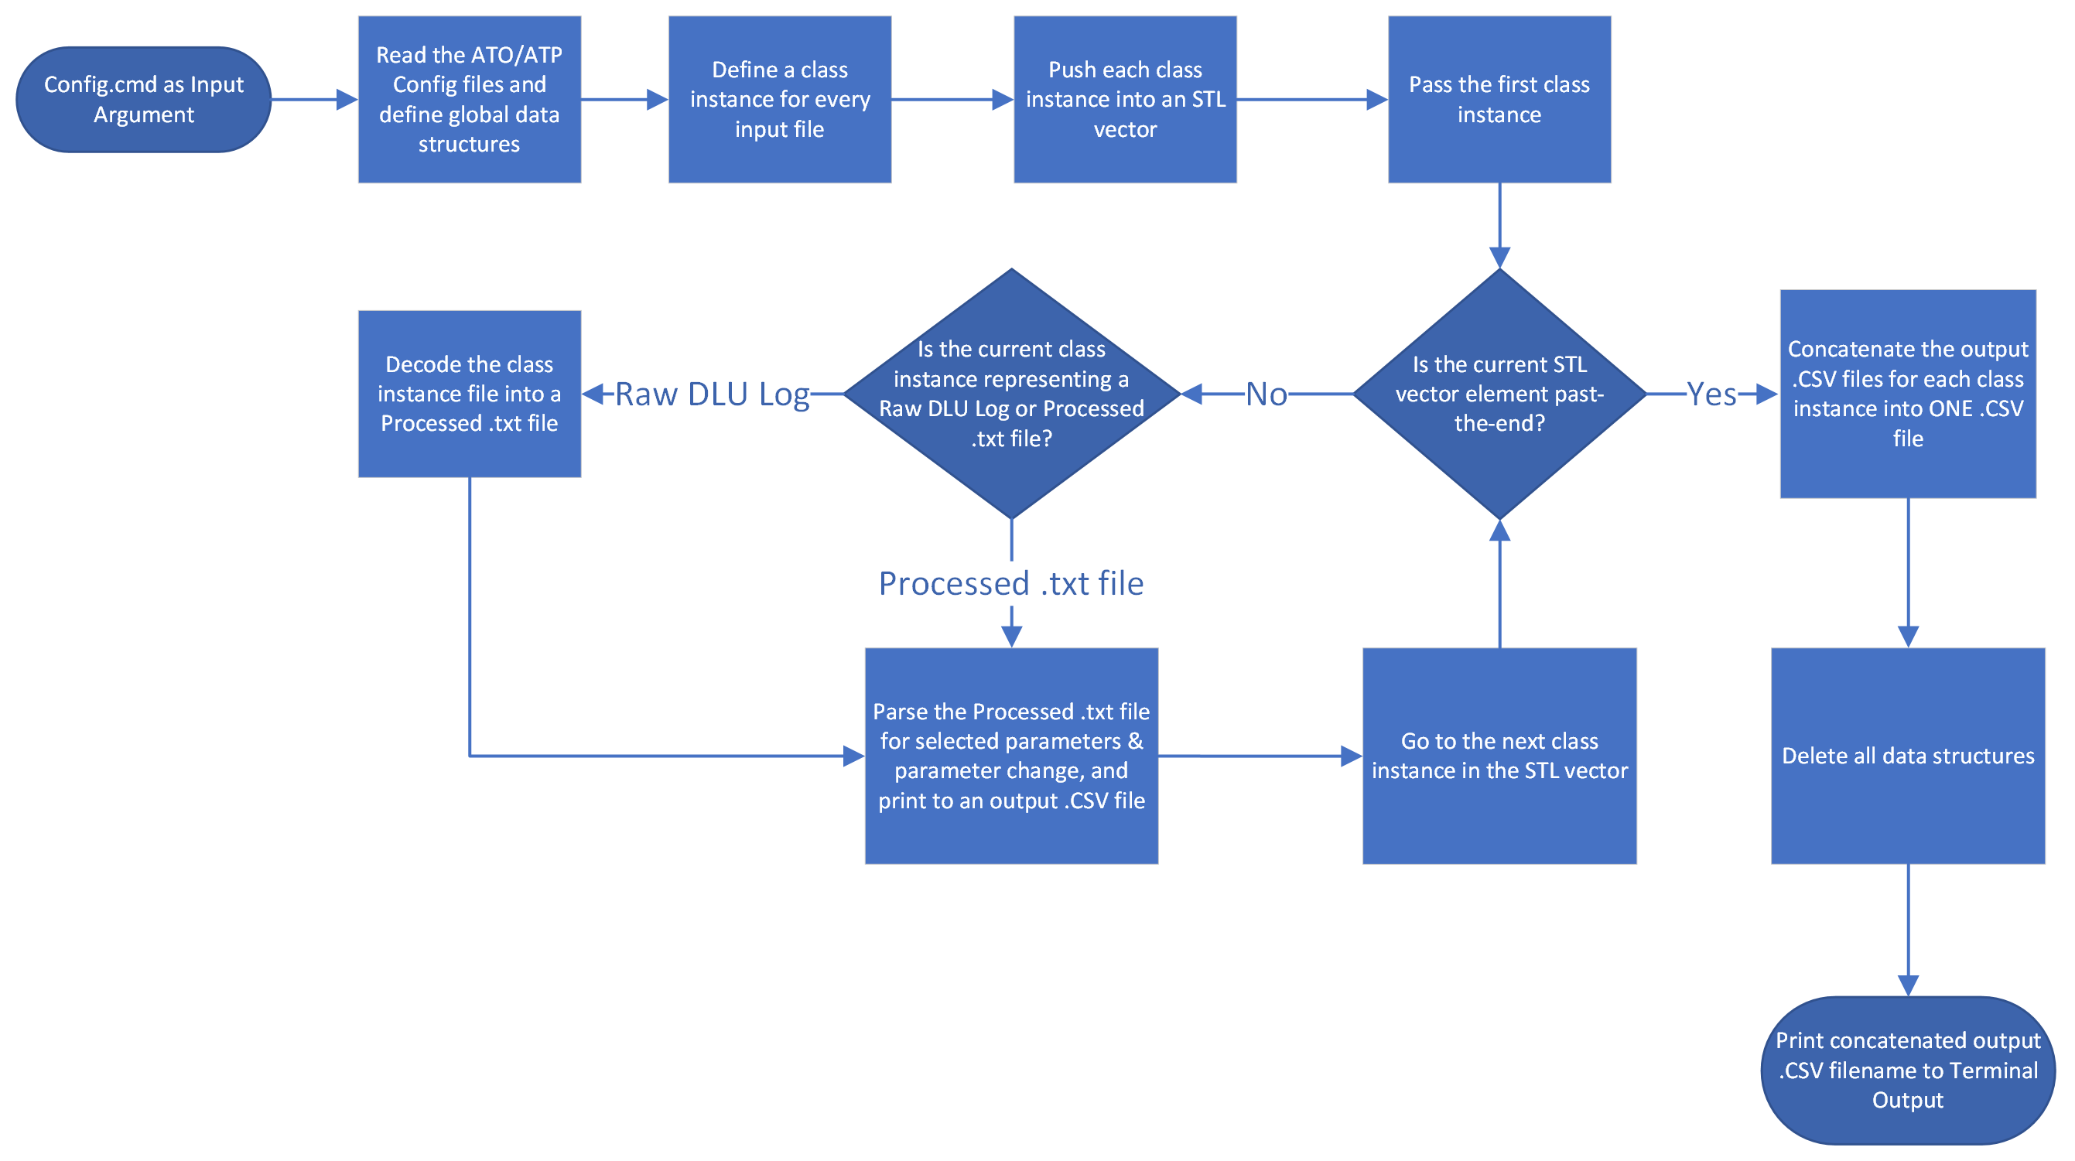
High-Level Overview - Backend

Slide 13
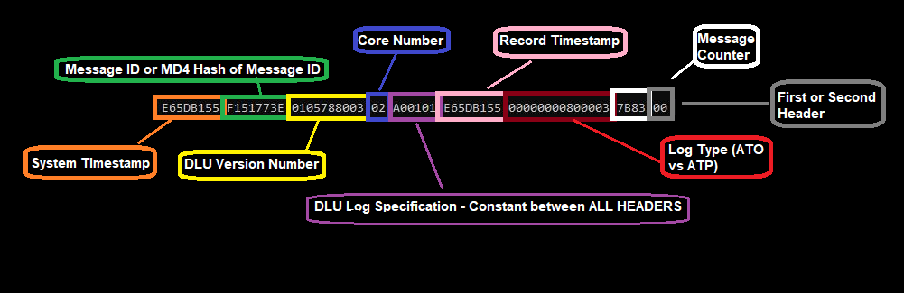
Design Challenges
The HBS & RBS come After the Nullish Byte Sequence (NBS)
The NBS is Variable in length & value
Therefore, how do we determine the bit positions of the HBS & RBS?
Impossible to predict the preliminary sequence – How do we find a constant?
Work backwards; the HBS will tell you in itself
HBS

Slide 14
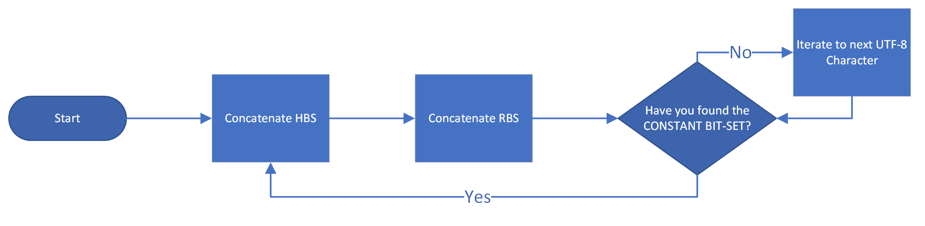
Design Challenges
HBS of non-correlated files & records

Slide 15
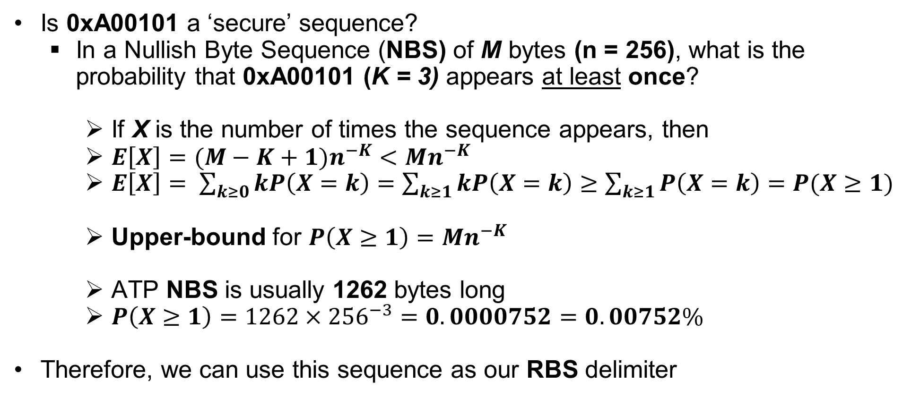
Design Challenges
Is 0xA00101 a ‘secure’ sequence?
In a Nullish Byte Sequence (NBS) of M bytes (n = 256), what is the probability that 0xA00101 (K = 3) appears at least once?
If X is the number of times the sequence appears, then
$E\left[X\right]=(M−K+1{)n}^{−K}<Mn^{−K}$
$E\left[X\right]= \sum_{k≥0}{kP\left(X=k\right)=\sum_{k≥1}{kP\left(X=k\right)≥\sum_{k≥1}{P\left(X=k\right)=P(X≥1)}}}$
Upper-bound for $P\left(X≥1\right)=Mn^{−K}$
ATP NBS is usually 1262 bytes long
$P\left(X≥1\right)=1262×{256}^{−3}=0.0000752=0.00752\%$
Therefore, we can use this sequence as our RBS delimiter

Slide 16
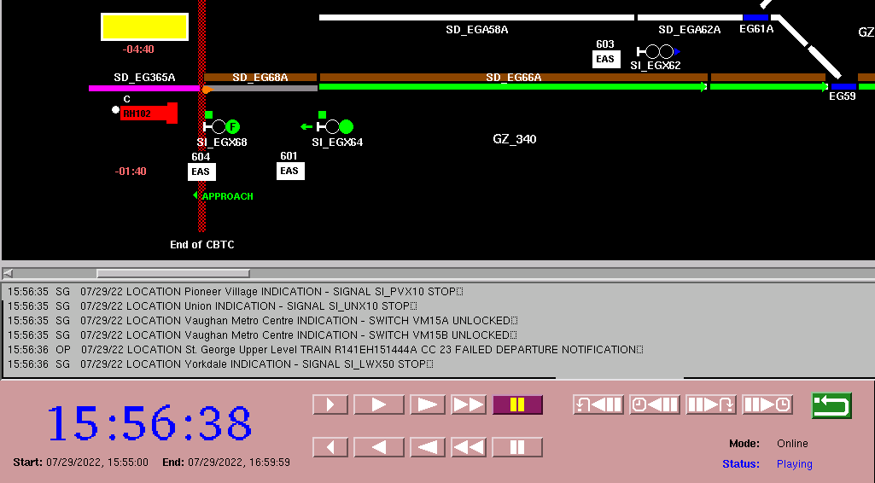
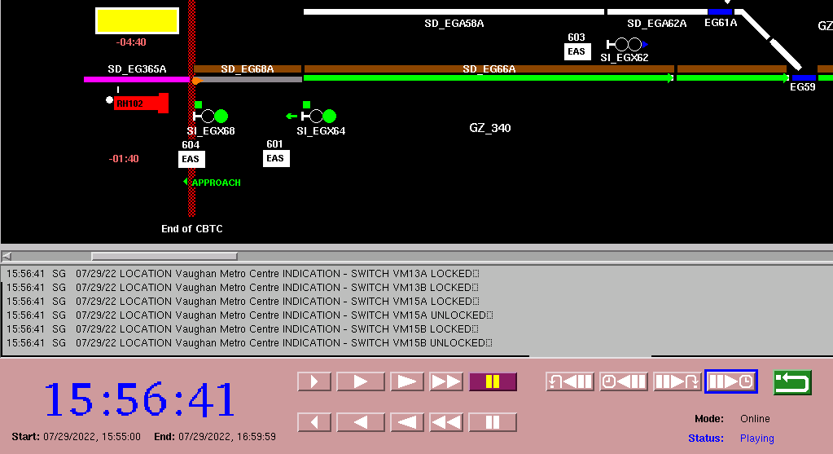
Demonstration
CABS → Invalid

Slide 17
Demonstration
To determine why CABS is lost, analyze:
• Cabin of driver
• C1 V TF 2 block id
• C2 V TF 2 block id
• Filtered Stop
• CABS_Available
• ATO_Available
• VIO1_FDI_6 – ATO Pushbutton Contact #1 in A1 Car
• VIO1_FDI_7 – ATO Pushbutton Contact #2 in A1 Car
• VIO2_FDI_6 – ATO Pushbutton Contact #1 in A6 Car
• VIO2_FDI_7 – ATO Pushbutton Contact #2 in A6 Car
• VIO1_SafetyInput_3 – ATC Mode Selector set to RM in A1 Car
• VIO1_SafetyInput_4 – ATC Mode Selector set to ATC in A1 Car
• VIO1_SafetyInput_8 – ATC Mode Selector set to MAN in A1 Car
• VIO1_Safety Input_10 – ATC Mode Selector set to OFF in A1 Car
• VIO2_SafetyInput_3 – ATC Mode Selector set to RM in A6 Car
• VIO2_SafetyInput_4 – ATC Mode Selector set to ATC in A6 Car
• VIO2_SafetyInput_8 – ATC Mode Selector set to MAN in A6 Car
• VIO2_Safety Input_10 – ATC Mode Selector set to OFF in A6 Car

Slide 18
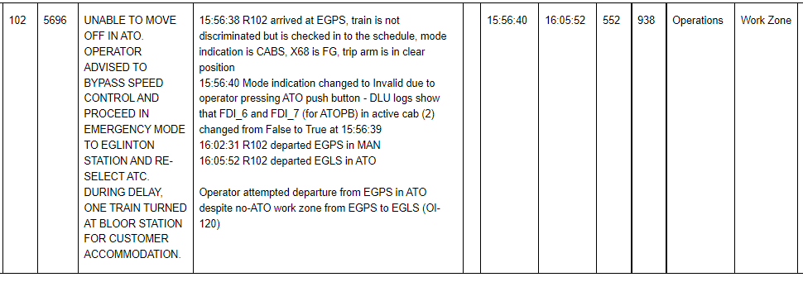
Demonstration Summary
We can come to a summary like this from our analysis

Slide 19
Current Status
This project attempts a full understanding of Raw DLU Logs & OMAP
More work is needed to further understand NBS & its variability
Frontend runs client-side through HTML file
Backend runs through Drag & Drop of Config.cmd file
Decoding Algorithm has been optimized fully for performance
~7.6 seconds for ATO files on Industrial Laptop (18,500,000 Operations)
~2.4 seconds for ATP files on Industrial Laptop (6,300,000 Operations)

Slide 20
Future Enhancements
Bypass the creation of an entire processed .txt file
Don’t decode every parameter, only decode selected parameters
Expand compatibility for compressed DLU logs

Slide 21
Questions and Comments?

