Slide 1
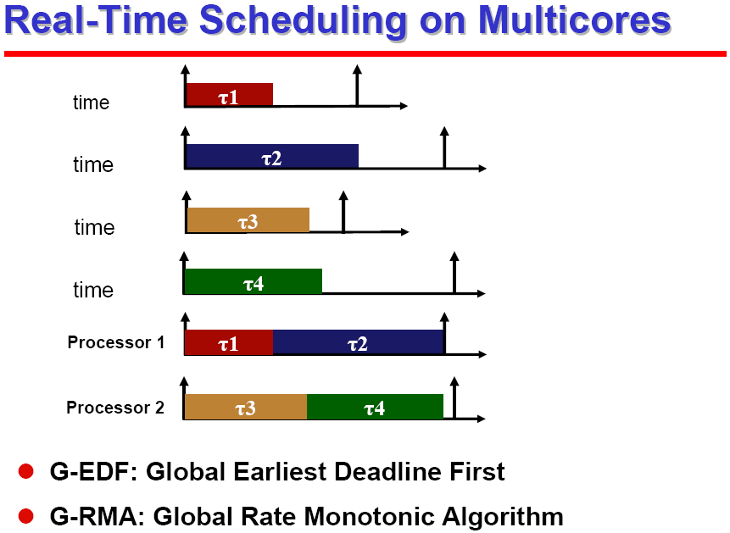
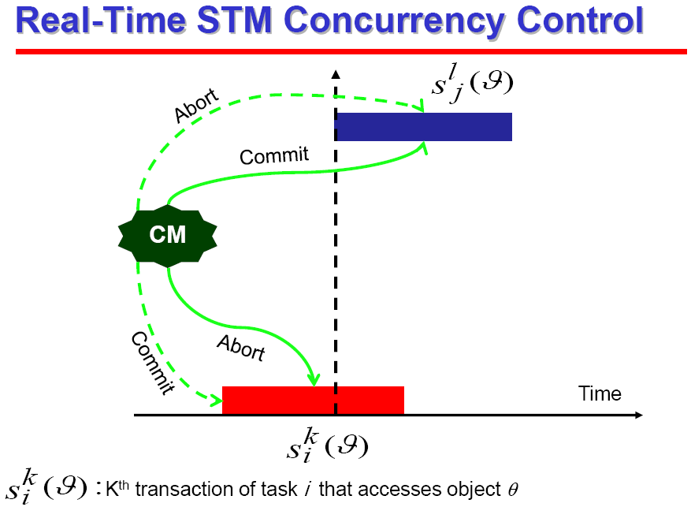
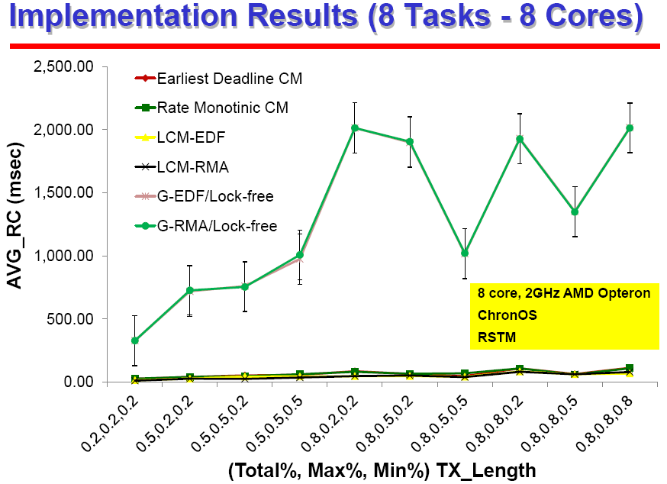
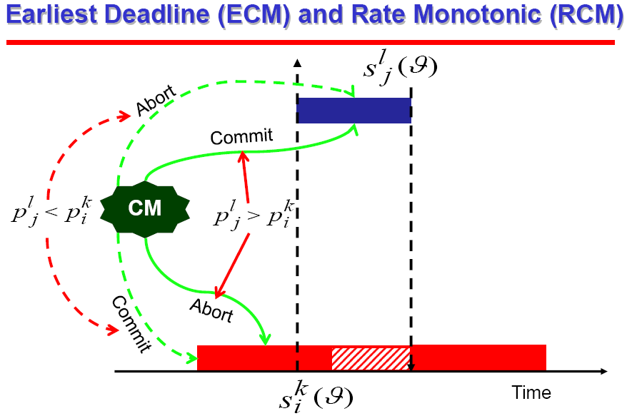
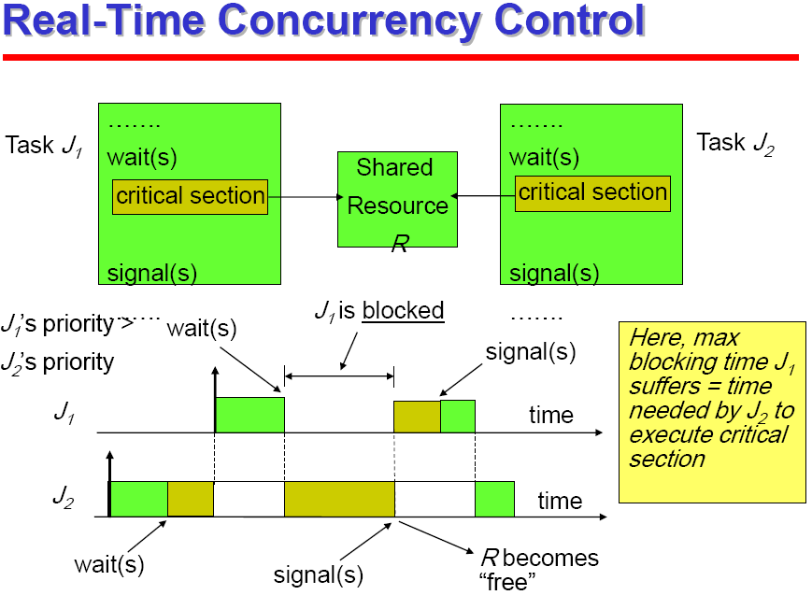
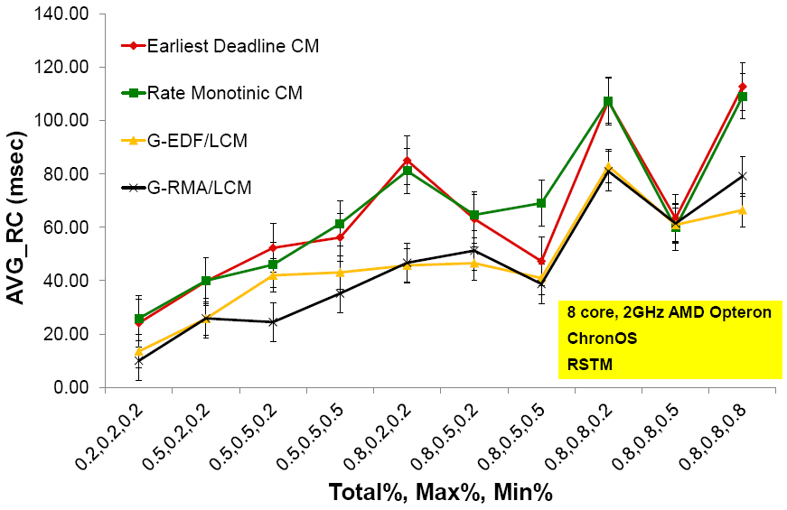
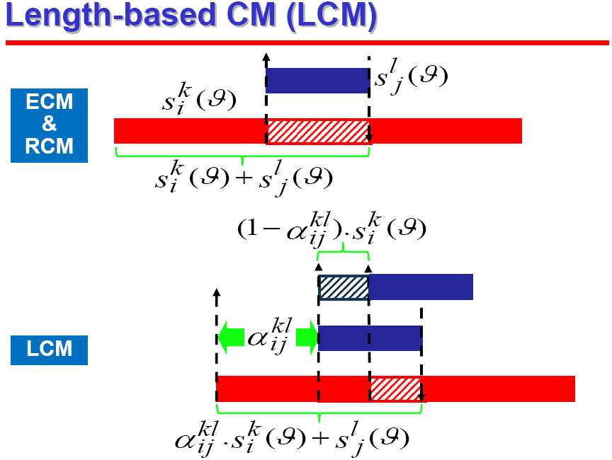
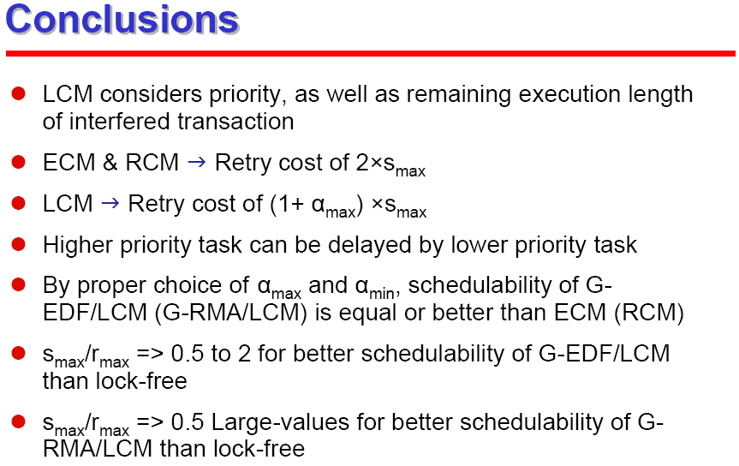
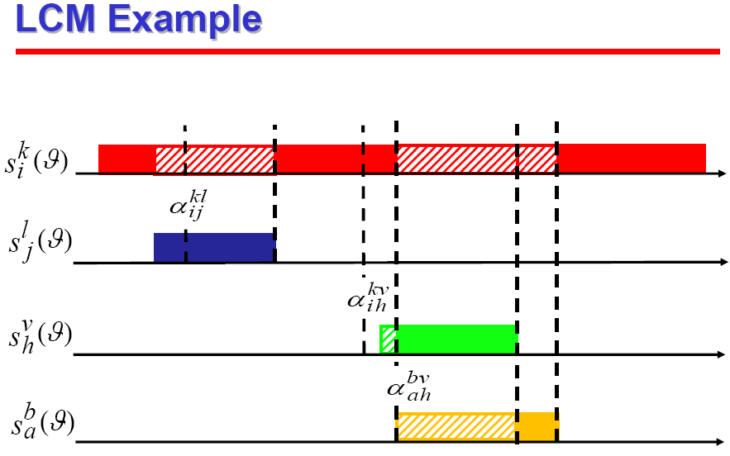
STM Concurrency Control for Embedded Real-Time Software with Tighter Time Bounds
Mohammed Elshambakey, Binoy Ravindran
ECE Dept., Virginia Tech, Blacksburg, Virginia
http://www.real-time.ece.vt.edu
Real-time locking protocols
PIP, PCP, SRP
Lock-free and wait-free
(Software) Transactional Memory (S)TM
Like database transactions
Atomicity, Consistency, Isolation and Durability properties
Easier to program
Fine-grained performance
Composable
STM uses Contention Manager (CM) to resolve conflicts
LCM considers priority, as well as remaining execution length of interfered transaction
ECM & RCM  Retry cost of 2×smax
LCM  Retry cost of (1+ αmax) ×smax
Higher priority task can be delayed by lower priority task
By proper choice of αmax and αmin, schedulability of G-EDF/LCM (G-RMA/LCM) is equal or better than ECM (RCM)
smax/rmax => 0.5 to 2 for better schedulability of G-EDF/LCM than lock-free
smax/rmax => 0.5 Large-values for better schedulability of G-RMA/LCM than lock-free
public boolean add(int item) {
Node pred, curr;
atomic {
pred = head;
curr = pred.next;
while (curr.val < item) {
pred = curr;
curr = curr.next;
}
if (item == curr.val) {
return false;
} else {
Node node = new Node(item);
node.next = curr;
pred.next = node;
return true;
}
}

