Slide 1
ChronOS Linux: A Best-Effort Real-Time Linux Kernel*
Matthew Dellinger
ECE Dept., Virginia Tech
Blacksburg, Virginia
mdelling@vt.edu
http://www.real-time.ece.vt.edu/
*Joint effort with Piyush Garyali (Qualcomm) and Binoy Ravindran (Virginia Tech)
Notes:
Revised 08/08/2004

Slide 2
The Real-Time Problem Space
Traditional SMP Real-Time Scheduling
  Mostly focused on hard real-time systems
    The goal is to meet all deadlines all the time
  SMP real-time schedulers are being increasingly well understood
    G-EDF, G-RMS, PFair, etc.
  Known well in theory, but few mature implementation platforms
    LITMUS^{RT} – vanilla Linux kernel + SMP RT scheduling
Real-Time Linux
  Vanilla Linux isn’t sufficient for many real-time environments
    Soft real-time support (POSIX, high-resolution timers, etc)
  Variety of distributions, but none provide advanced scheduling
  Two approaches: nano-kernel (RTLinux) and kernel modification (PREEMPT_RT)
    Nano-kernel provides more determinism, modification provides traditional Linux application space

Slide 3
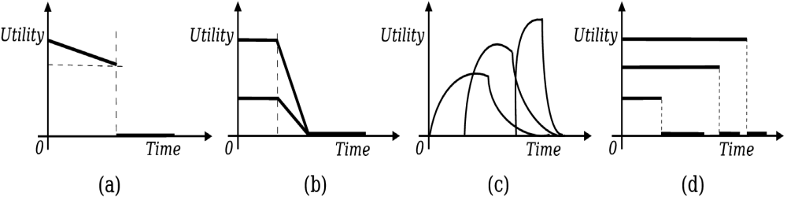
The Real-Time Problem Space
Best-effort Scheduling
  We’d like all applications to be completely deterministic
    Not always possible – context/data dependent execution, etc.
  Want performance to gracefully degrade
    Keep “important” tasks, discard others
  Need to separate importance and urgency
    Done with TUFs (Time-Utility Functions) (Jensen et. al. 1985)
    Downward step TUFs subsume deadlines
  Algorithms exist (gMUA, G-GUA, etc), but no SMP platforms exist

Slide 4
Three Overlapping Fields
No SMP Platforms
LITMUS^{RT}
Best-Effort
SMP Real-Time
Scheduling
Real-Time
Linux
Our goal
PREEMPT_RT
RTAI, Xenomai

Slide 5
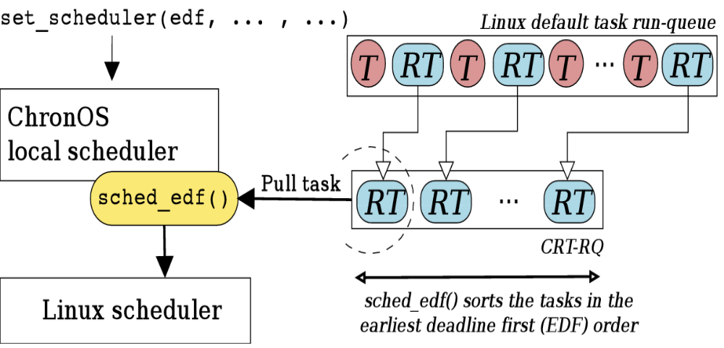
ChronOS Linux
Build on the PREEMPT_RT Patch
  Modifies vanilla Linux kernel to improve determinism
Builds on Linux SCHED_FIFO
  Utilizes existing priority structure
  Doesn’t break POSIX
Hierarchical scheduling framework
  Allows a wide range of algorithms

Slide 6
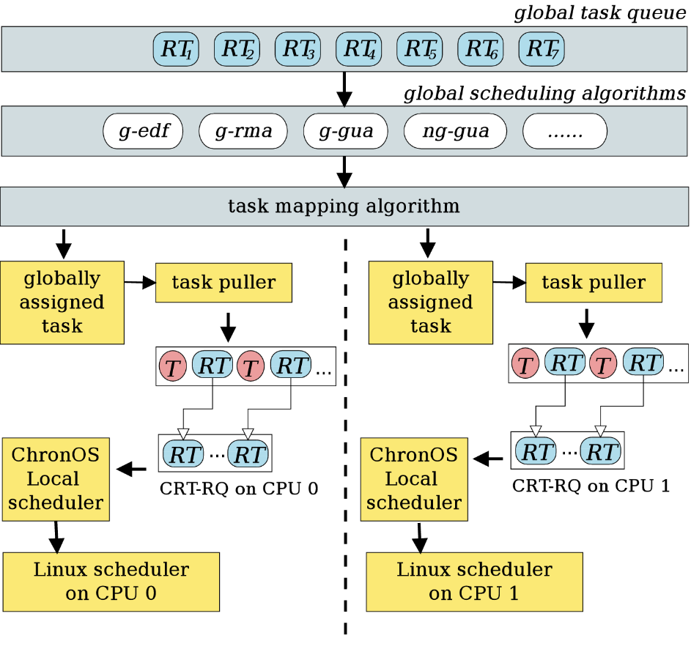
ChronOS Linux
Global scheduling builds on uniprocessor scheduling
  Allows flexible algorithm design
Modular approach allows extensibility
  All schedulers are Linux kernel modules
Scheduling subsystems are divided into two “architectures”
  Handle migration, scheduler invocation, etc.

Slide 7
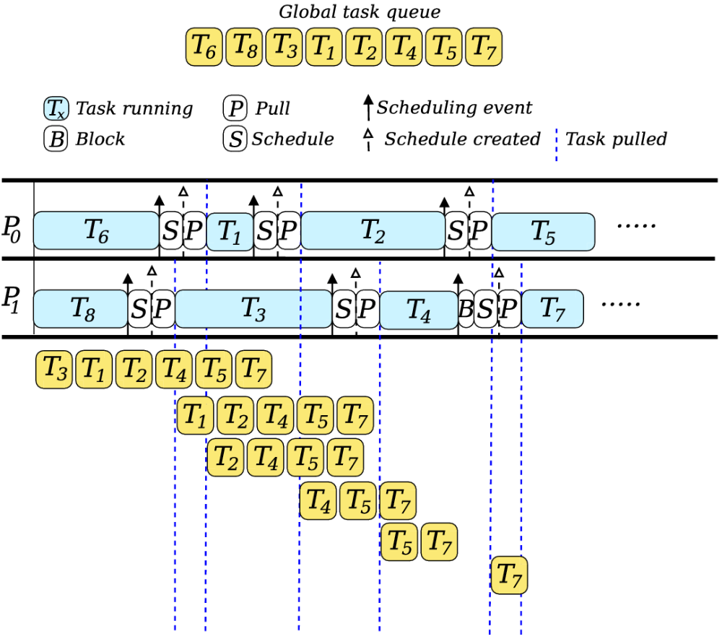
Application Concurrent Architecture
Concurrent architecture
  Each processor schedules for itself from the global queue
  Little contention for shared resources -> highly scalable
  Only a few types of algorithms can be implemented

Slide 8
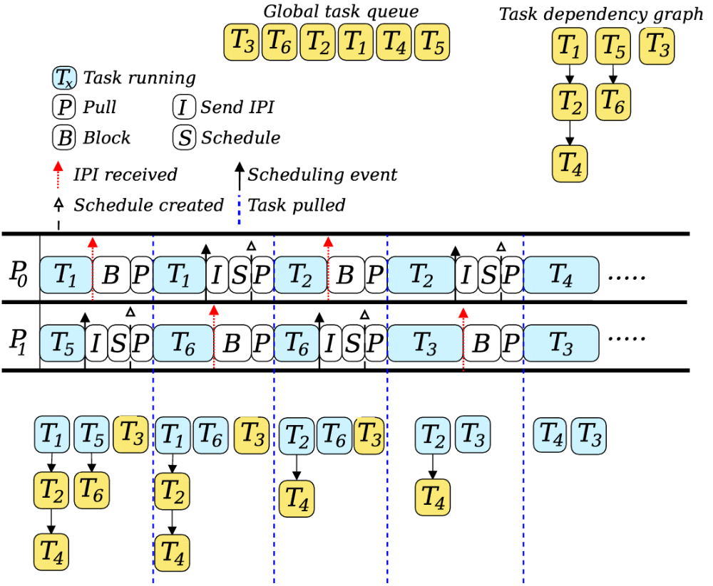
Stop-The-World Architecture
Stop-The-World architecture
  Create a schedule for all processors
  Communicate scheduling events with inter-processor interrupts (IPIs)
  Supports most SMP algorithms (G-EDF, etc)

Slide 9
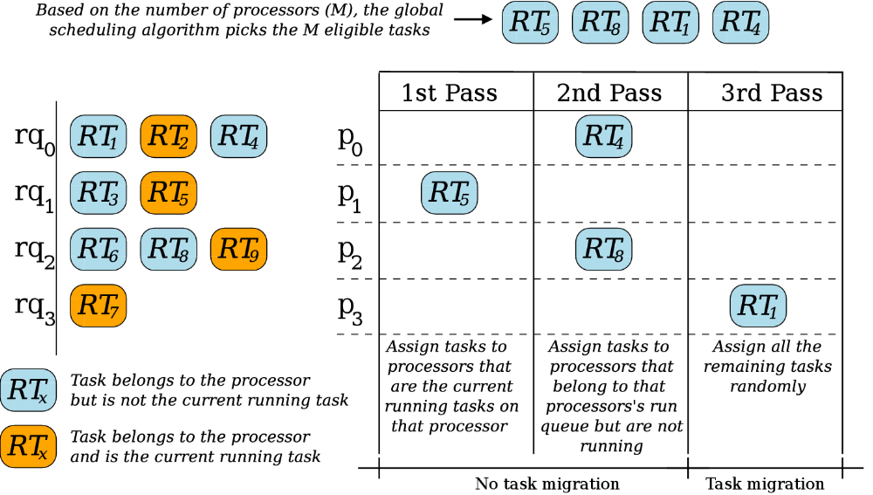
Task Mapping
Most global scheduling algorithms are mapping-agnostic
  Pick M tasks for execution on M processors, but don’t specify which processor which task executes on
  This assignment is done by the mapping algorithm

Slide 10
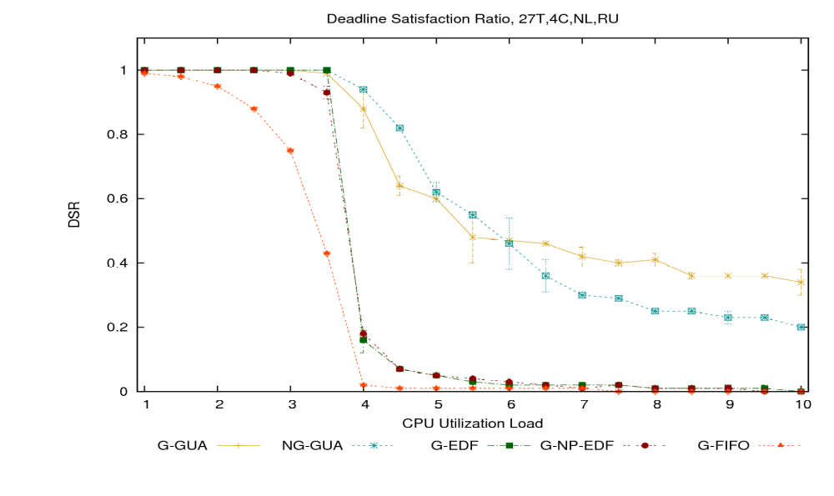
Experimental Results

Slide 11
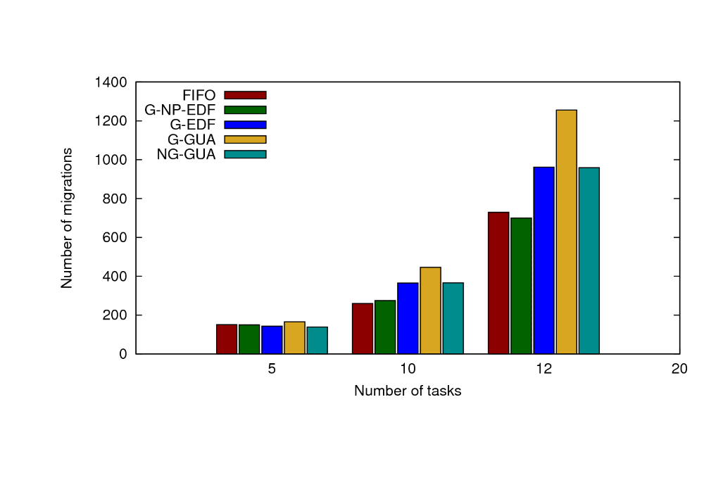
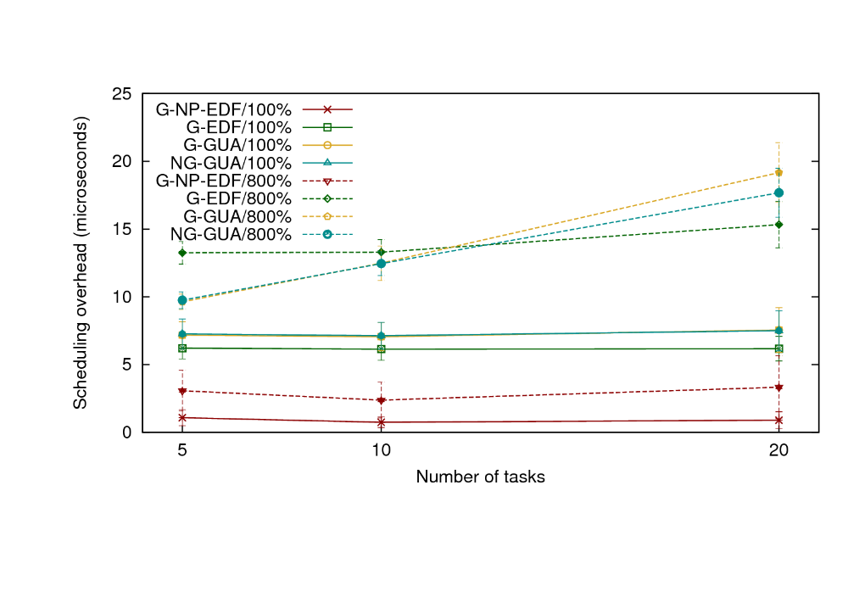
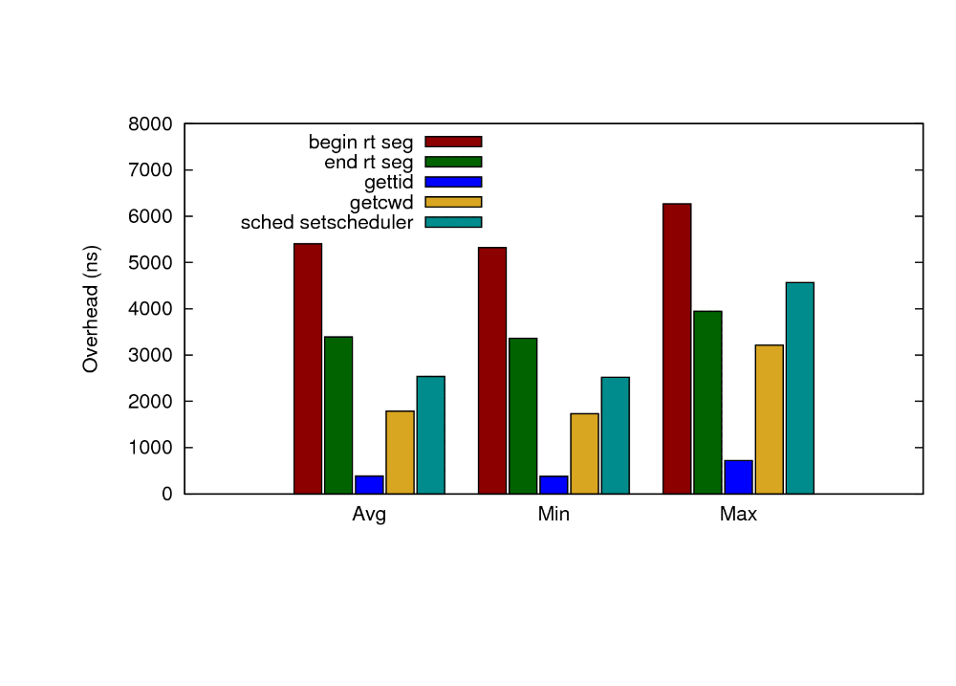
Overheads
Number of Task Migrations
Scheduling Overheads
System Call Overheads

Slide 12
Conclusions
Introduced ChronOS Linux
Goals
  Real-time Linux
    Via the PREEMPT_RT patch
  Multiprocessor real-time scheduling
  Best-effort performance in overloads
Conclusions
  It is possible to build real-time Linux kernel with advanced real-time scheduling
  It is possible to do it in a flexible, extensible way, all without breaking POSIX
  Get sourcecode, etc. at www.chronoslinux.org

