Slide 1
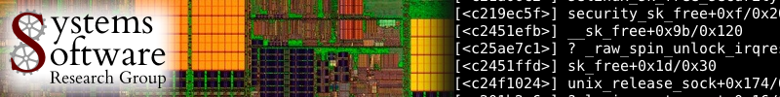

On Real-Time STM Concurrency Control
for Embedded Software
with Improved Schedulability
Mohammed El-Shambakey and Binoy Ravindran
Virginia Tech
USA
{shambake,binoy}@vt.edu
ASP-DAC 2013

Slide 2
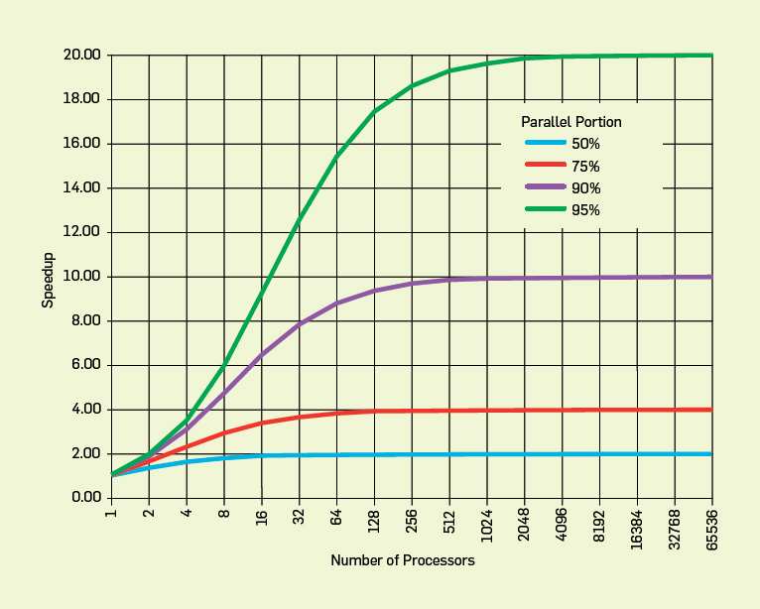
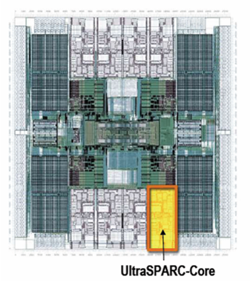
Concurrency control on chip multiprocessors significantly affects performance (and programmability)
Improve performance by exposing greater concurrency
  Amdahl’s law: relationship between sequential execution time and speedup reduction is not linear
Significant implications for embedded real-time software
  Inherently concurrent – react to multiple streams of sensor input and control multiple actuators
  Often concurrently read/write shared data objects
Sun T2000 Niagara (8-core)

Slide 3
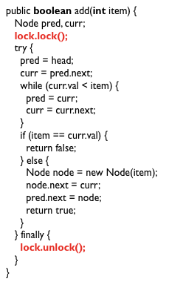
Lock-based concurrency control has serious drawbacks
Coarse grained locking
  Simple
  But no concurrency

Slide 4
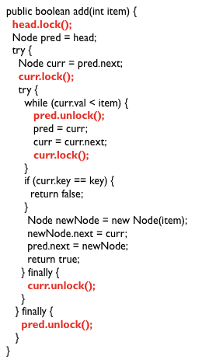
Fine-grained locking is better, but…
Excellent performance
Poor programmability
Lock problems don’t go away!
  Deadlocks, livelocks, lock-convoying, priority inversion,….
Most significant difficulty – composition

Slide 5
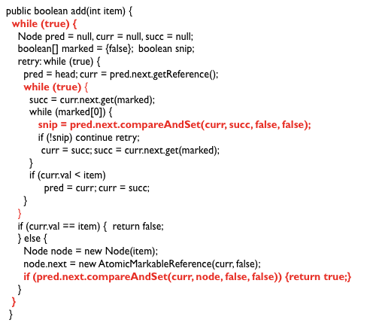
Lock-free synchronization overcomes some of these difficulties, but…
“lock-free retry loop”

Slide 6
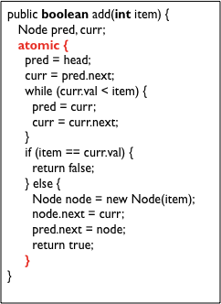
Transactional Memory
Like database transactions
ACI properties (no D)
Easier to program
Fine-grained performance
Composable
First HTM, then STM, later HyTM
M. Herlihy and J. B. Moss (1993). Transactional memory: Architectural support for lock-free data structures. ISCA. pp. 289–300.
N. Shavit and D. Touitou (1995). Software Transactional Memory. PODC. pp. 204—213.

Slide 7
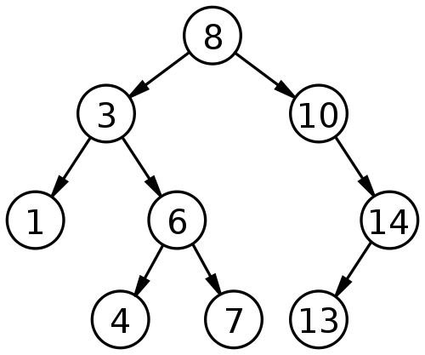
How does TM work?
Idea: speculate
Example: add 9 and 15 concurrently

Slide 8
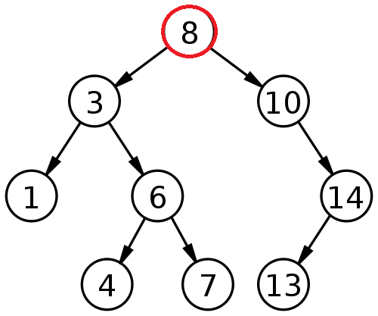
Thread A adds 9 and thread B adds 15
Thread A
Read-set: 8
Write-set:
Thread B
Read-set: 8
Write-set:

Slide 9
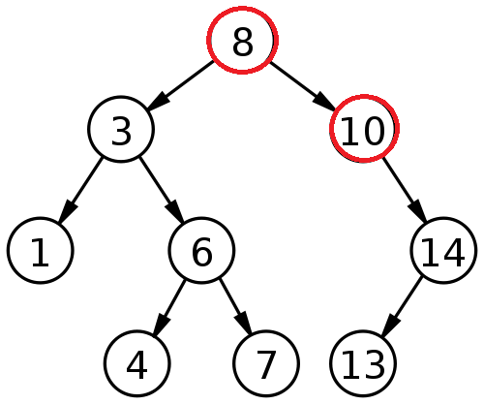
Thread A adds 9 and thread B adds 15
Thread A
Read-set: 8,10
Write-set:
Thread B
Read-set: 8,10
Write-set:

Slide 10
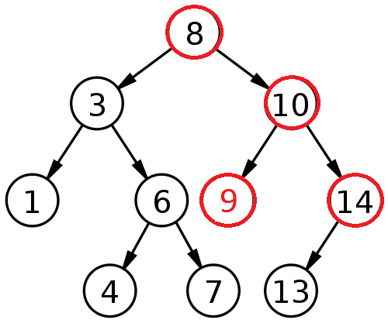
Thread A adds 9 and thread B adds 15
Thread A
Read-set: 8,10
Write-set: 10 (LC)
Thread B
Read-set: 8,10,14
Write-set:

Slide 11
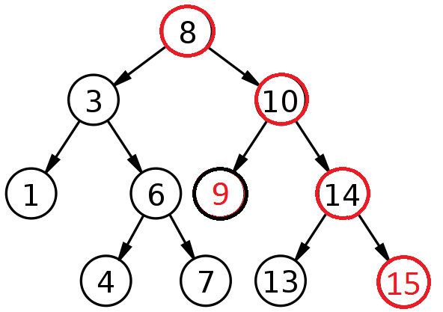
Thread A adds 9 and thread B adds 15
Thread A
Read-set: 8,10
Write-set: 10 (LC)
Thread B
Read-set: 8,10,14
Write-set: 14 (RC)
(Committed successfully)

Slide 12
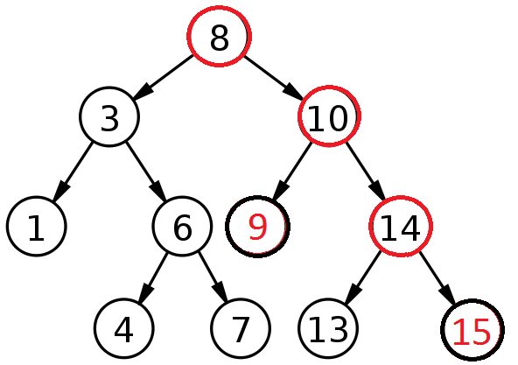
Thread A adds 9 and thread B adds 15
Thread A
Read-set: 8,10
Write-set: 10 (LC)
Thread B
Read-set: 8,10,14
Write-set: 14 (RC)
(Committed successfully)
(Committed successfully)

Slide 13
Object-based granularity causes conflict
(in this case)
Thread A
Read-set: 8,10
Write-set: 10
Thread B
Read-set: 8,10,14
Write-set: 14
Write-after-read
(Committed successfully)
(Conflict, so abort and retry)

Slide 14
Optimistic execution yields performance gains at the simplicity of coarse-grain, but no silver bullet
Time
Coarse-grained locking
Irrevocable operations
Interaction between transactions and non-transactions
Conditional waiting
……
STM
Fine-grained locking
Threads
E.g., C/C++ Intel Run-Time System STM (B. Saha et. al. (2006). McRT-STM: A High Performance Software Transactional Memory. ACM PPoPP.)

Slide 15
Three key mechanisms needed to create atomicity illusion
Versioning
Conflict detection
T0
T1
atomic{
x = x + y;
}
atomic{
x = x + y;
}
atomic{
x = x / 25;
}
Where to store new x until commit?
  Eager: store new x in memory; old in undo log
  Lazy: store new x in write buffer
How to detect conflicts between T0 and T1?
  Record memory locations read in read set
  Record memory locations wrote in write set
  Conflict if one’s read or write set intersects the other’s write set

Slide 16
Third mechanism determines transactional progress
Conflict resolution or contention management
T0
T1
x = x + y;
x = x / 25;
x = x / 25;
Which transaction to abort?
  Polite: familiar exponential backoff
  Greedy: favor those with an earlier start time
  Karma: ….
(Starvation may occur)

Slide 17
Wait-free progress is necessary for real-time STM
Bound retry cost to satisfy time constraints
Rely on existing versioning and conflict detection techniques
Contention management directly affects transactional progress
  Starvation-freedom is necessary

Slide 18
Paper’s contribution
Prior research have developed real-time contention managers, with bounded retry costs and response times
  Earliest deadline first contention manager (ECM)
  Rate monotonic contention manager (RCM)
  Length-based contention manager (LCM)
But they restrict to one object access per transaction
Paper presents new contention manager: PNF
  Allows multiple objects per transaction
  Bounds retry cost and response time
Formal comparison with past CMs and lock-free
Implementation
  M. El-Shambakey and B. Ravindran. STM concurrency control for embedded real-time software with tighter time bounds. In DAC, pages 437–446, 2012

Slide 19
Model is traditional real-time model
Threads arrive periodically, with deadlines equal to periods
Threads subsume transactions
Execute on a CMP
Two schedulers: global EDF (G-EDF) and global RMA (G-RMA)
Total thread utilization demand satisfies G-EDF (G-RMA)’s schedulable utilization bound
Thread release
τ_{i}
Thread completion
Transaction
Next thread release
Time
Thread period, T_{i} = relative thread deadline

Slide 20
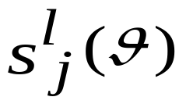
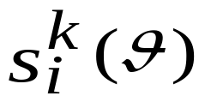
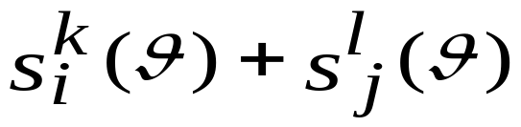


Earliest Deadline CM
  γ_{i}: tasks sharing objects θ with τ_{i}
  : l^{th} atomic section of τ_{j}
  s_{max}(θ): longest atomic section in all tasks
  : longest atomic section in τ_{i} accessing θ

Slide 21


Thread execution time is inflated with worst-case transactional retry cost
Each interference may cause a retry
C_{ji} is the inflated WCET of τ_{j} relative to τ_{i}:
  C_{j} : WCET of τ_{j} without retries
  ɵ: shared object between τ_{j} and τ_{i}
  len(s_{j}(ɵ)) : length of all atomic sections in τ_{j} that accesses ɵ
  RC(τ_{ji}): retry cost of τ_{j} without considering τ_{i}
G-EDF (G-RMA)’s response time analysis can now be used to determine schedulability of ECM
Notes:
C_ji excludes retry cost of task I in task J, but it includes all retries of task J due to all other tasks

Slide 22
ECM was formally compared with
G-EDF/lock-free synchronization
Utilization demand-based schedulability (i.e., U_{i} = C_{i}/T_{i})
  Less demand is better
ECM is better than G-EDF/lock-free if s_{max} < r_{max}/2
  s_{max} : max cost of one transactional retry
  r_{max} : max cost of one lock-free retry
(Similar result for RCM and LCM)
  M. El-Shambakey and B. Ravindran. STM concurrency control for embedded real-time software with tighter time bounds. In DAC, pages 437–446, 2012

Slide 23
Priority CM with Negative value and First access (PNF)
ECM, RCM, and LCM suffer from transitive retry
Significantly wasted processor time for lower priority jobs
s^{e}_{f}(θ3, θ4)
s^{c}_{d}(θ2, θ3)
s^{c}_{d}(θ2, θ3)
wasted processor time
sª_{b}(θ1, θ2)
sª_{b}(θ1, θ2)

Slide 24
Design goals of PNF…
Allow multiple objects per transaction
Tight bound for transitive retry
Reduce wasted processor time

Slide 25


PNF design
m_set
p1
n_set
sª_{b}(θ1, θ2)
sª_{b}(θ1, θ2)
s^{c}_{d}(θ3, θ4)
p2
s^{c}_{d}(θ3, θ4)
p3
s^{e}_{f}(θ1, θ5)

Slide 26
PNF rationale
m_set
p1
n_set
sª_{b}(θ1, θ2)
sª_{b}(θ1, θ2)
s^{c}_{d}(θ3, θ4)
p2
s^{e}_{f}(θ1, θ5)
s^{c}_{d}(θ3, θ4)
p3
s^{e}_{f}(θ1, θ5)
s^{e}_{f}(θ1, θ5)

Slide 27
PNF rationale
m_set
p1
n_set
sª_{b}(θ1, θ2)
sª_{b}(θ1, θ2)
s^{c}_{d}(θ3, θ4)
p2
s^{e}_{f}(θ1, θ5)
s^{c}_{d}(θ3, θ4)
p3
s^{e}_{f}(θ1, θ5)
s^{e}_{f}(θ1, θ5)
p4
s^{g}_{h}(θ1, θ6)

Slide 28
PNF rationale
m_set
p1
n_set
sª_{b}(θ1, θ2)
sª_{b}(θ1, θ2)
s^{g}_{h}(θ1, θ6)
s^{c}_{d}(θ3, θ4)
p2
s^{e}_{f}(θ1, θ5)
s^{c}_{d}(θ3, θ4)
s^{i}_{j}(θ5, θ7)
p3
s^{e}_{f}(θ1, θ5)
s^{e}_{f}(θ1, θ5)
p4
s^{g}_{h}(θ1, θ6)
s^{g}_{h}(θ1, θ6)
p5
s^{i}_{j}(θ5, θ7)
p3
τ^{l}_{k}

Slide 29
PNF rationale
m_set
p1
n_set
sª_{b}(θ1, θ2)
sª_{b}(θ1, θ2)
s^{g}_{h}(θ1, θ6)
s^{c}_{d}(θ3, θ4)
p2
s^{e}_{f}(θ1, θ5)
s^{c}_{d}(θ3, θ4)
s^{i}_{j}(θ5, θ7)
p3
s^{e}_{f}(θ1, θ5)
s^{e}_{f}(θ1, θ5)
p4
s^{g}_{h}(θ1, θ6)
s^{g}_{h}(θ1, θ6)
p5
s^{i}_{j}(θ5, θ7)
Notes:
S_i,j directly conflicts with S_e,f, which conflicts with S_a,b. Thus, S_i,j has transitively conflicts with S_a,b. But note that, PNF removes this transitive conflict: S_e,f is added to the n-set; so S_j,j can now execute, as it does not conflict with S_a,b.

Slide 30
PNF rationale
m_set
p1
n_set
sª_{b}(θ1, θ2)
sª_{b}(θ1, θ2)
s^{g}_{h}(θ1, θ6)
s^{c}_{d}(θ3, θ4)
p2
s^{e}_{f}(θ1, θ5)
s^{c}_{d}(θ3, θ4)
s^{g}_{h}(θ1, θ6)
p3
s^{e}_{f}(θ1, θ5)
s^{e}_{f}(θ1, θ5)
p4
s^{g}_{h}(θ1, θ6)
s^{g}_{h}(θ1, θ6)

Slide 31
PNF rationale
m_set
n_set
s^{c}_{d}(θ3, θ4)
p2
s^{e}_{f}(θ1, θ5)
s^{c}_{d}(θ3, θ4)
s^{e}_{f}(θ1, θ5)
s^{g}_{h}(θ1, θ6)
p3
s^{e}_{f}(θ1, θ5)
s^{e}_{f}(θ1, θ5)
p4
s^{g}_{h}(θ1, θ6)
Notes:
Size of m-set is m, which is the # processors
Size of n-set is n, which is # tasks

Slide 32


PNF’s retry cost and response time bounds
Retry cost bound during interval L
Blocking time bound due to lower priority jobs
Response time bound of τ_{i}^{x}

Slide 33
Key schedulability comparison
PNF ≥ lock-free if s_{max}/r_{max} ≤ 1
  Better than ECM!
  (Better than RCM and LCM)

Slide 34
Implementation studies
Implemented ECM, RCM, LCM, and PNF in Rochester STM
RSTM CAS for lock-free
ChronOS real-time Linux kernel (chronoslinux.org)
8-core, 2GHz AMD Opteron

Slide 35
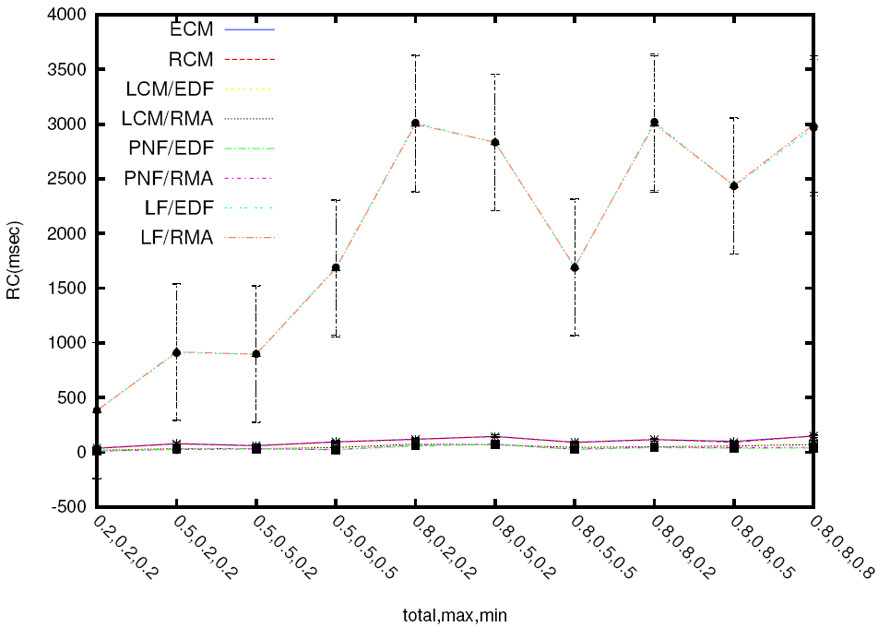
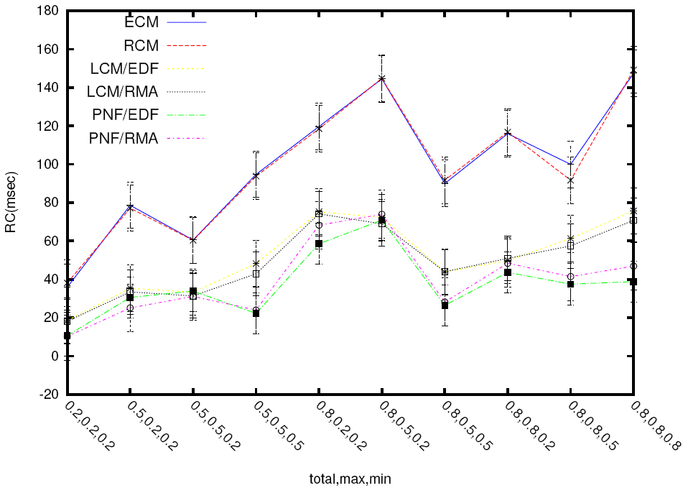
Implementation studies: retry cost under single shared object
  4 tasks
  1 shared object per transaction
  CMs and lock-free
Retry cost measured by varying max transaction length, min transaction length, and # transactions: (total, max, min)

Slide 36
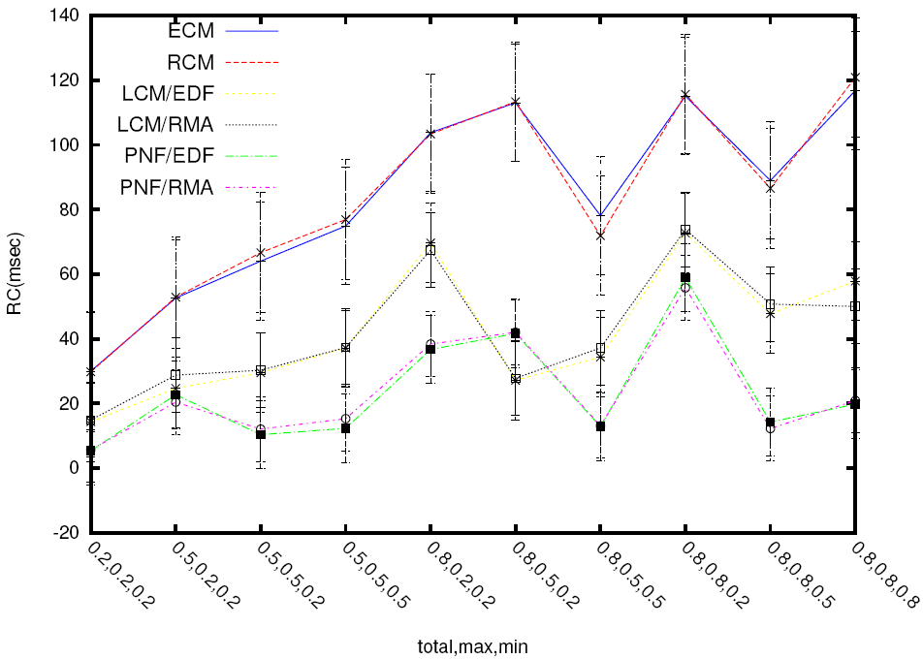
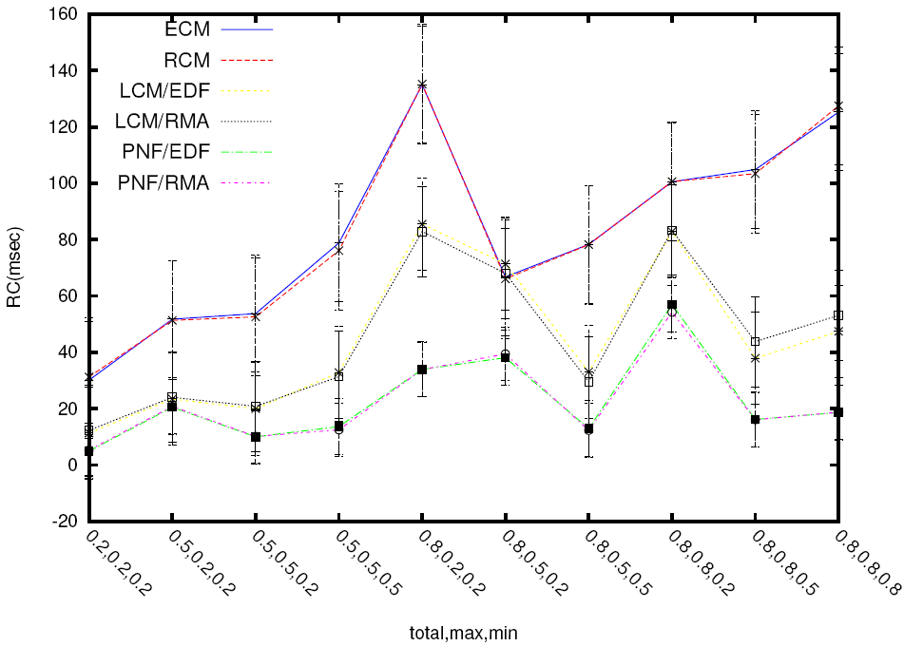
Implementation studies: retry cost under multiple shared objects
  4 tasks
  40 shared objects per transaction
  80% write
  4 tasks
  20 shared objects per transaction
  40% write

Slide 37
Conclusions
Presented a real-time STM contention manager: PNF
  Allows multiple objects per transaction; avoids transitive retry
  Bounded retry cost and response time
  Schedulability comparison
  Implementation
Allows reaping STM’s programmability and composability advantages for a broader range than previously possible
On the negative side:
  Relatively complex implementation
  Greater priority inversion
  Must declare all transactional objects at transaction-start
  FBLT: A Real-Time Contention Manager with Improved Real-Time Schedulability, M. El-Shambakey and B. Ravindran, DATE 2013

