Slide 1

Real-Time Software Transactional Memory: Contention Managers, Time Bounds, and Implementations
Mohammed Elshambakey and Binoy Ravindran
ECE Department, Virginia Tech
Blacksburg, Virginia, USA
{shambake, binoy}@vt.edu
ASP-DAC 2013

Slide 2
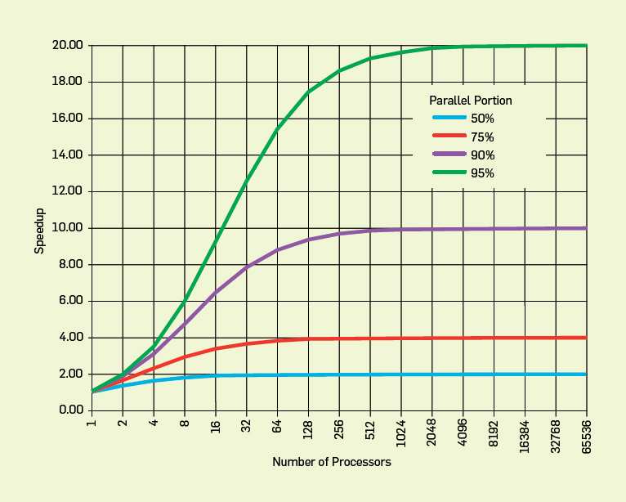
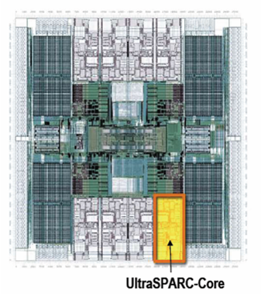
Concurrency control on chip multiprocessors significant affects performance (and programmability)
Improve performance by exposing greater concurrency
  Amdahl’s law: relationship between sequential execution time and speedup reduction is not linear
Significant implications for embedded real-time software
  Inherently concurrent – react to multiple streams of sensor input and control multiple actuators
  Often concurrently read/write shared data objects
Sun T2000 Niagara (8-core)

Slide 3
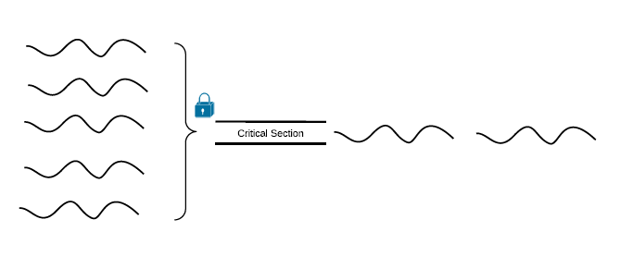
Concurrency Control (2)
Lock-based synchronization
  Coarse-grained locking
  Fine-grained locking
Locks problems
  Deadlocks, livelocks, lock-convoying, priority inversion, non-composable

Slide 4
Coarse vs. Fine Grained Locking
public boolean add(int item) {
Node pred, curr;
lock.lock();
try {
pred = head;
curr = pred.next;
while (curr.val < item) {
pred = curr;
curr = curr.next;
}
if (item == curr.val) {
return false;
} else {
Node node = new Node(item);
node.next = curr;
pred.next = node;
return true;
}
} finally {
lock.unlock();
}
}
public boolean add(int item) {
head.lock();
Node pred = head;
try {
Node curr = pred.next;
curr.lock();
try {
while (curr.val < item) {
pred.unlock();
pred = curr;
curr = curr.next;
curr.lock();
}
if (curr.key == key) {
return false;
}
Node newNode = new Node(item);
newNode.next = curr;
pred.next = newNode;
return true;
} finally {
curr.unlock();
}
} finally {
pred.unlock();
}
}

Slide 5
Concurrency Control (3)
Lock-free synchronization
public boolean add(int item) {
while (true) {
Node pred = null, curr = null, succ = null;
boolean[] marked = {false}; boolean snip;
retry: while (true) {
pred = head; curr = pred.next.getReference();
while (true) {
succ = curr.next.get(marked);
while (marked[0]) {
snip = pred.next.compareAndSet(curr, succ, false, false);
if (!snip) continue retry;
curr = succ; succ = curr.next.get(marked);
}
if (curr.val < item)
pred = curr; curr = succ;
}
}
if (curr.val == item) { return false;
} else {
Node node = new Node(item);
node.next = new AtomicMarkableReference(curr, false);
if (pred.next.compareAndSet(curr, node, false, false)) {return true;}
}
}
}

Slide 6
Transactional Memory
Like database transactions
ACID properties
Easier to program
Fine-grained performance
Composable
public boolean add(int item) {
Node pred, curr;
atomic {
pred = head;
curr = pred.next;
while (curr.val < item) {
pred = curr;
curr = curr.next;
}
if (item == curr.val) {
return false;
} else {
Node node = new Node(item);
node.next = curr;
pred.next = node;
return true;
}
}

Slide 7
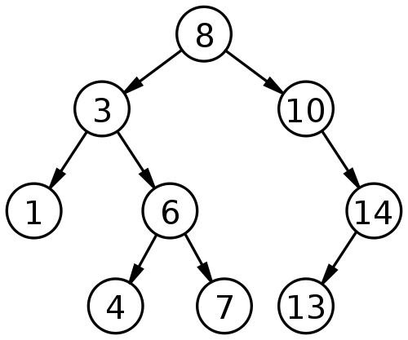
How TM works?
Optimistic concurrency
Example: Adding 9 & 15 concurrently

Slide 8
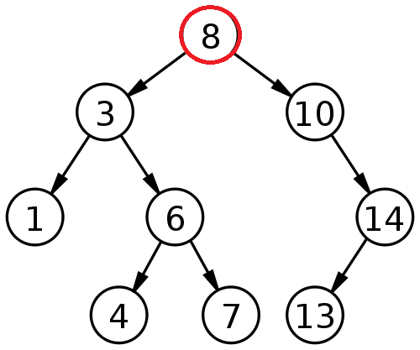
Thread A adds 9 & Thread B adds 15
Thread A
Read-set: 8
Write-set:
Thread B
Read-set: 8
Write-set:

Slide 9
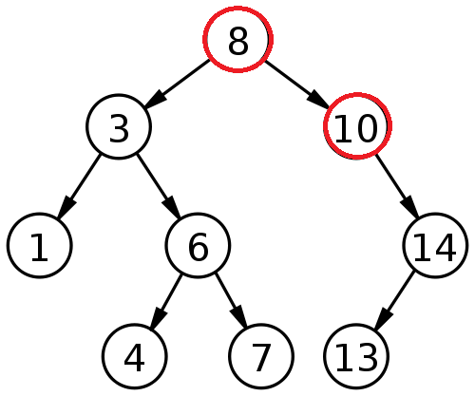
Thread A adds 9 & Thread B adds 15
Thread A
Read-set: 8, 10
Write-set:
Thread B
Read-set: 8, 10
Write-set:

Slide 10
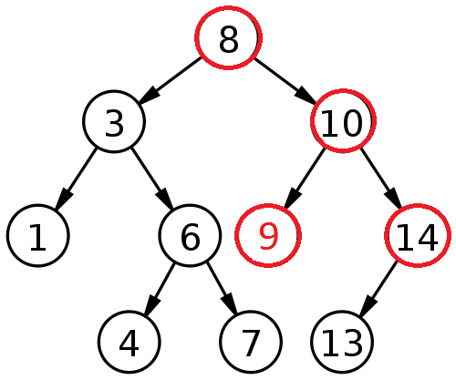
Thread A adds 9 & Thread B adds 15
Thread A
Read-set: 8, 10
Write-set: 10 (left child pointer)
Thread B
Read-set: 8, 10, 14
Write-set:

Slide 11
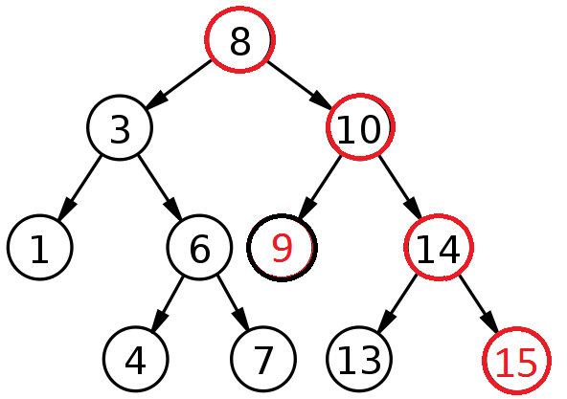
Thread A adds 9 & Thread B adds 15
Thread A
Read-set: 8, 10
Write-set: 10 (left child pointer)
Committed successfully
Thread B
Read-set: 8, 10, 14
Write-set: 14 (right child pointer)

Slide 12
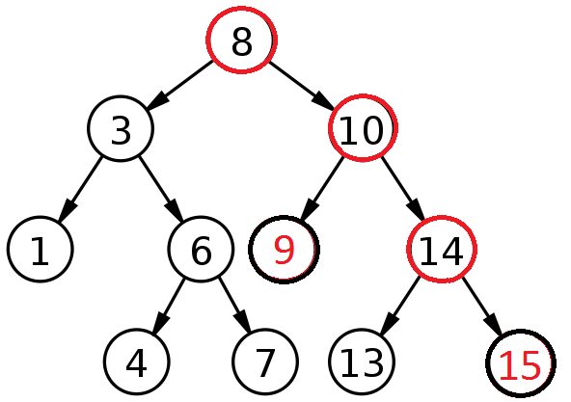
Thread A adds 9 & Thread B adds 15
Thread A
Read-set: 8, 10
Write-set: 10 (left child pointer)
Committed successfully
Thread B
Read-set: 8, 10, 14
Write-set: 14 (right child pointer)
Committed successfully

Slide 13
Object-based granularity
Thread A
Read-set: 8, 10
Write-set: 10
Committed successfully
Thread B
Read-set: 8, 10, 14
Write-set: 14
Conflict ➔ Abort
WAR

Slide 14
Three key mechanisms needed to create atomicity illusion
Versioning
Conflict detection
T0
T1
atomic{
x = x + y;
}
atomic{
x = x + y;
}
atomic{
x = x / 25;
}
Where to store new x until commit?
  Eager: store new x in memory; old in undo log
  Lazy: store new x in write buffer
How to detect conflicts between T0 and T1?
  Record memory locations read in read set
  Record memory locations wrote in write set
  Conflict if one’s read or write set intersects the other’s write set

Slide 15
Third mechanism determines transactional progress (need wait-free progress for real-time software)
Conflict resolution or contention management
T0
T1
x = x + y;
x = x / 25;
x = x / 25;
Which transaction to abort?
  Polite: familiar exponential backoff
  Greedy: favor those with an earlier start time
  Karma: ….
(Starvation may occur)

Slide 16
Optimistic execution yields performance gains at the simplicity of coarse-grain, but no silver bullet
Time
Coarse-grained locking
Irrevocable operations
Interaction between transactions and non-transactions
Conditional waiting
……
STM
Fine-grained locking
Threads
E.g., C/C++ Intel Run-Time System STM (B. Saha et. al. (2006). McRT-STM: A High Performance Software Transactional Memory. ACM PPoPP.)

Slide 17
Optimistic execution yields performance gains at the simplicity of coarse-grain, but no silver bullet
Time
Coarse-grained locking
Irrevocable operations
Interaction between transactions and non-transactions
Conditional waiting
……
STM
Fine-grained locking
Threads
E.g., C/C++ Intel Run-Time System STM (B. Saha et. al. (2006). McRT-STM: A High Performance Software Transactional Memory. ACM PPoPP.)

Slide 18
Model is traditional real-time model
Threads arrive periodically, with deadlines equal to periods
Threads subsume transactions
Execute on a CMP, scheduled using global EDF (G-EDF) / global RMA (G-RMA) scheduling policy
Total thread utilization demand satisfies G-EDF(G-RMA)’s schedulable utilization bound
Thread release
T_{i}
Thread completion
Transaction
Next thread release
Time
Thread period, t(T_{i}) = relative thread deadline

Slide 19
Transactional retries is upper bounded using knowledge of thread arrival behaviors
Deadline of τ_{j}‘s earliest invocation that can execute within [t, t + T_{i} ]
τ_{j} may conflict with τ_{i} , causing τ_{i} to retry during [t, t + T_{i} ]
Release of τ_{j}‘s earliest invocation that can execute within [t, t + T_{i} ]
Last invocation of τ_{j} interfering with τ_{i} in case of RCM
Thread T_{j}’s releases
T_{i}’s next release
Thread T_{i}’s releases
t - t(T_{j})
t
t + t(T_{i})
Time
[0, t(T_{i}) + t(T_{j})]

Slide 20
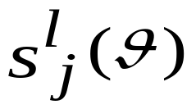
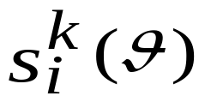
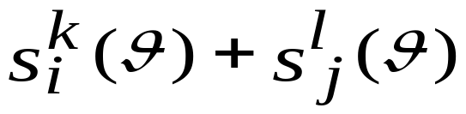


Earliest Deadline CM
  γ_{i}: tasks sharing objects θ with τ_{i}.
  : l^{th} atomic section of τ_{j}.
  s_{max}(θ): longest atomic section in all tasks.
  : longest atomic section in τ_{i} accessing θ.

Slide 21


Thread execution time can be inflated with worst-case transactional retry cost
Each interference may cause a retry
C_{ji}  The WCET of τ_{j} relative to τ_{i}
G-EDF’s response time analysis can now be used to determine schedulability of ECM

Slide 22
ECM can be formally compared with
G-EDF/lock-free synchronization
Utilization demand-based schedulability (i.e., U_{i} = C_{i}/T_{i})
  Less demand is better
Claim 4: ECM is better than G-EDF/lock-free if s_{max} < r_{max}/2
  s_{max} : max cost of one transactional retry
  r_{max} : max cost of one lock-free retry
With low conflicting tasks  s_{max} approaches r_{max}
r_{max}
STM can tolerate higher retry costs than lock-free and still be competitive
s_{max}
r_{max}/2
Retry cost
Thread set

Slide 23
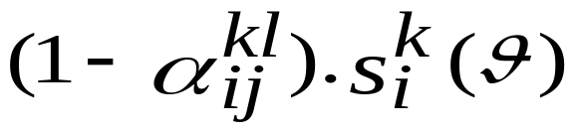

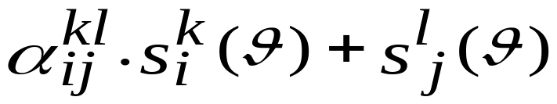
Length-based CM (LCM)

Slide 24
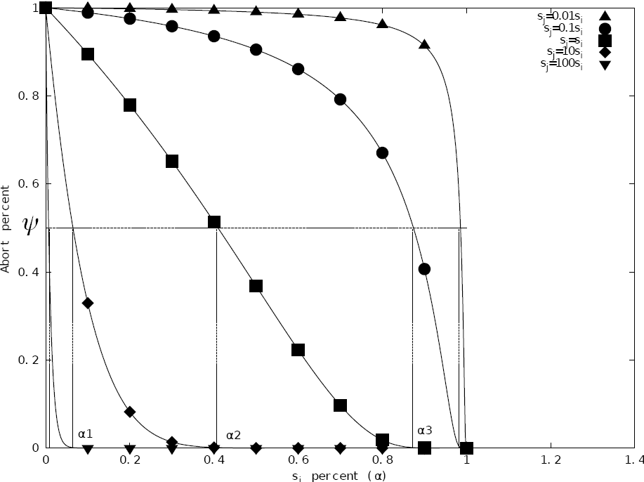

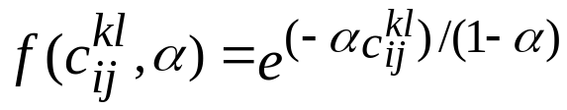
Length-based CM (LCM)
  Ψ: predefined threshold
  c
  C
  Considers not only priority, but also length of interfering transaction to remaining length of interfered transaction

Slide 25
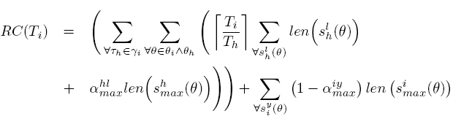
LCM Retry Cost
G-EDF/LCM
G-RMA/LCM

Slide 26


LCM Schedulability Comparison
G-EDF/LCM schedulability ≥ ECM’s if
G-EDF/LCM schedulability ≥ lock-free if upper bound on s_{max}/r_{max} ranges between 0.5 and 2
  Higher than ECM which ranges between 0.5 and 1
G-RMA/LCM schedulability ≥ RCM’s if
G-RMA/LCM schedulability ≥ lock-free if upper bound on s_{max}/r_{max} ≤0.5.
  s_{max}/r_{max} >>0.5 with large values of α_{min}, α_{max} and low contention

Slide 27
Priority CM with Negative value and First access (PNF)
ECM, RCM, LCM suffer from transitive retry
Wasted processor time for lower priority jobs
s^{e}_{f}(θ3, θ4)
s^{c}_{d}(θ2, θ3)
s^{c}_{d}(θ2, θ3)
Wasted Processor Time
sª_{b}(θ1, θ2)
sª_{b}(θ1, θ2)

Slide 28


PNF Rationale
m_set
p1
n_set
sª_{b}(θ1, θ2)
sª_{b}(θ1, θ2)
s^{c}_{d}(θ3, θ4)
p2
s^{c}_{d}(θ3, θ4)
p3
s^{e}_{f}(θ1, θ5)

Slide 29
PNF Rationale
m_set
p1
n_set
sª_{b}(θ1, θ2)
sª_{b}(θ1, θ2)
s^{c}_{d}(θ3, θ4)
p2
s^{e}_{f}(θ1, θ5)
s^{c}_{d}(θ3, θ4)
p3
s^{e}_{f}(θ1, θ5)
s^{e}_{f}(θ1, θ5)

Slide 30
PNF Rationale
m_set
p1
n_set
sª_{b}(θ1, θ2)
sª_{b}(θ1, θ2)
s^{c}_{d}(θ3, θ4)
p2
s^{e}_{f}(θ1, θ5)
s^{c}_{d}(θ3, θ4)
p3
s^{e}_{f}(θ1, θ5)
s^{e}_{f}(θ1, θ5)
p4
s^{g}_{h}(θ1, θ6)

Slide 31
PNF Rationale
m_set
p1
n_set
sª_{b}(θ1, θ2)
sª_{b}(θ1, θ2)
s^{g}_{h}(θ1, θ6)
s^{c}_{d}(θ3, θ4)
p2
s^{e}_{f}(θ1, θ5)
s^{c}_{d}(θ3, θ4)
s^{i}_{j}(θ5, θ7)
p3
s^{e}_{f}(θ1, θ5)
s^{e}_{f}(θ1, θ5)
p4
s^{g}_{h}(θ1, θ6)
s^{g}_{h}(θ1, θ6)
p5
s^{i}_{j}(θ5, θ7)
p3
τ^{l}_{k}

Slide 32
PNF Rationale
m_set
p1
n_set
sª_{b}(θ1, θ2)
sª_{b}(θ1, θ2)
s^{g}_{h}(θ1, θ6)
s^{c}_{d}(θ3, θ4)
p2
s^{e}_{f}(θ1, θ5)
s^{c}_{d}(θ3, θ4)
s^{i}_{j}(θ5, θ7)
p3
s^{e}_{f}(θ1, θ5)
s^{e}_{f}(θ1, θ5)
p4
s^{g}_{h}(θ1, θ6)
s^{g}_{h}(θ1, θ6)
p5
s^{i}_{j}(θ5, θ7)

Slide 33
PNF Rationale
m_set
p1
n_set
sª_{b}(θ1, θ2)
sª_{b}(θ1, θ2)
s^{g}_{h}(θ1, θ6)
s^{c}_{d}(θ3, θ4)
p2
s^{e}_{f}(θ1, θ5)
s^{c}_{d}(θ3, θ4)
s^{g}_{h}(θ1, θ6)
p3
s^{e}_{f}(θ1, θ5)
s^{e}_{f}(θ1, θ5)
p4
s^{g}_{h}(θ1, θ6)
s^{g}_{h}(θ1, θ6)

Slide 34
PNF Rationale
m_set
n_set
s^{c}_{d}(θ3, θ4)
p2
s^{e}_{f}(θ1, θ5)
s^{c}_{d}(θ3, θ4)
s^{e}_{f}(θ1, θ5)
s^{g}_{h}(θ1, θ6)
p3
s^{e}_{f}(θ1, θ5)
s^{e}_{f}(θ1, θ5)
p4
s^{g}_{h}(θ1, θ6)

Slide 35


PNF Retry Cost and Response Time
Retry cost during interval L
Blocking time due to lower priority jobs
Response time of τ_{i}^{x}

Slide 36
PNF Schedulability Comparison
In the absence of transitive retry
PNF ≥ ECM when conflicting atomic sections have equal lengths
PNF ≥ RCM when a large number of tasks heavily conflict. PNF’s schedulability improves with increasing atomic section length as priority increases
PNF ≥ G-EDF/LCM’s if the conflicting atomic section lengths are approximately equal and all α terms approach 1
PNF ≥ G-RMA/LCM’s if:
  lower priority tasks suffer increasing number of conflicts from higher priority tasks
  Lengths of the atomic sections increase as task priorities increase
  α terms increase
PNF ≥ lock-free if s_{max}/r_{max} ≤ 1

Slide 37
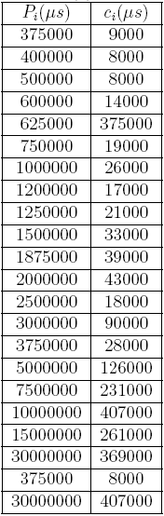
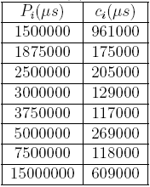
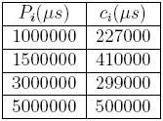
Implementation studies: Retry cost of different CMs and lock-free
Implemented ECM, RCM, LCM and PNF
3 task sets
ChronOS Linux kernel
8 core, 2GHz AMD Opteron
RSTM CAS for lock-free

Slide 38
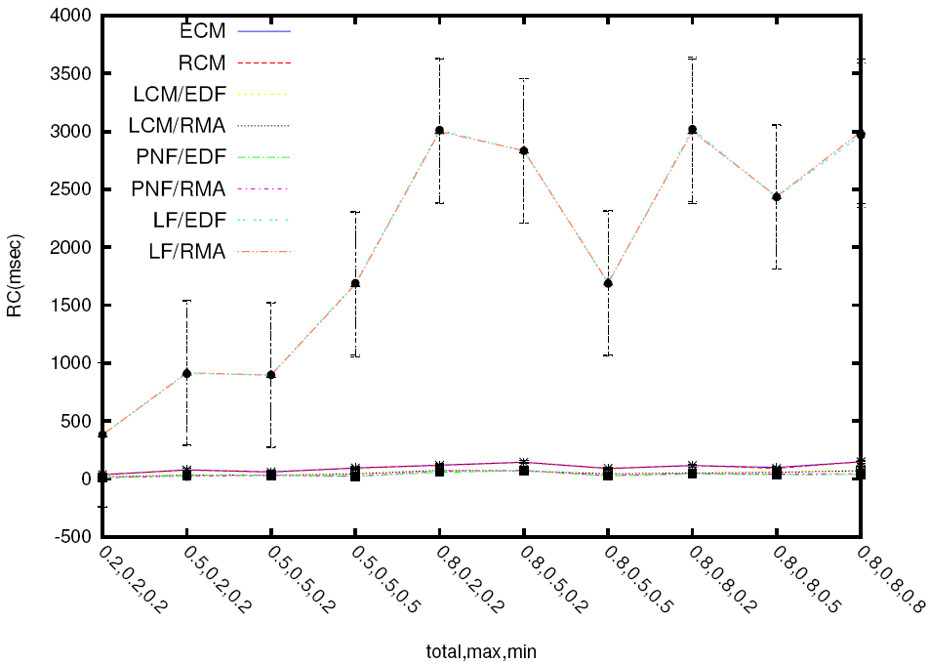
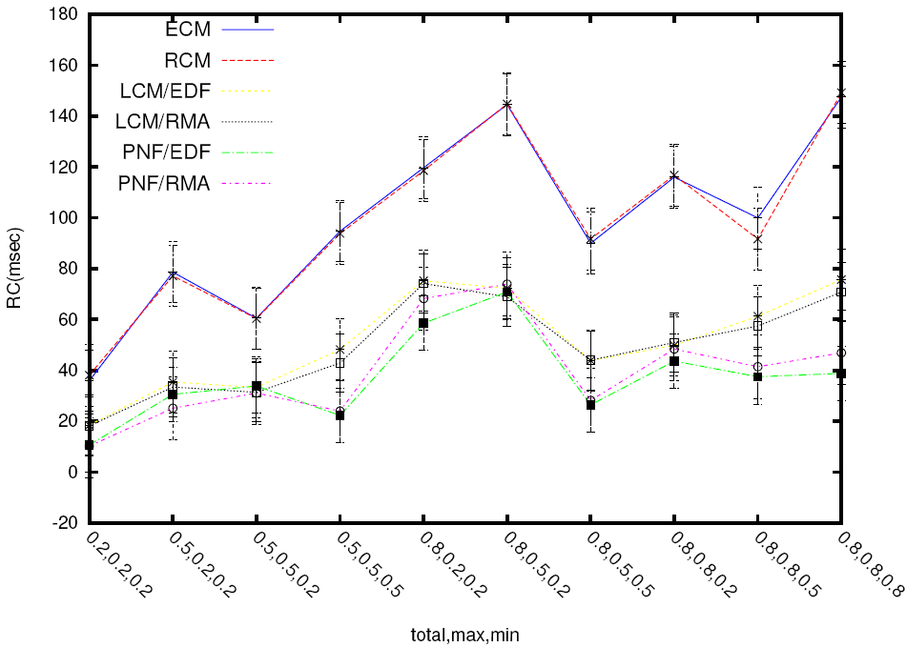
Implementation studies: Retry cost of different CMs and lock-free
  4 tasks- 1 shared object per transaction- CMs only
  4 tasks- 1 shared object per transaction- CMs and lock-free

Slide 39
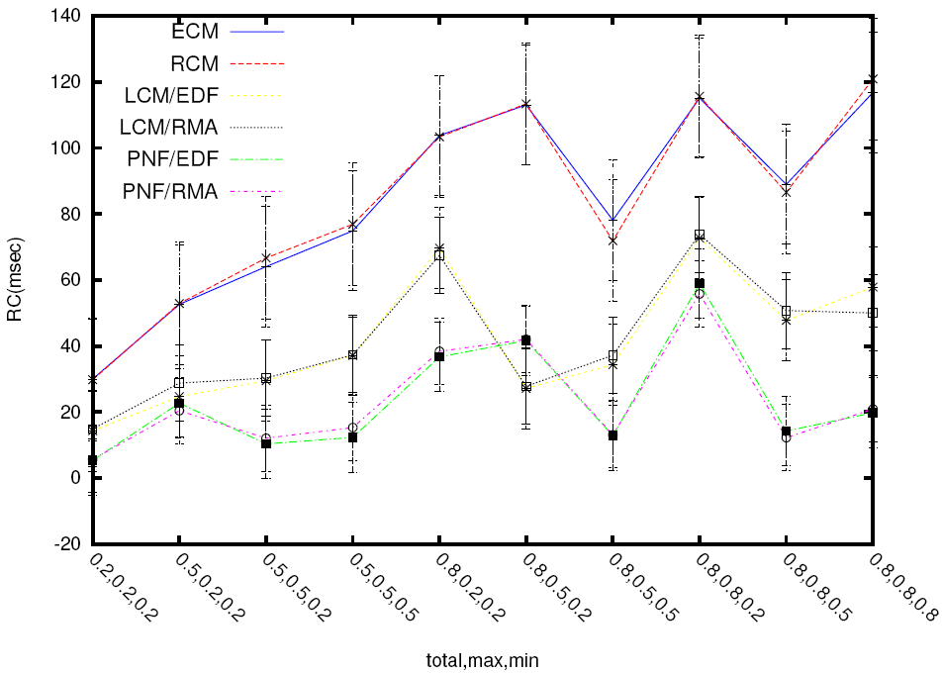
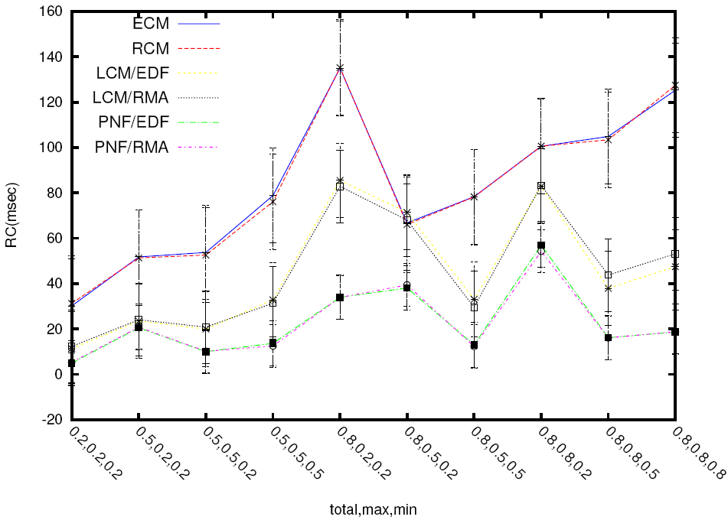
Implementation studies: Retry cost of different CMs
  4 tasks- 40 shared object per transaction- 80% wr- CMs only
  4 tasks- 20 shared object per transaction- 40% wr- CMs only

Slide 40
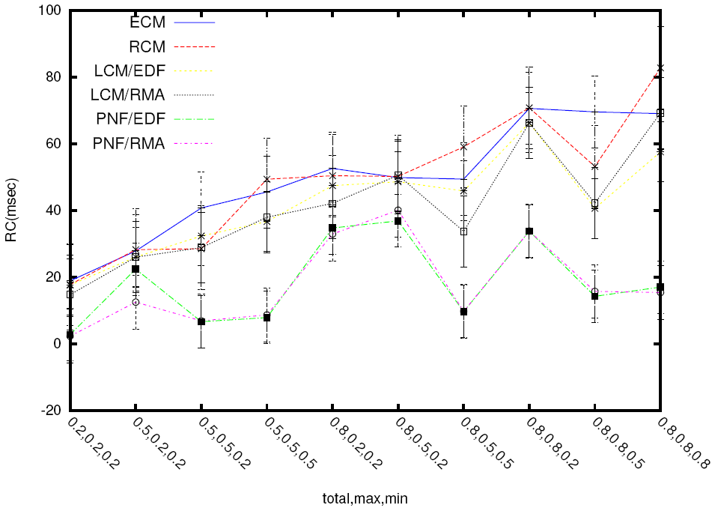
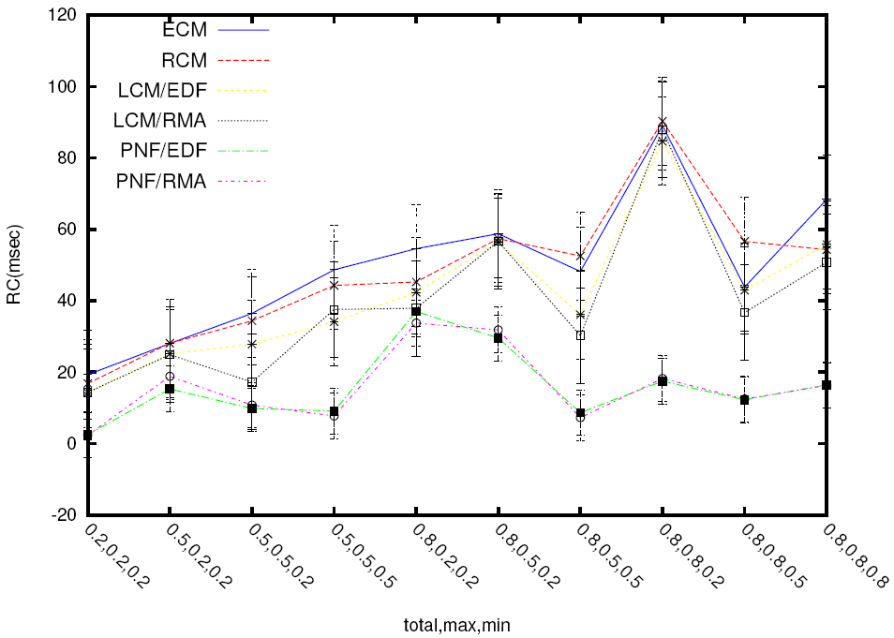
Implementation studies: Retry cost of different CMs
  8 tasks- 40 shared object per transaction- 80% wr- CMs only
  8 tasks- 20 shared object per transaction- 40% wr- CMs only

Slide 41
Conclusions
ECM and RCM
  Max of 2.s_{max} retry cost under ECM, RCM
  s_{max}/r_{max} for ECM => 0.5 to 1
  s_{max}/r_{max} for RCM => 0.5 (>1 in some cases)
LCM
  Retry cost of (1+ α_{max}) ×s_{max}
  Choice of α_{max} and α_{min} for better schedulability than ECM and RCM
  s_{max}/r_{max} => 0.5 to 2 for G-EDF/LCM
  s_{max}/r_{max} => 0.5 for G-RMA/LCM
PNF
  Avoids transitive and optimizes processor usage
  s_{max}/r_{max} for PNF ≤ 1

