Slide 1
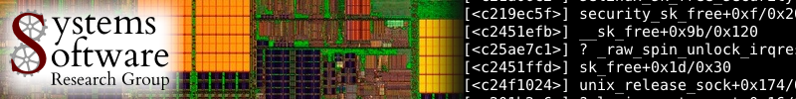

FBLT: A Real-Time Contention Manager
with Improved Schedulability
Mohammed El-Shambakey and Binoy Ravindran
Virginia Tech
USA
{shambake,binoy}@vt.edu
DATE 2013

Slide 2
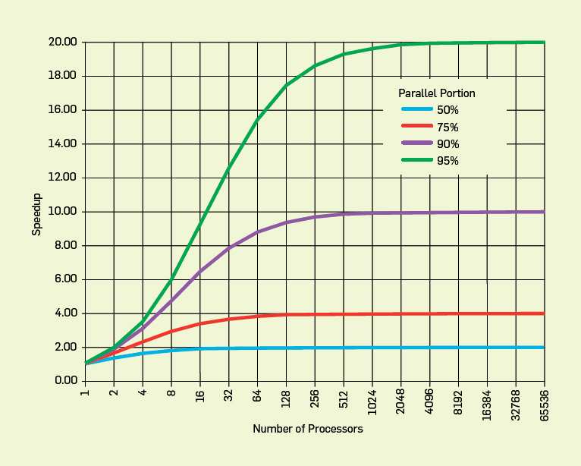
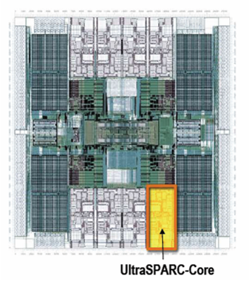
Concurrency control on chip multiprocessors significantly affects performance (and programmability)
Improve performance by exposing greater concurrency
  Amdahl’s law: relationship between sequential execution time and speedup reduction is not linear
Significant implications for embedded real-time software
  Inherently concurrent – react to multiple streams of sensor input and control multiple actuators
  Often concurrently read/write shared data objects
Sun T2000 Niagara (8-core)

Slide 3
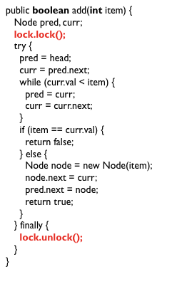
Lock-based concurrency control has serious drawbacks
Coarse grained locking
  Simple
  But no concurrency

Slide 4
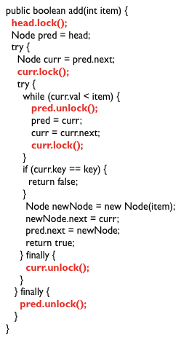
Fine-grained locking is better, but…
Excellent performance
Poor programmability
Lock problems don’t go away!
  Deadlocks, livelocks, lock-convoying, priority inversion,….
Most significant difficulty – composition

Slide 5
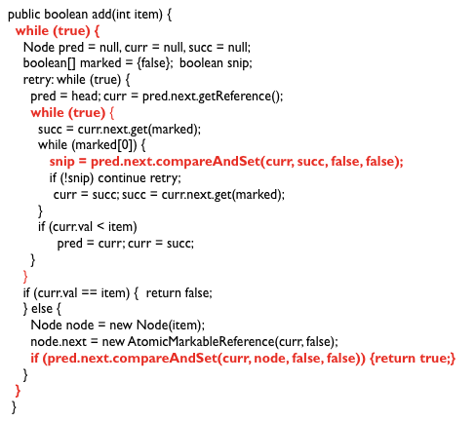
Lock-free synchronization overcomes some of these difficulties, but…
“lock-free retry loop”

Slide 6
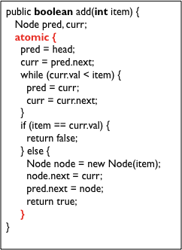
Transactional Memory
Like database transactions
ACI properties (no D)
Easier to program
Fine-grained performance
Composable
First HTM, then STM, later HyTM
M. Herlihy and J. B. Moss (1993). Transactional memory: Architectural support for lock-free data structures. ISCA. pp. 289–300.
N. Shavit and D. Touitou (1995). Software Transactional Memory. PODC. pp. 204—213.

Slide 7
Optimistic execution yields performance gains at the simplicity of coarse-grain, but no silver bullet
Time
Coarse-grained locking
Irrevocable operations
Interaction between transactions and non-transactions
Conditional waiting
……
STM
Fine-grained locking
Threads
E.g., C/C++ Intel Run-Time System STM (B. Saha et. al. (2006). McRT-STM: A High Performance Software Transactional Memory. ACM PPoPP.)

Slide 8
Three key mechanisms needed to create atomicity illusion
Versioning
Conflict detection
T0
T1
atomic{
x = x + y;
}
atomic{
x = x + y;
}
atomic{
x = x / 25;
}
Where to store new x until commit?
  Eager: store new x in memory; old in undo log
  Lazy: store new x in write buffer
How to detect conflicts between T0 and T1?
  Record memory locations read in read set
  Record memory locations wrote in write set
  Conflict if one’s read or write set intersects the other’s write set

Slide 9
Third mechanism determines transactional progress
Conflict resolution or contention management
T0
T1
x = x + y;
x = x / 25;
x = x / 25;
Which transaction to abort?
  Polite: familiar exponential backoff
  Greedy: favor those with an earlier start time
  Karma: ….
(Starvation may occur)

Slide 10
Wait-free progress is necessary for real-time STM
Bound retry cost to satisfy time constraints
Rely on existing versioning and conflict detection techniques
Contention management directly affects transactional progress
  Starvation-freedom is necessary

Slide 11
Past research have developed several real-time contention managers
Earliest deadline first contention manager (ECM)
Rate monotonic contention manager (RCM)
Length-based contention manager (LCM)
Priority with Negative Value and First access (PNF)
Some of their limitations:
  One object access per transaction
  Requires a-priori knowledge of all accessed objects per transaction
  Complex implementation
  STM concurrency control for embedded real-time software with tighter time bounds. In DAC, 2012
  On real-time STM concurrency control for embedded software with improved schedulability, In ASP-DAC, 2013

Slide 12
Paper’s contribution
Presents a new contention manager: FBLT
  Allows multiple objects per transaction
  No prior knowledge of objects accessed
  Simpler implementation
  Bounded retry cost and response time
Formal comparison with PNF
Implementation and experimental comparisons

Slide 13
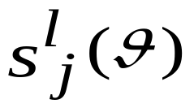
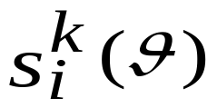
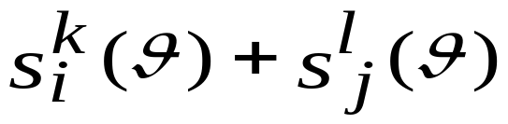
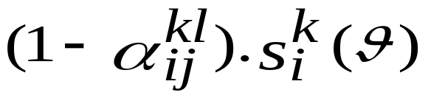
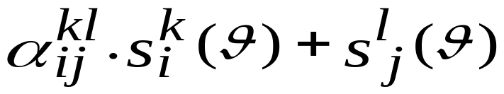
Length-based CM (LCM)
Notes:
S_k_i: kth transaction of task i accessing theta
Alpha is between 0 and 1. If 1, LCM = ECM.
If 0, LCM = FIFO
The superiority of LCM over others depend on alpha value

Slide 14
FBLT Design
ηª_{b} < σª_{b} (preemptive)
Yes
Increment ηª_{b}
p1
sª_{b}(θ1, θ2)
Abort sª_{b} ?
LCM
η^{c}_{d} < σ^{c}_{d} (preemptive)
Increment η^{c}_{d}
p2
s^{c}_{d}(θ2, θ4)
No
Notes:
Delta is between 0 and infinitey
If delta is 0, FBLT is FIFO
If delta is infinity, FBLT is LCM.
Eta: # times a transaction has been aborted
Delta: max # times a transaction is aborted before it executes non-preemptively

Slide 15
FBLT Design
ηª_{b} < σª_{b} (preemptive)
Increment ηª_{b}
p1
sª_{b}(θ1, θ2)
Abort sª_{b}
η^{c}_{d} > σ^{c}_{d}
(non-preemptive)
p2
s^{c}_{d}(θ3, θ4)

Slide 16
FBLT Design
ηª_{b} > σª_{b}
(non-preemptive)
p1
sª_{b}(θ1, θ2)
Abort sª_{b}
r(sª_{b})<
r(s^{c}_{d})?
No
Yes
η^{c}_{d} > σ^{c}_{d}
(non-preemptive)
p2
s^{c}_{d}(θ3, θ4)
Abort s^{c}_{d}
Notes:
r(s_a_b) is the time when transacton s_a_a becomes non-preemptive (i.e. time by which it is aborted more than its delta parameter).

Slide 17
Schedulability
Bounds on retry costs and response times
Formal comparison with previous best CM (PNF)
Comparison with lock-free synchronization:
  ECM and RCM is better than LF if s_{max} < r_{max}/2
  PNF is better than LF if s_{max} ≤ r_{max}
  FBLT is better than LF if s_{max} > r_{max}
(See paper)

Slide 18
Implementation studies
Implemented ECM, RCM, LCM, PNF, FBLT in Rochester STM
RSTM CAS for lock-free
ChronOS real-time Linux kernel (chronoslinux.org)
8-core, 2GHz AMD Opteron

Slide 19
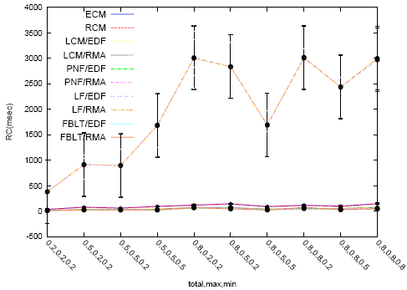
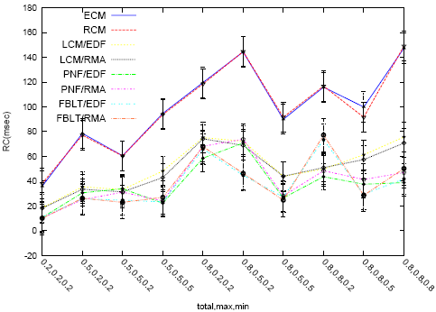
Implementation studies: retry cost under single shared object
  5 tasks
  1 shared object per transaction
  CMs and lock-free
Retry cost measured by varying max transaction length, min transaction length, and # transactions: (total, max, min)
Notes:
Worst is ECM and RCM. Followed by LCM, and then PNF (comparable)

Slide 20
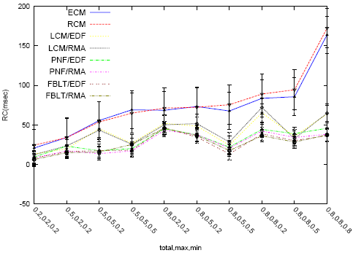
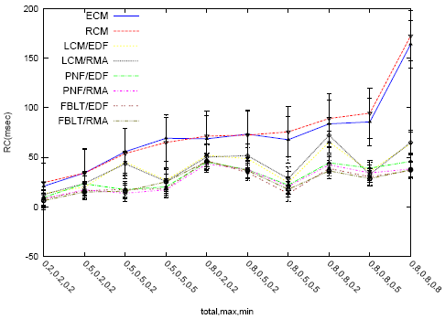
Implementation studies: retry cost under multiple shared objects
  20 tasks
  40 shared objects per transaction
  Transitive retry
  20 tasks
  40 shared objects per transaction
  Non-transitive retry

Slide 21
Conclusions
Presented a real-time STM contention manager: FBLT
  Allows multiple objects per transaction
  No prior knowledge of objects accessed
  Simpler implementation
  Schedulability comparison and implementation
Allows reaping STM’s programmability and composability advantages for a broader range than previously possible
Open questions
  Improved schedulability
  Coping with irrevocability
  Extensions to soft real-time

