Slide 1
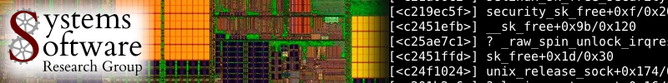

FBLT: A Real-Time Contention Manager with Improved Schedulability
Mohammed Elshambakey and Binoy Ravindran
{shambake, binoy}@vt.edu

Slide 2
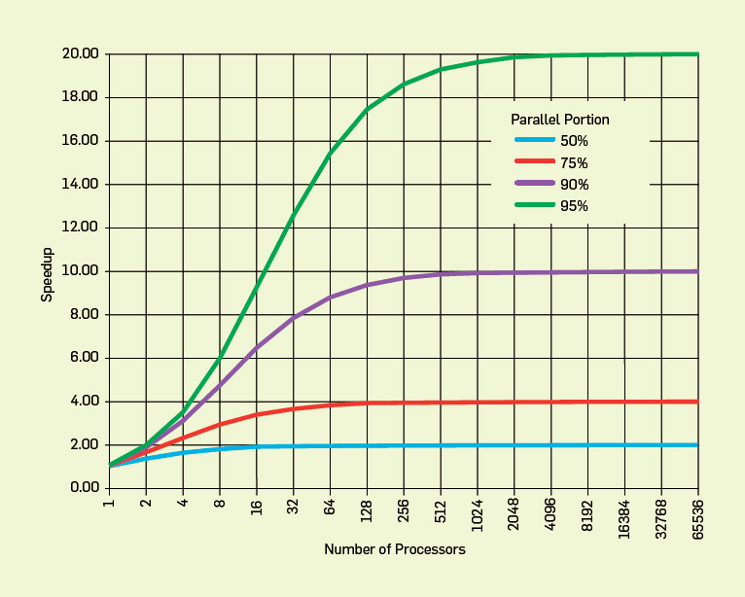
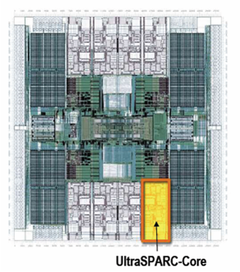
Concurrency control on chip multiprocessors significantly affects performance (and programmability)
Improve performance by exposing greater concurrency
Amdahl’s law: relationship between sequential execution time and speedup reduction is not linear
Significant implications for embedded real-time software
Inherently concurrent – react to multiple streams of sensor input and control multiple actuators
Often concurrently read/write shared data objects
Sun T2000 Niagara (8-core)

Slide 3
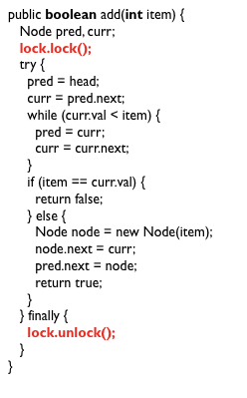
Lock-based concurrency control has serious drawbacks
Coarse grained locking
Simple
But no concurrency

Slide 4
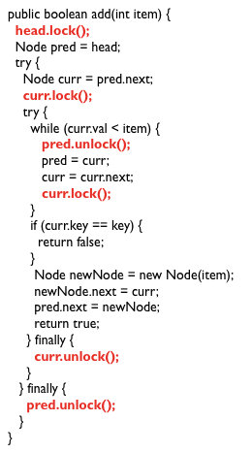
Fine-grained locking is better, but…
Excellent performance
Poor programmability
Lock problems don’t go away!
Deadlocks, livelocks, lock-convoying, priority inversion,….
Most significant difficulty – composition

Slide 5
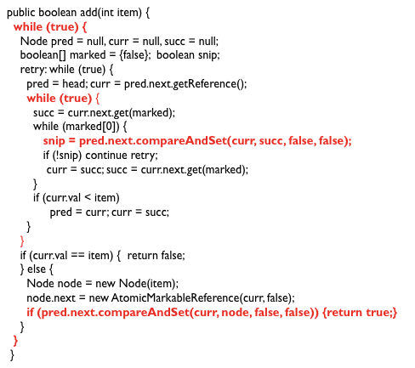
Lock-free synchronization overcomes some of these difficulties, but…
“lock-free retry loop”

Slide 6
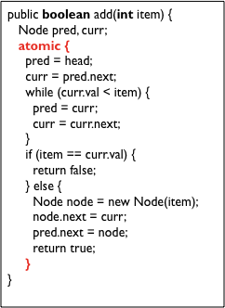
Transactional Memory
Like database transactions
ACI properties (no D)
Easier to program
Fine-grained performance
Composable
First HTM, then STM, later HyTM
M. Herlihy and J. B. Moss (1993). Transactional memory: Architectural support for lock-free data structures. ISCA. pp. 289–300.
N. Shavit and D. Touitou (1995). Software Transactional Memory. PODC. pp. 204—213.

Slide 7
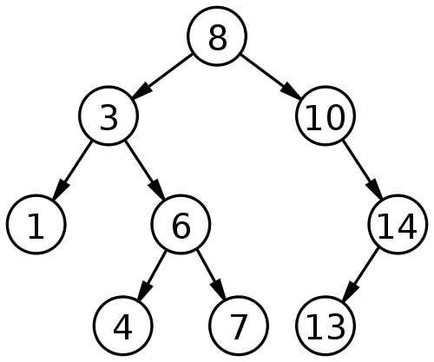
How does TM work?
Idea: speculate
Example: add 9 and 15 concurrently

Slide 8
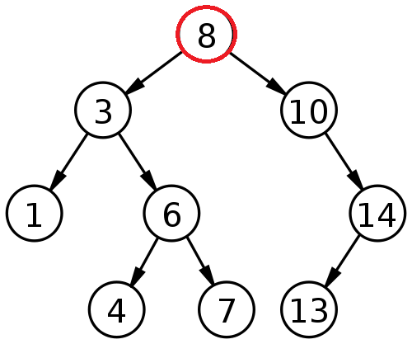
Thread A adds 9 and thread B adds 15
Thread A
Read-set: 8
Write-set:
Thread B
Read-set: 8
Write-set:

Slide 9
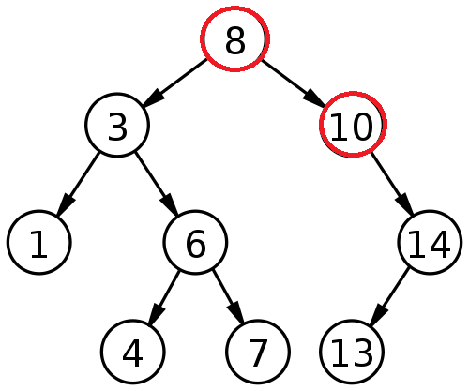
Thread A adds 9 and thread B adds 15
Thread A
Read-set: 8,10
Write-set:
Thread B
Read-set: 8,10
Write-set:

Slide 10
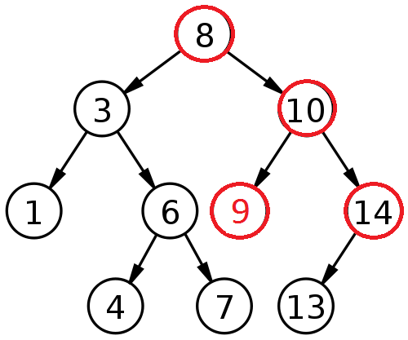
Thread A adds 9 and thread B adds 15
Thread A
Read-set: 8,10
Write-set: 10 (LC)
Thread B
Read-set: 8,10,14
Write-set:

Slide 11
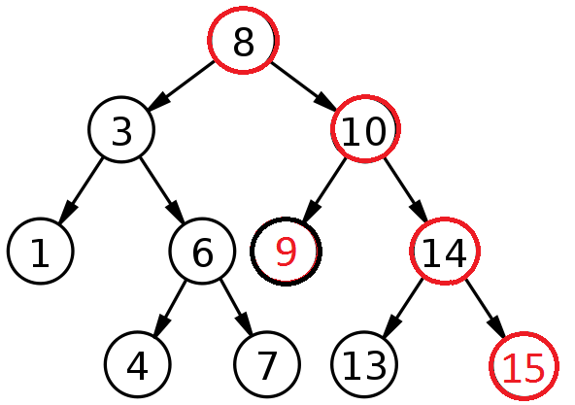
Thread A adds 9 and thread B adds 15
Thread A
Read-set: 8,10
Write-set: 10 (LC)
Thread B
Read-set: 8,10,14
Write-set: 14 (RC)
(Committed successfully)

Slide 12
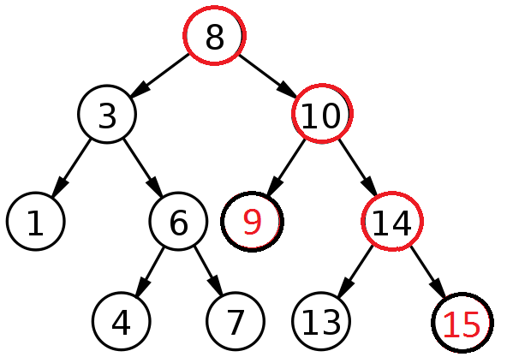
Thread A adds 9 and thread B adds 15
Thread A
Read-set: 8,10
Write-set: 10 (LC)
Thread B
Read-set: 8,10,14
Write-set: 14 (RC)
(Committed successfully)
(Committed successfully)

Slide 13
Object-based granularity causes conflict (in this case)
Thread A
Read-set: 8,10
Write-set: 10
Thread B
Read-set: 8,10,14
Write-set: 14
Write-after-read
(Committed successfully)
(Conflict, so abort and retry)

Slide 14
Optimistic execution yields performance gains at the simplicity of coarse-grain, but no silver bullet
Time
Coarse-grained locking
Irrevocable operations
Interaction between transactions and non-transactions
Conditional waiting
……
STM
Fine-grained locking
Threads
E.g., C/C++ Intel Run-Time System STM (B. Saha et. al. (2006). McRT-STM: A High Performance Software Transactional Memory. ACM PPoPP.)

Slide 15
Three key mechanisms needed to create atomicity illusion
Versioning
Conflict detection
T0
T1
atomic{
x = x + y;
}
atomic{
x = x + y;
}
atomic{
x = x / 25;
}
Where to store new x until commit?
Eager: store new x in memory; old in undo log
Lazy: store new x in write buffer
How to detect conflicts between T0 and T1?
Record memory locations read in read set
Record memory locations wrote in write set
Conflict if one’s read or write set intersects the other’s write set

Slide 16
Third mechanism determines transactional progress
Conflict resolution or contention management
T0
T1
x = x + y;
x = x / 25;
x = x / 25;
Which transaction to abort?
Polite: familiar exponential backoff
Greedy: favor those with an earlier start time
Karma: ….
(Starvation may occur)

Slide 17
Wait-free progress is necessary for real-time STM
Bound retry cost to satisfy time constraints
Rely on existing versioning and conflict detection techniques
Contention management directly affects transactional progress
Starvation-freedom is necessary

Slide 18
Paper’s contribution
Prior research have developed real-time contention managers, with bounded retry costs and response times
Earliest deadline first contention manager (ECM)
Rate monotonic contention manager (RCM)
Length-based contention manager (LCM)
Priority with Negative value and First access contention manager (PNF)
^{ECM, RCM, LCM}
Restrict to one object access per transaction
Suffer transitive retry in multiple objects per transaction
M. El-Shambakey and B. Ravindran. STM concurrency control for embedded real-time software with tighter time bounds. In DAC, pages 437–446, 2012
s^{e}_{f}(θ3, θ4)
s^{c}_{d}(θ2, θ3)
s^{c}_{d}(θ2, θ3)
sª_{b}(θ1, θ2)
sª_{b}(θ1, θ2)

Slide 19
Paper’s contribution
PNF
Allows multiple objects per transaction
Reduces wasted processor time while transitive retry
Requires a-priori knowledge of accessed objects per transaction
Centralized CM. Complex implementation
Paper presents FBLT
Multiple objects per transaction
Limited effect by transitive retry
No prior knowledge of objects per transaction
Decentralized CM. Easier implementation
Formal comparison with PNF
Implementation and Experimental comparison with previous CMs and lock-free

Slide 20
Model is traditional real-time model
Threads arrive periodically, with deadlines equal to periods
Threads subsume transactions
Execute on a CMP
Two schedulers: global EDF (G-EDF) and global RMA (G-RMA)
Total thread utilization demand satisfies G-EDF (G-RMA)’s schedulable utilization bound
Thread release
τ_{i}
Thread completion
Transaction
Next thread release
Time
Thread period, T_{i} = relative thread deadline

Slide 21
Length-based CM (LCM)

Slide 22
FBLT Design
ηª_{b} < σª_{b} (preemptive)
Yes
Increment ηª_{b}
p1
sª_{b}(θ1, θ2)
Abort sª_{b} ?
LCM
η^{c}_{d} < σ^{c}_{d} (preemptive)
Increment η^{c}_{d}
p2
s^{c}_{d}(θ3, θ4)
No

Slide 23
FBLT Design
ηª_{b} < σª_{b} (preemptive)
Increment ηª_{b}
p1
sª_{b}(θ1, θ2)
Abort sª_{b}
η^{c}_{d} > σ^{c}_{d}
(non-preemptive)
p2
s^{c}_{d}(θ3, θ4)

Slide 24
FBLT Design
ηª_{b} > σª_{b}
(non-preemptive)
p1
sª_{b}(θ1, θ2)
Abort sª_{b}
r(sª_{b})<
r(s^{c}_{d})?
No
Yes
η^{c}_{d} > σ^{c}_{d}
(non-preemptive)
p2
s^{c}_{d}(θ3, θ4)
Abort s^{c}_{d}

Slide 25

FBLT’s retry cost and response time bounds
Total retry cost bound during interval L
χ_{i}^{k}: Set of at most m-1 longest transactions conflicting (directly or indirectly) with s_{i}^{k}
Each transaction belongs to a distinct job
RC_{re}(L): Retry cost upper bound due to release of higher priority jobs

Slide 26


FBLT’s retry cost and response time bounds
Blocking time bound due to lower priority jobs
s_{jmax}: Maximum transactional length in τ_{j}^{l}
Response time bound of τ_{i}^{x}

Slide 27
FBLT’s schedulability ≥ PNF’s
For each s_{i}^{k}
For each τ_{i}^{x}
Length sum of at most m-1 longest transactions conflicting directly or indirectly with s_{i}^{k} | - | Length sum of all transactions conflicting directly with s_{i}^{k} | δ_{i}^{k} ≤
Length of s_{i}^{k}
Minimum number of times τ_{i}^{x} can be blocked due to non-conflicting transactions in all lower priority jobs | ≤ | Length of longest transaction in τ_{i}^{x} or lower priority jobs
Maximum release time of all jobs not belonging to τ_{i} |  | Length of smallest transaction in lower priority jobs

Slide 28
FBLT’s schedulability vs. Lock-free’s schedulabiltiy
Let δ_{max} be maximum abort number threshold for any transaction.
Under G-EDF and G-RMA, schedulability of FBLT is equal or better than lock-free with s_{max} larger than r_{max} if for each task τ_{i}:
Total number of conflicting accesses by other tasks under lock-free is much greater than number of processors multiplied by number of transactions in τ_{i} plus 1
δ_{max} is small

Slide 29
Experimental evaluation
Implemented ECM, RCM, LCM, PNF, and FBLT in Rochester STM
RSTM CAS for lock-free
ChronOS real-time Linux kernel (chronoslinux.org)
8-core, 2GHz AMD Opteron

Slide 30
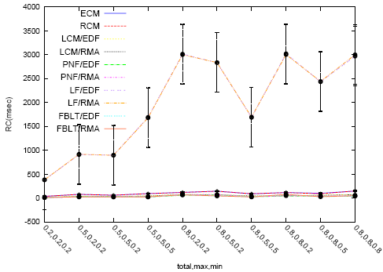
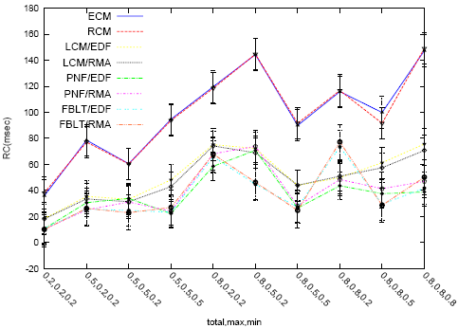
Experimental evaluation
5 tasks
1 shared object per transaction
CMs and lock-free
Retry cost measured by varying max transaction length, min transaction length, and # transactions: (total, max, min)

Slide 31
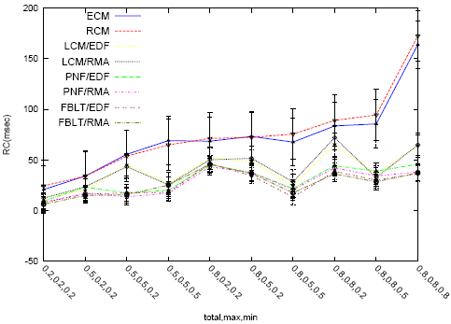
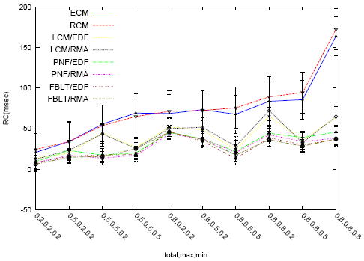
Experimental evaluation
20 tasks
40 shared object per transaction
Transitive retry
20 tasks
40 shared object per transaction
Non-transitive retry

Slide 32
Conclusions
Presented a real-time STM contention manager: FBLT
Allows multiple objects per transaction
No prior knowledge for objects per transaction
Decentralized CM
Bounded retry cost and response time
Limited affect by transitive retry
Schedulability comparison
Implementation

