Slide 1
STM Concurrency Control for Multicore Embedded
Real-Time Software: Time Bounds and Tradeoffs
By
Mohammed
Elshambakey
Binoy
Ravindran

Slide 2
Goal
Retry cost and response time of RTCM.
Dynamic G-EDF/EDF(ECM) and Fixed G-RMA/RMA(RCM).
Comparison against non STM lock-free and lock-based synchronization.

Slide 3
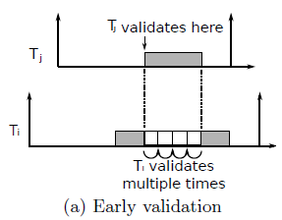
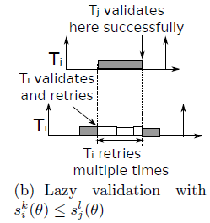
ECM Retry Pattern

Slide 4
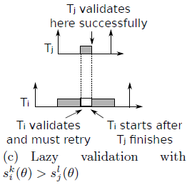
ECM Retry Pattern

Slide 5
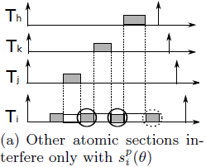
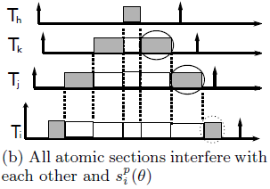

ECM Retry Pattern

Slide 6
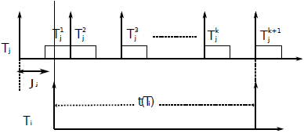
G-EDF max interference

Slide 7
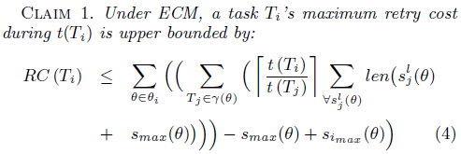
ECM Retry Cost

Slide 8
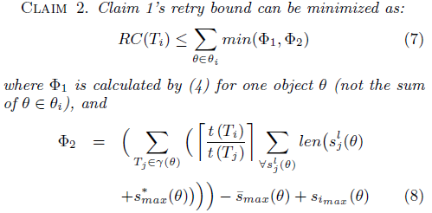
ECM Retry Cost

Slide 9
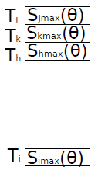
ECM Retry Cost

Slide 10
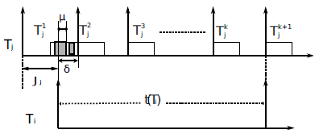
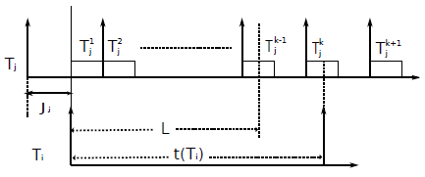
ECM Tighter Retry Cost

Slide 11
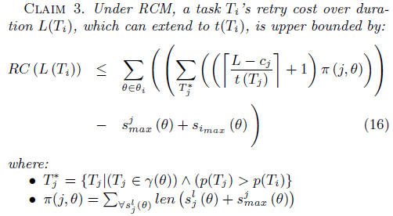
RCM Retry Cost

Slide 12
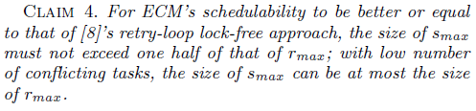
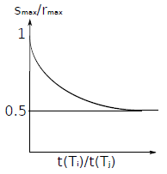
ECM vs. Lock-Free

Slide 13
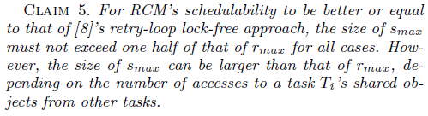
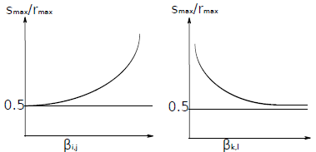
RCM vs. Lock-Free

Slide 14
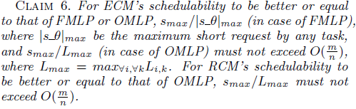
ECM & RCM vs FMLP & OMLP

