Slide 1

STM Concurrency Control for Multicore Embedded Real-Time Software: Time Bounds and Tradeoffs
Mohammed Elshambakey and Binoy Ravindran
ECE Department, Virginia Tech
Blacksburg, Virginia, USA
{shambake, binoy}@vt.edu
SAC 2012

Slide 2
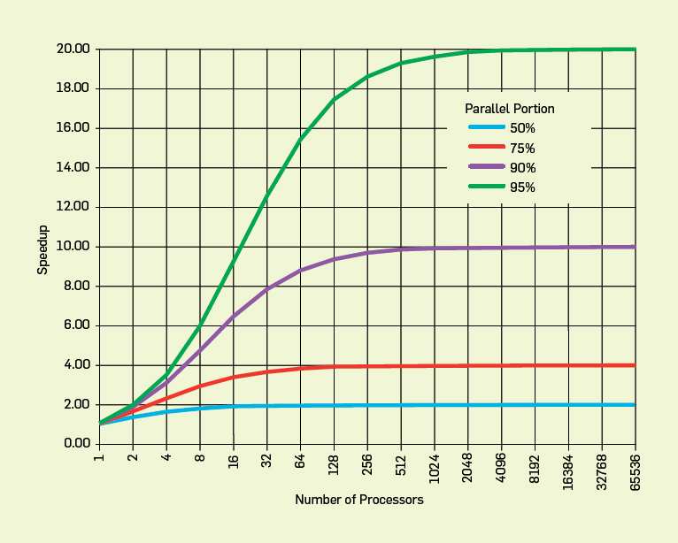
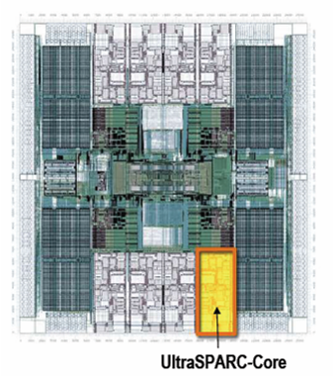
Concurrency control on chip multiprocessors significant affects performance (and programmability)
Improve performance by exposing greater concurrency
  Amdahl’s law: relationship between sequential execution time and speedup reduction is not linear
Significant implications for embedded real-time software
  Inherently concurrent – react to multiple streams of sensor input and control multiple actuators
  Often concurrently read/write shared data objects
Sun T2000 Niagara (8-core)

Slide 3
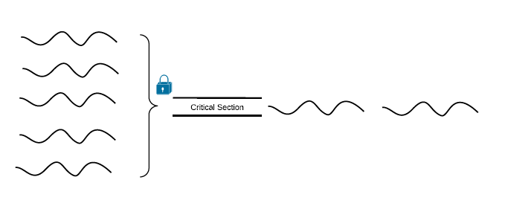
Concurrency Control (2)
Lock-based synchronization
  Coarse-grained locking
  Fine-grained locking
Locks problems
  Deadlocks, livelocks, lock-convoying, priority inversion, non-composable

Slide 4
Coarse vs. Fine Grained Locking
public boolean add(int item) {
Node pred, curr;
lock.lock();
try {
pred = head;
curr = pred.next;
while (curr.val < item) {
pred = curr;
curr = curr.next;
}
if (item == curr.val) {
return false;
} else {
Node node = new Node(item);
node.next = curr;
pred.next = node;
return true;
}
} finally {
lock.unlock();
}
}
public boolean add(int item) {
head.lock();
Node pred = head;
try {
Node curr = pred.next;
curr.lock();
try {
while (curr.val < item) {
pred.unlock();
pred = curr;
curr = curr.next;
curr.lock();
}
if (curr.key == key) {
return false;
}
Node newNode = new Node(item);
newNode.next = curr;
pred.next = newNode;
return true;
} finally {
curr.unlock();
}
} finally {
pred.unlock();
}
}

Slide 5
Concurrency Control (3)
Lock-free synchronization
public boolean add(int item) {
while (true) {
Node pred = null, curr = null, succ = null;
boolean[] marked = {false}; boolean snip;
retry: while (true) {
pred = head; curr = pred.next.getReference();
while (true) {
succ = curr.next.get(marked);
while (marked[0]) {
snip = pred.next.compareAndSet(curr, succ, false, false);
if (!snip) continue retry;
curr = succ; succ = curr.next.get(marked);
}
if (curr.val < item)
pred = curr; curr = succ;
}
}
if (curr.val == item) { return false;
} else {
Node node = new Node(item);
node.next = new AtomicMarkableReference(curr, false);
if (pred.next.compareAndSet(curr, node, false, false)) {return true;}
}
}
}

Slide 6
Transactional Memory
Like database transactions
ACID properties
Easier to program
Fine-grained performance
Composable
public boolean add(int item) {
Node pred, curr;
atomic {
pred = head;
curr = pred.next;
while (curr.val < item) {
pred = curr;
curr = curr.next;
}
if (item == curr.val) {
return false;
} else {
Node node = new Node(item);
node.next = curr;
pred.next = node;
return true;
}
}

Slide 7
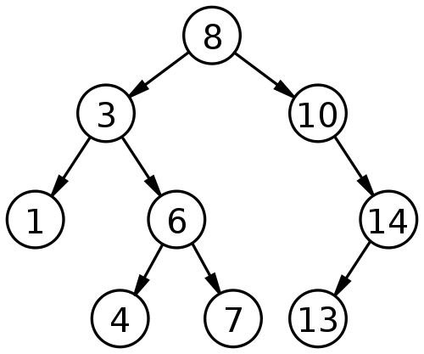
How TM works?
Optimistic concurrency
Example: Adding 9 & 15 concurrently

Slide 8
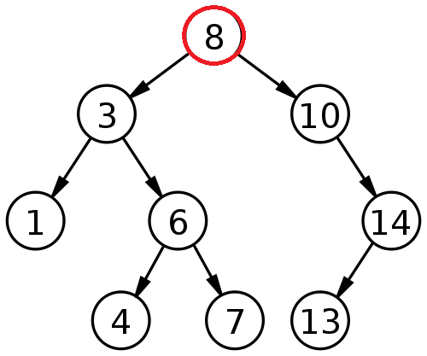
Thread A adds 9 & Thread B adds 15
Thread A
Read-set: 8
Write-set:
Thread B
Read-set: 8
Write-set:

Slide 9
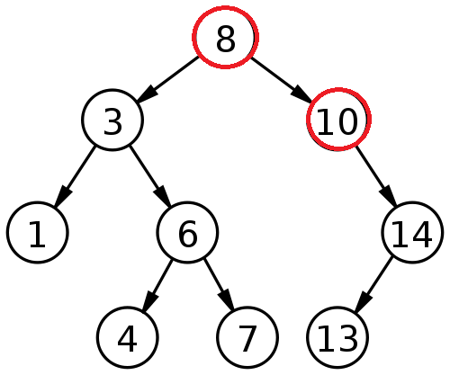
Thread A adds 9 & Thread B adds 15
Thread A
Read-set: 8, 10
Write-set:
Thread B
Read-set: 8, 10
Write-set:

Slide 10
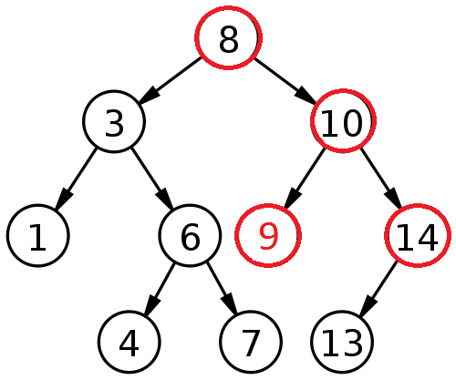
Thread A adds 9 & Thread B adds 15
Thread A
Read-set: 8, 10
Write-set: 10 (left child pointer)
Thread B
Read-set: 8, 10, 14
Write-set:

Slide 11
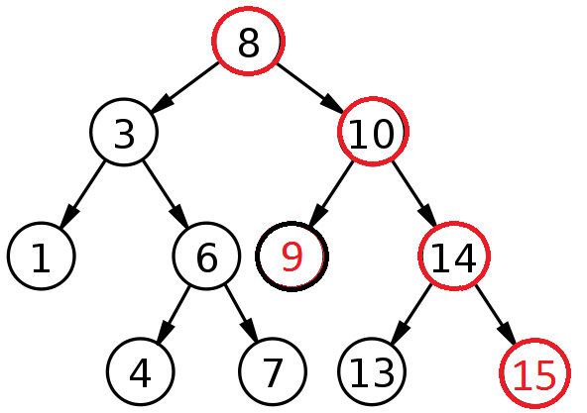
Thread A adds 9 & Thread B adds 15
Thread A
Read-set: 8, 10
Write-set: 10 (left child pointer)
Committed successfully
Thread B
Read-set: 8, 10, 14
Write-set: 14 (right child pointer)

Slide 12
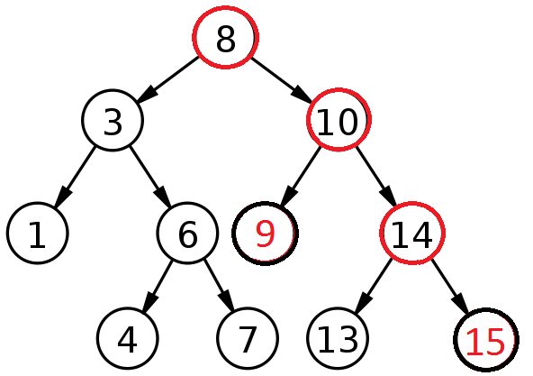
Thread A adds 9 & Thread B adds 15
Thread A
Read-set: 8, 10
Write-set: 10 (left child pointer)
Committed successfully
Thread B
Read-set: 8, 10, 14
Write-set: 14 (right child pointer)
Committed successfully

Slide 13
Object-based granularity
Thread A
Read-set: 8, 10
Write-set: 10
Committed successfully
Thread B
Read-set: 8, 10, 14
Write-set: 14
Conflict ➔ Abort
WAR

Slide 14
Three key mechanisms needed to create atomicity illusion
Versioning
Conflict detection
T0
T1
atomic{
x = x + y;
}
atomic{
x = x + y;
}
atomic{
x = x / 25;
}
Where to store new x until commit?
  Eager: store new x in memory; old in undo log
  Lazy: store new x in write buffer
How to detect conflicts between T0 and T1?
  Record memory locations read in read set
  Record memory locations wrote in write set
  Conflict if one’s read or write set intersects the other’s write set

Slide 15
Third mechanism determines transactional progress (need wait-free progress for real-time software)
Conflict resolution or contention management
T0
T1
x = x + y;
x = x / 25;
x = x / 25;
Which transaction to abort?
  Polite: familiar exponential backoff
  Greedy: favor those with an earlier start time
  Karma: ….
(Starvation may occur)

Slide 16
Optimistic execution yields performance gains at the simplicity of coarse-grain, but no silver bullet
Time
Coarse-grained locking
Irrevocable operations
Interaction between transactions and non-transactions
Conditional waiting
……
STM
Fine-grained locking
Threads
E.g., C/C++ Intel Run-Time System STM (B. Saha et. al. (2006). McRT-STM: A High Performance Software Transactional Memory. ACM PPoPP.)

Slide 17
Wait-free progress is necessary for real-time STM
Bound retry cost to satisfy time constraints
Rely on existing versioning and conflict detection techniques
Contention management directly affects transactional progress
  Starvation-freedom is necessary
We investigate earliest deadline contention management (ECM)
  S. Fahmy and B. Ravindran. On stm concurrency control for multicore embedded realtime software. In International Conference on Embedded Computer Systems (SAMOS), 2011
  Resolve conflict by favoring the transaction with the earliest deadline
  Modify retry cost analysis. Calculate response time.
  We propose rate monotonic contention management (RCM)
  Resolve conflict by favoring the transaction with smallest period.

Slide 18
Model is traditional real-time model
Threads arrive periodically, with deadlines equal to periods
Threads subsume transactions
Execute on a CMP, scheduled using global EDF (G-EDF) / global RMA (G-RMA) scheduling policy
Total thread utilization demand satisfies G-EDF(G-RMA)’s schedulable utilization bound
Thread release
T_{i}
Thread completion
Transaction
Next thread release
Time
Thread period, t(T_{i}) = relative thread deadline

Slide 19
Transactional retries is upper bounded using knowledge of thread arrival behaviors
Deadline of τ_{j}‘s earliest invocation that can execute within [t, t + T_{i} ]
τ_{j} may conflict with τ_{i} , causing τ_{i} to retry during [t, t + T_{i} ]
Release of τ_{j}‘s earliest invocation that can execute within [t, t + T_{i} ]
Last invocation of τ_{j} interfering with τ_{i} in case of RCM
Thread T_{j}’s releases
T_{i}’s next release
Thread T_{i}’s releases
t - t(T_{j})
t
t + t(T_{i})
Time
[0, t(T_{i}) + t(T_{j})]

Slide 20




Retry cost is upper bounded by
ECM
  γ_{i}: tasks sharing objects θ with τ_{i}.
  : l^{th} atomic section of τ_{j}.
  s_{max}(θ): longest atomic section in all tasks.
  : longest atomic section in τ_{i} accessing θ.
RCM
  : higher priority tasks sharing objects with τ_{i}
  : max atomic section in lower priority tasks than τ_{j} sharing θ
  : min for all

Slide 21

Thread execution time can be inflated with worst-case transactional retry cost
Each interference may cause a retry
C_{ji}  The WCET of τ_{j} relative to τ_{i}
  C_{j} : worst-case thread execution time without retries
  ɵ : shared object between τ_{j} and τ_{i}
  len(s_{j}(ɵ)) : length of all atomic sections in τ_{j} that accesses ɵ
  RC(τ_{ji}) : retry cost of τ_{j} without considering τ_{i}
G-EDF(G-RMA)’s response time analysis can now be used to determine schedulability of ECM(RCM)

Slide 22
ECM can be formally compared with
G-EDF/lock-free synchronization
Utilization demand-based schedulability (i.e., U_{i} = C_{i}/T_{i})
  Less demand is better
Claim 4: ECM is better than G-EDF/lock-free if s_{max} < r_{max}/2
  s_{max} : max cost of one transactional retry
  r_{max} : max cost of one lock-free retry
With low conflicting tasks  s_{max} approaches r_{max}
r_{max}
STM can tolerate higher retry costs than lock-free and still be competitive
s_{max}
r_{max}/2
Retry cost
Thread set

Slide 23
RCM can be formally compared with
G-RMA/lock-free synchronization
Utilization demand-based schedulability (i.e., U_{i} = C_{i}/T_{i})
  Less demand is better
Claim 5: RCM is better than G-RMA/lock-free if s_{max} < r_{max}/2
  s_{max} : max cost of one transactional retry
  r_{max} : max cost of one lock-free retry
With low sharing  s_{max} > r_{max}
s_{max}
r_{max}
STM can tolerate higher retry costs than lock-free and still be competitive
s_{max}
r_{max}/2
Retry cost
Thread set

Slide 24
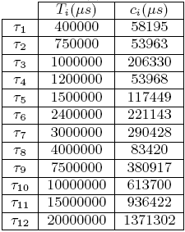
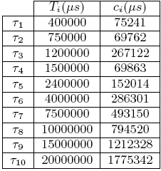
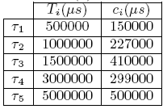
Implementation studies: Retry cost of ECM (RCM) is lower than lock-free/G-EDF(G-RMA)
Implemented ECM & RCM into RSTM in ChronOS Linux kernel
RSTM CAS for lock-free
8 core, 2GHz AMD Opteron
3 task sets

Slide 25
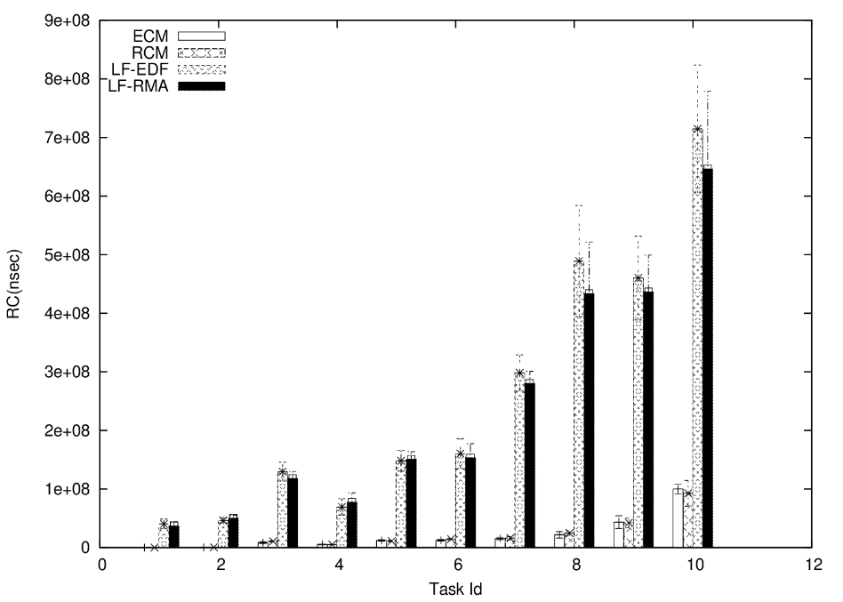
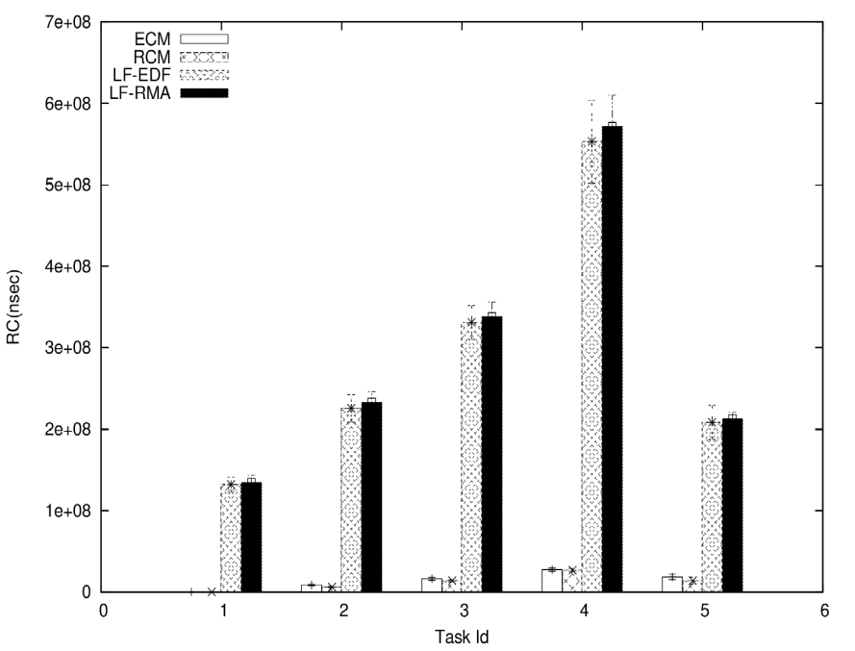
ECM(RCM) retry cost outperforms lock-free/G-EDF(G-RMA)
5 tasks
(total:0.2, max: 0.2, min: 0.2)
10 tasks
(total:0.2, max: 0.2, min: 0.2)

Slide 26
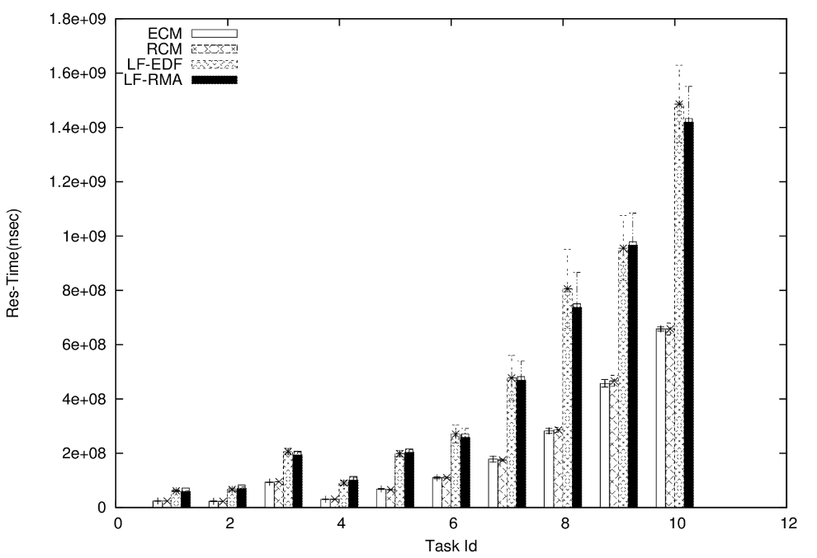
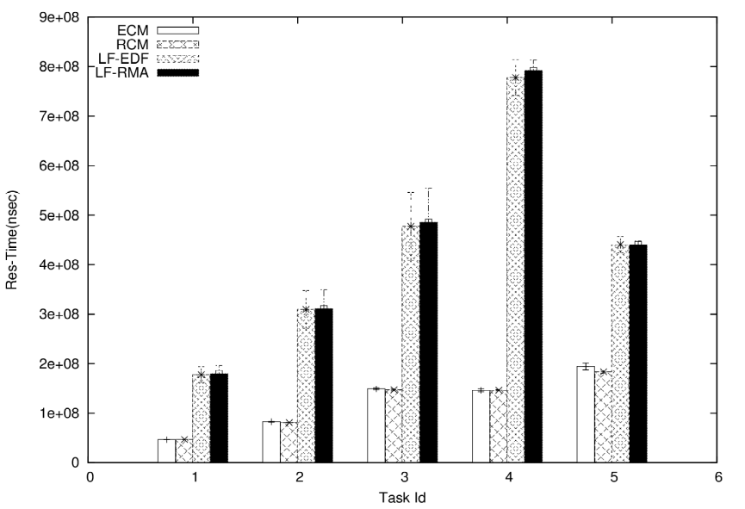
ECM(RCM) response time outperforms lock-free/G-EDF(G-RMA)
5 tasks
(total:0.2, max: 0.2, min: 0.2)
10 tasks
(total:0.2, max: 0.2, min: 0.2)

Slide 27
Conclusions
Max of 2.s_{max} retry cost under ECM, RCM
RCM, Lock-free ← Large number of conflicting instances
ECM, Lock-free ← All other tasks are conflicting
s_{max}/r_{max} for ECM => 0.5 to 1
s_{max}/r_{max} for RCM => 0.5 (>1 in some cases)
Tighter retry bounds?
Alternative real-time contention management policies?
Irrevocable instructions?

