Slide 1

On STM Concurrency Control for
Multicore Embedded Real-Time Software
Sherif Fahmy and Binoy Ravindran
ECE Department, Virginia Tech
Blacksburg, Virginia, USA
binoy@vt.edu
SAMOS 2011

Slide 2
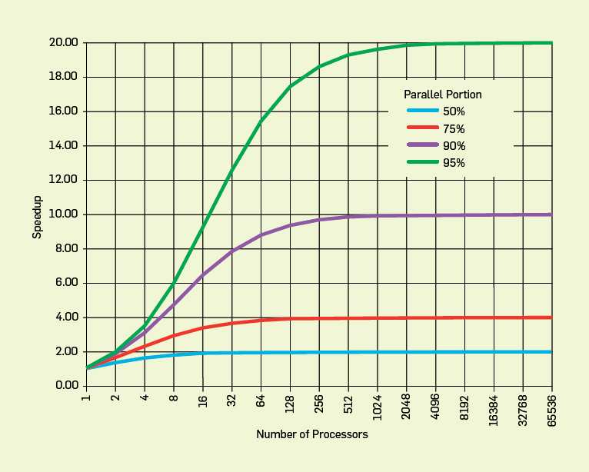
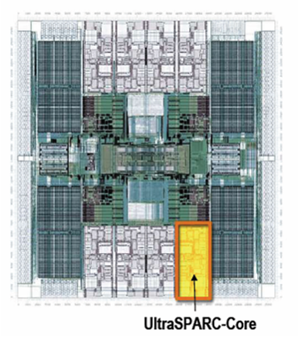
Concurrency control on chip multiprocessors significant affects performance (and programmability)
Improve performance by exposing greater concurrency
  Amdahl’s law: relationship between sequential execution time and speedup reduction is not linear
Significant implications for embedded real-time software
  Inherently concurrent – react to multiple streams of sensor input and control multiple actuators
  Often concurrently read/write shared data objects
Sun T2000 Niagara (8-core)

Slide 3
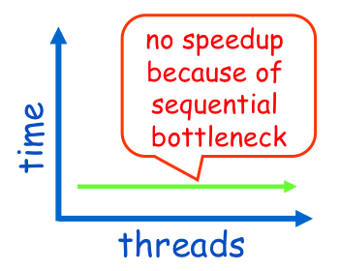
Lock-based concurrency control has serious drawbacks
Coarse-grained locking is simple, but permits little concurrency and difficult to exploit CMP parallelism
Fine-grained locking allows greater concurrency, but significantly error-prone
  Must acquire only necessary and sufficient locks
  Must avoid deadlocks
  Livelocks, lock convoying, priority inversion don’t go away

Slide 4
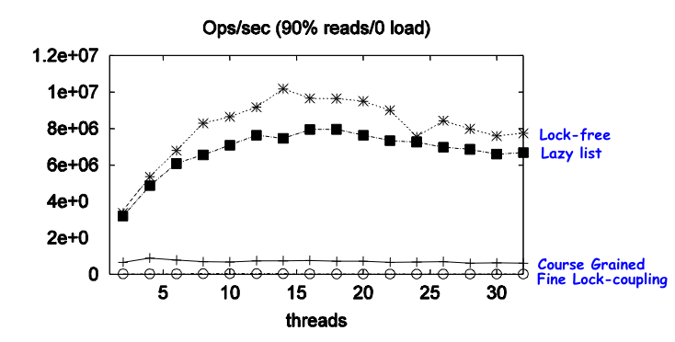
Lock-free concurrency control overcomes some of these difficulties, but…
Use atomic synchronization primitive for concurrency control (optimistically try and retry)
  Intel/AMD’s CMPXCHG, SPARC’s CAS, PowerPC/ARM’s LL/SC
Great performance!
Lock-inherent problems go away
  Deadlocks, livelocks, lock convoying, priority inversion
But programming is significantly complex
  Operate on a single word
  Sometimes have high overhead
Benchmark throughput of Java List-based Set algorithms on 16-node CMP

Slide 5
Transactional memory is an optimistic concurrency control alternative to locks
Organize code that access shared memory as transactions that (appear to) execute atomically and in isolation
Transactions optimistically execute, logging all changes
Two transactions conflict if they access same object and one is a write
  One is allowed to proceed and commit
  Other is aborted, changes rolled-back, and retried
atomic{
x = x + y;
}
M. Herlihy and J. B. Moss (1993). Transactional memory: Architectural support for lock-free data structures. ISCA. pp. 289–300.
N. Shavit and D. Touitou (1995). Software Transactional Memory. PODC. pp. 204—213.

Slide 6
TM example: modify node 3 in a thread-safe way
1
2
3
4
A. McDonald (2009). Architectures for Transactional Memory. PhD Thesis. Stanford University

Slide 7
TM example: modify node 3 in a thread-safe way
1
2
3
4

Slide 8
TM example: modify node 3 in a thread-safe way
1
2
3
4

Slide 9
TM example: modify node 3 in a thread-safe way
1
2
3
4

Slide 10
TM example: modify node 3 in a thread-safe way
1
2
3
4

Slide 11
TM example: modify node 3 in a thread-safe way
1
2
3
4

Slide 12
TM example: modify nodes 3 and 4 in a thread-safe way
1
2
3
4
Locking reduces concurrency

Slide 13
TM example: modify node 3 in a thread-safe way
1
2
3
4
Transaction A
READ:
WRITE:

Slide 14
TM example: modify node 3 in a thread-safe way
1
2
3
4
Transaction A
READ: 1, 2, 3
WRITE:

Slide 15
TM example: modify node 3 in a thread-safe way
1
2
3
4
Transaction A
READ: 1, 2, 3
WRITE: 3

Slide 16
TM example: modify nodes 3 and 4 in a thread-safe way
1
2
3
4
Transaction A
READ: 1, 2, 3
WRITE: 3
Transaction B
READ: 1, 2, 4
WRITE: 4

Slide 17
TM example: modify nodes 3 and 4 in a thread-safe way
1
2
3
4
Transaction A
READ: 1, 2, 3
WRITE: 3
WW conflicts
RW conflicts
Transaction B
READ: 1, 2, 4
WRITE: 4

Slide 18
TM example: modify node 3 in a thread-safe way
1
2
3
4
Transaction A
READ: 1, 2, 3
WRITE: 3
Transaction B
READ: 1, 2, 3
WRITE: 3

Slide 19
TM example: modify node 3 in a thread-safe way
1
2
3
4
Transaction A
READ: 1, 2, 3
WRITE: 3
WW conflicts
RW conflicts
Transaction B
READ: 1, 2, 3
WRITE: 3

Slide 20
Three key mechanisms needed to create atomicity illusion
Versioning
Conflict detection
T0
T1
atomic{
x = x + y;
}
atomic{
x = x + y;
}
atomic{
x = x / 25;
}
Where to store new x until commit?
  Eager: store new x in memory; old in undo log
  Lazy: store new x in write buffer
How to detect conflicts between T0 and T1?
  Record memory locations read in read set
  Record memory locations wrote in write set
  Conflict if one’s read or write set intersects the other’s write set

Slide 21
Third mechanism determines transactional progress (need wait-free progress for real-time software)
Conflict resolution or contention management
T0
T1
x = x + y;
x = x / 25;
x = x / 25;
Which transaction to abort?
  Polite: familiar exponential backoff
  Greedy: favor those with an earlier start time
  Karma: ….
(Starvation may occur)

Slide 22
Optimistic execution yields performance gains at the simplicity of coarse-grain, but no silver bullet
Time
Coarse-grained locking
Irrevocable operations
Interaction between transactions and non-transactions
Conditional waiting
……
STM
Fine-grained locking
Threads
E.g., C/C++ Intel Run-Time System STM (B. Saha et. al. (2006). McRT-STM: A High Performance Software Transactional Memory. ACM PPoPP.)

Slide 23
Wait-free progress is necessary for real-time STM
Rely on existing versioning and conflict detection techniques
Contention management directly affects transactional progress
  Starvation-freedom is necessary
We propose Earliest Deadline First (EDF) contention management
  Resolve conflict by favoring the transaction with the earliest deadline

Slide 24
Model is traditional real-time model
Threads arrive periodically, with deadlines equal to periods
Threads subsume transactions
Execute on a CMP, scheduled using global EDF (G-EDF) scheduling policy
Total thread utilization demand satisfies G-EDF’s schedulable utilization bound
Thread release
T_{i}
Thread completion
Transaction
Next thread release
Time
Thread period, t(T_{i}) = relative thread deadline

Slide 25

Transactional retries is upper bounded using knowledge of thread arrival behaviors
Release of T_{j}‘s earliest invocation that can execute within [t, t + t(T_{i})]
Deadline of T_{j}‘s earliest invocation that can execute within [t, t + t(T_{i})]
T_{j} may conflict with T_{i}, causing T_{i} to retry during [t, t + t(T_{i})]
Thread T_{j}’s releases
T_{i}’s next release
Thread T_{i}’s releases
t - t(T_{j})
t
t + t(T_{i})
Time
[0, t(T_{i}) + t(T_{j})]
Worst-case number retries of T_{i} =
β_{i,j} : number of accesses to transactional objects in T_{i} shared with T_{j}
γ_{i} : set of threads that share a transactional object with T_{i}

Slide 26
Thread execution time can be inflated with worst-case transactional retry cost
Each interference may cause a retry
C_{full} = C_{i} + (T_{i}‘s worst-case retries × s)
  C_{i}: worst-case thread execution time without retries
  s: cost of one retry
G-EDF’s schedulability analysis techniques can now be used to determine schedulability of G-EDF with STM (with EDF contention management)

Slide 27

G-EDF/STM can be formally compared with
G-EDF/lock-free and G-EDF/lock-based synchronization
Utilization demand-based schedulability (i.e., U_{i} = C_{i}/T_{i})
  Less demand is better
Claim 3: G-EDF/STM is better than G-EDF/lock-free if:
  s: cost of one transactional retry
  r: cost of one lock-free retry
Corollary 1: s ≤ c₁ r and 1 < c₁ < 2
C_{full}
2r
STM can tolerate higher retry costs than lock-free and still be competitive
s
r
Retry cost
Thread set

Slide 28
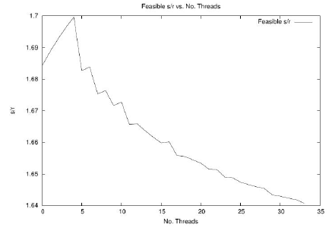

Implementation studies: s/r measurements show respecting bound for example app
Implemented STM with EDF-CM in LITMUS Linux kernel
Intel T3400 CMP
s/r bound ranges 1.64 – 1.7 for this app
  Actual s/r must respect this bound (for STM to be competitive to lock-free)
Measured s/r for:
  CAS-based lock-free skiplist [26]
  Herlihy et. al.’s STM [12] – HSTM
  Fraser’s STM [26] – FSTM
  Only write instructions
s/r bound is satisfied, allowing STM to be competitive

Slide 29
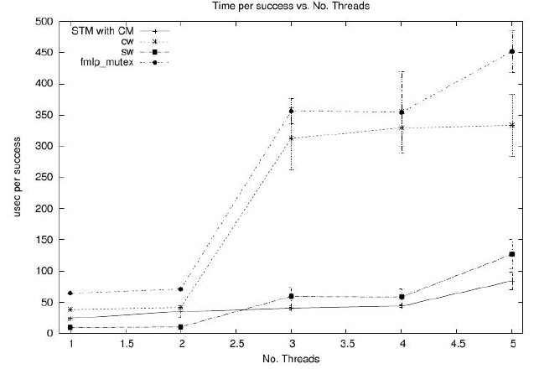
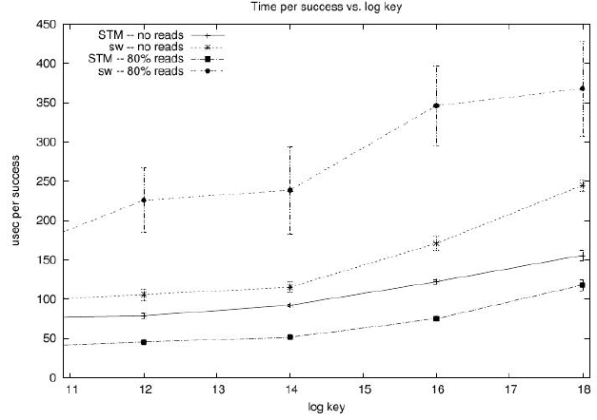
STM/EDF-CM outperforms coarse-grained real-time locking and competitive to fine-grained
Red/black tree
Only write operations
FMLP and two fine-grained solutions due to Fraser [26]: concurrent writers (cw); serialized writers (sw)
STM ≅ sw >> cw >> FMLP
STM versus sw for different %reads
Time versus log of keysize
STM >> sw

Slide 30
Conclusions
Wait-free progress can be obtained with STM through real-time contention management
  Retry bounds by analyzing thread arrival behavior patterns
STM is highly competitive to fine-grained locking for complex data structures
  Many locks needed for high concurrency
  Overhead of many locks compares against an atomic region
Programming model is simpler
Tighter retry bounds?
Alternative real-time contention management policies?
Irrevocable instructions?

