Slide 1

Scheduling Memory Transactions in Distributed Systems
Presented by Junwhan Kim
Preliminary Examination Proposal
Committee Members:
Binoy Ravindran, Chair
Robert P. Broadwater
Paul E. Plassmann
Anil Vullikanti
Maurice Herlihy

Slide 2
Dissertation Problem and Solutions
Problem
How to Schedule Memory Transactions in DTM?
Solutions
Five Transactional Schedulers
Three Transactional Schedulers for the post preliminary exam

Slide 3
Introduction
Multi-core architectures are the future.
Concurrent programming will become common
Lock-based programming is error prone
Deadlock, Livelock, Priority Inversion, and Non-Composability
Transactional Memory (TM) simplifies concurrent programming significantly.
Like database transactions
ACI properties
Easier to program
Composable

Slide 4
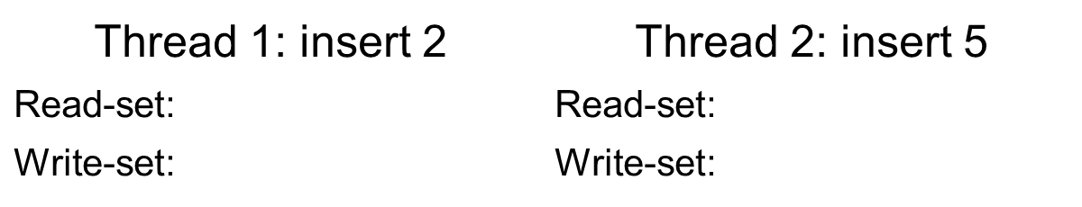
How TM works
6, 3, 1
6, 3, 4
1
4
6
3
8
1
4
7
9
Source: Chi’s defense slide

Slide 5
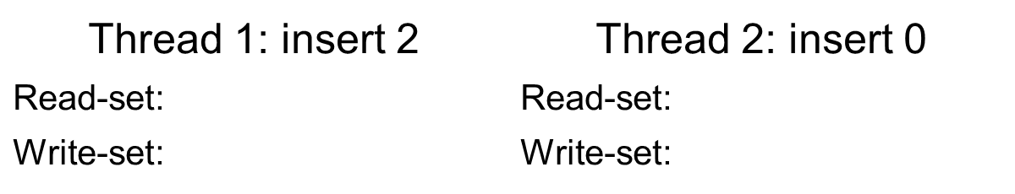
How TM works
6, 3, 1
6, 3, 1
1
1
6
3
8
1
4
7
9
conflict
Source: Chi’s defense slide

Slide 6
Transactional Memory
Hardware TM (HTM) [29, 33, 46, 53, 57]
Best performance
Limited in size & time
Software TM (STM) [20, 32, 34, 45, 66]
Entirely in software
Not limited or flexible
Higher overhead
Hybrid TM [17, 42, 13, 72]
Hardware TM+Software TM

Slide 7
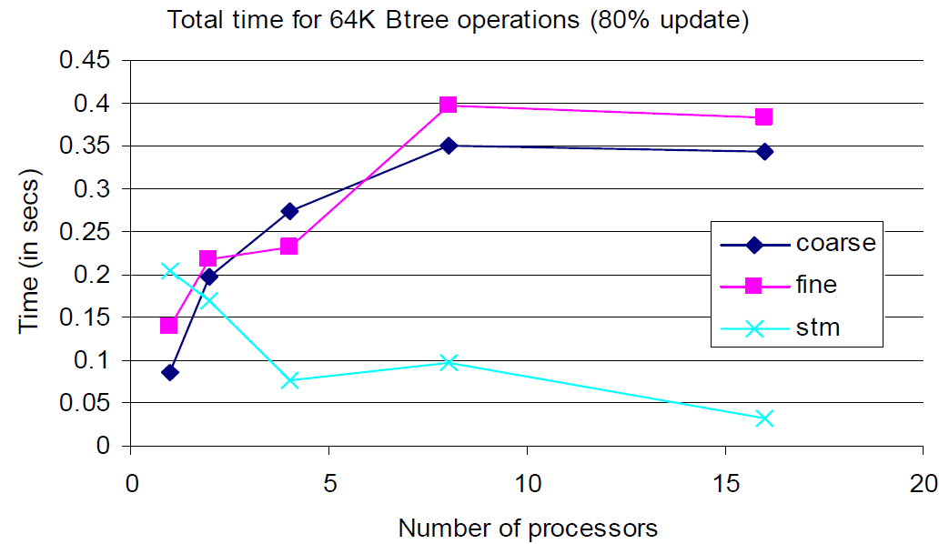
(Coarse and Fine-grained) Lock vs. STM for Btree [65]

Slide 8
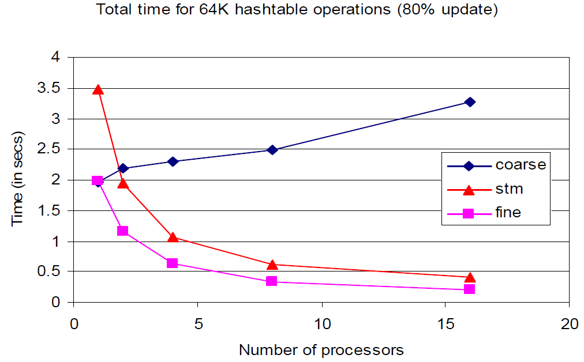
(Coarse and Fine-grained) Lock vs. STM for HashTable [65]

Slide 9
Transactional Scheduler in STM
Contention Manager
Decides how a conflict should be resolved.
One of the conﬂicting transactions is aborted (the loser) and rolled back while the other is allowed to proceed (the winner).
Transactional Scheduler [43]
Motivations
Too many aborts, e.g., when a long running transaction conflicts with shorter transactions
Lack of precision, since an aborted transaction may wait too long.
Its goal is to address the problem of repeated aborts in STM.

Slide 10
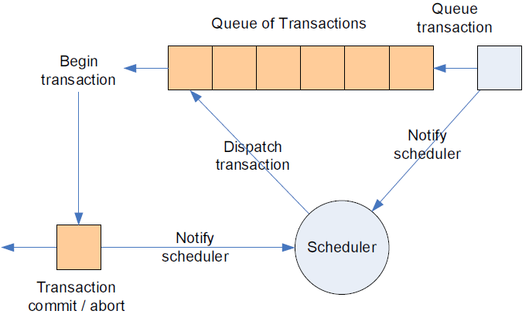
Past Transactional Schedulers on Multi-processor
Queuing
transactions
BIMODAL
Scheduler [5]
Adaptive
Scheduler [45]
memory
Proactive
Scheduler [7]

Slide 11
Execution and Network Models for Distributed TM
Execution Models
Data flow DTM [35, 38, 39, 73, 74]
Transactions are immobile
Objects migrate to invoking transactions
Control flow DTM [60]
Objects are immobile
Transactions move from node to node
Network Models
Cache-coherence (cc) DTM [35, 78, 63]
A number of nodes are interconnected using message-passing links over a communication network
Cluster DTM [16, 60, 61]
A group of linked computers works closely together to form a single computer

Slide 12

Data-flow cc Distributed TM (DTM)
A network of nodes
Distributed Transactional memory
Local request:
Local object – return copy
Remote object – locate with a cache-coherence protocol
Remote request:
Object not in use – invalidate copies and send
Object in use – abort or send
Commit:
No invalidations
Abort
Invalidations
requester 1
Remote
request
An object
moves
Remote
request
abort or
the object moves
requester 2

Slide 13
Atomicity, Consistency, and Isolation in data-flow DTM
T₁, T₂, and T₃ request o₁.
T₄ requests o₁ and aborts.
Object o₁
t₁
t₂
t₃
t₄
t₅
time
LC =14
* LC is a local clock
T₂ Validates o₁.
o₁ is updated at 30
T₁ and T₃ try to validate and abort,
because LC=30, was 14
Transactional Forwarding Algorithm (TFA) [63]
Early validation of remote objects
Atomicity for object operations in the presence of asynchronous clocks

Slide 14
Current Research and Contributions (Five Transactional Schedulers in data-flow DTM)
Bi-interval Scheduler
Published in SSS 10
Reactive Transactional Scheduler
Accepted in IPDPS 12
Cluster-based Transactional Scheduler
Submitted to SRDS 12
Dependency-based Transactional Scheduler
Submitted to ICPP 12
Progressive Transactional Scheduler
Submitted to SC 12

Slide 15
Outline
Bi-interval Scheduler
Motivation/Design/Analysis/Evaluation
Reactive Transactional Scheduler
Motivation/Design/Analysis/Evaluation
Cluster-based Transactional Scheduler
Motivation/Design/Analysis/Evaluation
Conclusion of Current Research and Contributions
Proposed Post Preliminary-Exam Work

Slide 16
Bi-interval Scheduler
Motivation / Design
Example / Evaluation
T₂
T₅
requesting o₁
requesting o₂
n₂
n₅
n₁
o₁
o₁
requesting o₁
requesting o₁
T₄
o₁
o₁
T₃
n₄
n₃
Requesting o₁
Note: Object o₁, Transaction T, and Node n
Node n₁ is the object owner of o₁

Slide 17
Bi-interval Scheduler
Motivation / Design
Example / Evaluation
T₂
T₅
Attempted
validation
validation
n₂
n₅
n₁
abort
Attempted
validation
Attempted
validation
abort
T₄
abort
T₃
n₄
n₃
Validating o₁
n₅ becomes the owner of o₁

Slide 18
Bi-interval Scheduler
Motivation / Design
Example / Evaluation
T₂
n₅
requesting o₁
n₂
o₁
requesting o₁
requesting o₁
T₄
o₁
o₁
T₃
n₄
n₃
requesting o₁ again
Aborts lead to communication delays

Slide 19
Bi-interval Scheduler
Motivation / Design
Example / Evaluation
Bi-interval categorizes requests into read and write intervals.
A read interval
an object is simultaneously sent to the nodes invoking read transactions.
A write interval
an object visits according to the nearest nodes invoking write transactions.
Assigns backoff times to aborted read and write transactions
For read transactions, assigns a local execution time.
For write transactions, assigns the sum of local execution times.

Slide 20
Bi-interval Scheduler
Motivation / Design
Example / Evaluation
T₂
T₃
T₄
T₅
T₂
T₅
requesting o₁
requesting o₂
n₂
n₅
n₁
o₁
o₁
requesting o₁
requesting o₁
T₄
o₁
o₁
T₃
n₄
n₃
Requesting o₁

Slide 21
Bi-interval Scheduler
Motivation / Design
Example / Evaluation
T₂
T₃
T₄
T₂
T₅
validation
n₂
n₅
n₁
abort
T₄
abort
T₃
abort
n₄
n₃
Validating o₁

Slide 22
Bi-interval Scheduler
Motivation / Design
Example / Evaluation
T₂
T₃
T₄
T₂
n₅
n₂
o₁
T₄
o₁
T₃
n₄
n₃
T₄
o₁
Assume that T₂ is a read transaction and T₃ and T₄ are write transactions.
Schedule T₃ T₄, due to d(n₅, n₃)<d(n₅, n₄)

Slide 23
Bi-interval Scheduler
Motivation / Design
Example / Evaluation
Definition: Competitive Ratio =
Theorem 4.5.3. Competitive Ratio (bi-interval) = O(log(N))
Competitive Ratio(no scheduler) = O(N) [75]
Theorem 4.5.6. Average Competitive Ratio(bi-interval) = ϴ(log(N-k)), where k read transactions

Slide 24
Bi-interval Scheduler
Motivation / Design
Example / Evaluation
Implementation and experimental set up
Implemented with TFA [62,63]
Low contention: 90% read transactions
High contention: 10% read transactions
48 Nodes , 1.9 GHz each, 1~ 50ms network delay
1 million transactions per node
Benchmarks: bank, vacation, loan, RB-tree
Transactional throughput: the number of committed transactions per second under increasing number of requesting nodes

Slide 25
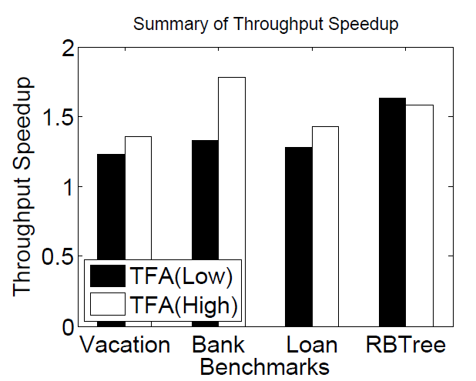
Bi-interval Scheduler
Motivation / Design
Example / Evaluation
Speedup: the ratio of Bi-interval’s throughput to the throughput of TFA.
Bi-interval enhances transactional throughput over TFA as much as 1.65 ~ 1.77 speedup under low and high contention, respectively.

Slide 26
Reactive Transactional Scheduler
Motivation / Design
Example / Evaluation
1 tx_begin
2 x++;
3 y++;
4 tx_begin
5 i++
6 tx_end
7 z++;
8 tx_end
T₁
Outer Transaction
T₁
Inner Transaction
T₁₋₁
T₁
Nested Transaction
Flat Nesting
Closed Nesting
Open Nesting

Slide 27
Reactive Transactional Scheduler
Motivation / Design
Example / Evaluation
Flat inner transactions accessing a shared object
T₁
commit
T₂
commit
abort
Closed inner transactions accessing a shared object
T₁
commit
T₂
commit
T₂'s inner transaction may proceed after T₁ commits
Source [74]

Slide 28
Reactive Transactional Scheduler
Motivation / Design
Example / Evaluation
Closed outer transactions accessing a shared object
T₁
commit
T₂
commit
commit
The inner transaction is not related to the conflict,
but it must restart

Slide 29
Reactive Transactional Scheduler
Motivation / Design
Example / Evaluation
Focus on outer transactions including committed inner transactions
RTS performs two actions for a losing outer transaction.
determining whether a losing outer transaction is aborted or enqueued.
If its inner transactions have committed, it is enqueued.
checking contention level
if it is an outer transaction with a “high” contention level, it aborts.
If it is an outer transaction with a “low” contention level, it is enqueued.

Slide 30
Reactive Transactional Scheduler
Motivation / Design
Example / Evaluation
Closed outer transactions accessing a shared object
T₁
commit
T₂
commit
commit
restart
T₃
abort

Slide 31
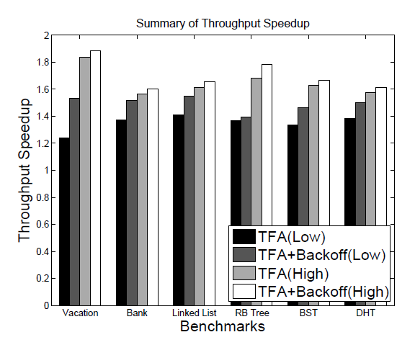
Reactive Transactional Scheduler
Motivation / Design
Example / Evaluation
Definition: makespan_{A} is the time that A needs to complete N transactions.
Theorem 7.5.4: makespan_{RTS} < makespan_{TFA_ClosedNesting}

Slide 32
Cluster-based Transactional Scheduler
Motivation / Design
Example / Evaluation
Model
No Replication: Scalable, Non-fault-tolerant
Full Replication: Non-Scalable, fault-tolerant, High memory usage
Partial Replication: Scalable, fault-tolerant
With Single object copy,
Node/link failures cannot be tolerated.
Broadcasting replicated objects in data flow DTM is non-scalable due to expensive brute-force replication of all objects on all nodes.

Slide 33
Cluster-based Transactional Scheduler
Motivation / Design
Example / Evaluation
Partitioning:
k clustering algorithm selects k nodes for distributing replicas of each object.
k clusters have small intra-cluster distances
Reduced requesting times
Scheduling:
Each object owner enqueues transactions
Assigns a backoff-time to an aborted transaction
The object is directly sent to the aborted transaction
Reduced the number of requests

Slide 34
Cluster-based Transactional Scheduler
Motivation / Design
Example / Evaluation
T₃
n₃
requesting o₁
object o₁
T₁
validating o₁
T₇
n₁
requesting o₁
n₀
n₅
requesting o₁
n₇
object o₁
object o₁
requesting o₂
requesting o₁
object o₂
object o₁
T₂
T₆
n₂
n₆
Cluster 1
Cluster 2

Slide 35
Cluster-based Transactional Scheduler
Motivation / Design
Example / Evaluation
T₃
n₃
T₁
abort
T₇
n₁
n₀
n₅
n₇
abort
abort
abort
T₂
T₆
n₂
n₆
Cluster 1
Cluster 2

Slide 36
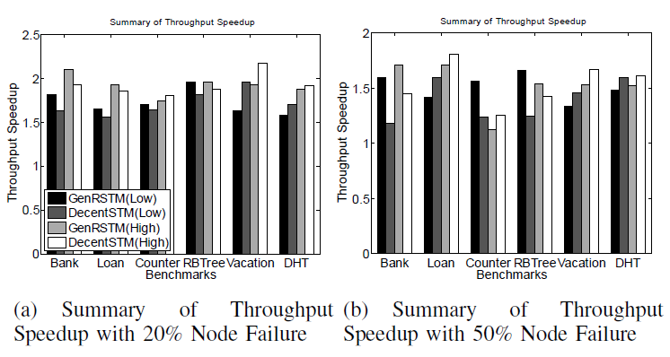
Cluster-based Transactional Scheduler
Motivation / Design
Example / Evaluation
Definition: makespan_{A} is the time that A needs to complete N transactions.
Definition: One-copy serializability: The effect of transactions on replicated objects should be the same as if they had been performed one at time on a single set of objects.
Theorem 6.5.5: makespan(FR) < makespan(PR) < makespan(NR)
Theorem 6.5.6: makespan_{CTS}(PR) < makespan(FR), where N > 3.
Theorem 6.5.7: CTS ensures one-copy serializability

Slide 37
Conclusion
Bi-interval Scheduler
Single object copy DTM model
Exploit concurrency of reading transactions
Minimize object moving times through visiting nearest nodes
Reactive Transactional Scheduler
Closed nested transactions in data flow DTM model
Prevent outer transactions from aborts to preserve their the committed inner transactions
Cluster-based Transactional Scheduler
A partial replicated model for DTM
Minimize object moving time through small inter node communications of each cluster.
Identifying the underlying causes for each model.
Eliminating them can yield significant throughput improvement.

Slide 38
Proposed Post Preliminary-Exam Work
Satisfy Update Serializability (US) [30]
Read transactions never abort.
Achieve US by multi-version concurrency.
Design a new transactional scheduler to support US.
Satisfy Strong Eventual Consistency (SEC) [70]
An object is SEC if it has “eventual delivery” and “strong convergence”.
High object availability and performance
Design a new transactional scheduler to support SEC.
Leverage Genuine Atomic Multicast (GAM) [69]
GAM performs better than Non-GAM in high contention [69]
Apply GAM to CTS
Evaluate using Industrial-strength Benchmarks
TPC-B [1]
Berkley Database [54]
Yahoo cloud-serving benchmark [15]

Slide 39
Thank you.

