Slide 1
STM Concurrency Control for Multicore Embedded
Real-Time Software: Time Bounds and Tradeoffs
SAC 2012
March 29, 2012
Mohammed Elshambakey
Binoy Ravindran
Virginia Tech University

Slide 2
Outline
Real-time concurrency control.
ECM.
Retry cost.
Response time.
ECM vs. Lock-free.
RCM.
Retry cost.
Response time.
RCM vs. Lock-free.
Results.
Conclusions.
Future Work.
Questions.

Slide 3
Real-Time Concurrency Control
Lock-based:
  PIP, PCP, SRP, FMLP, OMLP.
  Coarse-grained, fine-grained.
  Deadlocks, livelocks, lock-convoying, priority inversion, non-composable.
Lock-free:
  Numerous advantages vs. locks (e. g., deadlock-freedom).
  Programmability is challenging.
  Best suited for simple data structures.
Transaction Memory ==>

Slide 4
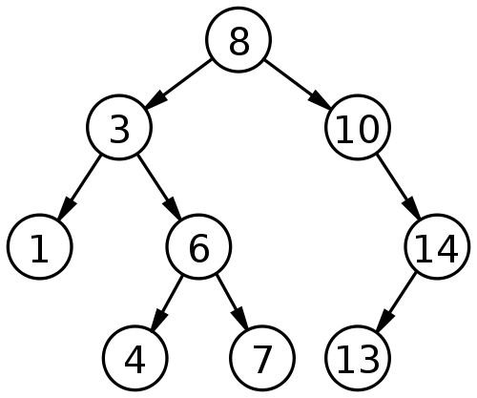
How TM works?
Optimistic concurrency
Example: Adding 9 & 15 concurrently

Slide 5
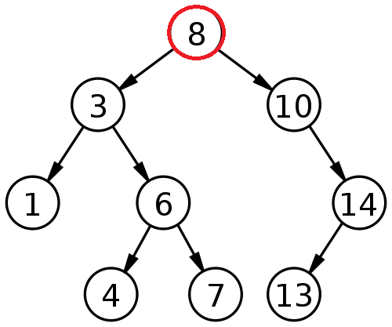
Thread A adds 9 & Thread B adds 15
Thread A
Read-set: 8
Write-set:
Thread B
Read-set: 8
Write-set:

Slide 6
Thread A adds 9 & Thread B adds 15
Thread A
Read-set: 8
Write-set:
Thread B
Read-set: 8
Write-set:

Slide 7
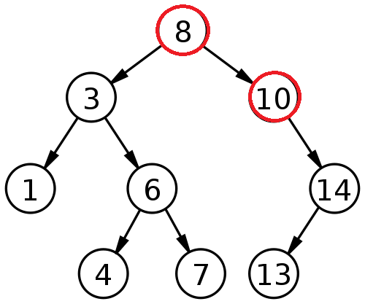
Thread A adds 9 & Thread B adds 15
Thread A
Read-set: 8, 10
Write-set:
Thread B
Read-set: 8, 10
Write-set:

Slide 8
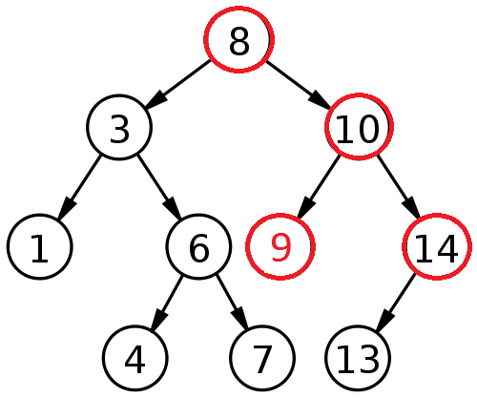
Thread A adds 9 & Thread B adds 15
Thread A
Read-set: 8, 10
Write-set: 10 (left child pointer)
Thread B
Read-set: 8, 10, 14
Write-set:

Slide 9
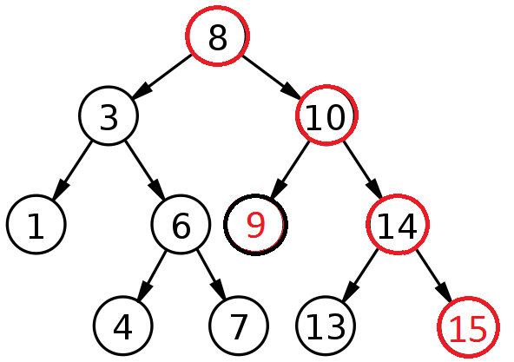
Thread A adds 9 & Thread B adds 15
Thread A
Read-set: 8, 10
Write-set: 10 (left child pointer)
Committed successfully
Thread B
Read-set: 8, 10, 14
Write-set: 14 (right child pointer)

Slide 10
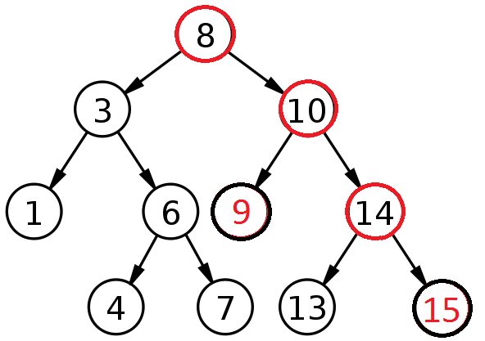
Thread A adds 9 & Thread B adds 15
Thread A
Read-set: 8, 10
Write-set: 10 (left child pointer)
Committed successfully
Thread B
Read-set: 8, 10, 14
Write-set: 14 (right child pointer)
Committed successfully

Slide 11
Real-Time Concurrency Control
(Real-time) Transactional memory:
  A lot of common of (real-time) database transactions.
  ACID properties.
  Easier to program.
  Fine-grained performance.
  Composable.
  HTM, STM, Hybrid.
HOW TO RESOLVE CONFLICTS PROVIDED REAL-TIME CONSTRAINTS (reduce retry cost, response time)

Slide 12




Retry Cost
Example (a)
Example (b)

Slide 13





ECM
Earliest Deadline Contention Manager
Algorithm
Data: interfered transaction.
interfering transaction.
If then
aborts
Else
aborts
End

Slide 14
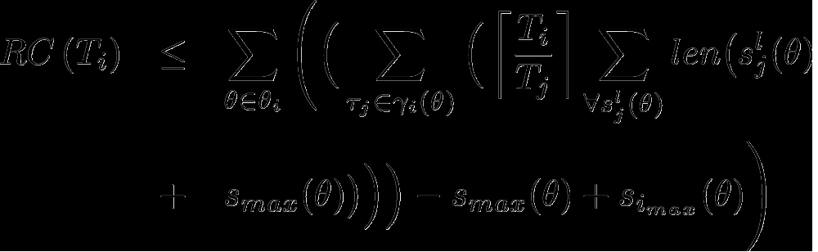
Retry Cost
Claim 1
Under ECM, a task τ_{i} ’s maximum retry cost during T_{i} is upper bounded by:

Slide 15
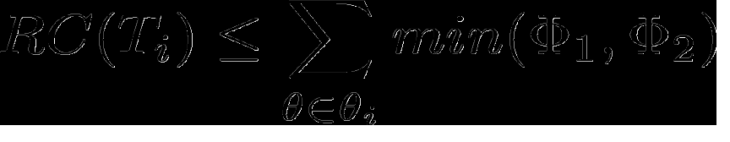


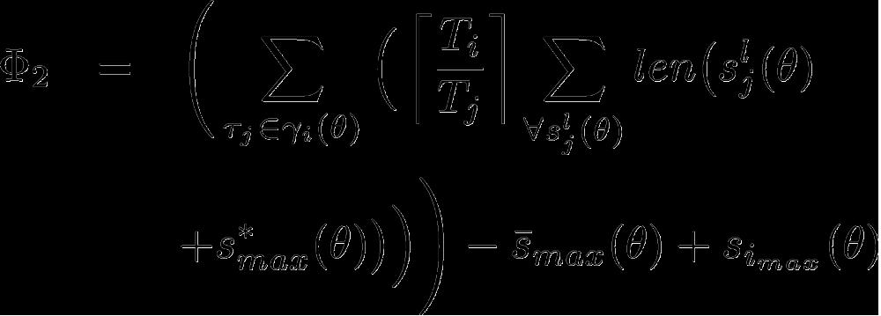
Retry Cost
Claim 2
Retry cost upper bound can be minimized as:
Where as before for single object

Slide 16

Retry Cost
Upper bound can be further reduced by :
Over T_{i}
min{RC(R_{i} ), RC(T_{i} )}
T_{i}

Slide 17
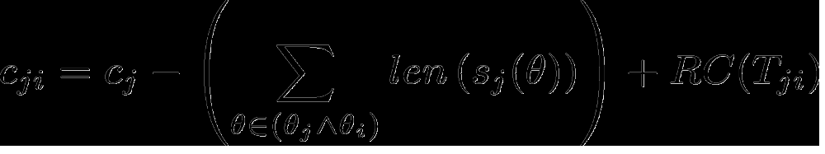
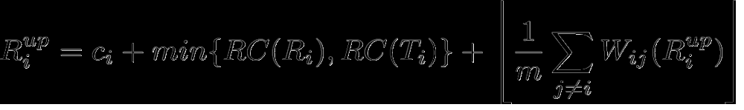
Response Time
WCET of is modified to

Slide 18
ECM vs. Lock-free
For ECM’s schedulability to be better or equal to that of retry-loop lock-free approach, the size of s_{max} must not exceed one half of that of r_{max} , where r_{max} is the maximum execution cost of a single iteration of any lock-free retry loop of any task.
With low number of conflicting tasks, the size of s_{max} can be at most the size of r_{max} .

Slide 19

RCM
Rate Monotonic Contention Manager
Algorithm
Data: interfered transaction.
interfering transaction.
If then
aborts
Else
aborts
End

Slide 20
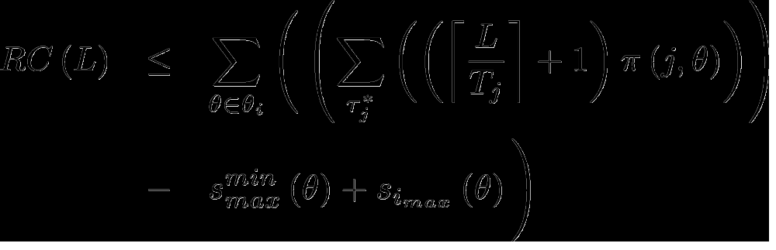

Retry Cost
Claim 3
Under RCM, a task τ_{i} ’s retry cost over duration L, which can extend to T_{i} , is upper bounded by:
Where

Slide 21
Response Time
Same as ECM

Slide 22
RCM vs. Lock-free
For RCM’s schedulability to be better or equal to that of retry-loop lock-free approach, the size of s_{max} must not exceed one half of that of r_{max} for all cases.
However, the size of s_{max} can be larger than that of r_{max} , depending on the number of accesses to a task T_{i} ’s shared objects from other tasks.

Slide 23
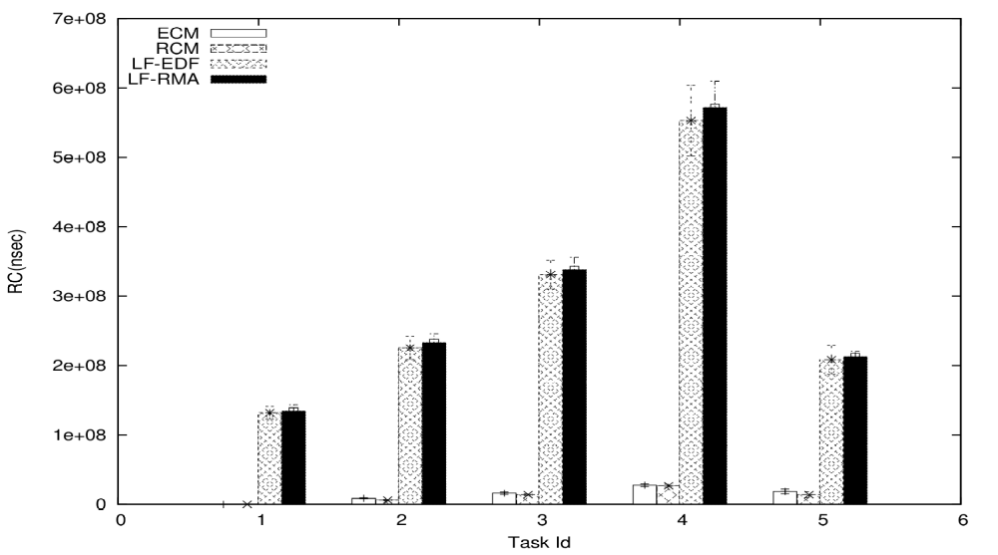
Results
Retry Cost - 5 tasks - (total:0.2, max: 0.2, min: 0.2)

Slide 24
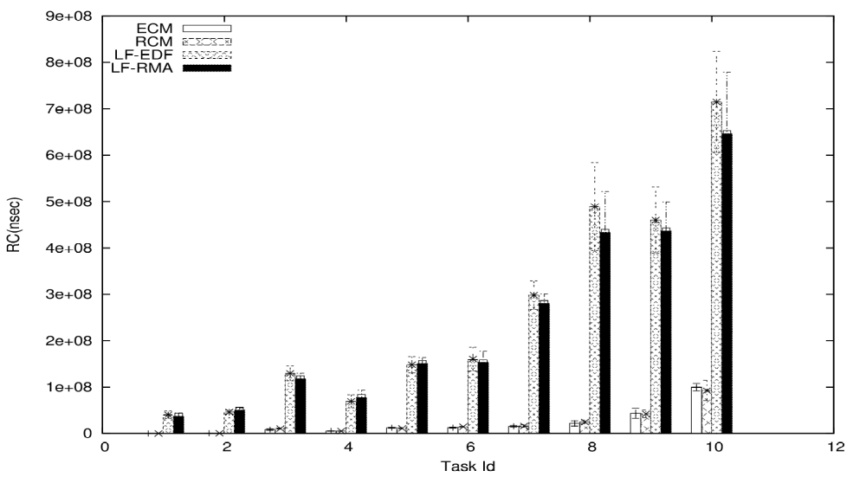
Results
Retry Cost - 10 tasks - (total:0.2, max: 0.2, min: 0.2)

Slide 25
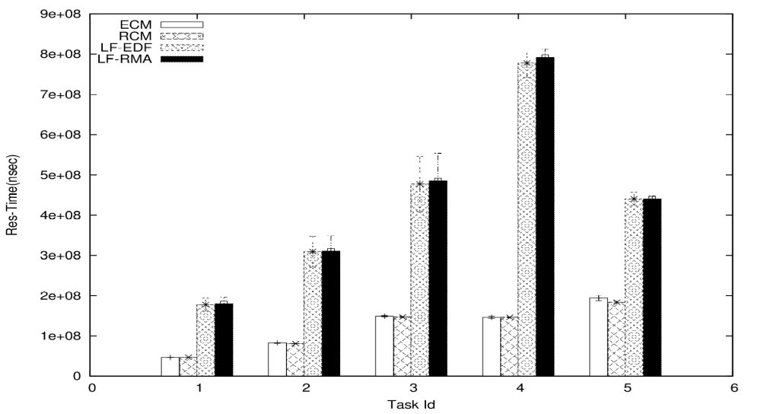
Results
Response time - 5 tasks - (total:0.2, max: 0.2, min: 0.2)

Slide 26
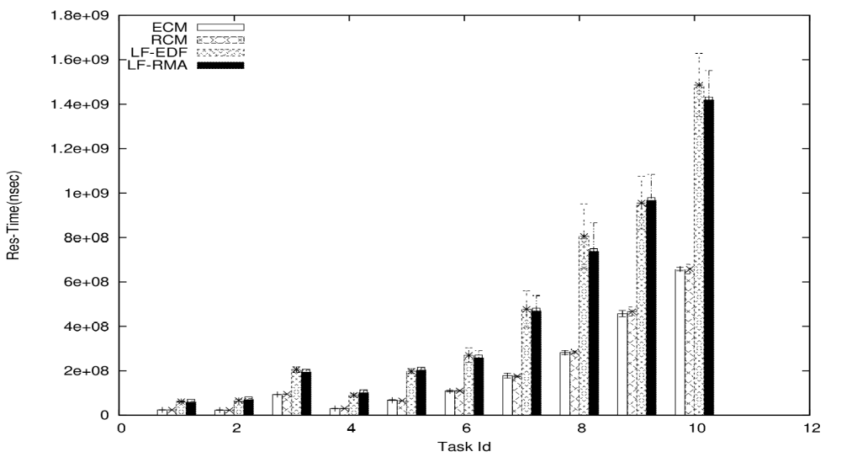
Results
Response time - 10 tasks - (total:0.2, max: 0.2, min: 0.2)

Slide 27

Conclusions
Max of 2.s_{max} retry cost under ECM, RCM.
RCM, Lock-free <= Large number of conflicting instances.
ECM, Lock-free <= All other tasks are conflicting.
s_{max}/r_{max} for ECM => 0.5 to 1.
s_{max}/r_{max} for RCM => 0.5 (>1 in some cases).

Slide 28
Future work
Reduce retry cost than 2.s_{max}.
Multiple objects per transaction.
Comparison against locks.
Nested transactions.
Questions?

