Slide 1

Real-Time Software Transactional Memory: Contention Managers, Time Bounds, and Implementations
Presented by Mohammed El-Shambakey
Preliminary Examination Proposal
Committee Members:
Binoy Ravindran, Chair
Robert P. Broadwater
Cameron D. Patterson
Mohamed Rizk Mohamed
Anil Vullikanti

Slide 2
Dissertation Problem, Solutions and Post Work
Problem
  How to do STM concurrency control for real-time software? What are the tradeoffs with locks?
Contributions
  Developed four STM real-time contention managers that target different models and yield different properties: ECM, RCM, LCM and PNF
  Post preliminary
  Develop real-time contention managers with
      optimized time bounds
      support for transactional nesting
  Comparison with real-time locking protocols

Slide 3
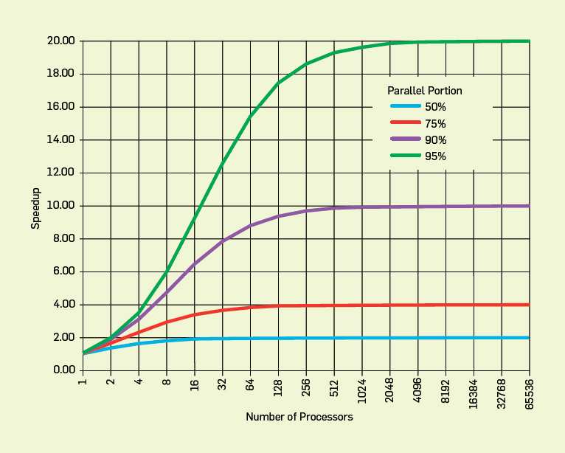
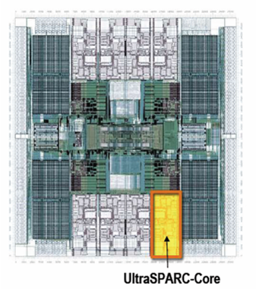
Concurrency control on chip multiprocessors significant affects performance (and programmability)
Improve performance by exposing greater concurrency
  Amdahl’s law: relationship between sequential execution time and speedup reduction is not linear
Significant implications for embedded real-time software
  Inherently concurrent – react to multiple streams of sensor input and control multiple actuators
  Often concurrently read/write shared data objects
Sun T2000 Niagara (8-core)

Slide 4
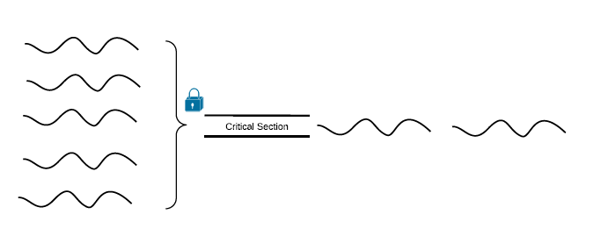
Concurrency Control (2) “From ByteSTM: Java Software Transactional Memory at the Virtual Machine Level, Mohamed Mohamedin, MS Thesis, February 2012”
Lock-based synchronization
  Coarse-grained locking
  Fine-grained locking
Locks problems
  Deadlocks, livelocks, lock-convoying, priority inversion, non-composable

Slide 5
Coarse vs. Fine Grained Locking “From ByteSTM: Java Software Transactional Memory at the Virtual Machine Level, Mohamed Mohamedin, MS Thesis, February 2012”
public boolean add(int item) {
Node pred, curr;
lock.lock();
try {
pred = head;
curr = pred.next;
while (curr.val < item) {
pred = curr;
curr = curr.next;
}
if (item == curr.val) {
return false;
} else {
Node node = new Node(item);
node.next = curr;
pred.next = node;
return true;
}
} finally {
lock.unlock();
}
}
public boolean add(int item) {
head.lock();
Node pred = head;
try {
Node curr = pred.next;
curr.lock();
try {
while (curr.val < item) {
pred.unlock();
pred = curr;
curr = curr.next;
curr.lock();
}
if (curr.key == key) {
return false;
}
Node newNode = new Node(item);
newNode.next = curr;
pred.next = newNode;
return true;
} finally {
curr.unlock();
}
} finally {
pred.unlock();
}
}

Slide 6
Concurrency Control (3) “From ByteSTM: Java Software Transactional Memory at the Virtual Machine Level, Mohamed Mohamedin, MS Thesis, February 2012”
Lock-free synchronization
public boolean add(int item) {
while (true) {
Node pred = null, curr = null, succ = null;
boolean[] marked = {false}; boolean snip;
retry: while (true) {
pred = head; curr = pred.next.getReference();
while (true) {
succ = curr.next.get(marked);
while (marked[0]) {
snip = pred.next.compareAndSet(curr, succ, false, false);
if (!snip) continue retry;
curr = succ; succ = curr.next.get(marked);
}
if (curr.val < item)
pred = curr; curr = succ;
}
}
if (curr.val == item) { return false;
} else {
Node node = new Node(item);
node.next = new AtomicMarkableReference(curr, false);
if (pred.next.compareAndSet(curr, node, false, false)) {return true;}
}
}
}

Slide 7
Transactional Memory “From ByteSTM: Java Software Transactional Memory at the Virtual Machine Level, Mohamed Mohamedin, MS Thesis, February 2012”
Like database transactions
ACID properties
Easier to program
Fine-grained performance
Composable
public boolean add(int item) {
Node pred, curr;
atomic {
pred = head;
curr = pred.next;
while (curr.val < item) {
pred = curr;
curr = curr.next;
}
if (item == curr.val) {
return false;
} else {
Node node = new Node(item);
node.next = curr;
pred.next = node;
return true;
}
}

Slide 8
Optimistic execution yields performance gains at the simplicity of coarse-grain, but no silver bullet
Time
Coarse-grained locking
Irrevocable operations
Interaction between transactions and non-transactions
Conditional waiting
……
STM
Fine-grained locking
Threads
E.g., C/C++ Intel Run-Time System STM (B. Saha et. al. (2006). McRT-STM: A High Performance Software Transactional Memory. ACM PPoPP.)

Slide 9
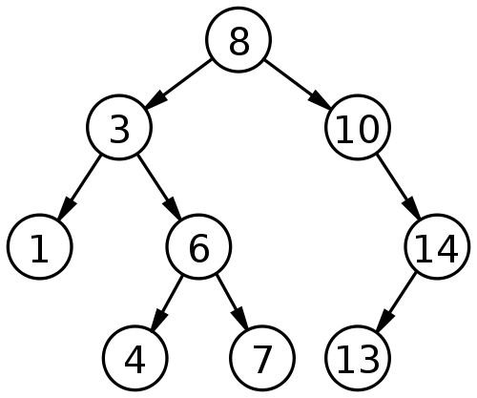
How TM works? “From ByteSTM: Java Software Transactional Memory at the Virtual Machine Level, Mohamed Mohamedin, MS Thesis, February 2012”
Optimistic concurrency
Example: Adding 9 & 15 concurrently

Slide 10
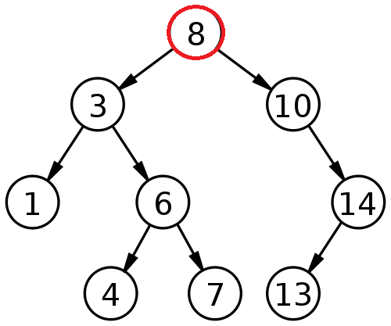
Thread A adds 9 & Thread B adds 15 “From ByteSTM: Java Software Transactional Memory at the Virtual Machine Level, Mohamed Mohamedin, MS Thesis, February 2012”
Thread A
Read-set: 8
Write-set:
Thread B
Read-set: 8
Write-set:

Slide 11
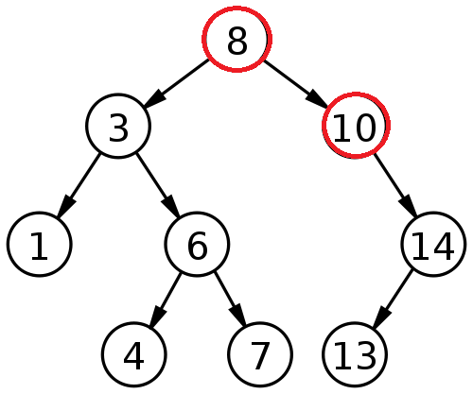
Thread A adds 9 & Thread B adds 15 “From ByteSTM: Java Software Transactional Memory at the Virtual Machine Level, Mohamed Mohamedin, MS Thesis, February 2012”
Thread A
Read-set: 8, 10
Write-set:
Thread B
Read-set: 8, 10
Write-set:

Slide 12
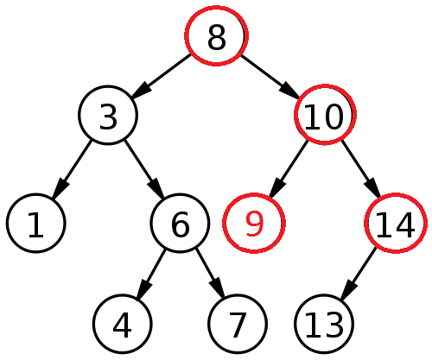
Thread A adds 9 & Thread B adds 15 “From ByteSTM: Java Software Transactional Memory at the Virtual Machine Level, Mohamed Mohamedin, MS Thesis, February 2012”
Thread A
Read-set: 8, 10
Write-set: 10 (left child pointer)
Thread B
Read-set: 8, 10, 14
Write-set:

Slide 13
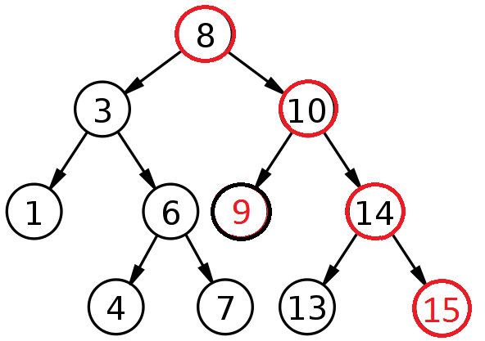
Thread A adds 9 & Thread B adds 15 “From ByteSTM: Java Software Transactional Memory at the Virtual Machine Level, Mohamed Mohamedin, MS Thesis, February 2012”
Thread A
Read-set: 8, 10
Write-set: 10 (left child pointer)
Committed successfully
Thread B
Read-set: 8, 10, 14
Write-set: 14 (right child pointer)

Slide 14
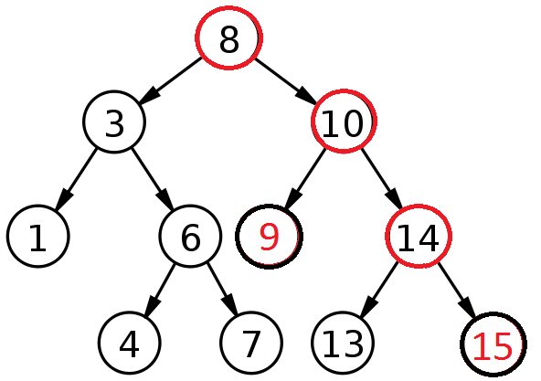
Thread A adds 9 & Thread B adds 15 “From ByteSTM: Java Software Transactional Memory at the Virtual Machine Level, Mohamed Mohamedin, MS Thesis, February 2012”
Thread A
Read-set: 8, 10
Write-set: 10 (left child pointer)
Committed successfully
Thread B
Read-set: 8, 10, 14
Write-set: 14 (right child pointer)
Committed successfully

Slide 15
Object-based granularity “From ByteSTM: Java Software Transactional Memory at the Virtual Machine Level, Mohamed Mohamedin, MS Thesis, February 2012”
Thread A
Read-set: 8, 10
Write-set: 10
Committed successfully
Thread B
Read-set: 8, 10, 14
Write-set: 14
Conflict ➔ Abort
WAR

Slide 16
Three key mechanisms needed to create atomicity illusion
Versioning
Conflict detection
T0
T1
atomic{
x = x + y;
}
atomic{
x = x + y;
}
atomic{
x = x / 25;
}
Where to store new x until commit?
  Eager: store new x in memory; old in undo log
  Lazy: store new x in write buffer
How to detect conflicts between T0 and T1?
  Record memory locations read in read set
  Record memory locations wrote in write set
  Conflict if one’s read or write set intersects the other’s write set

Slide 17
Third mechanism determines transactional progress (need wait-free progress for real-time software)
Conflict resolution or contention management
T0
T1
x = x + y;
x = x / 25;
x = x / 25;
Which transaction to abort?
  Polite: familiar exponential backoff
  Greedy: favor those with an earlier start time
  Karma: ….
(Starvation may occur)

Slide 18
Contributions
Real-Time CM
  ECM, RCM
    M. Elshambakey and B. Ravindran. Stm concurrency control for multicore embedded real-time software: Time bounds and tradeoffs. In SAC, 2012
  LCM
    Mohammed Elshambakey and Binoy Ravindran. Stm concurrency control for embedded real-time software with tighter time bounds. In DAC ’12, ”to appear”, 2012
  PNF
    M. Elshambakey and B. Ravindran. On real-time stm concurrency control with improved schedulability. Submitted to EMSOFT’12 (under review)

Slide 19
Contributions
Upper bound retry cost and response time for each CM
Analytical schedulability comparison between different CMs and lock-free
  When to use each CM
  Experimental comparison between different CMs and lock-free
  Different CMs achieve shorter average retry cost than lock-free
  PNF achieve shorter average retry cost than other CMs

Slide 20
Proposed Post-Preliminary
Supporting nested transactions
  Flat, open and closed nesting
Improved CMs
  Combination of LCM and PNF
    Reduce retry cost as well as avoid transitive retry
  Additional criterion for CM design
Formal and experimental comparison with real-time locking protocols
  FMLP [16,17,64], OMLP [18]

Slide 21
Previous Work on Real-Time Concurrency Control
Real-time locking protocols
  PIP, PCP, SRP [23,38,102, 26,69,73,91,92, 8,49,50]
  FMLP, OMLP [16,17,18,64]
Real-time lock-free [3–5,27,30,43,44,65,72]
  Appeared due to locking problems
  Atomic primitive iterates inside retry loop until success
    Needs to bound number of failed retries
    Single object access
    No nesting

Slide 22
Previous Work on Real-Time Concurrency Control
Real-time wait-free [2,12,25,27,28,31,44,62,94,109–111]
  Bound number of object access by sized buffer
  Single-writer/multi-reader & multi-writer/multi-reader for each object
  Space cost problem for embedded real-time systems
Hybrid approach
  [62] combines lock-free and wait-free
    Lock-free is used only when CAS suffices
  [12] combines locking and wait-free
    Reduce space cost compared to pure wait-free
    Reduce blocking time compared to locking protocols

Slide 23
Previous Work on Real-Time Concurrency Control
Real-time database concurrency control
  HP-2PL [74, 75, 90, 116]
    Lower priority transaction releases lock in favor of higher priority transaction
  RT-OCC [34, 47, 74–76, 116]
    Serialization at validation point, otherwise priority scheme determines which transaction to restart
Real-time TM concurrency control
  Programmability and scalability advantages
  Transactional retries should be bounded
  Contention managers decide which transaction to commit

Slide 24
Previous Work on Real-Time Concurrency Control
Traditional contention management policy
  Ex: Timestamp, Greedy and Prioritized versions
  Real-time systems need upper bounds on retry cost and response time for sporadic tasks containing transactions
Little work on real-time STM
  [64] bounds response time in distributed multi-core systems
  [97] proposes transactional scheduling based on deadline.
  [100] provides real-time HTM
  [45] uses task deadlines to resolve conflicts

Slide 25
Model is traditional real-time model
Threads arrive periodically, with deadlines equal to periods
Threads subsume transactions
Execute on a CMP, scheduled using global EDF (G-EDF) / global RMA (G-RMA) scheduling policy
Total thread utilization demand satisfies G-EDF(G-RMA)’s schedulable utilization bound
Thread release
T_{i}
Thread completion
Transaction
Next thread release
Time
Thread period, t(T_{i}) = relative thread deadline

Slide 26
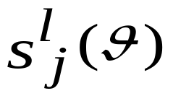
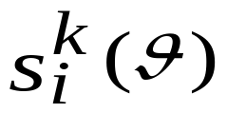
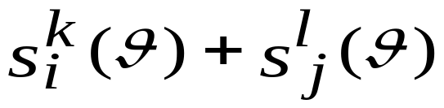


Earliest Deadline CM
  γ_{i}: tasks sharing objects θ with τ_{i}.
  : l^{th} atomic section of τ_{j}.
  s_{max}(θ): longest atomic section in all tasks.
  : longest atomic section in τ_{i} accessing θ.

Slide 27


Thread execution time can be inflated with worst-case transactional retry cost
Each interference may cause a retry
C_{ji}  The WCET of τ_{j} relative to τ_{i}
G-EDF’s response time analysis can now be used to determine schedulability of ECM

Slide 28
ECM can be formally compared with
G-EDF/lock-free synchronization
Utilization demand-based schedulability (i.e., U_{i} = C_{i}/T_{i})
  Less demand is better
Claim 4: ECM is better than G-EDF/lock-free if s_{max} < r_{max}/2
  s_{max} : max cost of one transactional retry
  r_{max} : max cost of one lock-free retry
With low conflicting tasks  s_{max} approaches r_{max}
r_{max}
STM can tolerate higher retry costs than lock-free and still be competitive
s_{max}
r_{max}/2
Retry cost
Thread set

Slide 29
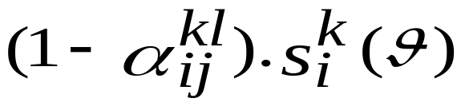

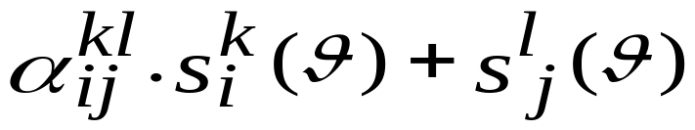
Length-based CM (LCM)

Slide 30
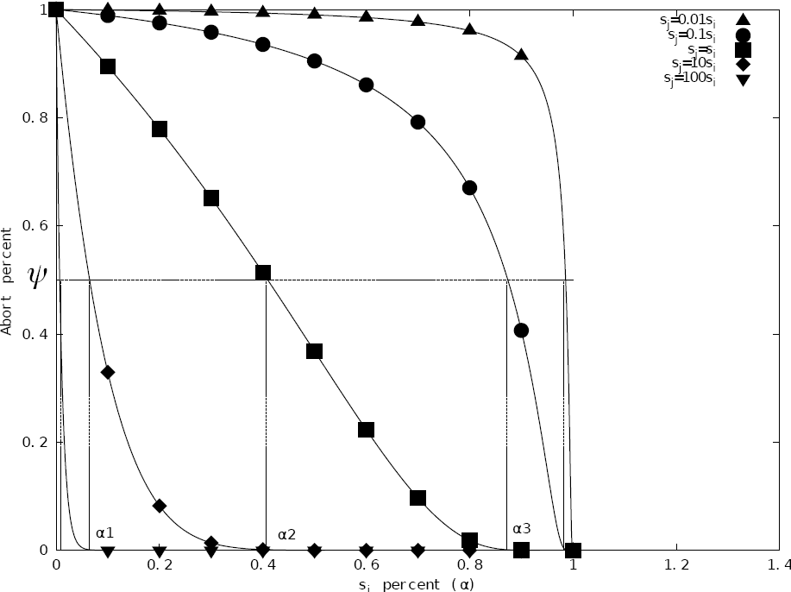

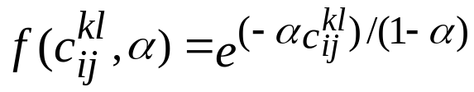
Length-based CM (LCM)
  Ψ: predefined threshold
  c
  C
  Considers not only priority, but also length of interfering transaction to remaining length of interfered transaction

Slide 31
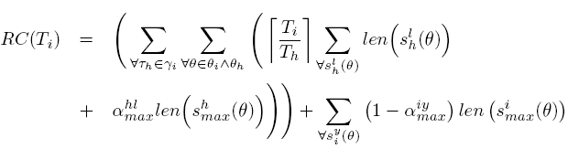
LCM Retry Cost
G-EDF/LCM
G-RMA/LCM

Slide 32


LCM Schedulability Comparison
G-EDF/LCM schedulability ≥ ECM’s if
G-EDF/LCM schedulability ≥ lock-free if upper bound on s_{max}/r_{max} ranges between 0.5 and 2
  Higher than ECM which ranges between 0.5 and 1
G-RMA/LCM schedulability ≥ RCM’s if
G-RMA/LCM schedulability ≥ lock-free if upper bound on s_{max}/r_{max} ≤0.5.
  s_{max}/r_{max} >>0.5 with large values of α_{min}, α_{max} and low contention

Slide 33
Priority CM with Negative value and First access (PNF)
ECM, RCM, LCM suffer from transitive retry
Wasted processor time for lower priority jobs
s^{e}_{f}(θ3, θ4)
s^{c}_{d}(θ2, θ3)
s^{c}_{d}(θ2, θ3)
Wasted Processor Time
sª_{b}(θ1, θ2)
sª_{b}(θ1, θ2)

Slide 34


PNF Rationale
m_set
p1
n_set
sª_{b}(θ1, θ2)
sª_{b}(θ1, θ2)
s^{c}_{d}(θ3, θ4)
p2
s^{c}_{d}(θ3, θ4)
p3
s^{e}_{f}(θ1, θ5)

Slide 35
PNF Rationale
m_set
p1
n_set
sª_{b}(θ1, θ2)
sª_{b}(θ1, θ2)
s^{c}_{d}(θ3, θ4)
p2
s^{e}_{f}(θ1, θ5)
s^{c}_{d}(θ3, θ4)
p3
s^{e}_{f}(θ1, θ5)
s^{e}_{f}(θ1, θ5)

Slide 36
PNF Rationale
m_set
p1
n_set
sª_{b}(θ1, θ2)
sª_{b}(θ1, θ2)
s^{c}_{d}(θ3, θ4)
p2
s^{e}_{f}(θ1, θ5)
s^{c}_{d}(θ3, θ4)
p3
s^{e}_{f}(θ1, θ5)
s^{e}_{f}(θ1, θ5)
p4
s^{g}_{h}(θ1, θ6)

Slide 37
PNF Rationale
m_set
p1
n_set
sª_{b}(θ1, θ2)
sª_{b}(θ1, θ2)
s^{g}_{h}(θ1, θ6)
s^{c}_{d}(θ3, θ4)
p2
s^{e}_{f}(θ1, θ5)
s^{c}_{d}(θ3, θ4)
s^{i}_{j}(θ5, θ7)
p3
s^{e}_{f}(θ1, θ5)
s^{e}_{f}(θ1, θ5)
p4
s^{g}_{h}(θ1, θ6)
s^{g}_{h}(θ1, θ6)
p5
s^{i}_{j}(θ5, θ7)
p3
τ^{l}_{k}

Slide 38
PNF Rationale
m_set
p1
n_set
sª_{b}(θ1, θ2)
sª_{b}(θ1, θ2)
s^{g}_{h}(θ1, θ6)
s^{c}_{d}(θ3, θ4)
p2
s^{e}_{f}(θ1, θ5)
s^{c}_{d}(θ3, θ4)
s^{i}_{j}(θ5, θ7)
p3
s^{e}_{f}(θ1, θ5)
s^{e}_{f}(θ1, θ5)
p4
s^{g}_{h}(θ1, θ6)
s^{g}_{h}(θ1, θ6)
p5
s^{i}_{j}(θ5, θ7)

Slide 39
PNF Rationale
m_set
p1
n_set
sª_{b}(θ1, θ2)
sª_{b}(θ1, θ2)
s^{g}_{h}(θ1, θ6)
s^{c}_{d}(θ3, θ4)
p2
s^{e}_{f}(θ1, θ5)
s^{c}_{d}(θ3, θ4)
s^{g}_{h}(θ1, θ6)
p3
s^{e}_{f}(θ1, θ5)
s^{e}_{f}(θ1, θ5)
p4
s^{g}_{h}(θ1, θ6)
s^{g}_{h}(θ1, θ6)

Slide 40
PNF Rationale
m_set
n_set
s^{c}_{d}(θ3, θ4)
p2
s^{e}_{f}(θ1, θ5)
s^{c}_{d}(θ3, θ4)
s^{e}_{f}(θ1, θ5)
s^{g}_{h}(θ1, θ6)
p3
s^{e}_{f}(θ1, θ5)
s^{e}_{f}(θ1, θ5)
p4
s^{g}_{h}(θ1, θ6)

Slide 41


PNF Retry Cost and Response Time
Retry cost during interval L
Blocking time due to lower priority jobs
Response time of τ_{i}^{x}

Slide 42
PNF Schedulability Comparison
In the absence of transitive retry
PNF ≥ ECM when conflicting atomic sections have equal lengths
PNF ≥ RCM when a large number of tasks heavily conflict. PNF’s schedulability improves with increasing atomic section length as priority increases
PNF ≥ G-EDF/LCM’s if the conflicting atomic section lengths are approximately equal and all α terms approach 1
PNF ≥ G-RMA/LCM’s if:
  lower priority tasks suffer increasing number of conflicts from higher priority tasks
  Lengths of the atomic sections increase as task priorities increase
  α terms increase
PNF ≥ lock-free if s_{max}/r_{max} ≤ 1

Slide 43
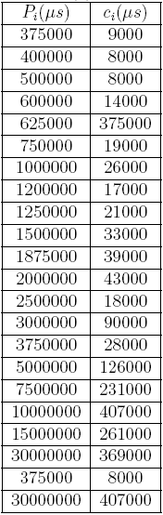
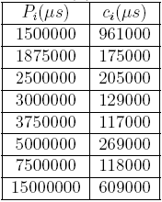
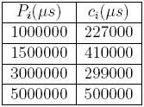
Implementation studies: Retry cost of different CMs and lock-free
Implemented ECM, RCM, LCM and PNF
3 task sets
ChronOS Linux kernel
8 core, 2GHz AMD Opteron
RSTM CAS for lock-free

Slide 44
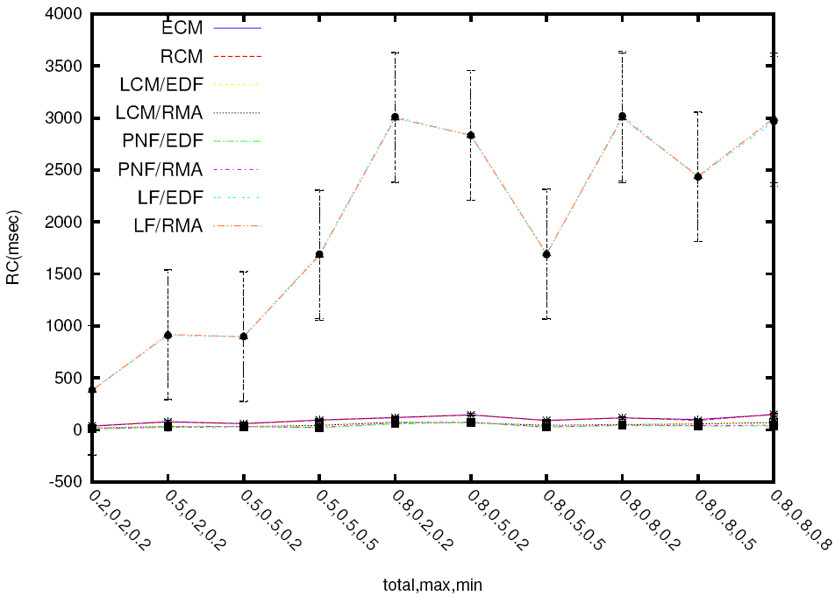
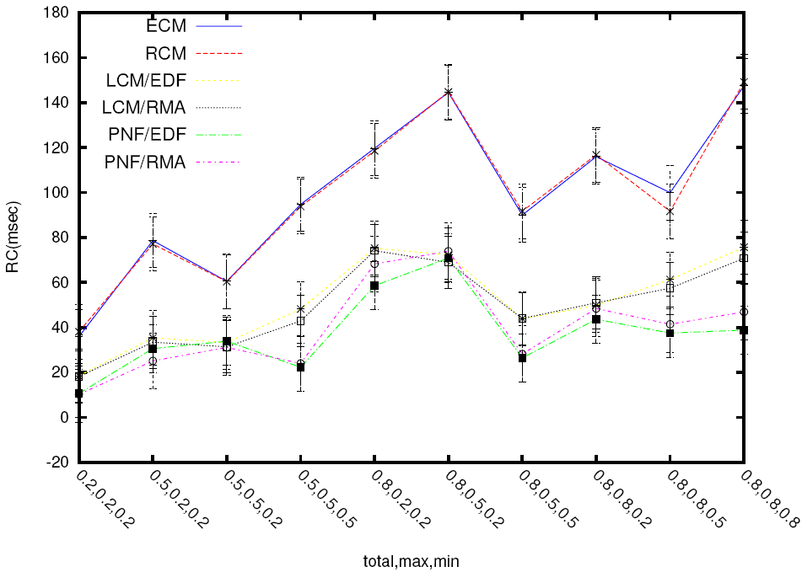
Implementation studies: Retry cost of different CMs and lock-free
  4 tasks- 1 shared object per transaction- CMs only
  4 tasks- 1 shared object per transaction- CMs and lock-free

Slide 45
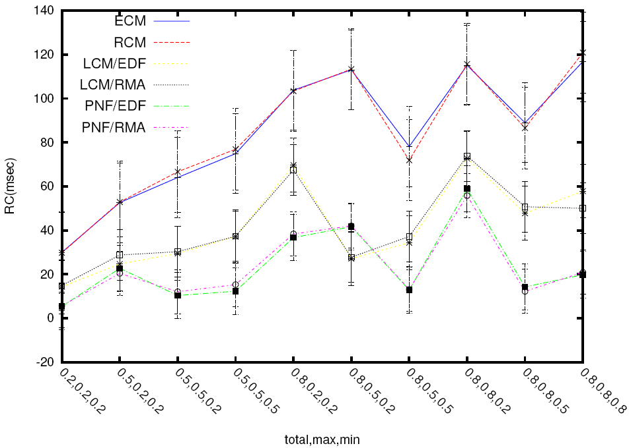
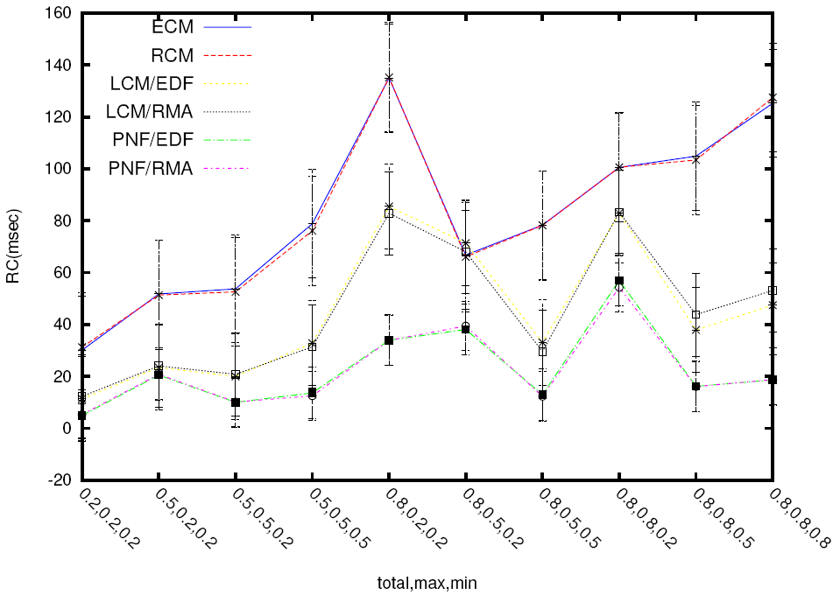
Implementation studies: Retry cost of different CMs
  4 tasks- 40 shared object per transaction- 80% wr- CMs only
  4 tasks- 20 shared object per transaction- 40% wr- CMs only

Slide 46
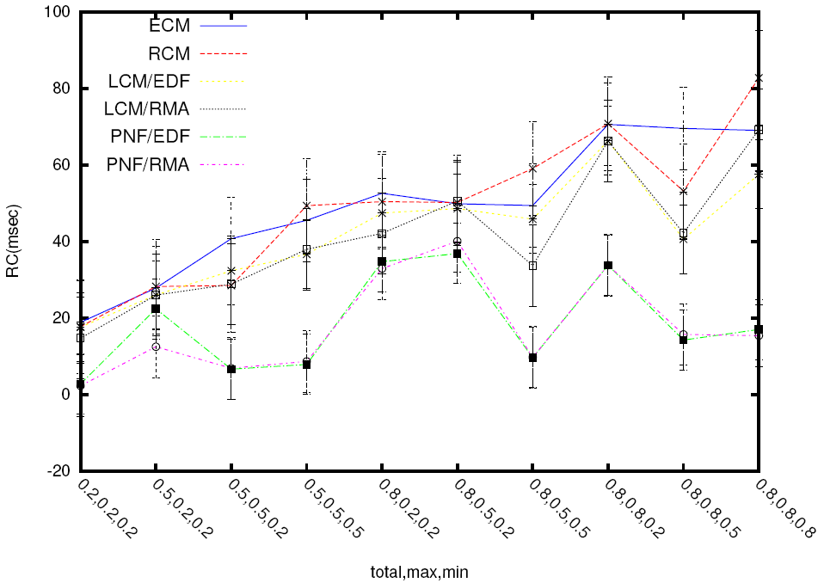
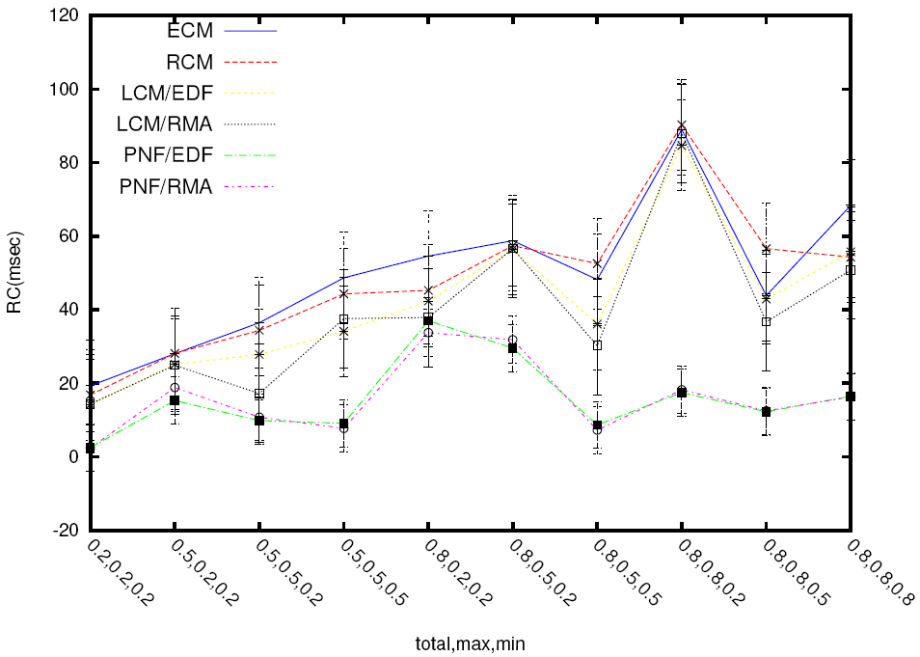
Implementation studies: Retry cost of different CMs
  8 tasks- 40 shared object per transaction- 80% wr- CMs only
  8 tasks- 20 shared object per transaction- 40% wr- CMs only

Slide 47
Conclusions
ECM and RCM
  Max of 2.s_{max} retry cost under ECM, RCM
  s_{max}/r_{max} for ECM => 0.5 to 1
  s_{max}/r_{max} for RCM => 0.5 (>1 in some cases)
LCM
  Retry cost of (1+ α_{max}) ×s_{max}
  Choice of α_{max} and α_{min} for better schedulability than ECM and RCM
  s_{max}/r_{max} => 0.5 to 2 for G-EDF/LCM
  s_{max}/r_{max} => 0.5 for G-RMA/LCM
PNF
  Avoids transitive and optimizes processor usage
  s_{max}/r_{max} for PNF ≤ 1

Slide 48
Proposed Post Preliminary-Exam Work
Supporting nested transaction
  Direct extension of previous CMs to abort or delay which transaction according to nesting type
  LCM may redefine α
  PNF’s implementation easier with nesting than LCM due to non-preemptive executing transactions
  RC calculation need modifications

Slide 49
Proposed Post Preliminary-Exam Work
Combining and optimizing LCM and PNF
  Decentralized PNF with no prior knowledge of objects
  Decide which CM to use depending on transitive retry level
  α can change with time
Formal and experimental comparison against locking protocols
  Implement FMLP and/or OMLP in ChronOS
  Nesting and non-nesting

