Slide 1

NovaRetail — Quarterly Business Review
Review Period: Q2 2026 Board Review
$1.28B
+4.5%
49.8
Total Revenue
QoQ Revenue Growth
Average Regional NPS
EXECUTIVE SUMMARY
Total revenue reached $1.28B with a +4.5% QoQ growth. APAC emerged as the strongest region in growth and returns, while Latin America represents the highest-risk region across operations and customer experience. Executive implication requires immediate operational remediation in Latin America to protect revenue.
NovaRetail Quarterly Business Review — Capstone Template
1

Slide 2
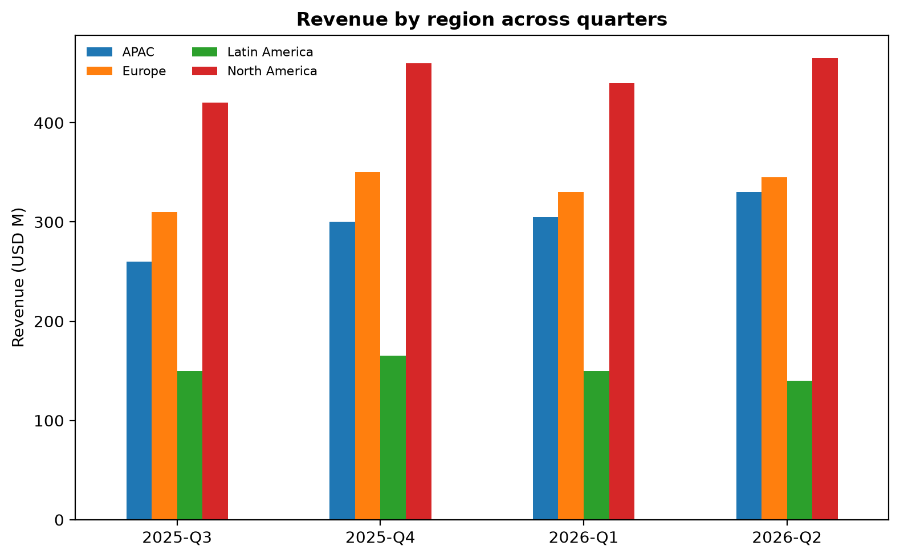

North America and APAC lead revenue generation while Latin America lags behind
• North America leads total revenue at $465M with 1,120k units sold and a marketing spend of $34M.
• APAC delivers the strongest growth, generating $330M revenue with 860k units sold and the lowest returns rate at 3.6%.
• Europe records $345M revenue with 880k units sold and a 4.1% returns rate.
• Latin America is the weakest region, generating $140M revenue with 390k units sold and the highest returns rate at 8.2%.
NovaRetail Quarterly Business Review — Capstone Template
2

Slide 3
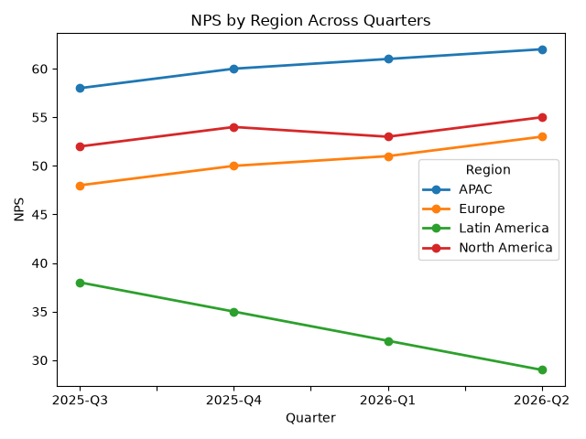

APAC achieves highest customer satisfaction while Latin America experiences severe sentiment decline
• APAC leads customer satisfaction with NPS at 62 and CSAT at 92, outperforming all other regions.
• Latin America customer experience severely lags with an NPS of 29, CSAT of 74, and 31 thousand support tickets.
• North America maintains steady customer metrics with an NPS of 55 and CSAT of 89 across 18 thousand support tickets.
• Europe records solid engagement with an NPS of 53, CSAT of 88, and 14 thousand support tickets delivered in 3.2 days.
NovaRetail Quarterly Business Review — Capstone Template
3

Slide 4
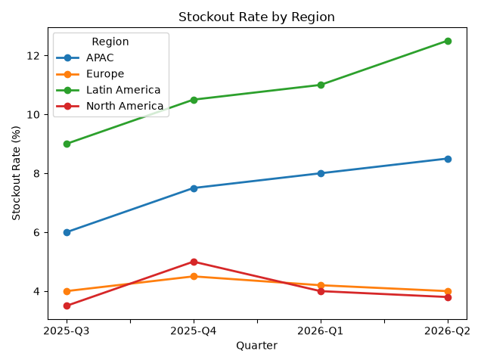

Latin America exhibits critical operational risk across stockouts, returns, and fraud incidents
• Latin America presents severe operational risks with a stockout rate of 12.5%, 30 fraud incidents, and 10 return processing days.
• APAC warehouse utilization reaches critical capacity at 92%, accompanied by an 8.5% stockout rate and 10 fraud incidents.
• North America maintains stable operational risk with a 3.8% stockout rate, 13 fraud incidents, and 4 return processing days.
• Europe operates efficiently with a 4.0% stockout rate, 11 fraud incidents, and 5 return processing days.
NovaRetail Quarterly Business Review — Capstone Template
4

Slide 5

Recommended Actions & Next Steps
• Optimize supply chain logistics in Latin America to lower the 12.5% stockout rate.
• Invest in fraud prevention systems across Latin America to reduce the 30 fraud incidents.
• Enhance warehouse capacity management in APAC where utilization has reached 92%.
• Deploy targeted customer support interventions in Latin America to address low NPS and tickets.
Executive focus must target Latin America operational bottlenecks and support escalations.
NovaRetail Quarterly Business Review — Capstone Template
5

