Slide 1

Basic Details of the Team and Problem Statement
Ministry/Organization Name/Student Innovation: Ministry of Jal Shakti
PS Code:SIH1293
Problem Statement Title: Automatic regulation of Valve for release of water based upon soil moisture availability in the root zone of the crop , using AI, in a piped and micro irrigation network of irrigation systems.
Team Name: Team 404:Error
Team Leader Name: Ekal Sharma
Institute Code (AISHE): U-0186
Institute Name: Jaypee University of Information Technology, Solan, HP.
Theme Name: Agriculture, Food Tech and Rural Development

Slide 2
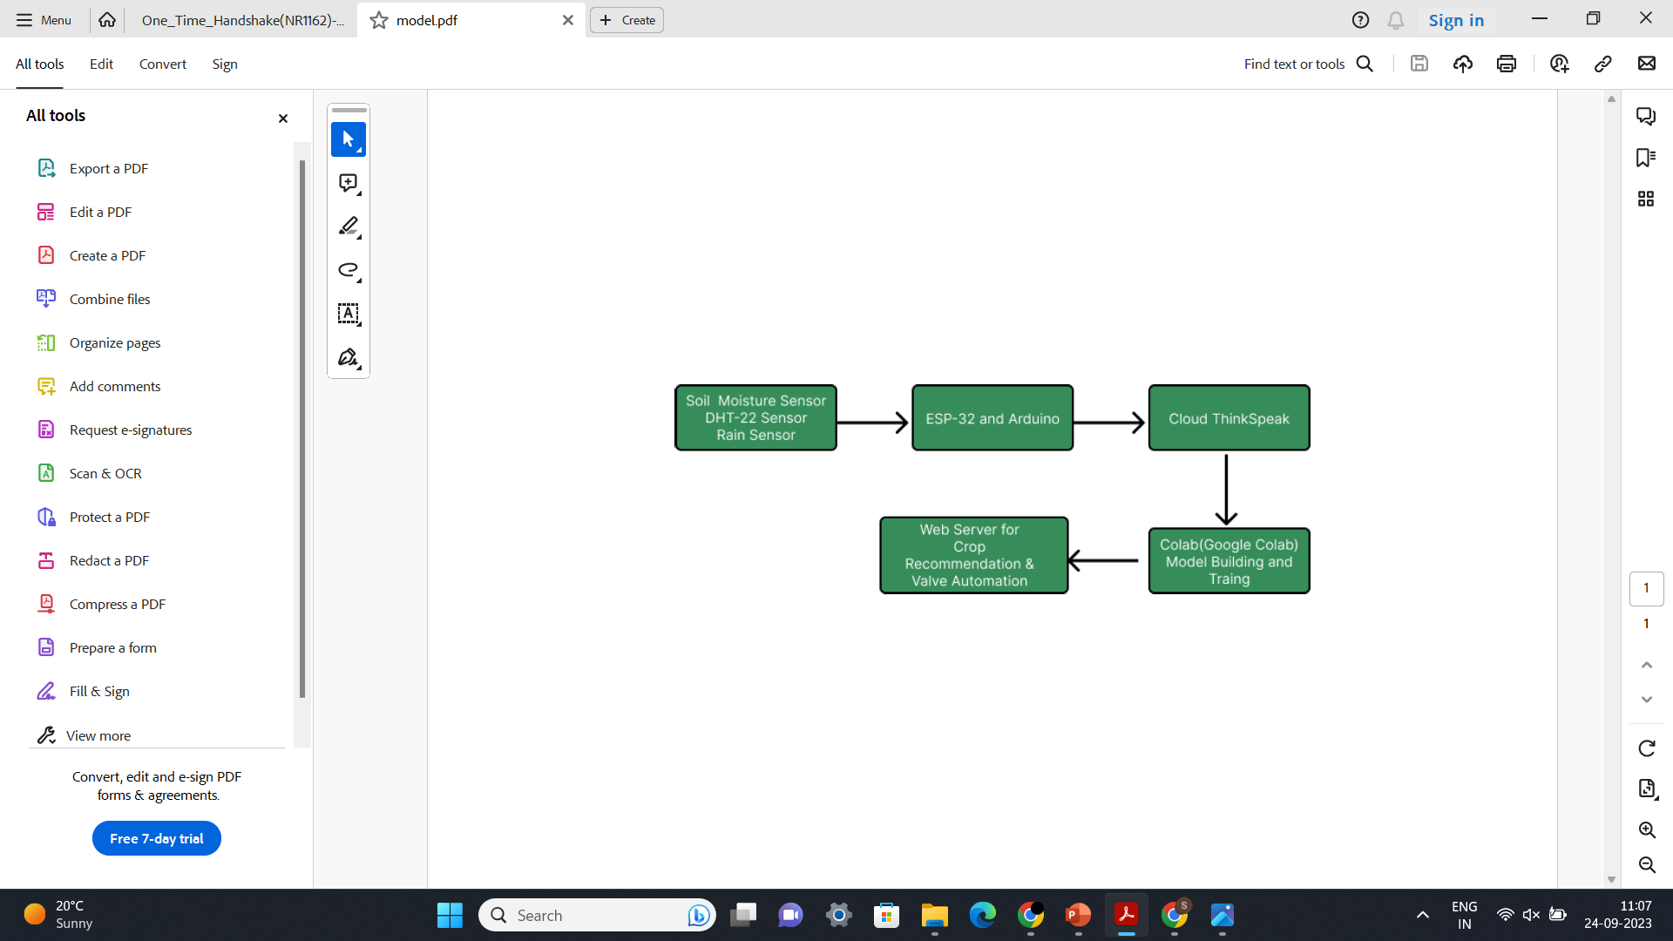
Idea/Approach Details
Idea and Solution:
https://github.com/shambhavi12345/HydroLogic.git
Use of AI to implement automatic valve management for water release based on the presence of soil moisture and crop recommendation on the basis of present physical factors.
Use of micro-controllers and sensors to fetch the data
Transfer the data to cloud(ThinkSpeak) using Wi-fi
Further transferring the data to colab for ML model building and training
Crop recommendation using Random Forest classifier and valve regulation using XGBoost model
Web deployment of the crop recommender using Flask and HTML/CSS
Technology stack:
Google Colab,NumPy, Pandas, scikit-learn, RandomForestClassifier, XGBoost- Model building and training
Matplotlib, Seaborn, Plotly –Data Visualization
Soil Moisture Sensor,DHT-22 sensor, Rain sensor, Microcontroller ESP-32,ThinkSpeak-IoT and Cloud services
Flask, HTML/CSS- for web deployment

Slide 3
Idea/Approach Details
Use Cases
Dependencies / Show stopper
Regions with water scarcity: Automated valves open and close as per the need of the crop thereby saving water
Greenhouses: Precise control of water level
Smallholder Farming: Help increase crop yield with minimum water resources
Nurseries and Landscaping: Manage water supply for ornamental plants
Commercial Agricultural Operations: optimize resource allocation and minimize operational costs
Sustainable Automated System: Prevents wastage of water with automated sensors and AI controlled valve system
High ROI: Financially suitable for cash crops and ornamental plants
Efficient Decision Making: ML model recommends the best crop as per the given conditions
Education and Research Value: Data collected from the sensors via ThinkSpeak can be visualized and analysed efficiently

Slide 4
Team Member Details
Team Leader Name: Ekal Sharma
B.Tech. ECE Year :IV
Team Member 1 Name: Manav Modi
B.Tech. ECE Year : IV
Team Member 2 Name: Jatin Rajput
B.Tech. CSE Year : III
Team Member 3 Name: Shambhavi Singh
B.Tech. CSE Year : III
Team Member 4 Name: Aayush Gupta
B.Tech. CSE Year : III
Team Member 5 Name: Anant Sharma
B.Tech. CSE Year : II

