Slide 1

Online Event Planner
By Team CAD

Slide 2

In a world marked by busy schedules, diverse preferences, and evolving event trends, the need for a comprehensive and user-friendly solution for event planning has never been more pronounced. The "Online Event Planner Project" emerges as a response to this demand, offering a dynamic and innovative platform to simplify and elevate the art of event management.
The Online Event Planner Project is poised to transform the way individuals and organizations plan, organize, and execute events. By harnessing the power of technology and intuitive design, our platform endeavors to provide users with a seamless and efficient experience, regardless of the scale or nature of their events. From weddings and corporate conferences to birthday parties and charity galas, this project promises to be the go-to solution for all event planning needs.

Slide 3
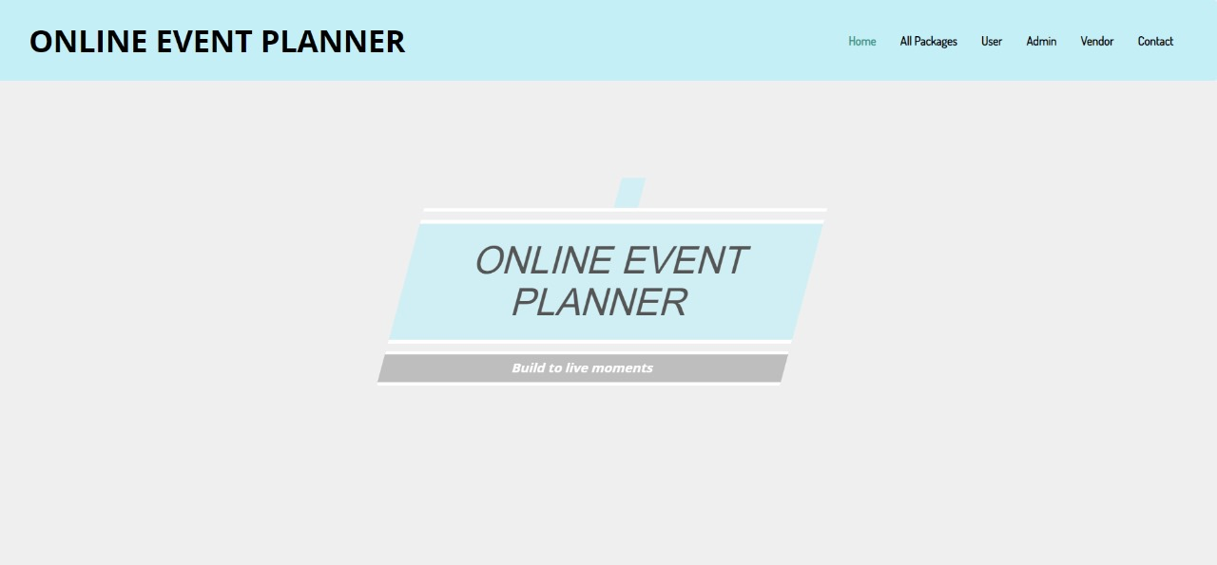
Home Page

Slide 4
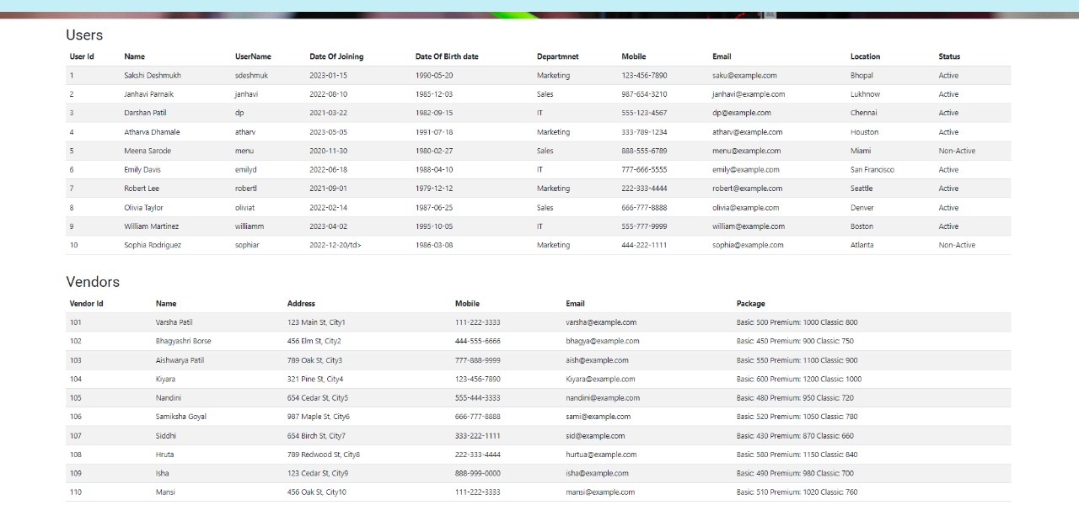
Admin Page

Slide 5
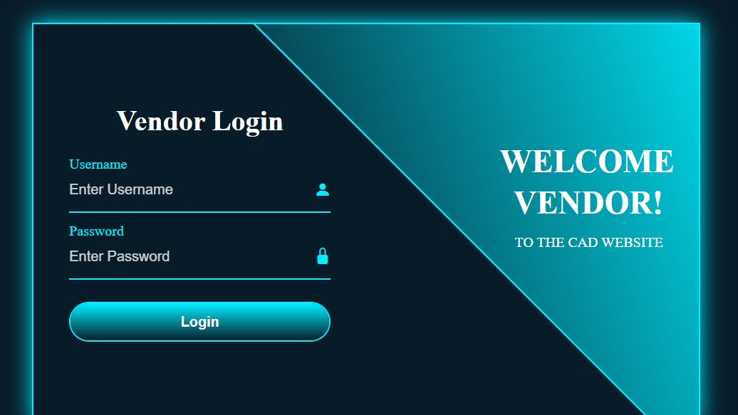
Vendor Login Page

Slide 6
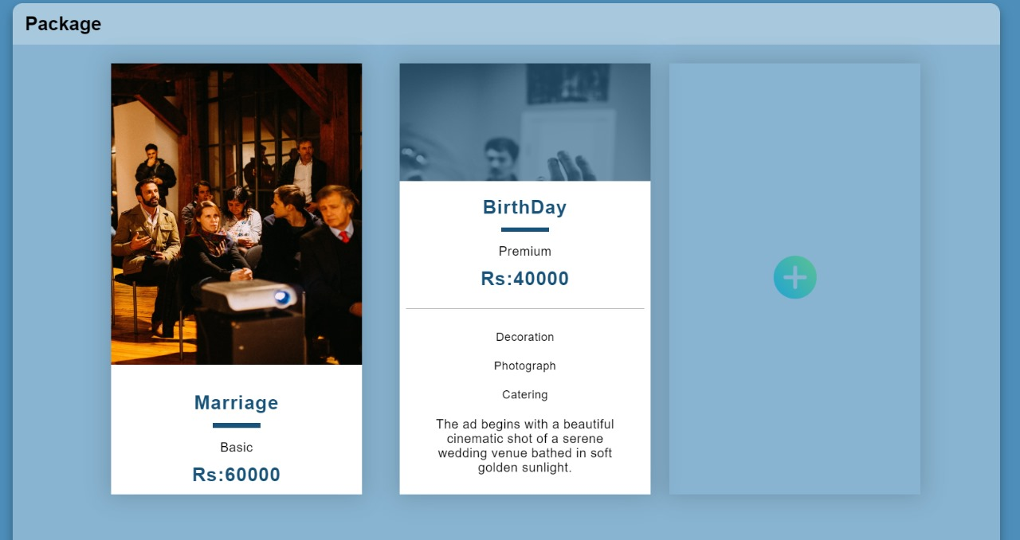
Services and Packages

Slide 7
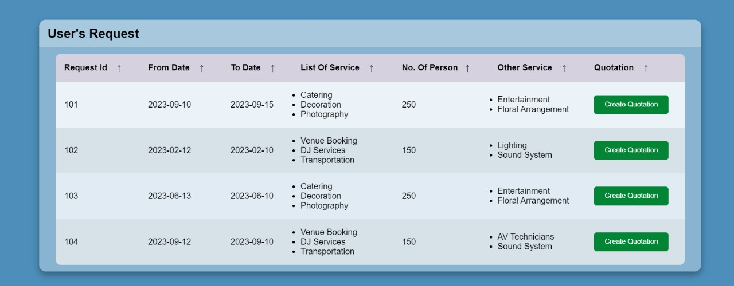
Quotation Page

Slide 8
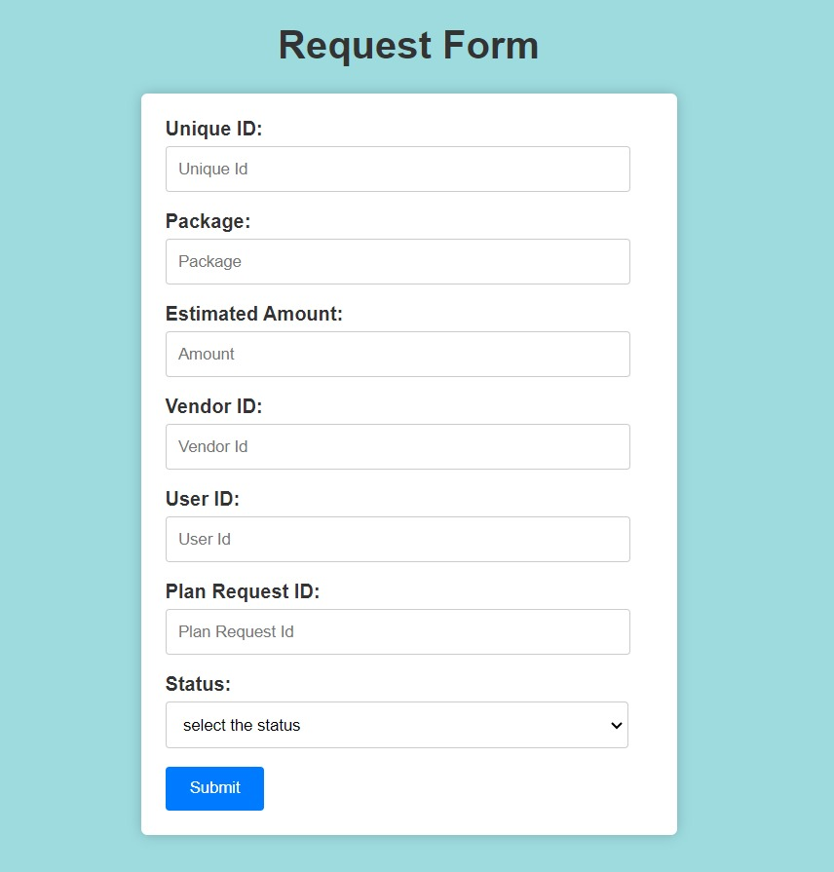
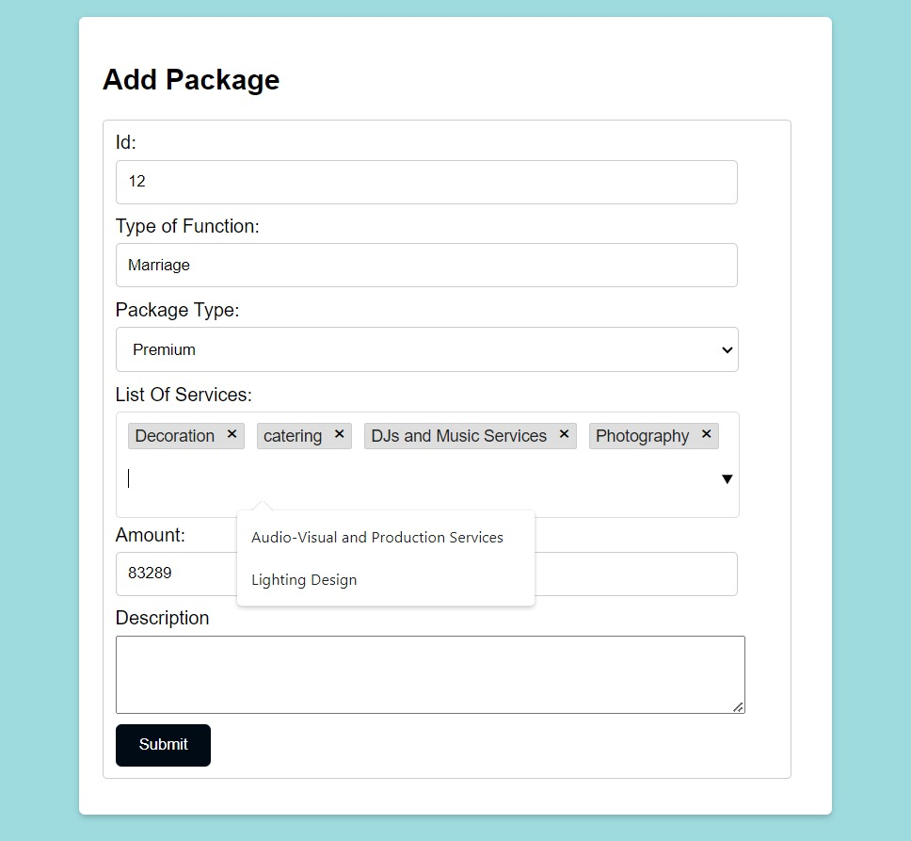
AddPackage and Request form

Slide 9
Thank You
In conclusion, developing an online event planner website is a multifaceted undertaking that requires careful planning and execution. The success of such a website hinges on a comprehensive understanding of both functional and non-functional requirements.
Functionally, the website must offer a seamless user experience by providing features like event listings, event planning tools, vendor management, and secure booking and payment systems. It should also prioritize user engagement through features like reviews, recommendations, and messaging.
Non-functionally, the website needs to meet high standards of performance, reliability, and security. This includes ensuring fast response times, high availability, robust data security, and adherence to legal and privacy regulations. Usability, accessibility, and compatibility are also vital for reaching a broad and diverse user base.
Ultimately, a well-executed online event planner website can empower users to discover, plan, and book events with ease, while also enabling event organizers and vendors to connect with their audience. Success in this endeavor requires a dedicated team, a solid technology stack, and ongoing maintenance and improvement efforts to meet evolving user needs and expectations. By addressing these aspects comprehensively, an online event planner website can thrive in the competitive digital landscape and provide value to both event-goers and event organizers.

