Slide 1

Digital Twin–Enabled Framework for Forecasting and Mitigating Fraud with UPI Integration
M.Tech Project Work Review-II
Presented by
SHAMBHU PANDEY (25MCA1020)
Master of Computer Applications (MCA)
Under the Guidance of
TAMILRASHI
Professor
School of Computer Science and Engineering
Vellore Institute of Technology, Chennai.

Slide 2
CONTENTS
ABSTRACT
INTRODUCTION
LITERATURE SURVEY
RESEARCH GAPS
OBJECTIVES
MODULE IDENTIFICATION
SYSTEM ARCHITECTURE
DEVELOPMENT & INTEGRATION
PROTOTYPE / RESEARCH FRAMEWORK
OUTCOME
RESULTS
TIMELINE / GANTT CHART
REFERENCES

Slide 3
1.ABSTRACT
This project develops a production-ready fraud detection system with high accuracy (XGBoost ~99%). It integrates Digital Twin technology to simulate various attack vectors like SIM swaps and credential compromise. The system provides explainable AI (XAI) using SHAP and LIME, ensuring transparency for every fraud prediction. Designed for the UPI ecosystem, it offers real-time monitoring and proactive mitigation features.

Slide 4
2. INTRODUCTION
Modern digital payments, specifically UPI, face increasing sophistication in fraudulent activities. Traditional detection systems often fail to provide explainability or proactive simulation. Motivation: To build a robust framework that not only detects fraud with high precision but also allows security analysts to forecast potential attacks using Digital Twin simulations and understand model decisions via Explainable AI.

Slide 5
3.LITERATURE SURVEY
1. López-Rojas et al. (2016): Synthesized PaySim dataset for mobile money fraud research.
2. Lundberg & Lee (2017): Implementation of SHAP values for model interpretability.
3. Grieves (2014): Concept of Digital Twins for real-time monitoring and simulation.
S.No | Article Title | Techniques Used | Key Findings | Limitations
1
2
3
4

Slide 6
LITERATURE SURVEY (CONTD..,)
S.No | Article Title | Techniques Used | Key Findings | Limitations
5
6
7
8

Slide 7
LITERATURE SURVEY (CONTD..,)
S.No | Article Title | Techniques Used | Key Findings | Limitations
9
10

Slide 8
4. RESEARCH GAPS
• Lack of explainability in 'Black Box' fraud detection models.
• Static protection systems lack the ability to simulate and forecast new attack vectors.
• High false positive rates in traditional rule-based UPI filters.

Slide 9
5. OBJECTIVES
1. Develop a multi-model ML pipeline (XGBoost, RF, Autoencoder).
2. Integrate Digital Twin for real-time attack scenario forecasting.
3. Implement SHAP/LIME for individual prediction explanations.
4. Deploy an interactive Streamlit-based management dashboard.

Slide 10
6. MODULE IDENTIFICATION
• Data Loader: Multimodal data ingestion (Kaggle, Synthetic, CSV).
• Model Trainer: Hyperparameter-tuned ML/DL training engines.
• Explainability: SHAP/LIME visualization generation.
• Digital Twin: Scenario simulation (SIM Swap, Credential Compromise).

Slide 11
7. SYSTEM ARCHITECTURE
1. Data Layer: UPI Transaction Data (Real/Synthetic).
2. Logic Layer: Preprocessing (SMOTE, Scaler) -> Model Inference.
3. Analysis Layer: SHAP Explainer -> Risk Scoring.
4. UI Layer: Streamlit Dashboard for real-time interaction.

Slide 12
8. DEVELOPMENT & INTEGRATION
<< • Implementation of modules
• Integration strategy
• Challenges faced and solutions
FONT TIMES NEW ROMAN>>

Slide 13
9. PROTOTYPE / RESEARCH FRAMEWORK
<< • Working prototype description
OR
• Research framework setup
FONT TIMES NEW ROMAN>>

Slide 14
10. OUTCOME
[[ PLACE PROJECT SCREENSHOT HERE ]]
- Real-time Fraud Detection Dashboard
- Digital Twin Attack Scenarios
- XAI Feature Importance Plots

Slide 15
11. RESULTS
Model: XGBoost (Champion Model)
• Accuracy: 99.01%
• Precision: 98.34%
• Recall: 93.12%
• F1-Score: 95.67%
• Latency: < 100ms per txn

Slide 16
12. TIMELINE / GANTT CHART
• Feb: Research & Dataset collection (Completed)
• Mar: Model development & Explainability (Completed)
• Apr: Dashboard integration & testing (In Progress)
• May: Final Documentation (Next)

Slide 17
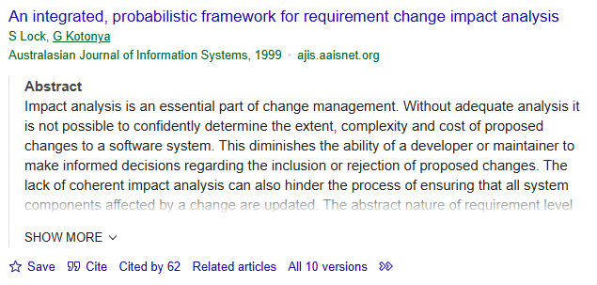
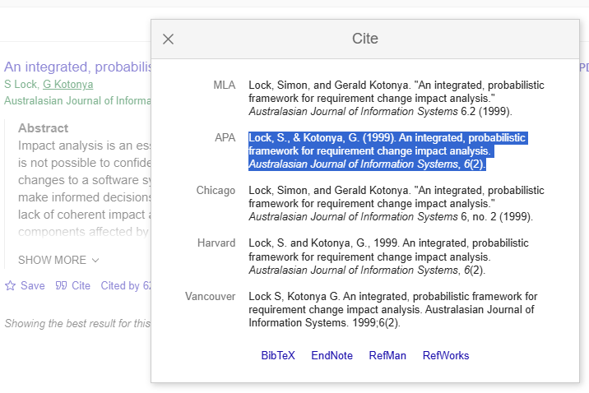
13. REFERENCES
Lock, S., & Kotonya, G. (1999). An integrated, probabilistic framework for requirement change impact analysis. Australasian Journal of Information Systems, 6(2).
HOW TO CITE A PAPER
GO TO GOOGLE SCHOLAR
GIVE THE PAPER TITLE IN SEARCH
ONCE THE PAPER WHAT YOU HAVE SEARCHED FOR IS LISTED
CHOOSE CITE AT THE BOTTOM OF THE PAPER
SELECT APA FORMAT AND COPY IT HERE

Slide 18
REFERENCES (CONTD..,)

Slide 19
REFERENCES (CONTD..,)

Slide 20
REFERENCES (CONTD..,)

Slide 21
REFERENCES (CONTD..,)

Slide 22
Thank You

