Slide 1

<<PROJECT TITLE **TIMES NEW ROMAN FONT SIZE 39**>>
M.Tech Project Work Review-II
Presented by
<<STUDENT NAME (STUDENT REGISTER NO)>>
<<M.Tech Computer Science and Engineering (SPECILAZATION)>>
Under the Guidance of
<<GUIDE NAME>>
<<GUIDE DESIGNATION>>
School of Computer Science and Engineering
Vellore Institute of Technology, Chennai.
Name: Shambhu Pandey Reg No: 25MCA1020 Guide: Tamilrashi

Slide 2
CONTENTS
ABSTRACT
INTRODUCTION
LITERATURE SURVEY
RESEARCH GAPS
OBJECTIVES
MODULE IDENTIFICATION
SYSTEM ARCHITECTURE
DEVELOPMENT & INTEGRATION
PROTOTYPE / RESEARCH FRAMEWORK
OUTCOME
RESULTS
TIMELINE / GANTT CHART
REFERENCES

Slide 3
1.ABSTRACT
<< NOT MORE THAN 200 WORDS FONT TIMES NEW ROMAN SIZE 24>>
<< Brief summary of project including problem, methodology, and expected outcome >>

Slide 4
2. INTRODUCTION
<< Overview of problem domain, motivation, and objectives (max 150 words) FONT TIMES NEW ROMAN SIZE 24>>

Slide 5
S.No | Article Title | Techniques Used | Key Findings | Limitations
1 | Statistical Fraud Detection Review | Statistical tests, rule-based | Surveys classical approaches and common fraud patterns | Older methods struggle with evolving fraud
2 | Data Mining for Financial Fraud | Decision trees, SVM, ensembles | ML improves detection over rules | Class imbalance reduces effectiveness
3 | XGBoost for Classification | Gradient boosting (XGBoost) | High accuracy and strong performance on imbalanced data | Requires careful hyperparameter tuning
4 | SHAP: Model Explanations | SHAP value explanations | Provides clear feature contributions | Computational cost for large datasets
5 | SMOTE: Oversampling Minority | SMOTE resampling + classifiers | Improves recall for minority class | Risk of overfitting synthetic samples
6 | Isolation Forest for Anomalies | Isolation Forest (unsupervised) | Detects novel/rare fraud patterns | High false positive rate on noisy data
7 | Autoencoder Anomaly Detection | Autoencoders (neural nets) | Finds unseen/novel frauds via reconstruction | Needs large clean data and tuning
8 | Cost‑Sensitive Learning | Cost-sensitive loss, class weighting | Reduces business cost by penalizing FN/FP | Choosing costs requires domain knowledge
9 | Real‑time Fraud Systems | Stream processing + lightweight ML | Supports low-latency scoring for live transactions | Engineering complexity and deployment overhead
10 | Ensemble & Hybrid Approaches | Stacking/ensembles (LR, RF, XGBoost) | Ensembles improve robustness and metrics | Increased inference latency and complexity
S.No | Article Title | Techniques Used | Key Findings | Limitations
1
2
3
4

Slide 6
LITERATURE SURVEY (CONTD..,)
S.No | Article Title | Techniques Used | Key Findings | Limitations
5
6
7
8

Slide 7
LITERATURE SURVEY (CONTD..,)
S.No | Article Title | Techniques Used | Key Findings | Limitations
9
10

Slide 8
4. RESEARCH GAPS

Slide 9
5. OBJECTIVES

Slide 10
6. MODULE IDENTIFICATION
<< • Identify key modules/subsystems
• Define functionality of each module
• Show module interaction
FONT TIMES NEW ROMAN SIZE 24>>

Slide 11
7. SYSTEM ARCHITECTURE
<< • Overall architecture diagram
• Data flow between modules
• Technology stack used TEXT FONT TIMES NEW ROMAN>>

Slide 12
8. DEVELOPMENT & INTEGRATION
<< • Implementation of modules
• Integration strategy
• Challenges faced and solutions
FONT TIMES NEW ROMAN>>

Slide 13
9. PROTOTYPE / RESEARCH FRAMEWORK
<< • Working prototype description
OR
• Research framework setup
FONT TIMES NEW ROMAN>>

Slide 14
10. OUTCOME
<< • Working model screenshots/results
OR
• Data classification & analysis
• Key insights/results
FONT TIMES NEW ROMAN>>

Slide 15
11. RESULTS
<< • Performance metrics
• Observations
• Validation of approach
FONT TIMES NEW ROMAN>>

Slide 16
12. TIMELINE / GANTT CHART
• Planned vs completed tasks
• Next milestones

Slide 17
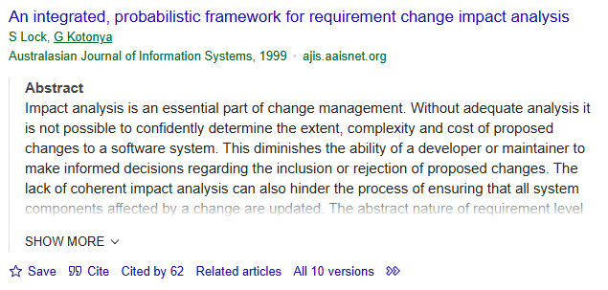
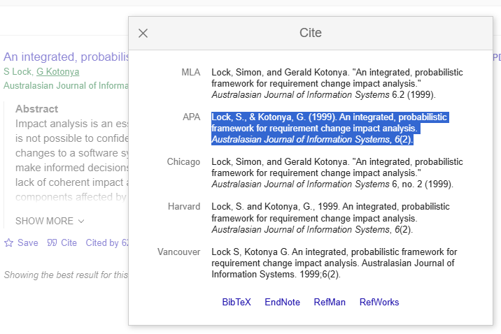
13. REFERENCES
Lock, S., & Kotonya, G. (1999). An integrated, probabilistic framework for requirement change impact analysis. Australasian Journal of Information Systems, 6(2).
HOW TO CITE A PAPER
GO TO GOOGLE SCHOLAR
GIVE THE PAPER TITLE IN SEARCH
ONCE THE PAPER WHAT YOU HAVE SEARCHED FOR IS LISTED
CHOOSE CITE AT THE BOTTOM OF THE PAPER
SELECT APA FORMAT AND COPY IT HERE

Slide 18
REFERENCES (CONTD..,)

Slide 19
REFERENCES (CONTD..,)

Slide 20
REFERENCES (CONTD..,)

Slide 21
REFERENCES (CONTD..,)

Slide 22
Thank You

Slide 23
1. ABSTRACT
Fraud detection: identifying suspicious transactions indicating theft or abuse.
Problem: financial fraud is increasing; rule-based systems miss novel attacks.
Solution: ML classifiers (Random Forest, XGBoost, Autoencoder) + preprocessing + threshold tuning.
Outcome: automated system flags likely fraud, outputs risk score and explanations.
[SPACE FOR OUTPUT SCREENSHOT]

Slide 24
2. INTRODUCTION
Fraud detection finds transactions that deviate from normal behaviour.
Important to prevent financial loss and preserve customer trust.
Real-world use: banks, payment gateways, e-commerce, UPI services.
Project includes a Streamlit dashboard for live prediction and explainability.

Slide 25
3. LITERATURE SURVEY
1. ML for Fraud Detection — Techniques: LR, RF — Findings: Ensembles improve accuracy — Limit: Data imbalance
2. Boosted Trees in Fraud — Techniques: XGBoost — Findings: High precision & recall — Limit: Needs tuning
3. Anomaly Detection with AE — Techniques: Autoencoder — Findings: Detects novel frauds — Limit: Needs large data
4. SMOTE for Imbalance — Techniques: SMOTE + classifiers — Findings: Improves recall — Limit: Possible overfitting
5. Explainable Fraud Models — Techniques: SHAP/LIME — Findings: Builds auditor trust — Limit: Computationally heavy
6. Real-time Fraud Systems — Techniques: Stream processing + ML — Findings: Low-latency detection possible — Limit: Engineering complexity

Slide 26
4. RESEARCH GAPS
Low detection accuracy on emerging fraud types.
Severe class imbalance: fraud << legitimate.
High false positives cause user friction.
Lack of explainability and deployable pipelines.

Slide 27
5. OBJECTIVES
Detect fraudulent transactions using ML.
Improve recall and F1-score.
Handle imbalanced datasets robustly.
Provide near real-time prediction.

Slide 28
6. MODULE IDENTIFICATION
Data Collection: PaySim, CICIDS, IEEE, BankSim, uploads.
Data Preprocessing: cleaning, imputation, scaling, leakage removal.
Feature Engineering: time, device, aggregates, encodings.
Model Training: LR, RF, XGBoost, Isolation Forest, Autoencoder.
Prediction System: thresholding, scoring, persistence.
UI: Streamlit dashboard (train/demo/explain).

Slide 29
7. SYSTEM ARCHITECTURE
Flow: User Input → Preprocessing → Model → Prediction → Output (risk + explanation).
Components: Data Loader → Preprocessor → Model Service → UI.
Tech stack: Python, scikit-learn, XGBoost, imbalanced-learn, SHAP, Streamlit.
[SPACE FOR ARCHITECTURE DIAGRAM]

Slide 30
8. DEVELOPMENT & INTEGRATION
Model building: pipeline with CV, hyperparameter tuning, threshold selection.
Integration: save models/metrics in models/, wire Streamlit UI to model.
Problems: data leakage, imbalance, mismatched features.
Solutions: remove leakage cols, SMOTE/Tomek, schema validation.

Slide 31
9. PROTOTYPE / FRAMEWORK
Working flow: select/upload dataset → preprocess → train/choose model → live predict.
Live prediction: sample transaction input → model returns probability + SHAP explanation.
Run demo: streamlit run app.py → open http://localhost:8501.
[SPACE FOR DEMO SCREENSHOT]

Slide 32
10. OUTCOME
Fraud transactions successfully detected in prototype.
Real-time prediction and risk scoring functional.
Multi-dataset support and model comparisons available.
Explainability (SHAP/LIME) present for each prediction.

Slide 33
11. RESULTS
Example metrics (PaySim): RF — Acc 0.931; Prec 0.998; Rec 0.997; F1 0.998.
XGBoost — Acc 0.987; Prec 0.994; Rec 0.997; F1 0.995.
Logistic Regression — baseline: good recall, lower precision.
Confusion matrix explained: TP detected fraud; FP legitimate flagged; FN missed fraud; TN correct legit.

Slide 34
12. TIMELINE
Week 1: Dataset collection and EDA.
Week 2: Data cleaning, preprocessing, feature engineering.
Week 3: Model training, CV, threshold tuning.
Week 4: Testing, evaluation, explainability integration.
Week 5: UI (Streamlit) development and demo prep.

Slide 35
13. REFERENCES
Bolton, R. J., & Hand, D. J. (2002). Statistical fraud detection: A review. Journal of Financial Crime.
Ngai, E. W. T., et al. (2011). The application of data mining techniques in financial fraud detection. Decision Support Systems.
Chen, T., & Guestrin, C. (2016). XGBoost: A scalable tree boosting system. KDD Proceedings.
Lundberg, S. M., & Lee, S.-I. (2017). A unified approach to interpreting model predictions. NIPS Workshop.
Chawla, N. V., et al. (2002). SMOTE. Journal of AI Research.

