Slide 1

<<PROJECT TITLE **TIMES NEW ROMAN FONT SIZE 39**>>
M.Tech Project Work Review-II
Presented by
<<STUDENT NAME (STUDENT REGISTER NO)>>
<<M.Tech Computer Science and Engineering (SPECILAZATION)>>
Under the Guidance of
<<GUIDE NAME>>
<<GUIDE DESIGNATION>>
School of Computer Science and Engineering
Vellore Institute of Technology, Chennai.
Name: Shambhu Pandey Reg No: 25MCA1020 Guide: Tamilrashi

Slide 2
CONTENTS
ABSTRACT
INTRODUCTION
LITERATURE SURVEY
RESEARCH GAPS
OBJECTIVES
MODULE IDENTIFICATION
SYSTEM ARCHITECTURE
DEVELOPMENT & INTEGRATION
PROTOTYPE / RESEARCH FRAMEWORK
OUTCOME
RESULTS
TIMELINE / GANTT CHART
REFERENCES

Slide 3
1.ABSTRACT
<< NOT MORE THAN 200 WORDS FONT TIMES NEW ROMAN SIZE 24>>
<< Brief summary of project including problem, methodology, and expected outcome >>

Slide 4
2. INTRODUCTION
<< Overview of problem domain, motivation, and objectives (max 150 words) FONT TIMES NEW ROMAN SIZE 24>>

Slide 5
3.LITERATURE SURVEY
S.No | Article Title | Techniques Used | Key Findings | Limitations
1
2
3
4

Slide 6
LITERATURE SURVEY (CONTD..,)
S.No | Article Title | Techniques Used | Key Findings | Limitations
5
6
7
8

Slide 7
LITERATURE SURVEY (CONTD..,)
S.No | Article Title | Techniques Used | Key Findings | Limitations
9
10

Slide 8
4. RESEARCH GAPS

Slide 9
5. OBJECTIVES

Slide 10
6. MODULE IDENTIFICATION
<< • Identify key modules/subsystems
• Define functionality of each module
• Show module interaction
FONT TIMES NEW ROMAN SIZE 24>>

Slide 11
7. SYSTEM ARCHITECTURE
<< • Overall architecture diagram
• Data flow between modules
• Technology stack used TEXT FONT TIMES NEW ROMAN>>

Slide 12
8. DEVELOPMENT & INTEGRATION
<< • Implementation of modules
• Integration strategy
• Challenges faced and solutions
FONT TIMES NEW ROMAN>>

Slide 13
9. PROTOTYPE / RESEARCH FRAMEWORK
<< • Working prototype description
OR
• Research framework setup
FONT TIMES NEW ROMAN>>

Slide 14
10. OUTCOME
<< • Working model screenshots/results
OR
• Data classification & analysis
• Key insights/results
FONT TIMES NEW ROMAN>>

Slide 15
11. RESULTS
<< • Performance metrics
• Observations
• Validation of approach
FONT TIMES NEW ROMAN>>

Slide 16
12. TIMELINE / GANTT CHART
• Planned vs completed tasks
• Next milestones

Slide 17
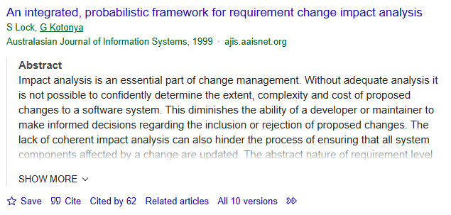
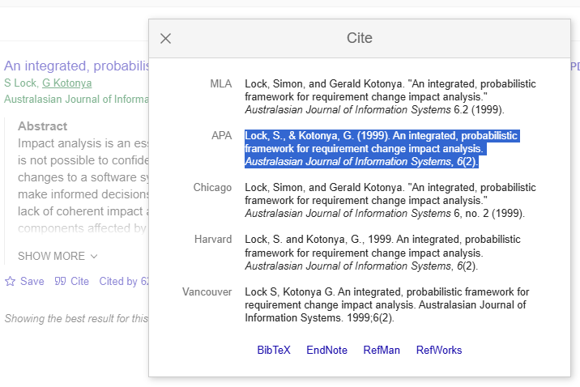
13. REFERENCES
Lock, S., & Kotonya, G. (1999). An integrated, probabilistic framework for requirement change impact analysis. Australasian Journal of Information Systems, 6(2).
HOW TO CITE A PAPER
GO TO GOOGLE SCHOLAR
GIVE THE PAPER TITLE IN SEARCH
ONCE THE PAPER WHAT YOU HAVE SEARCHED FOR IS LISTED
CHOOSE CITE AT THE BOTTOM OF THE PAPER
SELECT APA FORMAT AND COPY IT HERE

Slide 18
REFERENCES (CONTD..,)

Slide 19
REFERENCES (CONTD..,)

Slide 20
REFERENCES (CONTD..,)

Slide 21
REFERENCES (CONTD..,)

Slide 22
Thank You

Slide 23
Objective
Build a real-time fraud detection dashboard with UPI simulation
Support multiple datasets (PaySim, CICIDS, IEEE, BankSim)
Provide explainability (SHAP/LIME) and digital twin simulations

Slide 24
Dataset & Preprocessing
Dataset: PaySim - Payment Fraud
Source file: data/paysim_clean.csv
Target column: isFraud
Sample size (default): 250000

Slide 25
Methodology
Data preprocessing: imputation, normalization, leakage removal
Imbalance handling: SMOTE / resampling
Models: Logistic Regression, Random Forest, XGBoost, Isolation Forest, Autoencoder
Model selection via cross-validation and metrics (Precision/Recall/F1/ROC-AUC)

Slide 26
Models & Key Results
Dataset: PaySim - Payment Fraud
Recommended model: Random Forest
Logistic Regression — Acc: 0.890, Prec: 0.207, Rec: 0.878, F1: 0.335, Thr: 0.225
Random Forest — Acc: 0.931, Prec: 0.998, Rec: 0.997, F1: 0.998, Thr: 0.005
XGBoost — Acc: 0.987, Prec: 0.994, Rec: 0.997, F1: 0.995, Thr: 1.0
Isolation Forest — Acc: 0.858, Prec: 0.013, Rec: 1.000, F1: 0.025, Thr: 0.54

Slide 27
Artifacts & Files
Saved models: models/ (timestamps + names)
Evaluation metrics: models/evaluation_metrics.json
Selected thresholds: models/thresholds_selected.json
Prediction checks: models/prediction_checks.csv

Slide 28
Demo — Project Screenshot
[PASTE DEMO PROJECT SCREENSHOT HERE]

Slide 29
Conclusions & Future Work
High-performing models achieved strong recall and precision on PaySim
Threshold tuning provides business-driven trade-offs between FP/FN
Future: deploy model endpoint, online learning, drift monitoring

Slide 30
Acknowledgements
Student: Shambhu Pandey
Guide: Tamilrashi
Tools: Streamlit, scikit-learn, XGBoost, SHAP, LIME

