Slide 1
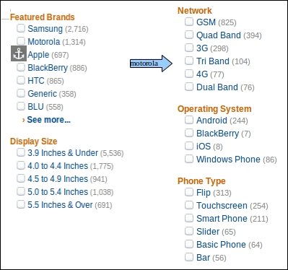
The e-commerce problem statement
E-commerce provides an easy way to sell products to a large customer base. However, there is a lot of competition among multiple e-commerce sites. When users land on an e-commerce site, they expect to find what they are looking for quickly and easily. Also, users are not sure about the brands or the actual products they want to purchase. They have a very broad idea about what they want to buy. Many customers nowadays search for their products on Google rather than visiting specific e-commerce sites. They believe that Google will take them to the e-commerce sites that have their product.
The purpose of any e-commerce website is to help customers narrow down their broad ideas and enable them to finalize the products they want to purchase. For example, suppose a customer is interested in purchasing a mobile. His or her search for a mobile should list mobile brands, operating systems on mobiles, screen size of mobiles, and all other features as facets. As the customer selects more and more features or options from the facets provided, the search narrows down to a small list of mobiles that suit his or her choice. If the list is small enough and the customer likes one of the mobiles listed, he or she will make the purchase.
The challenge is also that each category will have a different set of facets to be displayed. For example, searching for books should display their format, as in paperpack or hardcover, author name, book series, language, and other facets related to books. These facets were different for mobiles that we discussed earlier. Similarly, each category will have different facets and it needs to be designed properly so that customers can narrow down to their preferred products, irrespective of the category they are looking into.
The takeaway from this is that categorization and feature listing of products should be taken care of. Misrepresentation of features can lead to incorrect search results. Another takeaway is that we need to provide multiple facets in the search results. For example, while displaying the list of all mobiles, we need to provide facets for a brand. Once a brand is selected, another set of facets for operating systems, network, and mobile phone features has to be provided. As more and more facets are selected, we still need to show facets within the remaining products.

