Slide 1
Design and Manufacturing of Road Garbage Collecting Machine
Pune Vidyarthi Griha's College of Engineering and Technology, Pune
Team Members:
1) Shambhuraj Mane
2) Anup Deshmukh
3) Vedant Kau

Slide 2
Design and Manufacturing of Road Garbage Collecting Machine
Team ID: STP-PI-37
Product Description
Introduction:
The current scenario in India of garbage cleaning is not automated. From garbage collection to separation, everything is done manually.
There are some automated systems of garbage cleaning vehicles in India are available only in metropolitan cities. But those are very costly and not affordable in every region in India. So there is a need of automated garbage cleaning system which also reduces human efforts and fatigue in reasonable cost in Indian conditions.
To tackle this problem, a semi-automated battery operated (SABO) garbage cleaning vehicle can be introduced which cleans the garbage and collect effectively .
Notes:
1st current methods are manual and vacuum cleaning. Vacuum cleaning is inefficient for its cost and maintenance issues (like frequent changing of filters used in vacuum cleaners)
2nd vacuum is not feasible for indian “garbage present on road” conditions (do fact check)
4th can spread microbial organisms causes respiratory diseases

Slide 3
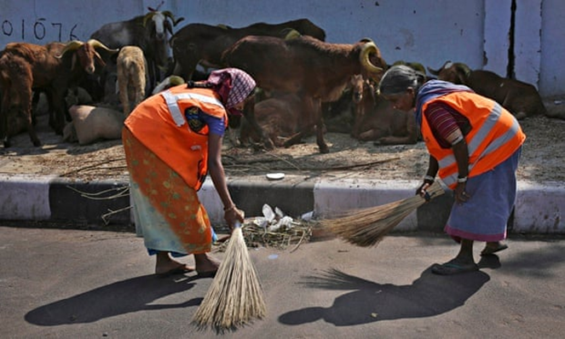
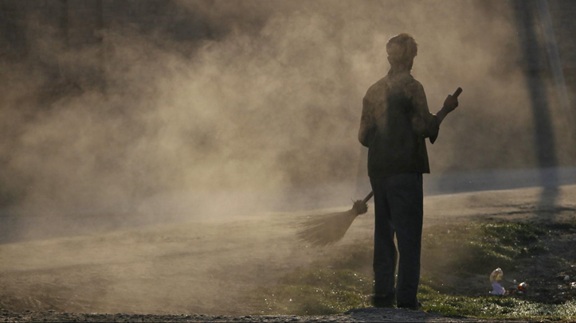
Design and Manufacturing of Road Garbage Collecting Machine
Team ID: STP-PI-37
Product Description
Problem Statement:
Current methods of sweeping and garbage collection are under efficient.
Conventional garbage collection methods are not ergonomic and thus utilize unnecessary labor.
Dust clouds that occur due to sweeping cause harm to labours and passers-by.
Cost effective solution is not available.
Notes:
1st current methods are manual and vacuum cleaning. Vacuum cleaning is inefficient for its cost and maintenance issues (like frequent changing of filters used in vacuum cleaners)
3th can spread microbial organisms causes respiratory diseases

Slide 4
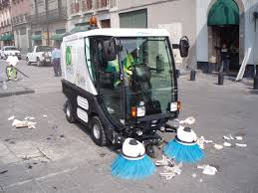
Design and Manufacturing of Road Garbage Collecting Machine
Team ID: STP-PI-37
Product Description
Existing Solution: Vacuum Cleaning
Initial Cost is above ₹ 16 Lakhs .
Maintenance is complex and costly.
Complexity of this technology does not allow us to prioritize the quantity needed for maximum effect.
Proposed Solution:
A Semi Automatic Battery Operated (SABO) garbage cleaning vehicle.
It uses the same principle of manual sweeping method but with a long continuous brush that rotates at certain RPM in an enclosed trolley.
It also reduces labour effort as well as reduces dust pollution, thus making the product a social and environmental advantageous.
Notes:
Existing solution
1st because of garbage present on road (do fact check)
Proposed solution
2nd reciprocating sweeping to rotating sweeping method

Slide 5
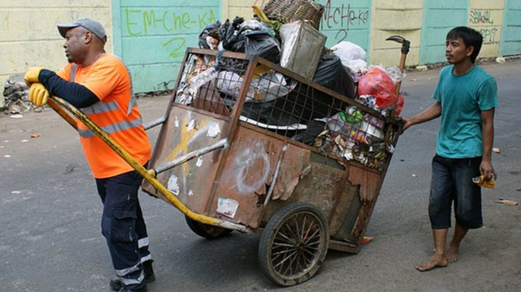

Design and Manufacturing of Road Garbage Collecting Machine
Team ID: STP-PI-37
Product Description
Main Unique Selling Points:
More efficient ,time saving in road and ground cleaning process.
Reduced labour cost and labour fatigue.
Considerable increase in work output.
Economically feasible.
Bristles of the brush adapt to the terrain conditions .
Conventional method of garbage collection
Notes:
1st labour cost or something else
2nd with advantage of reduced cost of tool

Slide 6
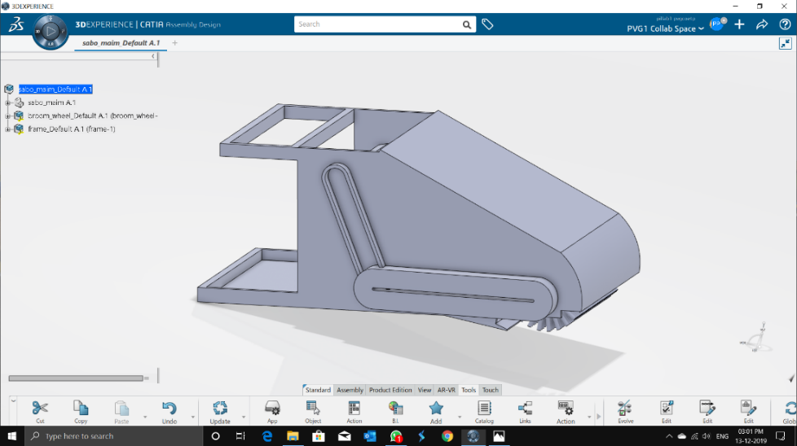
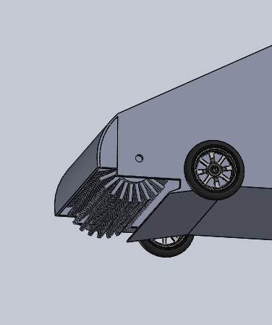
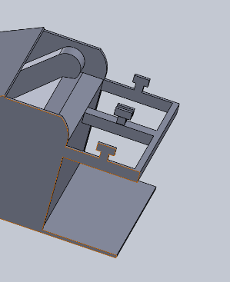
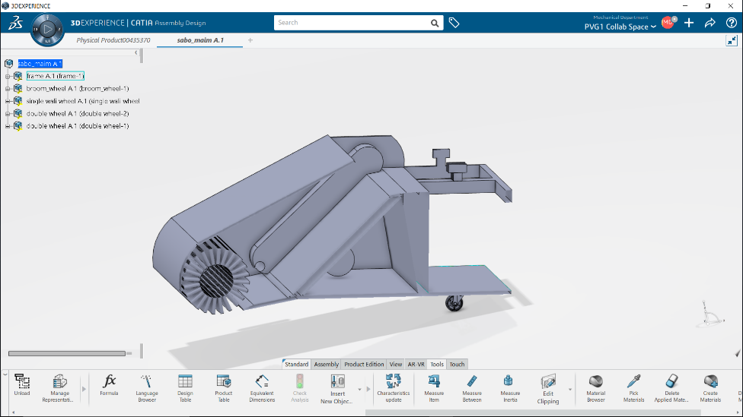
Design and Manufacturing of Road Garbage Collecting Machine
Team ID: STP-PI-37
Product Description
Solid Modelling:
Rotary brush and motor system
Segregation and Collection area

Slide 7
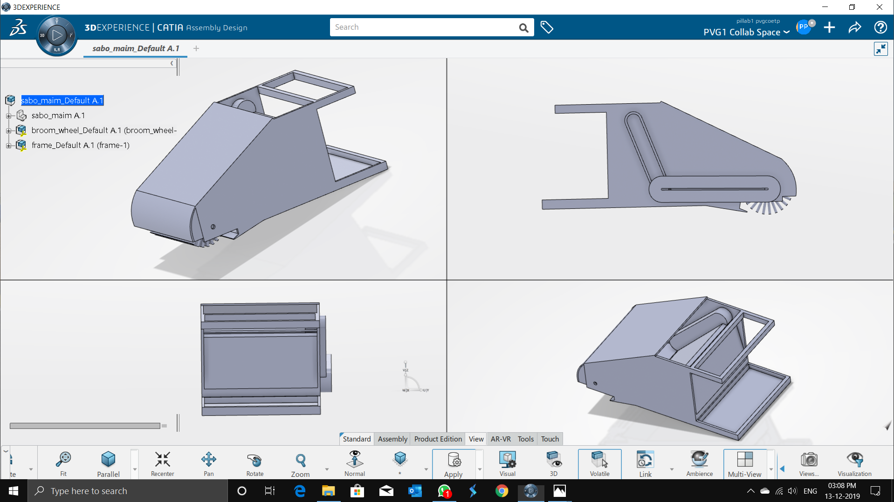
Design and Manufacturing of Road Garbage Collecting Machine
Team ID: STP-PI-37
Product Description: Solid Modelling

Slide 8





Design and Manufacturing of Road Garbage Collecting Machine
Team ID: STP-PI-37
Apps of 3DEXPERIENCE
Modelling the various components of the SABO garbage sweeping machine.
Assembling said components to complete the Sweeping machine.
Analyse the motion in the parts of the assembly.
Analysing the stresses acting on the sweeping machine.
Analysing the change in behaviour of the component as and when forces and other parameters act on it.

Slide 9
Design and Manufacturing of Road Garbage Collecting Machine
Team ID: STP-PI-37
Estimated Cost Structure to make a working prototype:
Sr. No. | Components |  | Quantity | Price | Total
Electronic Components
1 | Rechargeable Battery |  | 1 | 25,000 | 25,000
Actuators
2 | Front brush Motor with mounting bracket |  | 1 | 3,000 | 3,000
3 | Sprocket Motor with mounting bracket |  | 1 | 4,000 | 4,000
Belt mechanism
4 | Rubber Belt with horizontal pad |  | 1 | 1,500 | 1500
5 | Sprockets with brackets |  | 2 | 1,500 | 3,000
6 | Chain for sprocket |  | 1 | 500 | 500
Mechanical Components
7 | Garbage collection bag locking system |  | 1 | 1,000 | 1,000
8 | Frame |  | 1 | 3,500 | 3,500
9 | Bottom plate for supporting garbage bag |  | 1 | 500 | 500
10 | Horizontal rotary Brush (300mm dia) |  | 1 | 2,000 | 2,000
11 | Front road wheels for brush with bracket |  | 2 | 1,500 | 3,000
12 | Rear road wheel for steering |  | 1 | 1,000 | 1,000
13 | Top handle for steering the road wheel |  | 1 | 1,000 | 1,000
14 | Gunny bags for locking collected garbage |  | 100 | 10 | 1,000
15 | Miscellaneous and labor charges |  |  | 10,000 | 10,000
Total Cost |  |  |  |  | 60,000
Deadline for working prototype: last week of February.

Slide 10
Design and Manufacturing of Road Garbage Collecting Machine
Team ID: STP-PI-37
Conclusion
The proposed solution of a SABO garbage sweeping machine theoretically solves the problems faced effectively.
The estimate of the cost structure of prototyping verifies the economic feasibility of the product.
The product, when used extensively will prove to be socially and environmentally advantageous.
In further development solar panel can be integrated to make product self sufficient.

Slide 11
Design and Manufacturing of Road Garbage Collecting Machine
Team ID: STP-PI-37
THANK YOU !!!!!

